Slide 1


Slide 2
Chapter 6
The
Relational Algebra and
Relational Calculus

Slide 3
Chapter Outline
Unary Relational Operations
Relational Algebra Operations from Set Theory
Binary relational Operations
Additional Relational Operations
The Tuple Relational Calculus
The Domain Relational Calculus

Slide 4

Unary Relational Operations
The relational algebra is a set of operators that take and return relations
Unary operations take one relation,
and return one relation:
  SELECT operation
  PROJECT operation
  Sequences of unary operations
  RENAME operation

Slide 5
The SELECT Operation
It selects a subset of tuples from a relation that satisfy a SELECT condition.
The SELECT operation is denoted by:
σ _{<Selection condition>} (R)
The selection condition is a Boolean expression specified on the attributes of relation R

Slide 6
The SELECT Operation
The degree of the relation resulting from a SELECT operation is the same as that of R
For any selection-condition c, we have
| σ _{<c>} (R) | ≤ | R |
The SELECT operation is commutative, that is,
σ _{<c1>} (σ _{<c2>} ( R )) = σ _{<c2>} (σ _{<c1>} ( R ))

Slide 7
The PROJECT Operation
The PROJECT operation , selects certain columns from a relation and discards the columns that are not in the PROJECT list
The PROJECT operation is denoted by:
π _{<attribute list>} ( R )
Where attribute-list is a list of attributes from the relation R

Slide 8
The PROJECT Operation
The degree of the relation resulting from a PROJECT operation is equal to the number of attributes in attribute-list.
If only non-key attributes appear in an attribute-list, duplicate tuples are likely to occur. The PROJECT operation, however, removes any duplicate tuples –this is called duplicate elimination
The PROJECT operation is not commutative

Slide 9
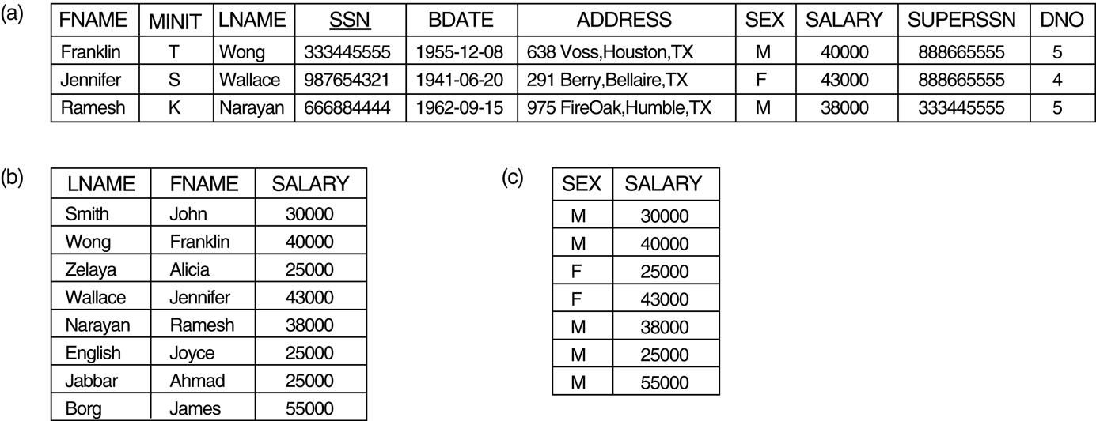
FIGURE 6.1
Results of SELECT and PROJECT operations.
(a) σ(DNO=4 AND SALARY>25000) OR (DNO=5 AND SLARY>30000)(EMPLOYEE).
(b) π _{LNAME, FNAME, SALARY} (EMPLOYEE)
(c) π _{SEX, SALARY}(EMPLOYEE).

Slide 10
Relational Algebra Operations
Two relations R₁ and R₂ are said to be union compatible if they have the same degree and all their attributes (correspondingly) have the same domain.
The UNION, INTERSECTION, and SET DIFFERENCE operations are applicable on union compatible relations
The resulting relation has the same attribute names as the first relation

Slide 11
The UNION operation
The result of UNION operation on two relations, R₁ and R₂, is a relation, R₃, that includes all tuples that are either in R₁, or in R₂, or in both R₁ and R₂.
The UNION operation is denoted by:
R₃ = R₁ ∪ R₂
The UNION operation eliminates duplicate tuples

Slide 12
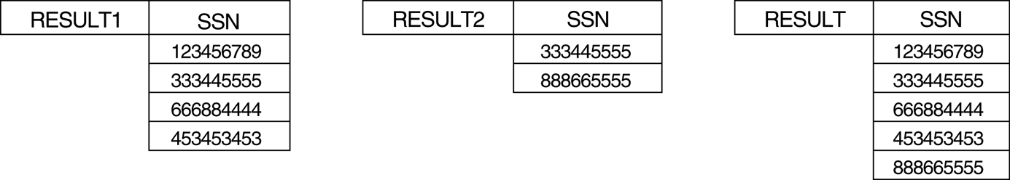
FIGURE 6.3
Results of the UNION operation
RESULT = RESULT1 ∪ RESULT2.

Slide 13
The INTERSECTION operation
The result of INTERSECTION operation on two relations, R₁ and R₂, is a relation, R₃, that includes all tuples that are in both R₁ and R₂.
The INTERSECTION operation is denoted by:
R₃ = R₁ ∩ R₂
The both UNION and INTERSECTION operations are commutative and associative operations

Slide 14
The SET DIFFERENCE Operation
The result of SET DIFFERENCE operation on two relations, R₁ and R₂, is a relation, R₃, that includes all tuples that are in R₁ but not in R₂.
The SET DIFFERENCE operation is denoted by:
R₃ = R₁ – R₂
The SET DIFFERENCE (or MINUS) operation is not commutative

Slide 15
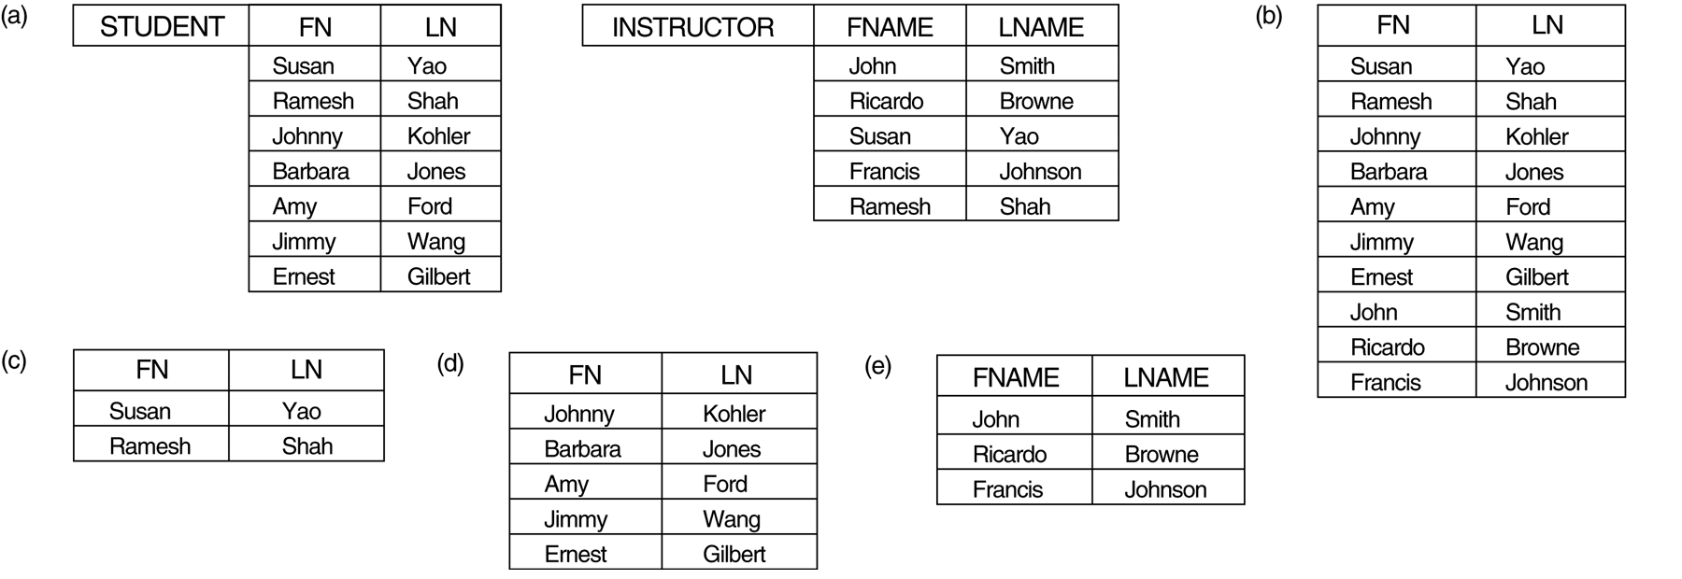
FIGURE 6.4
Two union-compatible relations. (b) STUDENT ∪ INSTRUCTOR.
(c) STUDENT ∩ INSTRUCTOR. (d) STUDENT – INSTRUCTOR.
INSTRUCTOR – STUDENT

Slide 16
The CARTESIAN PRODUCT Operation
This operation (also known as CROSS PRODUCT or CROSS JOIN) denoted by:
R₃ = R₁ × R₂
The resulting relation, R₃, includes all combined tuples from two relations R₁ and R₂
Degree (R₃) = Degree (R₁) + Degree (R₂)
|R₃| = |R₁| × |R₂|

Slide 17
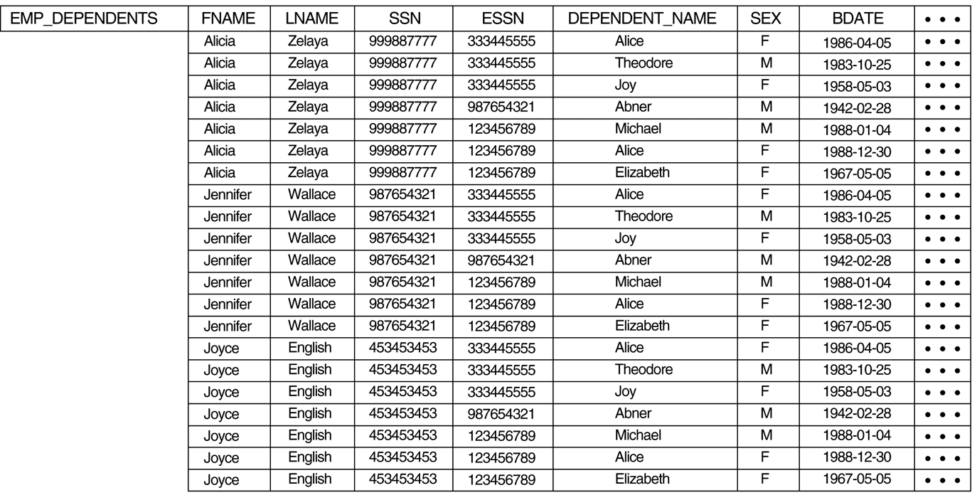
FIGURE 6.5b
The CARTESIAN PRODUCT (CROSS PRODUCT)

Slide 18
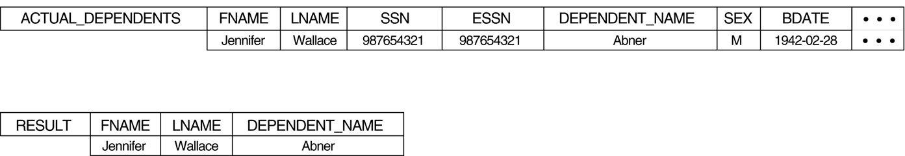
FIGURE 6.5c
The CARTESIAN PRODUCT (CROSS PRODUCT)

Slide 19
Binary Relational Operations
An important operation for any relational database is the JOIN operation, because it enables us to combine related tuples from two relations into single tuple
The JOIN operation is denoted by:
R₃ = R₁ ⋈ _{<join condition>} R₂
The degree of resulting relation is
degree(R₁) + degree(R₂)

Slide 20
The JOIN Operation
The difference between CARTESIAN PRODUCT and JOIN is that the resulting relation from JOIN consists only those tuples that satisfy the join condition
The JOIN operation is equivalent to CARTESIAN PRODUCT and then SELECT operation on the result of CARTESIAN PRODUCT operation, if the select-condition is the same as the join condition

Slide 21
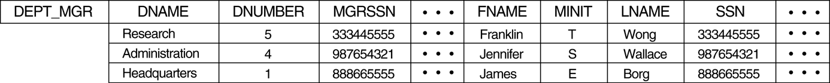
FIGURE 6.6
Result of the JOIN operation DEPT_MGR ← DEPARTMENT JOIN _{MGRSSN=SSN} EMPLOYEE .

Slide 22
The EQUIJOIN Operation
If the JOIN operation has equality comparison only (that is, = operation), then it is called an EQUIJOIN operation
In the resulting relation on an EQUIJOIN operation, we always have one or more pairs of attributes that have identical values in every tuples

Slide 23
The NATURAL JOIN Operation
In EQUIJOIN operation, if the two attributes in the join condition have the same name, then in the resulting relation we will have two identical columns. In order to avoid this problem, we define the NATURAL JOIN operation
The NATURAL JOIN operation is denoted by:
R₃ = R₁ *_{<attribute list>} R₂
In R₃ only one of the duplicate attributes from the list are kept

Slide 24
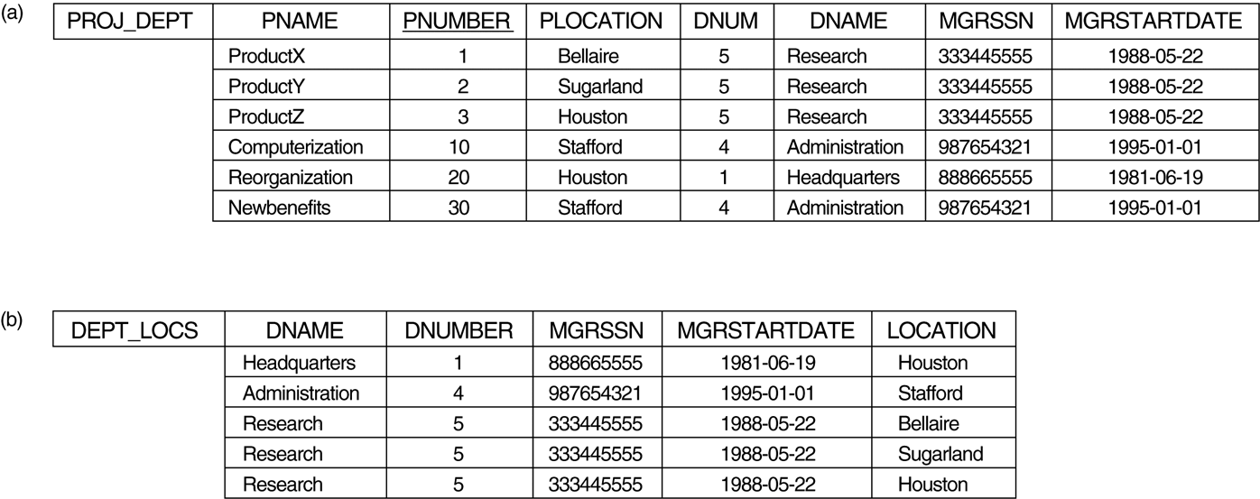
FIGURE 6.7
(a) PROJ_DEPT ← PROJECT * DEPT.
(b) DEPT_LOCS ← DEPARTMENT * DEPT_LOCATIONS.

Slide 25
A Complete Set of Relational Algebra
The set of relational algebra operations
{σ, π, ∪, -, x }
Is a complete set. That is, any of the other relational algebra operations can be expressed as a sequence of operations from this set.
For example:
R ∩ S = (R ∪ S) – ((R – S) ∪ (S – R))

Slide 26
The DIVISION Operation
The DIVISION operation is useful for some queries. For example, “Retrieve the name of employees who work on all the projects that ‘John Smith’ works on.”
The Division operation is denoted by:
R₃ = R₁ ÷ R₂
In general, attributes in R₂ are a subset of attributes in R₁

Slide 27
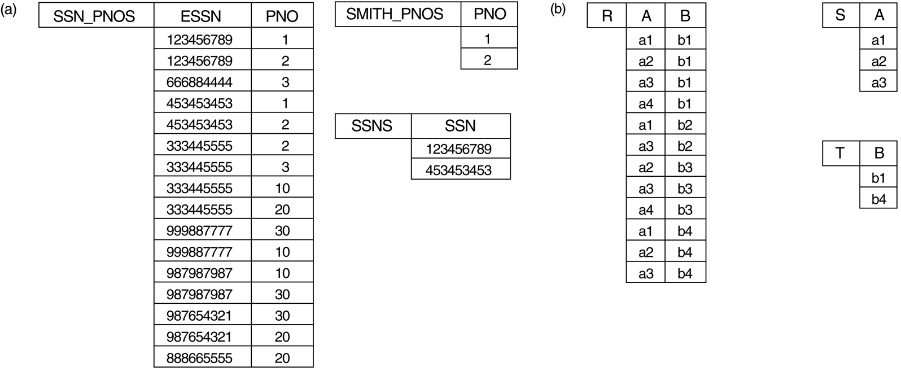
FIGURE 6.8
Dividing SSN_PNOS by SMITH_PNOS.
T ← R ÷ S.

Slide 28
Additional Relational Operations
Statistical queries cannot be specified in the basic relational algebra operation
We define aggregate functions that can be applied over numeric values such as, SUM, AVERAGE, MAXIMUM, MINIMUM, and COUNT
The aggregate function is denoted by
<grouping attributes> δ _{<function list>} (R)
where aggregation (grouping) is based on the <attributes-list>. If not present, just 1 group

Slide 29
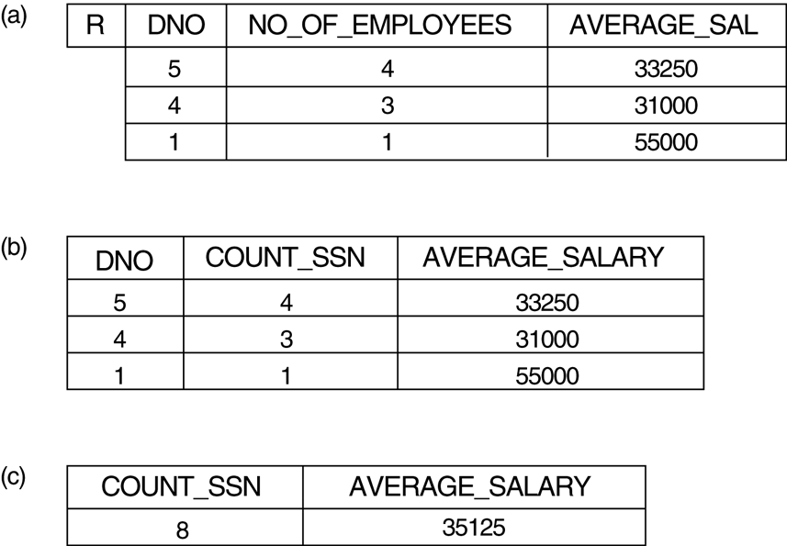
FIGURE 6.9
The AGGREGATE FUNCTION operation.

Slide 30
The Tuple Relational Calculus
The relational algebra is procedural
The relational calculus is nonprocedural
Any query that can be specified in the basic relational algebra can also be specified in relational calculus, and vice versa (their expressive power are identical)
A relational query language is said to be relationally complete if any query can be expressed in that language

Slide 31
Tuple Variables and Range Relations
The tuple relational calculus is based on specifying a number of tuple variables
The range of each tuple variable is a relation
A tuple relational calculus query is denoted by
{t | COND(t)}, where t is a tuple variable and COND(t) is a conditional expression involving t.
For example,
{t | EMPLOYEE(t) AND t.SALARY>50000}

Slide 32
Expressions and Formulas in TRC
A general expression is of the form
{t₁.A₁,…, t _{n}.A _{n} | COND(t₁,…, t _{n}, t _{n+1}, …, t _{m})}
Each COND is a condition or formula of the tuple relational calculus
A condition/formula is made up of one or more atoms connected via the logical operators AND, OR, and NOT

Slide 33

The Existential and Universal Quantifiers
Two quantifier can appear in a tuple relational calculus formula
  The universal quantifier, ∀
  The existential quantifier, ∃
A tuple variable, t, is bound if it is quantified, that is, appears in an (∃t) or (∀t) clause, otherwise it is free

Slide 34
The Existential and Universal Quantifiers
It is possible to transform a universal quantifier into an existential quantifier, and vice versa
For example:
(∀x)(P(x)) ≡ NOT (∃x) (NOT (P(x))
(∃x)(P(x)) ≡ NOT (∀x) (NOT(P(x))
(∀x)(P(x) AND (Q(x))) ≡ NOT(∃x)(NOT(P(x)) OR(NOT(Q(x))))

Slide 35
Safe and Unsafe Expressions
In relational calculus, an expression is said to be safe if it guaranteed to yield a finite number of tuples as its result
The expression {t | NOT (EMPLOYEE(t))} is unsafe, because it yields all tuples in the universe that are not EMPLOYEE tuples
In a safe expression all resulting values are from the domain of the expression

Slide 36
The Domain Relational Calculus
In domain relational calculus, the variables range over single values from domains of attributes
SQL is based on tuple relational calculus, while QBE(Query-by-Example) is developed over the domain relational calculus
To form a relation of degree ‘n’ for a query result, we must have ‘n’ domain variables

Slide 37
The Domain Relational Calculus
A domain relational calculus expression is of the form
{x₁, …, x_{n} | COND(x₁, …, x_{n}, x _{n+1}, …, x _{n+m})}
where x₁, …, x _{n+m} are domain variables that range over domain of attributes, and COND is a condition or formula. For example,
{uv | (∃q)(∃r)(∃s)(∃t)(∃w)(∃x)(∃y)(∃z) (EMPLOYEE (qrstuvwxyz) AND (q = ‘John’) AND (r=‘B’) AND (s=‘Smith’))}
Alternatively, we can write
{uv | EMPLOYEE(‘John’, ‘B’, ‘Smith’, t,u,v,w,x,y,z)}

