Slide 1
Smart Retail
An IOT Solution

Slide 2
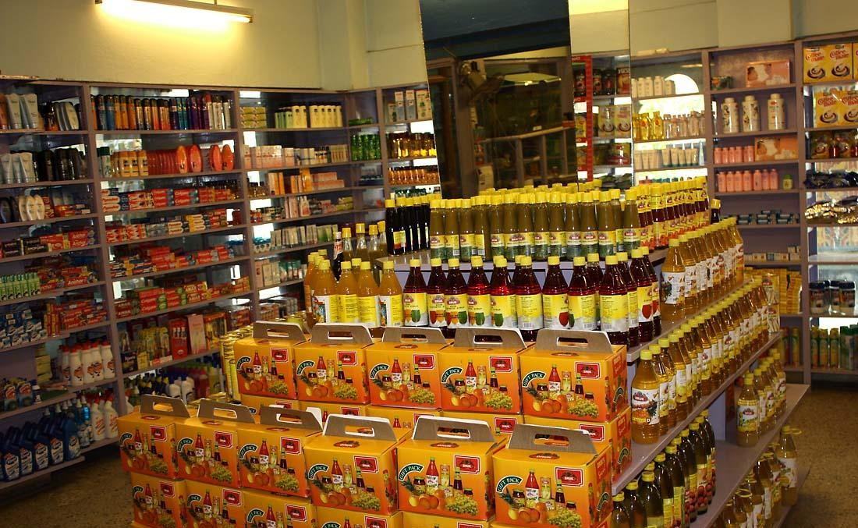
The Problem …
Retailers spend exorbitantly on storing multiple copies of the same product
Emphasis has shifted from variety to bulk storage .
Retail industry lacks innovation
A traditional retail Store

Slide 3
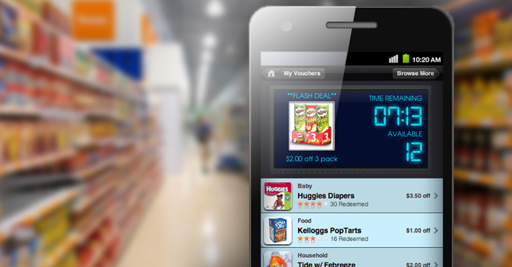
The Proposed Solution
A single item of each product is to replace bulk display
Emphasis to be asserted on variety and user experience rather than storage
A stir in the retail using IOT

Slide 4

Implementation : Brief
NFC tags are to be embedded in each of the products
The NFC tags will be imprinted with details of the product
The consumer uses his/her mobile device to scan the product and add to cart

Slide 5

Implementation : Brief
When done shopping , a request is sent to a warehouse .
The warehouse fetches the request made by the user and forwards it to the billing counter

Slide 6
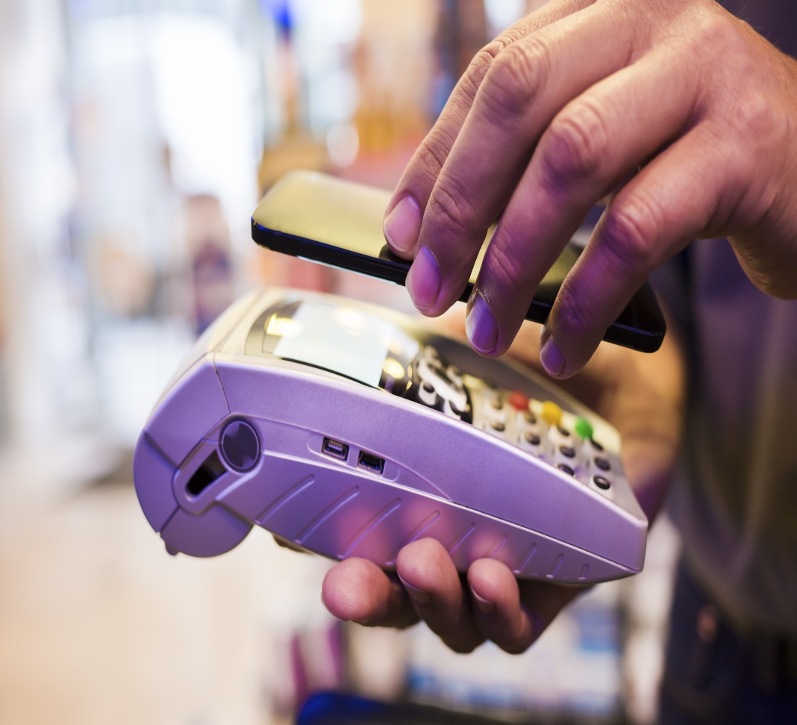
Implementation : Brief
At the billing counter the shopper simply pays via his on-device app
The user collects his /her package after completing the transaction

Slide 7
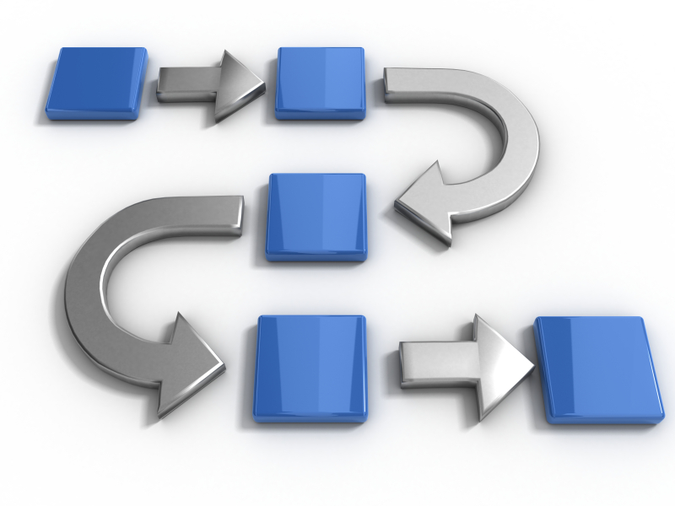
Workflow
Stage – I : Web Development
Stage – II : Application Development
Stage – III : Hardware
Stage – IV : Orchestration

Slide 8

Stage - I
Aim : To develop a build the backend server for the warehouse and a server to display crate reading .
Sever built using the Django framework
The warehouse server must will be populated with the customers order
The crate-weights server will be populated with reading from the various crates via load cells

Slide 9

Stage – II
A) Client Application
The users mobile device is equipped with an application to read and display the NFC contained data
A running total of products added to cart is also provided
On submitting the order , the warehouse server is updated

Slide 10

Stage – II
A) Employer's Application
The employer’s app is meant to write data to the NFC tags
For this purpose a custom application is provided to the employees and there devices are interfaced with barcode scanners

Slide 11
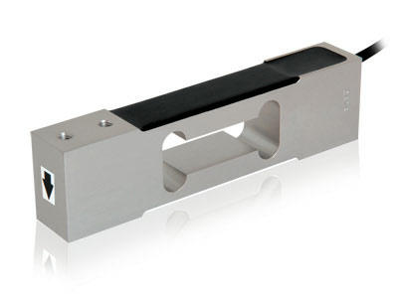
Stage - III
An Edison board is interfaced with a load-cell
The microcontroller processes the reading and updates the weights in on the server
If the weight in a crate falls below a certain minimum , an alert is set off

Slide 12

Stage IV
The aforementioned stages are orchestrated to build a cohesive system

Slide 13

FAQ
How feasible is your solution ?
How is your solution different from e-shopping ?
What does the retailer gain ?

Slide 14
Thank you ….

