Slide 1
We’ll Name This Presentation Later…
FA542: Financial Econometrics and Time Series Analysis
Andre Sealy
Fredrica Malamisura
Swapnil Pant

Slide 2
Motivation: Modeling Asset Prices in Tech
Our analysis primarily focuses on the technology sector
Tech stocks tend to have higher betas
They’re more sensitive to information shocks in the market
We also consider the growth aspect of the market (Macroeconomic Trends, Interest Rates, etc.

Slide 3
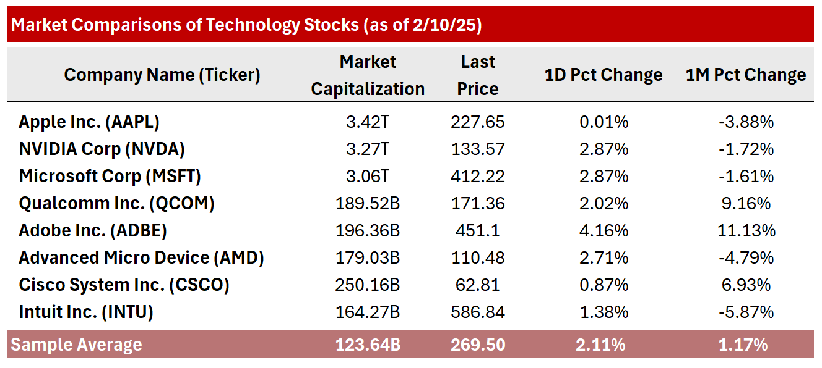
Our Sample Universe

Slide 4
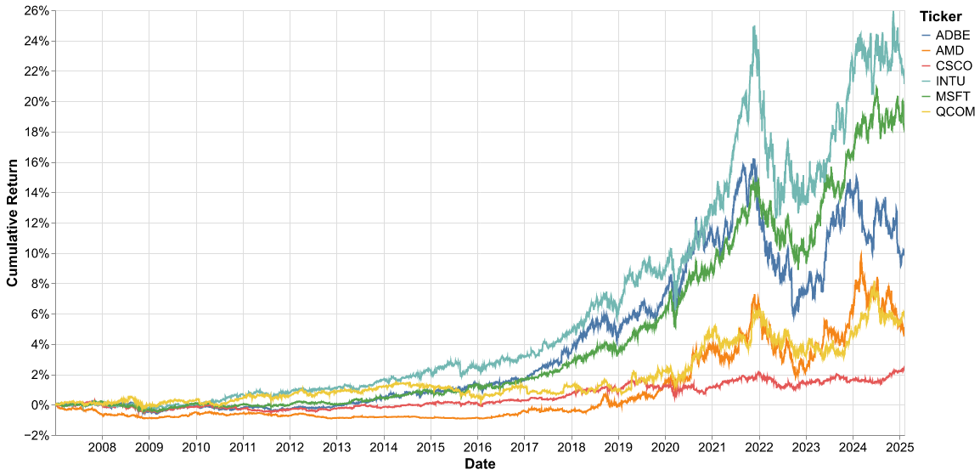
Our Sample Universe

Slide 5
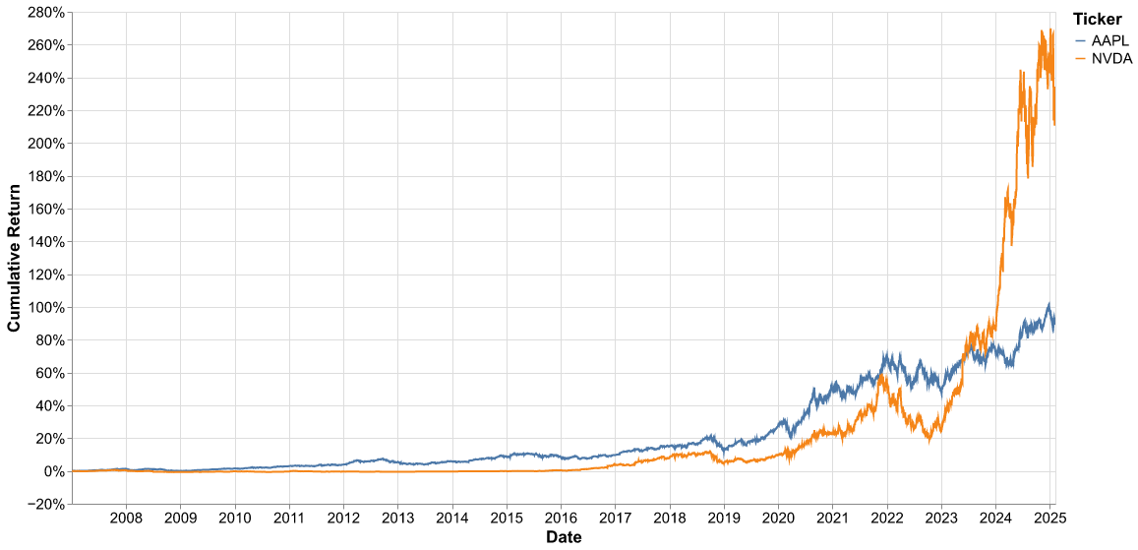
Our Sample Universe

Slide 6
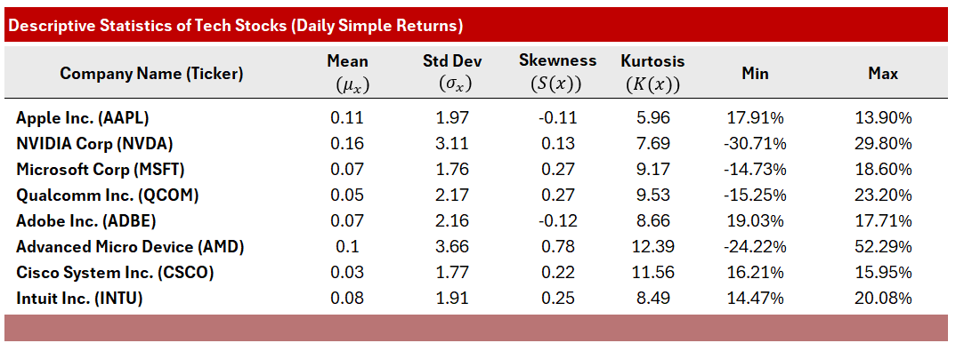
Descriptive Statistics

Slide 7
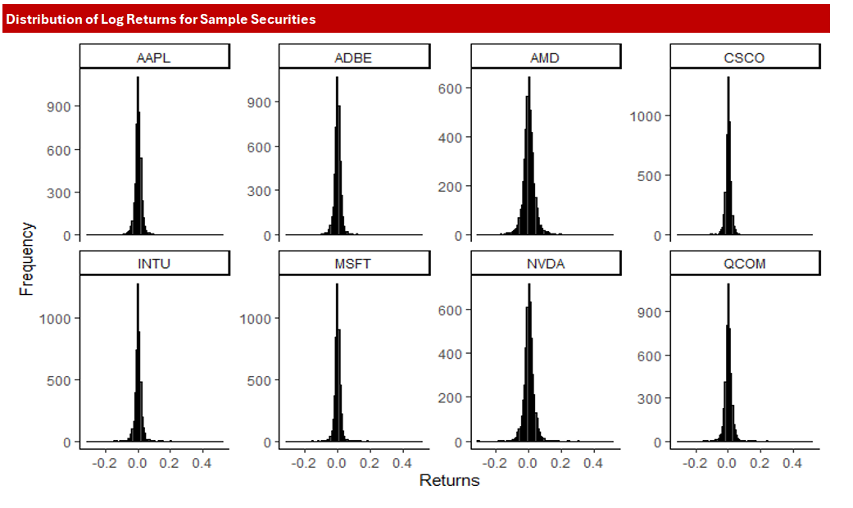
Test for Normality (Jarque-Bera Test)

Slide 8
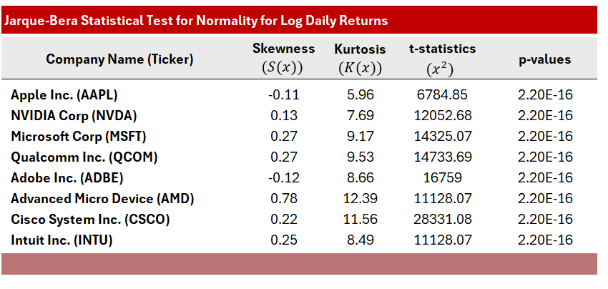
Test for Normality (Jarque-Bera Test)

Slide 9
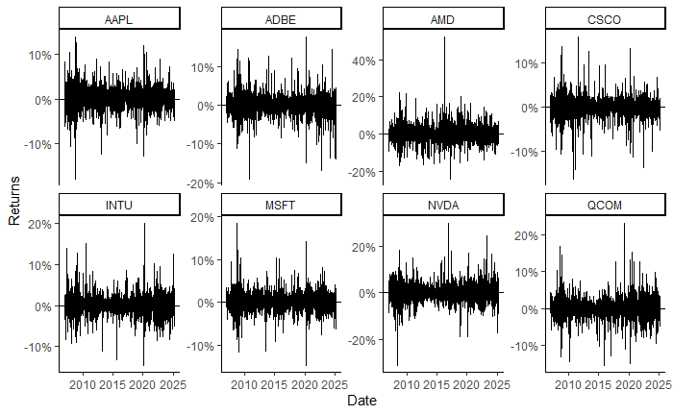
White Noise (Ljung-Box)

Slide 10
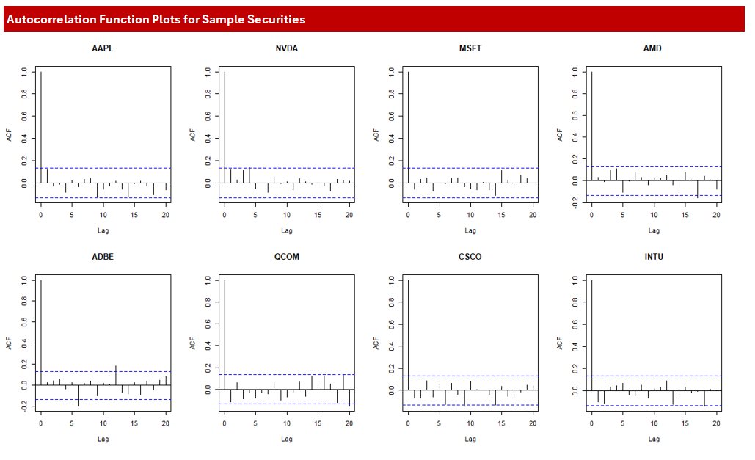
White Noise (Ljung-Box)

Slide 11
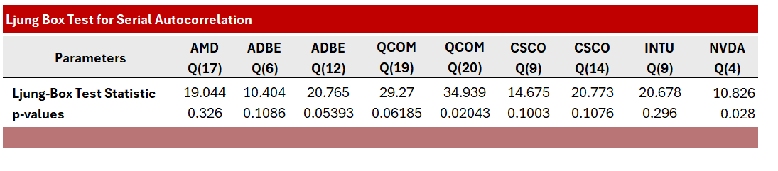
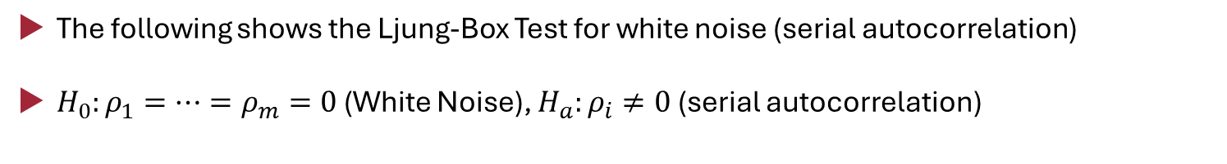
White Noise (Ljung-Box)
The following shows the Ljung-Box Test for white noise (serial autocorrelation)
$H_{0}:ρ_{1}=…=ρ_{m}=0$ (White Noise), $H_{a}:ρ_{i}≠0$ (serial autocorrelation)

Slide 12
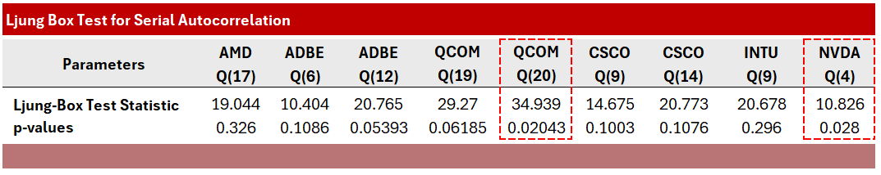
White Noise (Ljung-Box)
We find that Qualcomm Inc. (QCOM) and NVIDIA Corp (NVDA) have significant lags, suggesting some lag dependence.
For the remainder of the analysis, we turn our attention on these two assets.

Slide 13
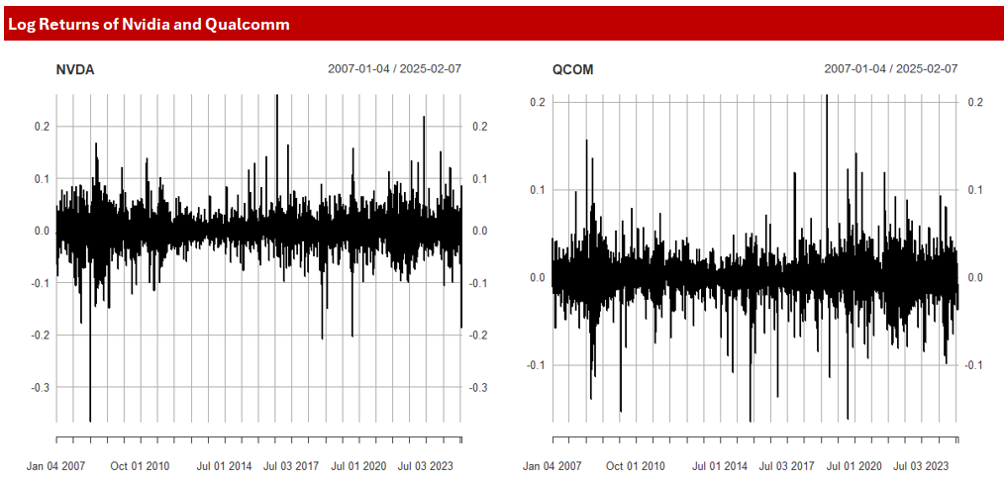
Stationarity (Augmented Dickey-Fuller Test)

Slide 14
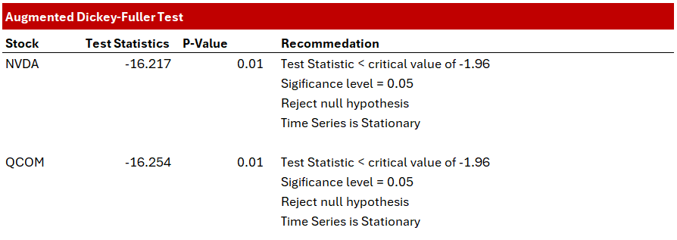
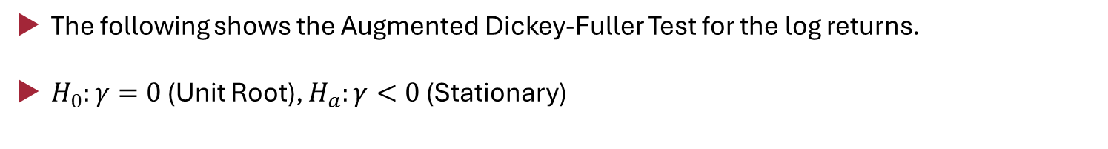
Stationarity (Augmented Dickey-Fuller Test)
The following shows the Augmented Dickey-Fuller Test for the log returns.
$H_{0}:γ=0$ (Unit Root), $H_{a}:γ<0$ (Stationary)

Slide 15
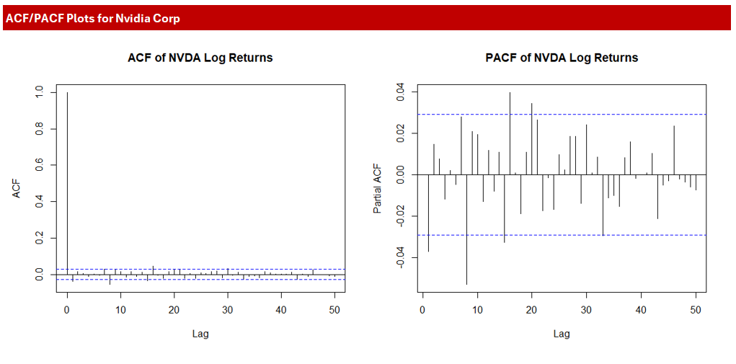
Model Selection

Slide 16
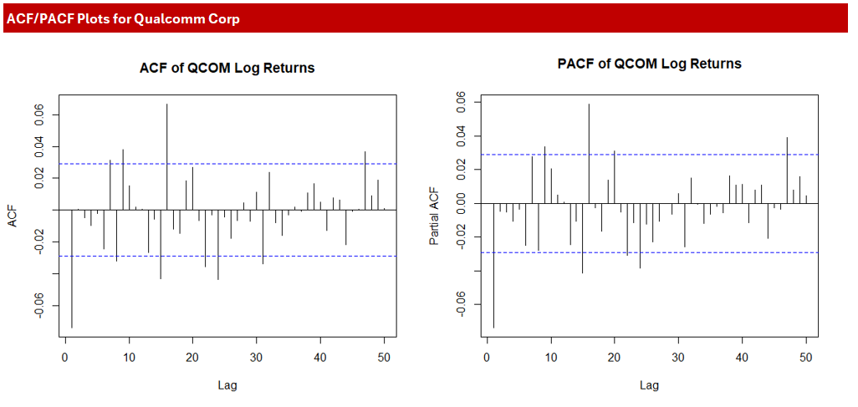
Model Selection

Slide 17
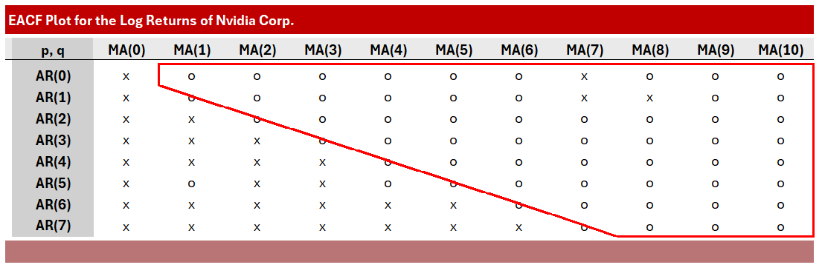
Model Selection

Slide 18
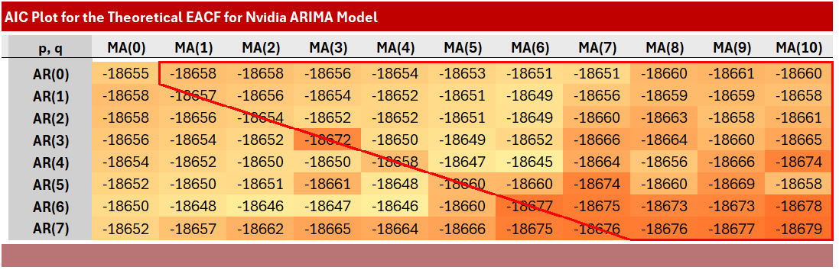
Model Selection

Slide 19
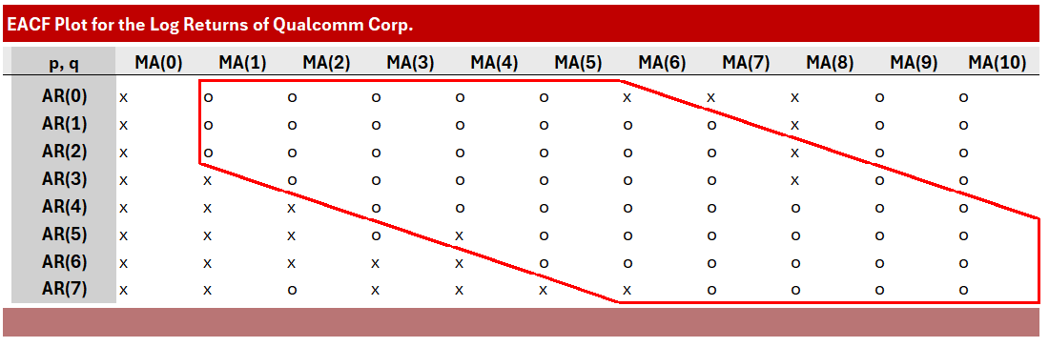
Model Selection

Slide 20
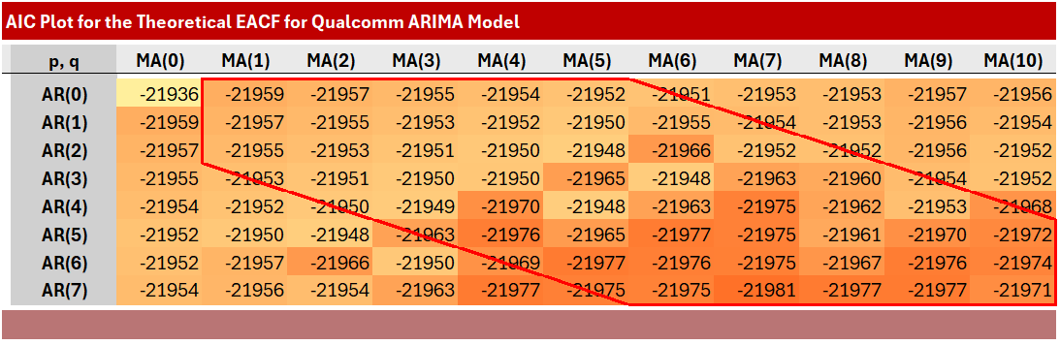
Model Selection

Slide 21
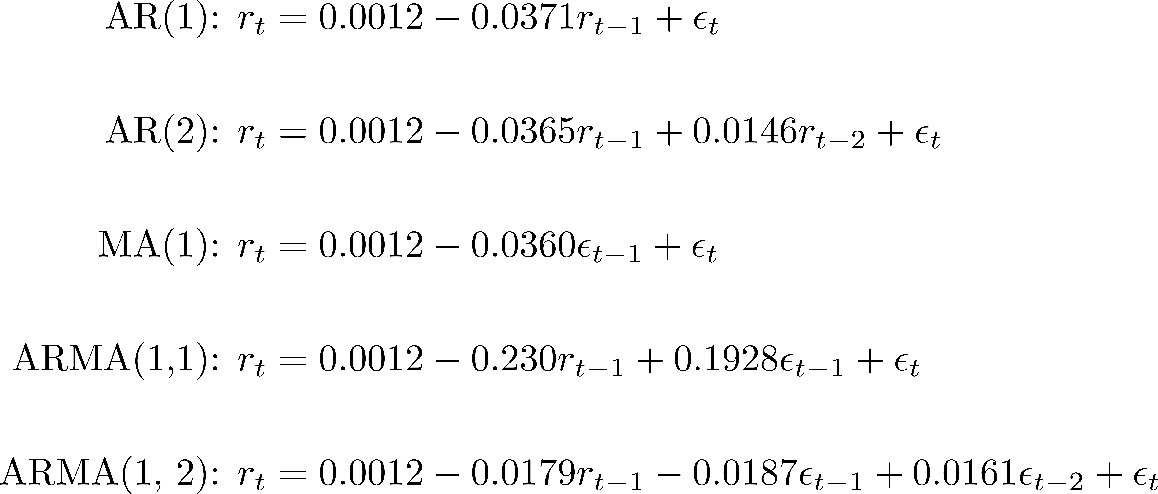
ARIMA Models (Nvidia)
The following outlines the models generated from our selection criteria.

Slide 22
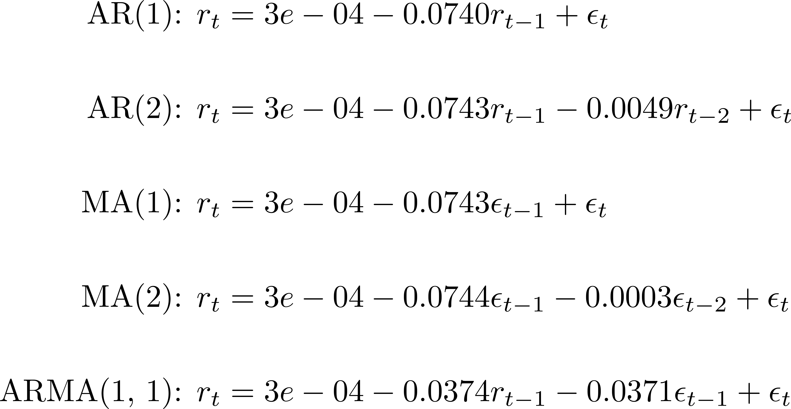
ARIMA Models (Qualcomm)
The following outlines the models generated from our selection criteria.

Slide 23
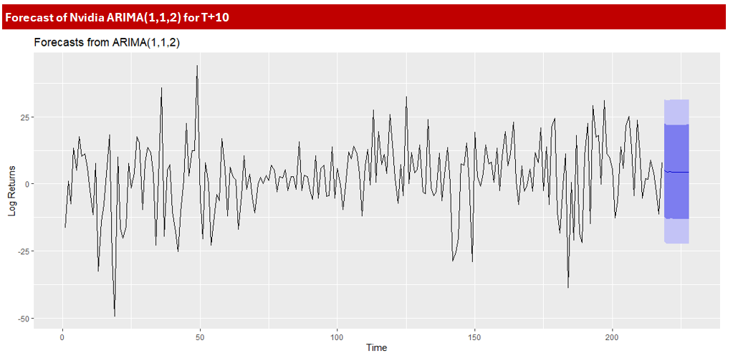
Forecast

