Slide 1

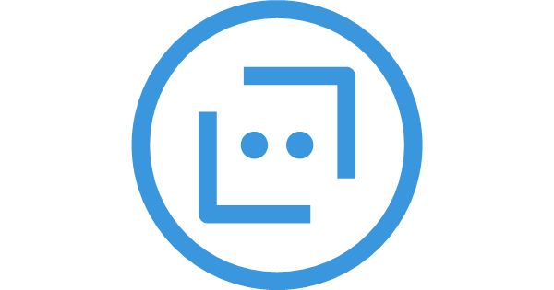



1. Teams – Health Bot Registration
1
2
3
Initiate conversation
Call bot with Teams context
Register the user
Teams
Azure Health Bot
Power Automate API
4
Storage
Pre-Requisites
Register Health Bot in Teams
Dataverse
Flow
Initiate a conversation with the Health Bot in Teams
Health Bot captures the Teams conversation context
Call Power Automate with Teams context
Save the user’s Teams context in Dataverse

Slide 2


2. Teams – Health Bot Integration
Function Key protected
Get Health Bot Token
Azure Functions
3
1
OAuth protected
3
4
Message to post
Teams payload with message and response
Teams post and response
Power Automate API
Azure Health Bot
Teams
Store user response
Get users that have registered
2
Storage
5
Flow
Post a message to a team and channel to an API
Gets list of users that belongs to that teams and channel
Power Automate gets JWT token and call Health Bot
Health Bot posts Adaptive Cards to teams with message
All user’s responses are stored in Azure Queue
Storage Queue
Dataverse

