Slide 1
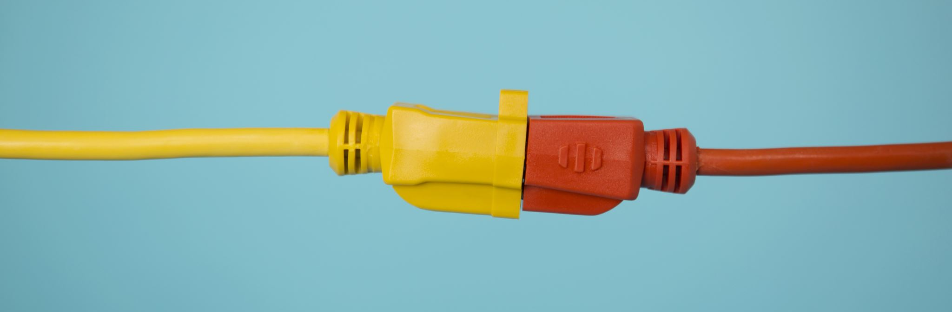


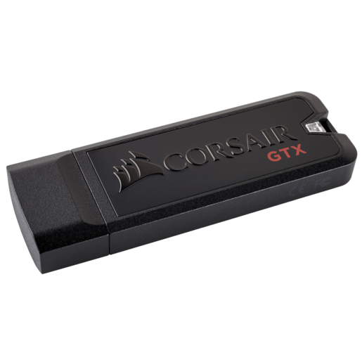
USB
Phan Như Khôi 20119189
Trần Quang Nhật 20119189

Slide 2
Outline
Chapter 1 Overview
Chapter 2 Theoretical basic
Chapter 3 Introducing Spartan 3E KIT
Chapter 4 Design USB data transfer
Chapter 5 Write code for USB transmitter and emulation

Slide 3
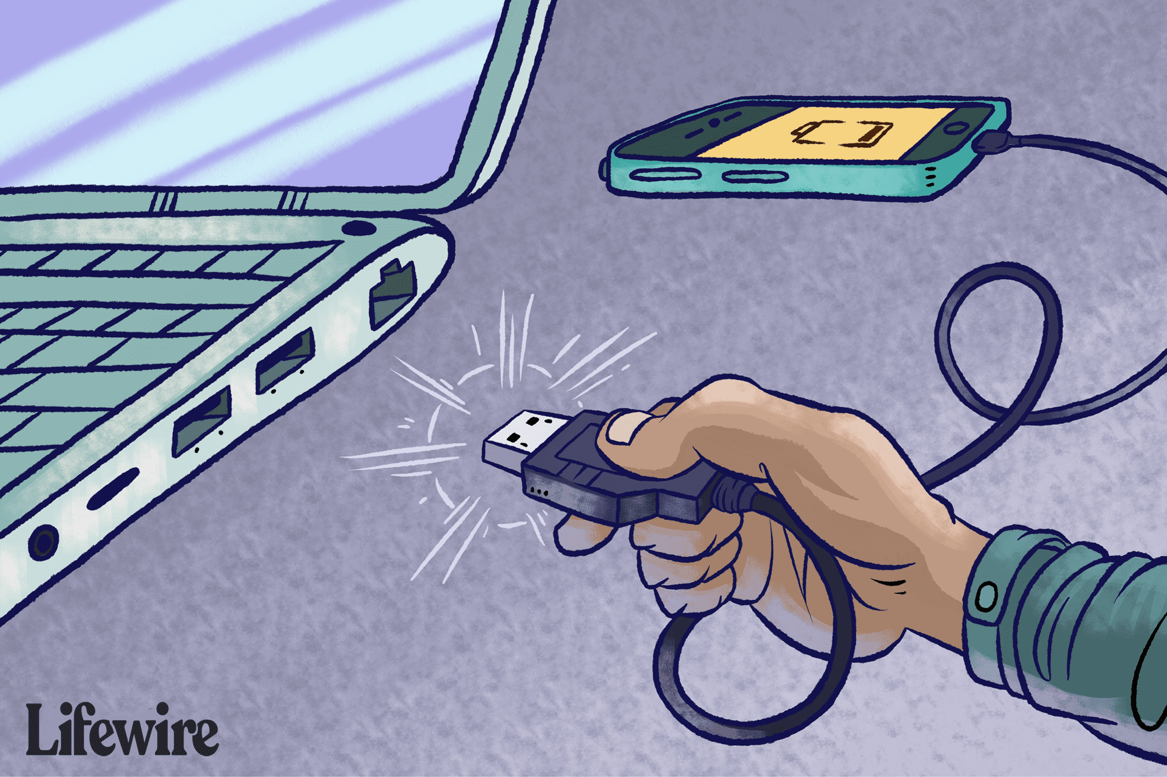
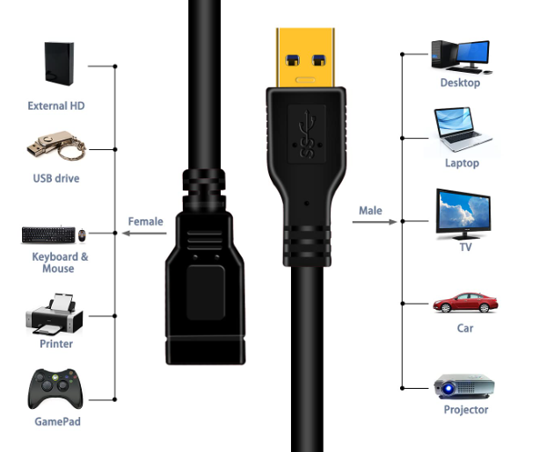
Chapter 1 Overview
USB port (Universal Serial Bus) is a serial standard developed by a group of many companies: Compaq, DEC, IBM, Intel, Microsoft, NEC and Nortel

Slide 4
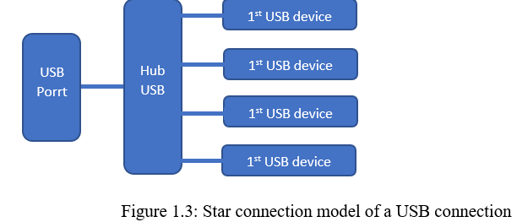
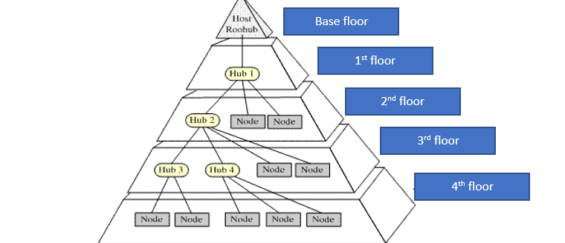
Chapter 2 Theoretical Basic
The basic structure of the USB network is the star layers. A USB system consists of one or more peripherals, one or more hubs, and a host controller.

Slide 5
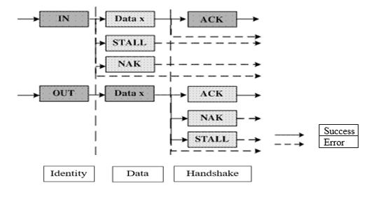
Interrupt Transfer
Chapter 2 Theoretical Basic
Isochronous Transfers
Interrupt Transfers
USB transfer processes
Bulk Transfers
Have 2 types :
Interrupt In
Interrupt Out
Control Transfers

Slide 6
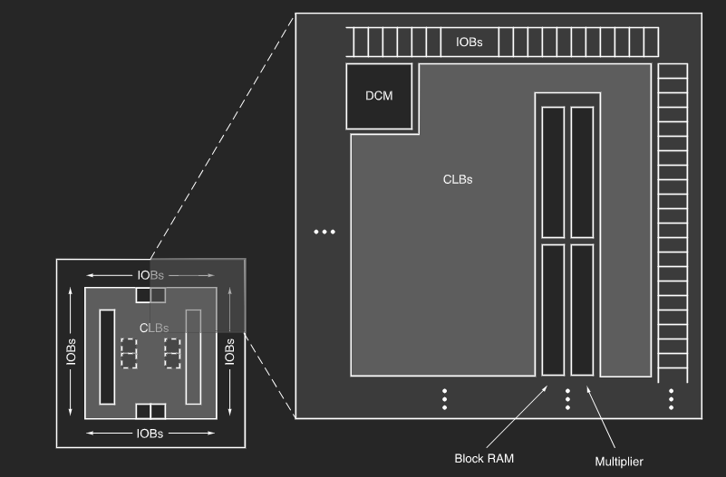
Chapter 3 Introducing Spartan 3E KIT
Input/Output Blocks (IOBs): I/O blocks
Configurable Logic Blocks (CLBs) : made up of Look-Up Tables (LUTs).
Block RAM: Supports 16 Kb RAM per RAM Block
Multiplier Blocks: 18-bit input multiplier block.
Digital Clock Manager (DCM) Blocks: clk pulse control block.
Interconnect: Connections.

Slide 7
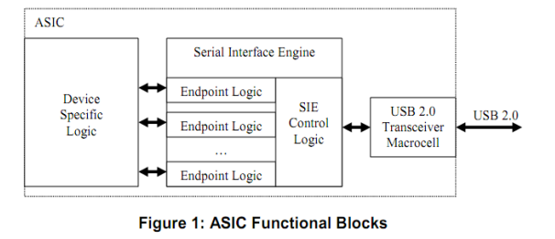
CHAPTER 4: DESIGN USB DATA TRANSFER
The USB Transceiver or UTMI (USB Transceiver Macrocell Interface) acts as an intermediary between the serial device interface and the physical transmission line.

Slide 8
