Slide 1
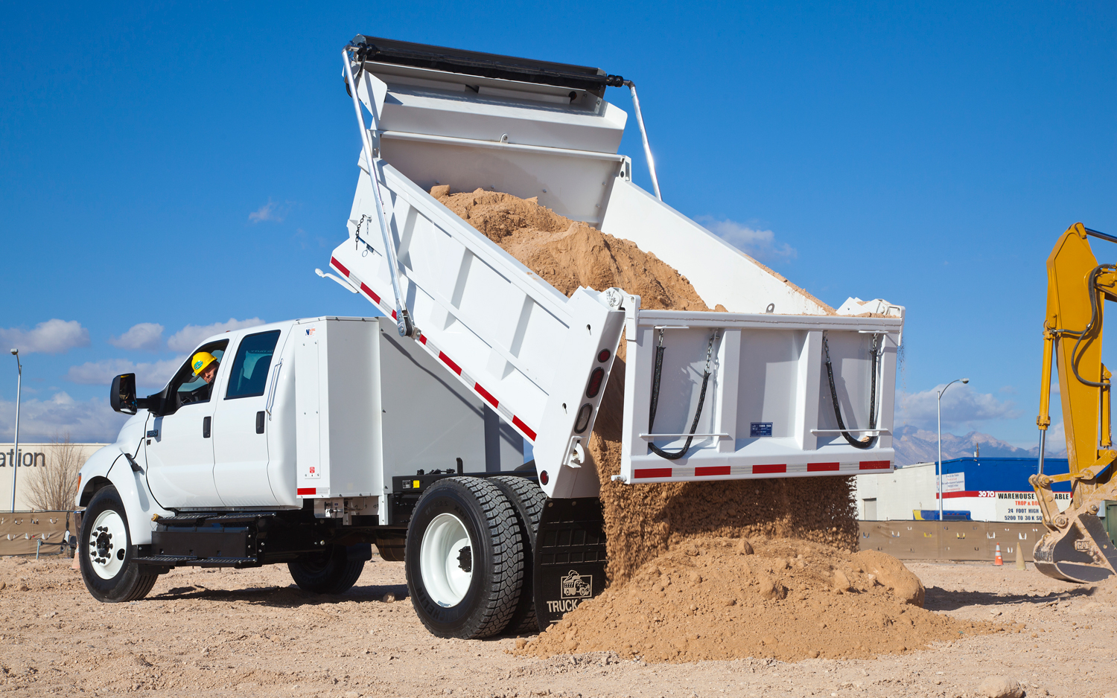
Dump Truck Force Effect

Slide 2
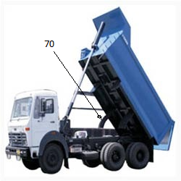
Introduction
A dump truck (or, UK, dumper/tipper truck) is a truck used for transporting loose material (such as sand, gravel, or dirt) for construction.
A typical dump truck is equipped with an open-box bed, which is hinged at the rear and equipped with hydraulic pistons to lift the front, allowing the material in the bed to be deposited ("dumped") on the ground behind the truck at the site of delivery.
The dump truck is thought to have been first conceived in the farms of late 19th century western Europe

Slide 3
Objective
The General Objective of this Project is to Develop a Mobile and Desktop Application that compute how much volume of load can a Dump truck deposit and unloaded it to the ground and the angle can it lifts dumping bed for a given volume of load in the bed.

Slide 4
Specific Objective
To achieve the general objective stated above this proposed project is expected to address the following specific objective
Designing a user friendly Android mobile and Desktop based Application
Developing application that compute the capacity of volume Dump truck can deposit to the ground for a given situation.
Developing application that compute the angle by which the dumper can lift the bed.
Developing application by identifies weather the load can be lifted or not and also giving a suggestion of what to do.

Slide 5
Scope
Our project provides program in different platform for our users to get what they want at any time (that is , in android mobile and desktop app.).user can install in there mobile(android) or Computer to use this software.
Our project is scooped to the extent that help student to learn how to design an application for calculated lifting and unloading of load being given.

Slide 6
Project Methodology
When Dumper lift the material the material slide in varying velocity and acceleration. The car capacity to lift the material is depend on the volume the car and the mass(weight the object).
In our project we assumed that car is at rest and carry one type of object at once. When the car start to lift up the object, the object start to slide down to the earth because of gravity, there is also frictional force between the object and the plane of the car.
In addition to this, when car start to lift up the angle of lifting increase in range of 0 to 70 degrees. 90 is maximum limit of angle of lifting.
To use this program user must install the software(application) to there platform(either android or windows).and this program take input form user to calculate the required parameter and Graph of volume(car) ~ Weight(object)

Slide 7
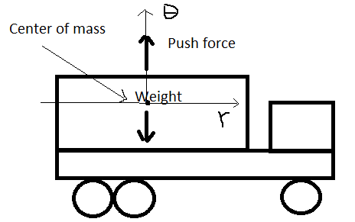
Dynamic analysis
To find the lift acceleration a theta as the lift force pushes the barrel up
∑F_{ᵝ} = push-weight=ma
a =( push – weight)/m

Slide 8
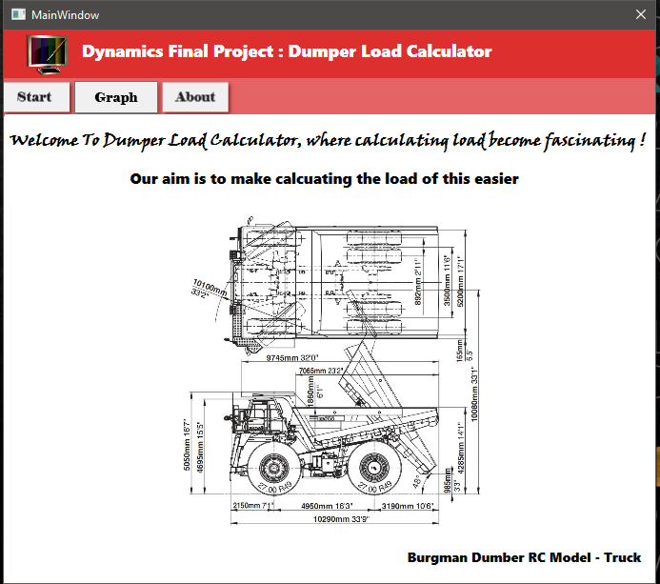
Interface of the program

Slide 9
Last say for the project !!!
The application that we develop is flexible and designed with assumption that it would be amended for future use.
Therefor, the graph section and many other features that left unimplemented for the time being will be highly considered in the beta version release.

