Slide 1
History of computing 1980-1999

Slide 2
The micro age
You can enter a subtitle here if you need it

Slide 3
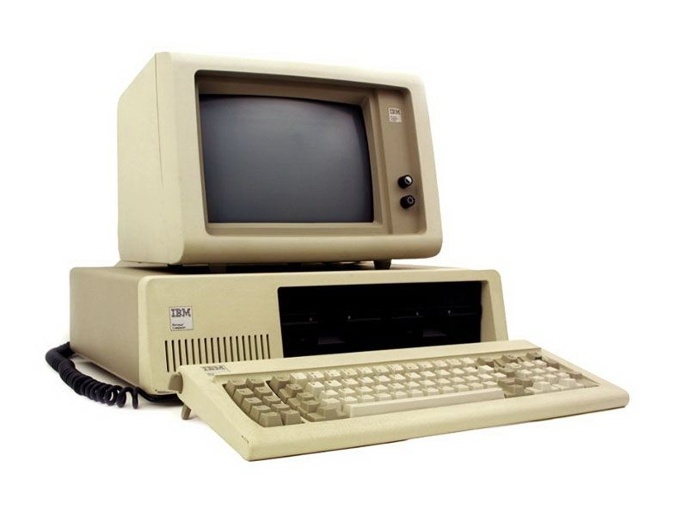
The IBM PC and DOS
Released in 1981, this was one of the most influential pieces of software ever made
This computer was not only a computer small enough to buy, but also included numerous functional programs and other tools that were needed for the computer to actually do anything
It was also a computer built for and marketed to businesspeople
In a day, it would become the best selling computer ever, and birth the commercial PC industry
From the factory, it had no hard drive, but instead used two floppy drives

Slide 4
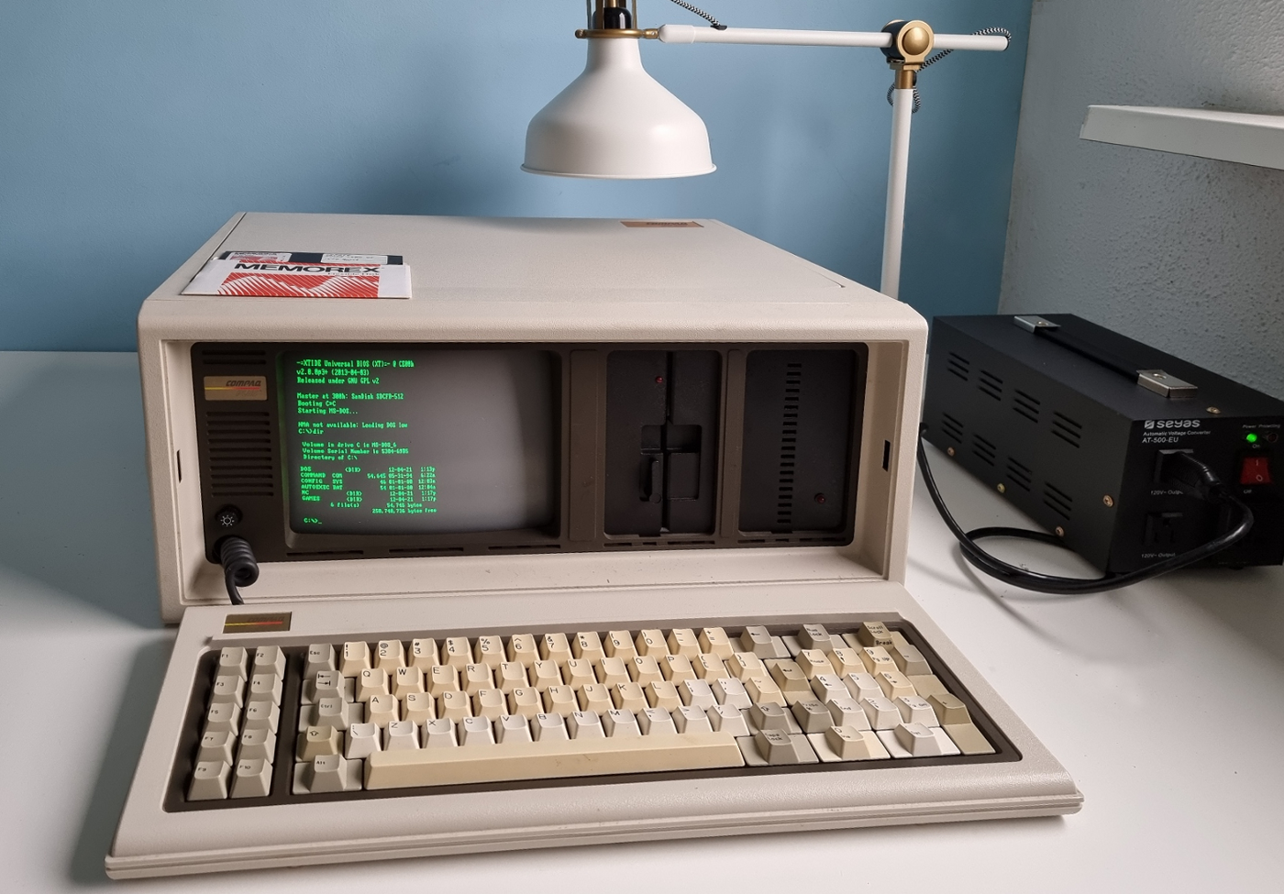
The PC compatibles
Almost immediately after the release and market success of the IBM PC, many companies began trying to clone and copy the PC
The first company to succeed in doing this was Compaq, but they would not be the last.
Every company wanted to cash in on the gold rush that IBM had created, and they did. Within the next few years, there were dozens of clone manufacturers, and IBM was beginning to loose market share in the industry that they created

Slide 5
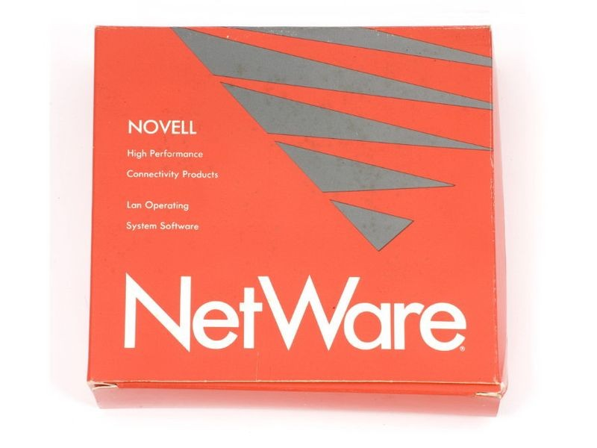
Netware
The lessons learned from networking larger computers like the alto and the mainframes of years past would be carried over to the world of microcomputers using novel NetWare
Netware was a specialized operating system that would run on these smaller computers providing simple network services like file storage, email, and printer sharing
While these early products wee relatively crude, they would go on to be a major stepping stone on the path to the modern internet that we have now

Slide 6
Lotus 123
Lotus was the first complete office suite
While the spreadsheet, database, and word processing products contained within had already been made and implemented elsewhere, lotus was the first combined package that would do it all
It was a breakout success, and would greatly increase the sales of the IBM PC and other compatible computers

Slide 7
GNU
The GNU GPL license was the first open-source license and it would lead to a very popular movement within the software development community
This license allowed anyone to use the source code for free, as long as any derivative work also used the GPL license
Consequently, open source software is software where users can freely download, modify, and redistribute the application’s source code
Nowadays, almost half of all software is open source, including every piece of software that will be used in this course (Linux, python, MariaDB, etc)

Slide 8
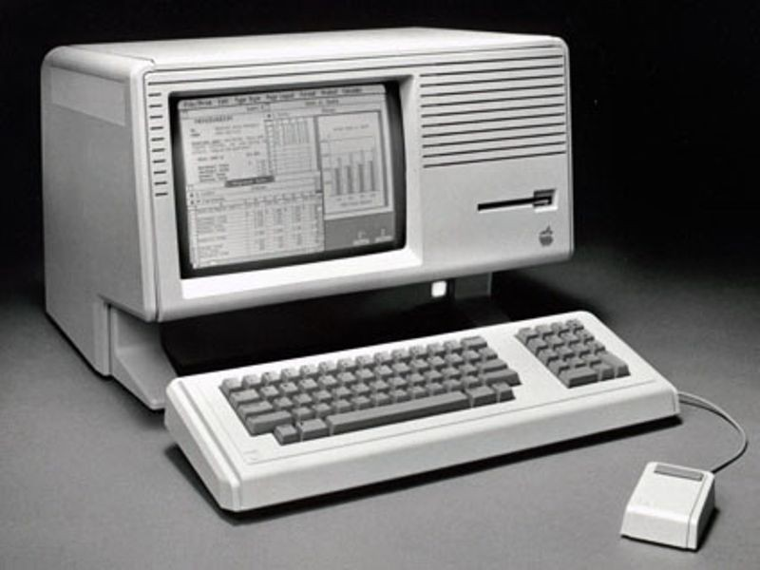
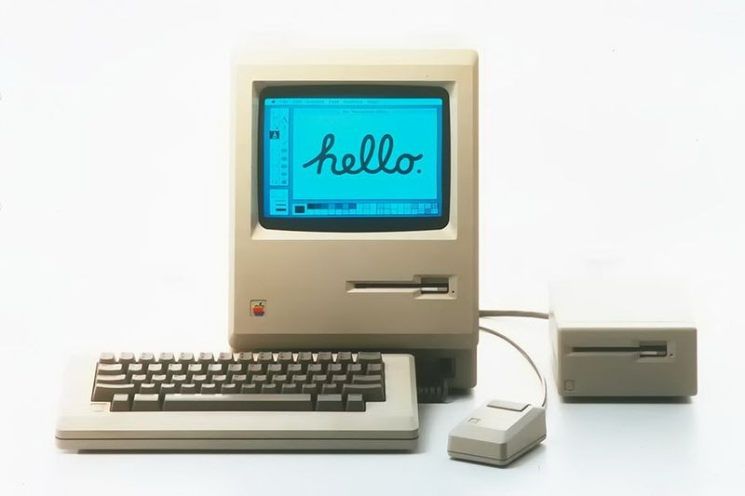
Lisa and the mac
The apple lisa and the mac, both computers from apple, would bring in the age of modern graphical desktops
The lisa (on the top) came first, and was the fisrt small computer using a desktop and graphical operating system, but it was unfortunately too expensive to be a commercial success (it cost over 10,000). Despite this, it set the stage for its successor the mac
The mac was the first really popular graphical computer. Retailing at a price that the average person could actually afford, this system was a major success. It not only saved apple computer from almost certain destruction, it also brought in the age of home graphics and computer artistry.

Slide 9
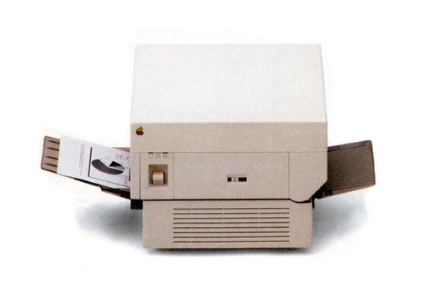
Desktop publishing
The release of the apple mac would allow for a major advance in how graphics and printed documents were made
This change was the release of desktop publishing software, which allowed anyone to create and print professional level graphics. Although it still required expensive software and hardware, it was now possible to print your own documents without contracting with an outside printing company. The three parts of this revolution were the following:
The apple laser writer printer – This was the first small laser printer, which allowed peple to print crisp clear text and graphics. It was a huge advantage over the dot matrix printers that came before, but there was still one major problem preventing it’s use. When it was initially released, it did not have communicates software with the mac or windows PCs at the time. This problem was solved with
Adobe postscript – This program was a specialist communication program that translated graphics, text, and documents could be converted into information that the printer could understand. This was a very key step in getting graphics off the ground.
Aldus PageMaker – this program was a package that would allow users to graphically lay out pages and documents. Although it was not the only graphics program, and would not stay as the top dog for long, it was the first.

Slide 10
Protocol wars and NSFNET
During this time, there was serious discussion on how to combine the dozens of separate, independent intranets together into bigger, communal networks. Unfortunate, before this could happen, a common protocol had to be selected.
At this time, every major computer manufacture had its own type of network, an a common one had to be selected. The competitors were:
IBM SNA – made by IBM for their mainframe computers, this was the large by amount of traffic at the time
DECNET – built by dec for VAX and PDP computers, it was another very popular choice at the time
OSI – the OSI model was the first to gain wide spread support among standards bodies, but it very little hardware adoption.
IP – currently used on the closed apranet, this standard was backed by the US federal government
Although the introduction of the NSFNET, the federal-backed network that merged all of the us government’s separate networks onto the IP protocol would help strengthen IP, the protocol wars would continue into 1995

Slide 11
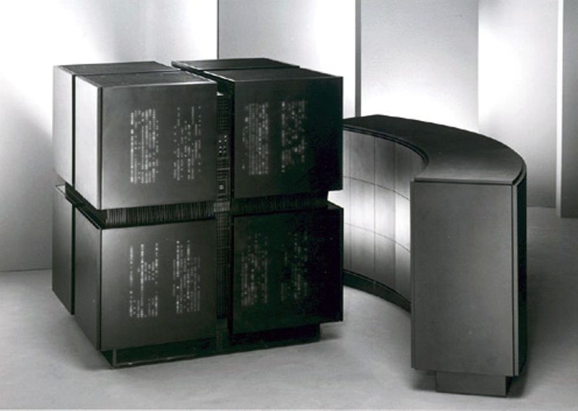
Connection machine
The connection machine was an experimental supercomputer that focused on parallel processing over induvial processing speed
This machine would show the benefits of parallel processing
It did not work best for all workloads, but it was very good for some (like AI, and certain types of math)

Slide 12
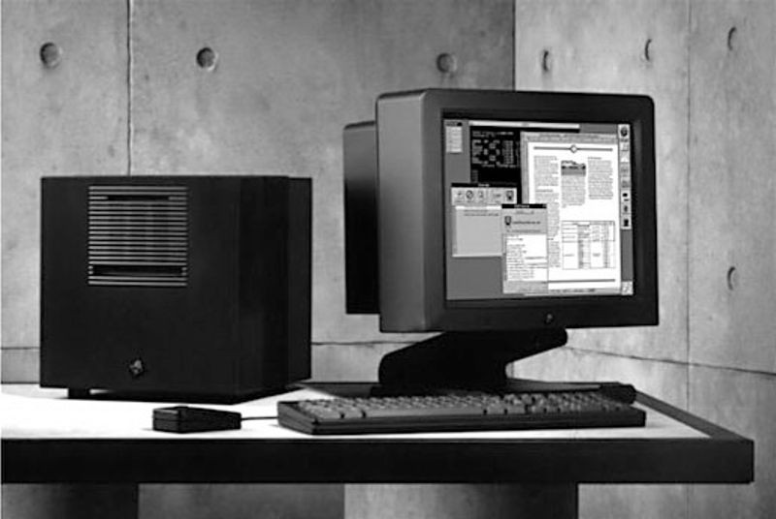
NeXT cube
The next cube was a computer created by Steve Jobs that would become very popular among software developers and other enthusiasts
The cube had 3 CPUs, and natively supported several more advanced programming methods out of the box, and included a high-capacity removable storage drive
It was used to develop a number of famous software programs, and was especially popular among animators and creatives

Slide 13
The information age

Slide 14
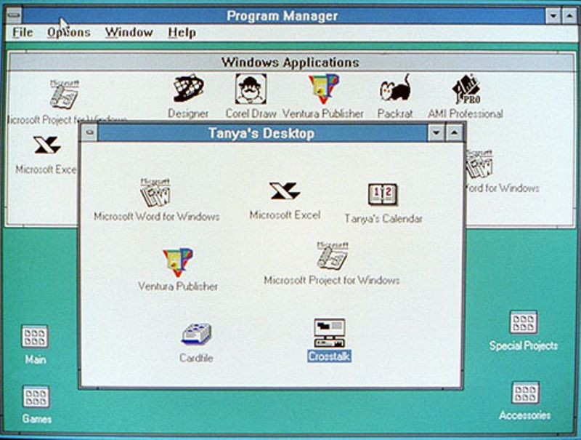
Windows 3.0
Windows 3.0 was the first successful version of windows. Unlike it’s predecessors, it actually worked, and it had enough features to be worth installing
Windows 3.0 also shamelessly copied a large number of features from the mac, prompting a lawsuit
Unlike the mac however, windows 3.0 was run on top of dos, instead of replacing it completely. This would allow the user to install windows 3.0 on top of their existing computer, and reuse their existing applications

Slide 15
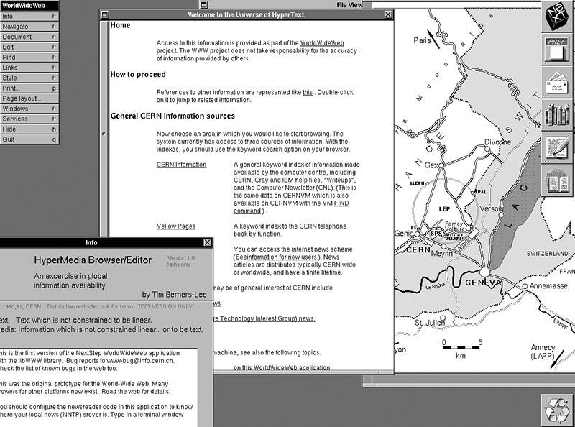
The world wide web
Also in 1990, the world wide web was invented. This system was first deployed internally at the CERN particle physics research center in Europe, but would become very popular over time
It is important to note that this early version of the internet just had text and links. The network still did not even support much styling yet
Despite these limitations, it was still a revolutionary tool for information exchange
These private internets were also still not connected together yet though

Slide 16
The internet made public
In 1991, the last key step in the adoption of the internet was completed. Restrictions on commercial use and use by corporations was lifted
Although it would still take several years for the internet to become a common fixture in the lives of most people, this single change was a very important milestone

Slide 17
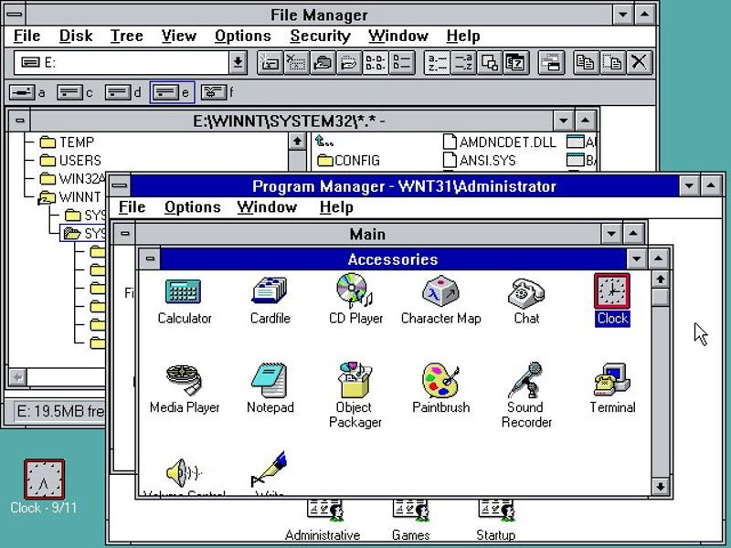
Windows NT
In 1993, Microsoft released the new version of windows NT, which was a complete re-implementation of the operating system away from DOS
Unlike it’s predecessors, NT rand without dos, starting directly into the windows environment
This made it much more stable, and became the de-facto windows version for corporations and serious users

Slide 18
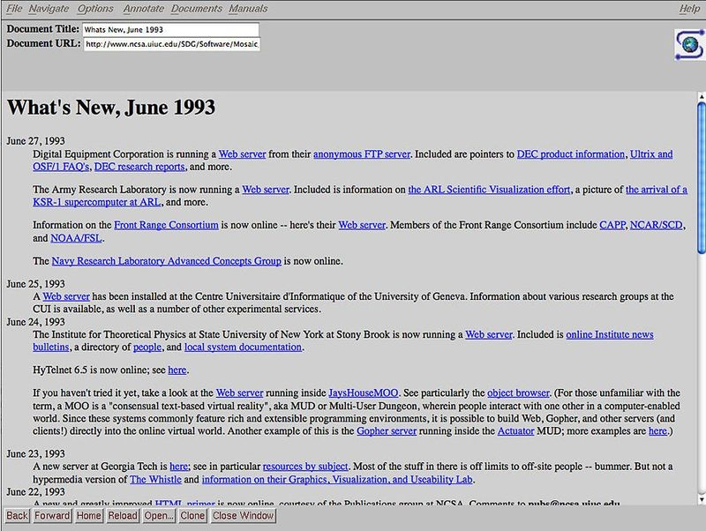
NCSA Mosaic
The first commercial web browser was released in 1993 as well
This program, made freely avalible by the government, was primitive, but it was still a major improvement over the prototypes that came before it
The inventor of Mosaic would later go on to create Netscape navigator, the first commercial web browser

Slide 19
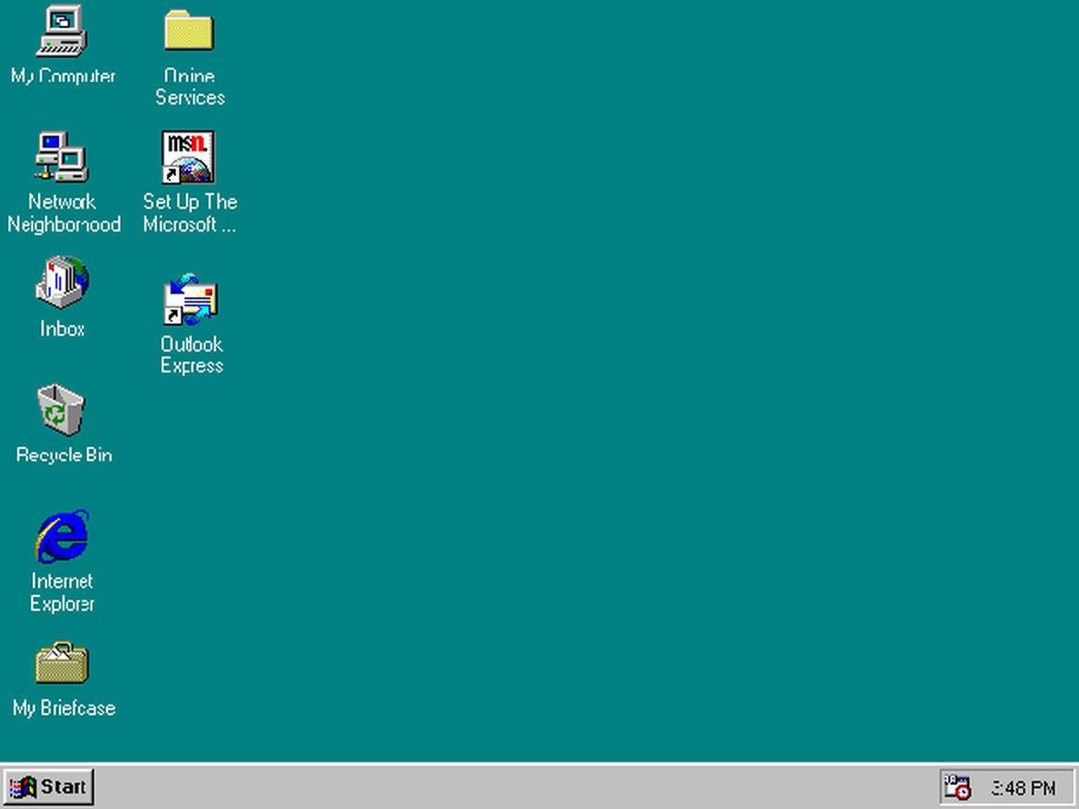
Windows 95
The first modern version of windows, 95 introduced the start menu, plug and play, and many other features that we know today
This was also the first version of windows that would include support for internet features like email, web browsing, and dialup connections
This version of windows, along with a massive marketing campaign by Microsoft would help propel them into almost complete dominance of the desktop PC space

Slide 20
Web becomes available
With the advent of windows 95, the availability of browsers like Mosaic, and commercial internet service providers offering access to the web, the internet age was officially born
This was the year the internet moved into homes on a wide and constant scale
At the time, the only way for a consumer to access the internet was to use dialup service providers which were quite slow
Many homes also did not have a network, in the way that we think of them today, but instead had a single computer connected directly to the internet

Slide 21
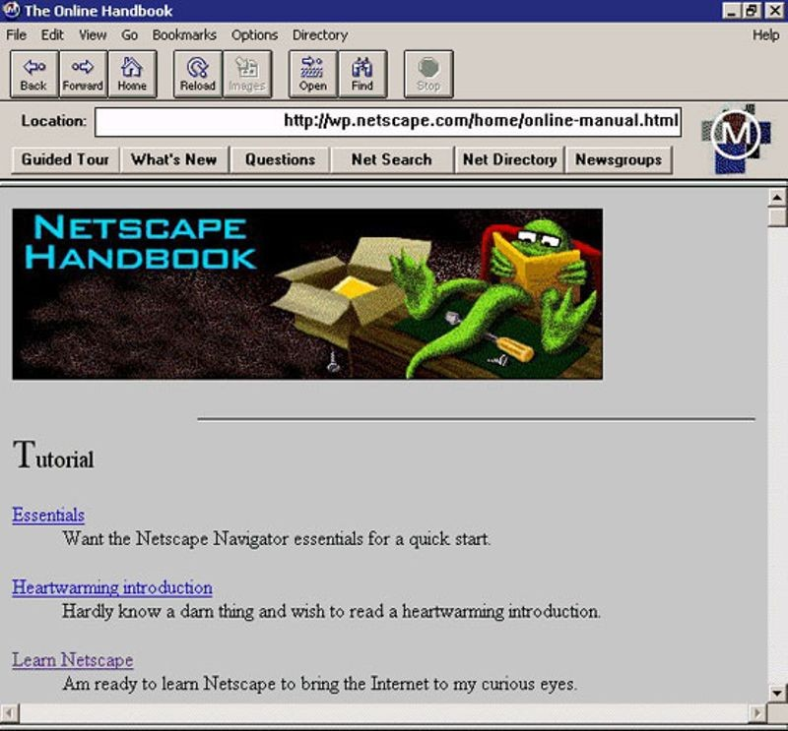
First browser war
The first browser war happened after the creators of NCSA mosaic broke off to form a new commercial enterprise: Netscape Navigator
Netscape was the first widely adopted commercial browser, and would have total control of the market for the first 2 years of its existence, but soon Microsoft would come along with Internet Explorer
Unlike Netscape, IE came bundled for free with Windows, and these manipulative tactics would allow IE to take over the market share of Netscape
This would lead to a massive lawsuit, but in the end, IE would win

Slide 22
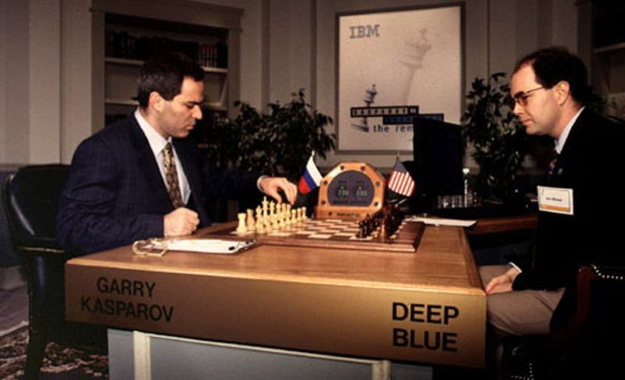
Deep blue
Deep blue, built using an IBM supercomputer, was the first computer to ever beat the world champion of chess
This had been a goal of AI researches for years, but it had taken until 1997 to make it possible

Slide 23
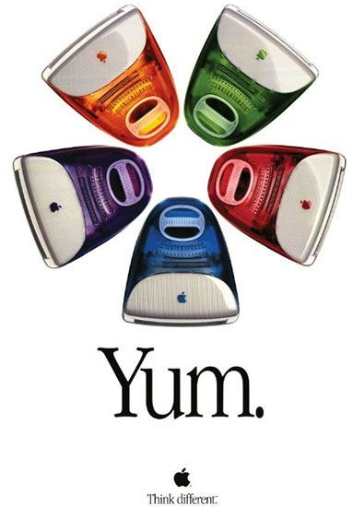
The mac
Released in 1998, apple’s new mac would be a turning point in the history of the company
Apple suffered major hard times after the release of the original mac, failing to fully capitalize on the success of the tech they had invented
The new mac designed by Steve jobs would change the companies fate
Built from the ground up to be user friendly and internet focused, is the direct predecessor to the modern apple computers

