Slide 1
Algorithms

Slide 2
What is an algorithm?
An algorithm is a list of steps that is used to solve a problem
All algorithms have the following characteristics:
It should terminate after a finite time.
It should produce at least one output.
It should take zero or more input.
It should be deterministic means giving the same output for the same input case.
Every step in the algorithm must be effective i.e. every step should do some work.

Slide 3
Inputs & Outputs
The most important part of these characteristics is that an algorithm is deterministic
When a function is given the same input, it should always produce the same output
Algorithms should also have clearly defined and expected outputs. You should be able to predict the output for any valid input

Slide 4
Language-neutral
An algorithm and the code that implements it are disconnected
An algorithm must be able to be implemented in any programming language.
Some programming languages may be better than others for certain tasks, but you should be able to use any language
When programming algorithms, you should first plan the algorithm, and then implement it

Slide 5
Modeling Algorithms
Modelling algorithms using both text and flowcharts is an essential skill, both for programming, and for the AP exam
This is also highly recommended throughout the year, especially for highly dense algorithms

Slide 6
Modeling Algorithms: Text
Text modeling is thankfully quite easy! Just write out what your program is going to do step by step
For conditional statements, just include the word if before the step that is conditional
These lists of steps should also be short. You don’t need a written step for every line of code, only important stuff

Slide 7
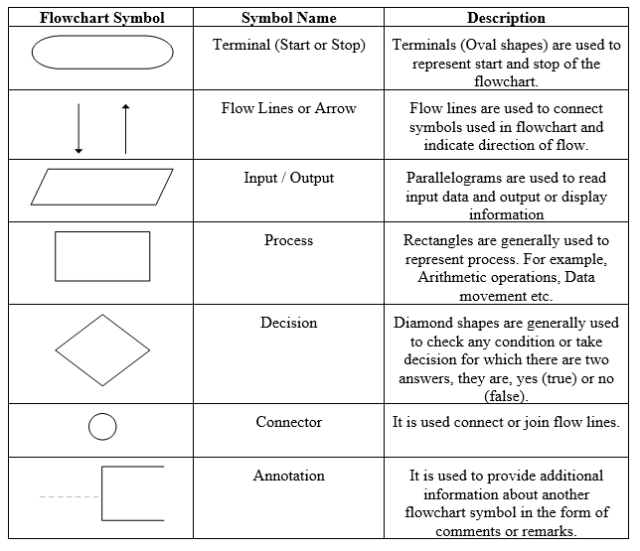
Modeling Algorithms: Flowcharting
When flowcharting, you are using the shapes to the left to build out the steps and flow of an algorithm
The objective here is just to model the algorithm, not every single line of code
These will be on the AP exam

