Slide 1
Debugging

Slide 2
What do you do when your program doesn’t work?
Debugging is a part of programming. (The biggest part, depending on who you ask)
Fixing these bugs can be straightforward, or difficult, but the process is generally the same.
We will be going through several examples of bugs in this lesson and practicing fixing them

Slide 3
Types of bugs
Generally, there bugs will produce one of two types of errors:
Syntax errors will result in the stoppage of program execution, and an error message by the interpreter
These bugs are much easier to spot, and ususally easier to fix
Logic errors occur when the program runs correctly, but produces weird or unexpected output
These programs can be much harder to spot, and are almost always more difficult to fix

Slide 4
Debugging process
When we debug issues of any kind, we follow a 5 step debugging process
First, we identify that a bug exists
Then, we find the general area of the code causing the bug
Third, we find the cause of the bug in the broken programs
Fourth, we design a fix for the bug, and implement it into the program
Last, we test the program again, to ensure the bug has been fixed

Slide 5
Identifying that a bug exists
In the case of a santax error, you will know about the presence of a bug immediately by the presence of the interpreter’s angry screed
Some logic errors are also quite easy to spot, causing obvious wrong or unexpected answers
Many other logic errors only appear in edge cases however. Spotting these can be much more difficult.
This is why it is important to test a wide range of inputs for your program, especially edge cases like zeros, and large numbers

Slide 6
Finding the error
Before we can identify the specific cause of the bug, we have to find it’s general location
In the case of syntax errors, this is usually provided by the interpreter
For logic errors, think about what part of the program could be causing the problem you now have
Take the example of our prime number program. Where would we look if it reported every number as prime?
Where would we look if our program stopped five numbers short of the given range?

Slide 7
Identifying the specific error
Once we have found the general area to start looking, we will start checking every line one by one
If we have a interpreter message, start looking for an error that matches the message
We should always first check for simple, “stupid mistakes” like incorrect brackets, missing colons, undeclared variables, spelling errors, and incorrect symbols
If we cannot see an obvious mistake, start running the code in your head, line by line. Take the input that is causing the error, and note its value after each line

Slide 8
Implementing the fix
Once you have found the specific problem, a fix will usually become readily apparent
You will not always get the correct fix on the first try, but you should always start somewhere
It is far more important to try something, and get more information for later debugging runs
You may also need to rewrite larger chucks of the code than you initially thought. Sometimes your initial implementation of the whole was not correct, and needs to be redone

Slide 9
Testing the fix
Never forget to test your fixes after implementing them
You may have not fixed the bug on your first try
You may have also caused new issues that need to be fixed

Slide 10
Examples!
We are now going to go over a few examples of broken programs, and fix each one individually

Slide 11
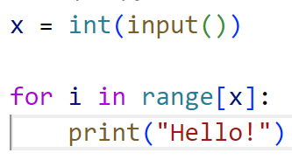
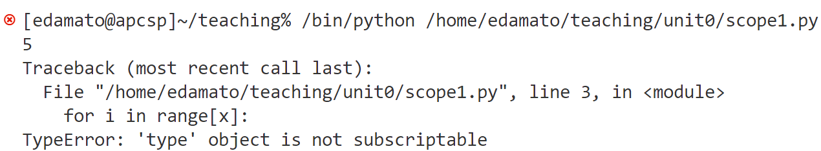
Example 1 – printing hello a number of times

Slide 12
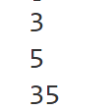
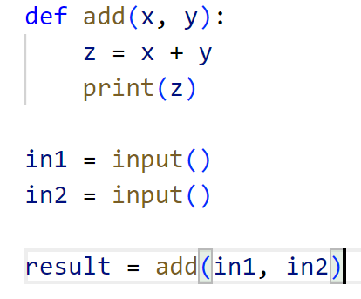
Example 2 – Adding program

Slide 13
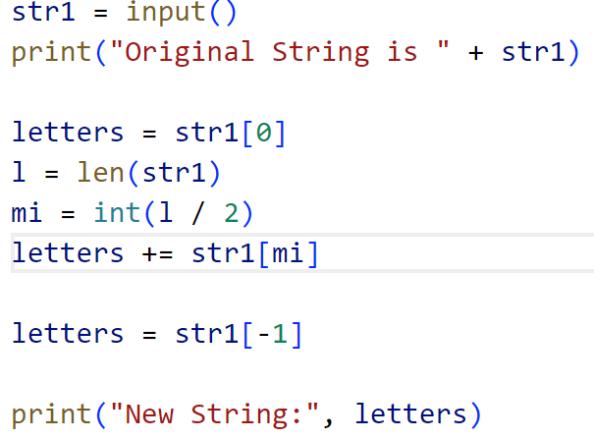
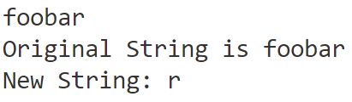
Example 3 – First, middle, and last letters in string

Slide 14
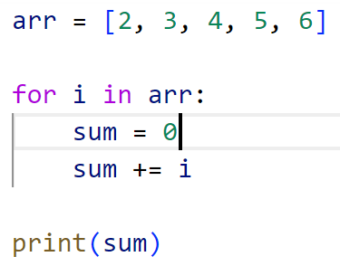
Example 4 – adding numbers in an array

Slide 15
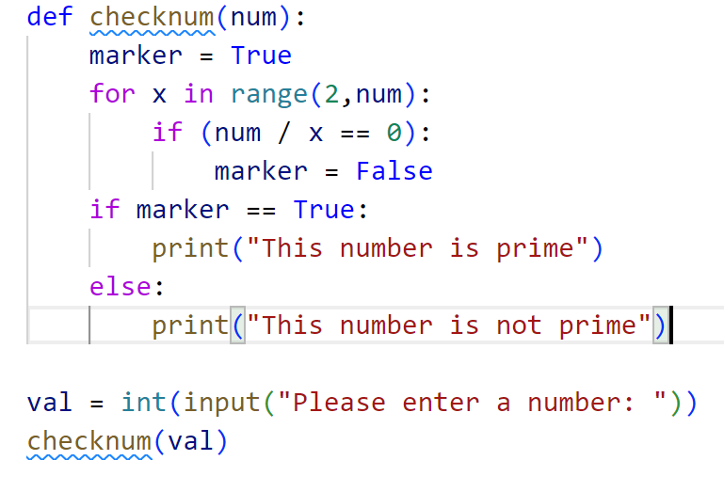

Example 5 – Prime numbers

