Slide 1
Normal forms

Slide 2
What is normalization?
Normalization is a process to ensure that databases continue to be usable over the long-term
Normalization helps to ensure that:
Data is not accidentally changed with anomalies
The schema can be easily extended in the future
Data can be accessed in a freeform, relational maner

Slide 3
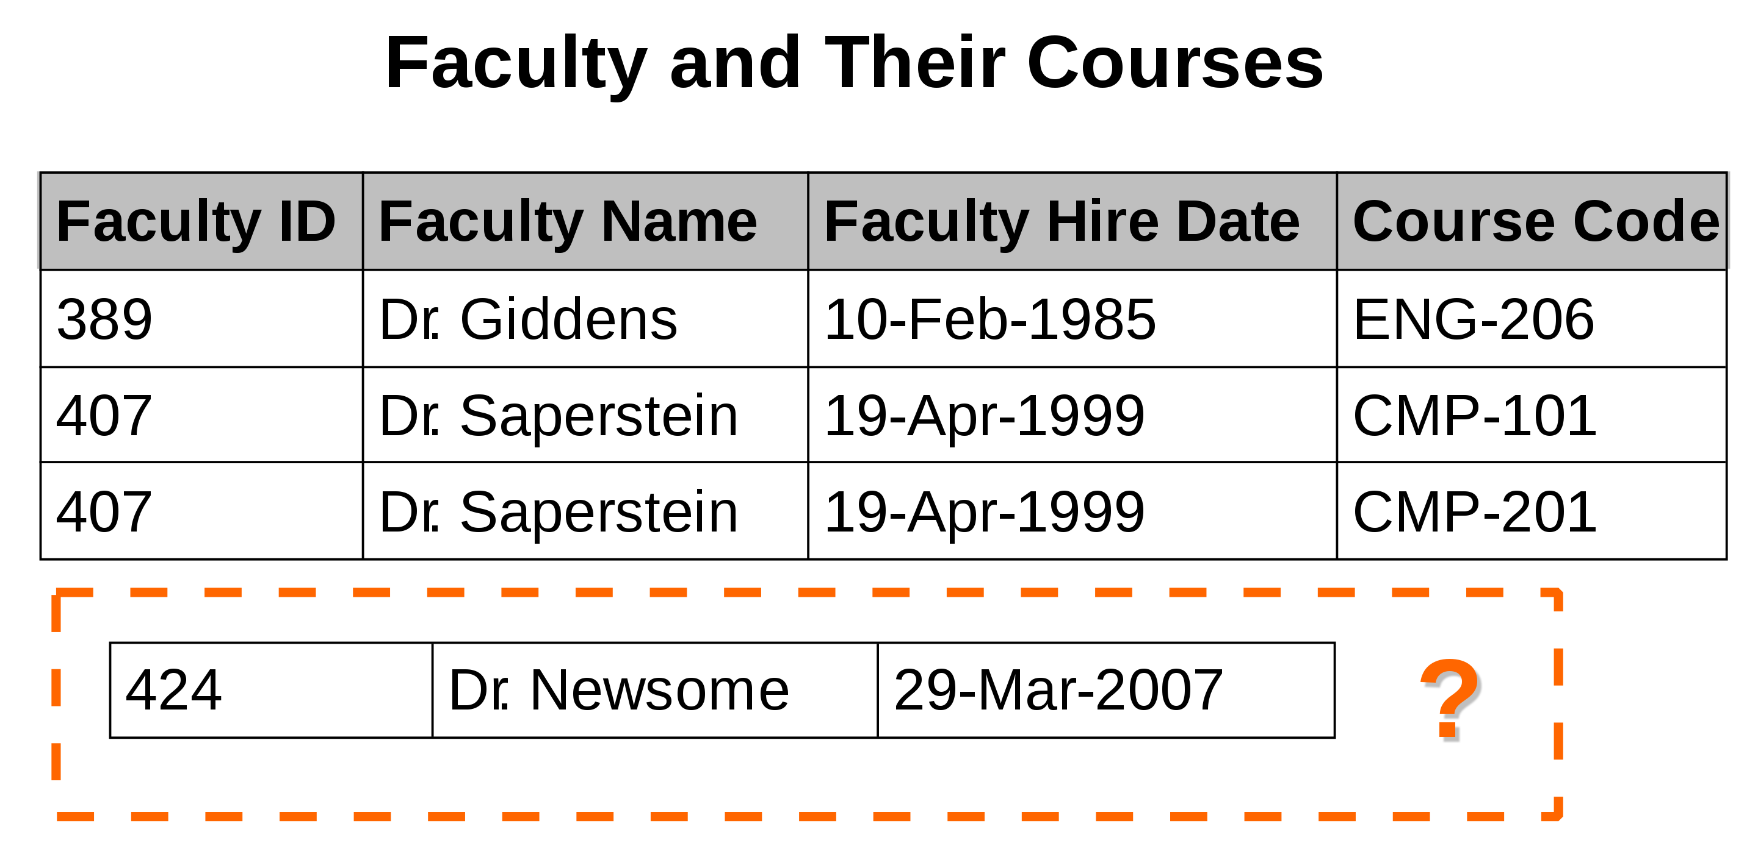
Anomalies: Insertion
Anomalies are issues that arise when data is updated or accessed in an improper manner, which can lead to inconsistent data
An insertion anomaly occurs when data cannot properly be added due to a missing field
In this case, D. Newsome cannot be added until he is assigned a course

Slide 4
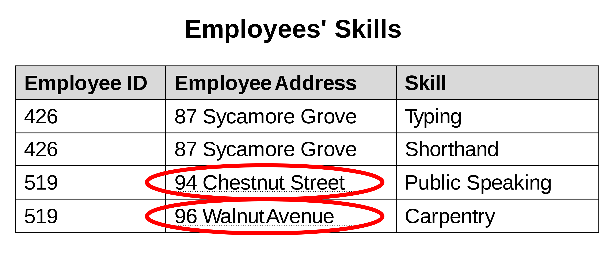
Anomalies: update
An update anomaly occus when a row is updated with data that contradicts with other parts of the database. This is usually caused by duplicate records.
In this example, Emp. # 519 has two records, and only one had their address changed.

Slide 5
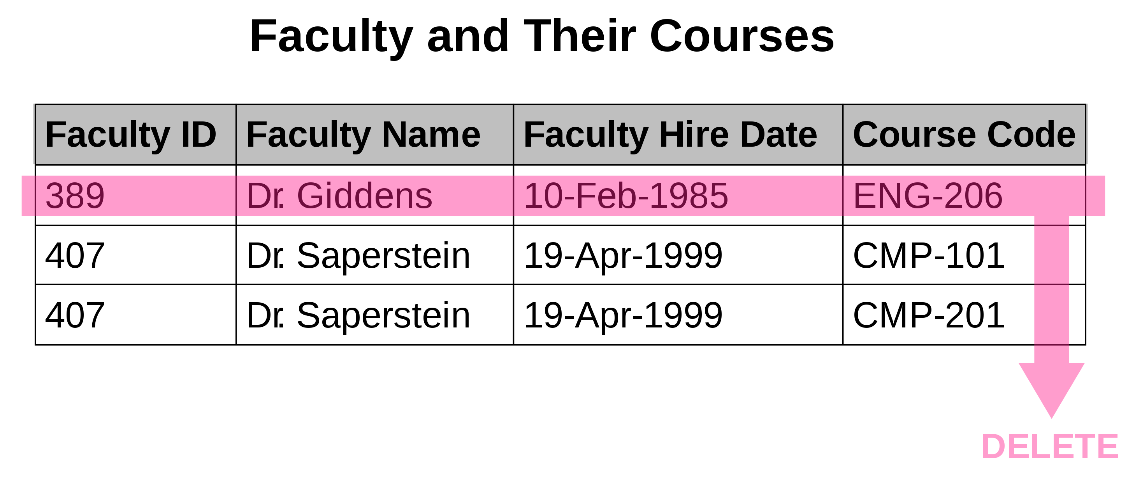
Anomalies: delete
Deletion anomalies occur when removing some of the data associated with an entity causes the loss of all or unwanted data
In this example, all data associated with Dr. Giddens is lost when he is no longer teaching a course

Slide 6
First normal form (1NF)
First normal form dictates that each table must:
Have a primary key
Have only one value per field (this is called an atomic field)

Slide 7
Second normal form (2NF)
2NF relates to the removal of partial dependencies.
This means that all fields are fully dependent on the primary key
This is designed to minimize the risk of data errors created during update and delete

Slide 8
Third normal form (3NF)
Third normal form relates to removing transitive dependancies:
Transitive dependences are elements that are dependent on attributes that are not the primary key
IE: A field called country would depend on State, non student ID

