Slide 1
Welcome to AP Computer Science Principals!
“Computers are incredibly fast, accurate, and stupid. Human beings are incredibly slow, inaccurate, and brilliant. Together they are powerful beyond imagination.”
- Albert Einstein
“The spread of computers and the Internet will put jobs in two categories. People who tell computers what to do, and people who are told by computers what to do.”
- Marc Andreessen
“Everybody should learn to program a computer, because it teaches you how to think.”
- Steve Jobs

Slide 2
Before we can begin: prior experience survey
Raise your hand if you:
Have a Chromebook
Have a mac
Have a PC
Have ever used Linux
Have ever programmed before
Use google docs
Can define DNS
Know the difference between the web and the internet
Would consider yourself experienced with computers
Would consider yourself a beginner
Have ever built your own computer
Have a favorite programming language

Slide 3
What is Computer Science?
Computer Science is the study of computers and computational systems. -MIT department of computer science
But what does this mean? What is a computer? What is computation?

Slide 4
A programmable device that can store, retrieve, and process data
OR
A machine that can add numbers and save the result

Slide 5
What is a computer?
Simply put, a computer can preform addition and subtraction, save the results, and preform another addition or subtraction on the result
When you program a computer, you are describing the starting values, order, and values of the operations in this sequence
Computer science is the study of how to extend these basic operations to do real, productive work in the most efficient way possible

Slide 6
What is this class?
AP Computer Science Principles is an introductory college-level computing course that introduces students to the breadth of the field of computer science. Students learn to design and evaluate solutions and to apply computer science to solve problems through the development of algorithms and programs. They incorporate abstraction into programs and use data to discover new knowledge. Students also explain how computing innovations and computing systems—including the internet—work, explore their potential impacts, and contribute to a computing culture that is collaborative and ethical.

Slide 7
What does this mean?
This course will cover an introduction to a wide variety of subjects, in multiple different aspects of computer science
The core of this course is learning basic programming skills
You will also learn about the history and impact of computing, digital ethics concerns, and how computing can be used in the real world.

Slide 8
What to expect from this course
This course has been designed with the goal of maximizing real experience with programming and computing while minimizing busywork.
With this in mind, you will still have to pass your AP exams, which are heavily dependent on your ability to answer oddly worded multiple choice questions

Slide 9
With this in mind...
You will have a short (~10 question) multiple choice quiz after each section (5 days), and a longer (~25 question) test after each unit (4 sections)
Your only homework will be week-long, self-paced, real-world programming projects that will require you to apply what you have learned in class
When a programming assignment is not applicable, you will have a writing task instead.
These assignments will be given out at the start of each section, and will be due on the first day of the section after the next one

Slide 10
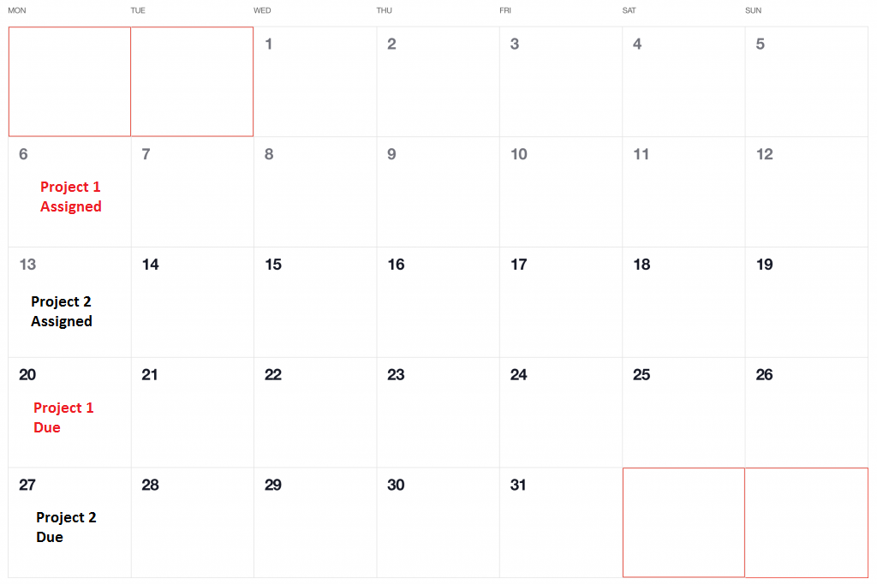
Scheduling
This way, you can learn all the material before you have to start your project!

Slide 11
Programming environment
All programming work for this course will be done on a provided Linux server, so that there are no problems with incompatibilities or submission of work
You will be able to access this environment through the VScode IDE, and a standard SSH terminal
All instruction and coursework will be done in python

Slide 12
Why python?
Java is extremely verbose, wordy, and it’s dependence on object orientation makes it difficult to use for may tasks
C++ is extremely hard, and would make teaching this class at a beginner level almost impossible
C does not have support for object orientation
JS is awful
All other languages are too obscure to be a good fit for a general course such as this one

Slide 13
Coursework resources
Assignment submission, grading, and similar functions will be handled through a private canvas instance for this class (because schoology is awful)
PowerPoints, and when possible, teacher provided notes will be hosted on canvas, and on the course website (apcsp.io)
Best effort will be made to crosspost content between the two sources, but some content is incompatible with canvas, so in these cases, links will be provided to the website
Quizzes and tests will be provided through bubble sheets designed to mimic the real AP exams closely as possible
The textbook will be available as a digital copy in both places

Slide 14
What I expect from you
That you know how to use google
That you let me know when you don’t understand a topic
That you take a level of notes that you are comfortable with
Do not copy the PowerPoints. They will be posted online
Do not expect teacher created notes for every lesson
Do not write down every single example, function call, or library command referenced in class – Google It

Slide 15

Discussing the elephant in the room

Slide 16
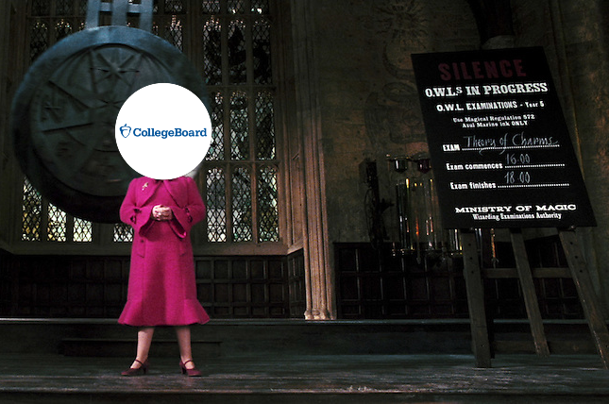
AP exam format
70 multiple choice questions over 120 min standard time, 70% of score
1 long-term performance task project, completed over a maximum of 1 month. Class time will be provided, 30% of score

Slide 17
What the AP exam means for you
This is an AP tested subject
This means that there is a certain amount of content that we will have to cover for you to pass your exam
I have built points into this class where we can slow down if we have to, but we still have to maintain a fairly decent pace
If you don’t know material, stop and ask for help before you are underwater
The long project deadlines and frequent quizzes are designed to give you a safety net. Use it

Slide 18
And now
Please write your email, first and last name and phone number on the paper that is being passed down to your now

