Slide 1
How does a computer work?
Subtitle

Slide 2
Parts of a computer

Slide 3
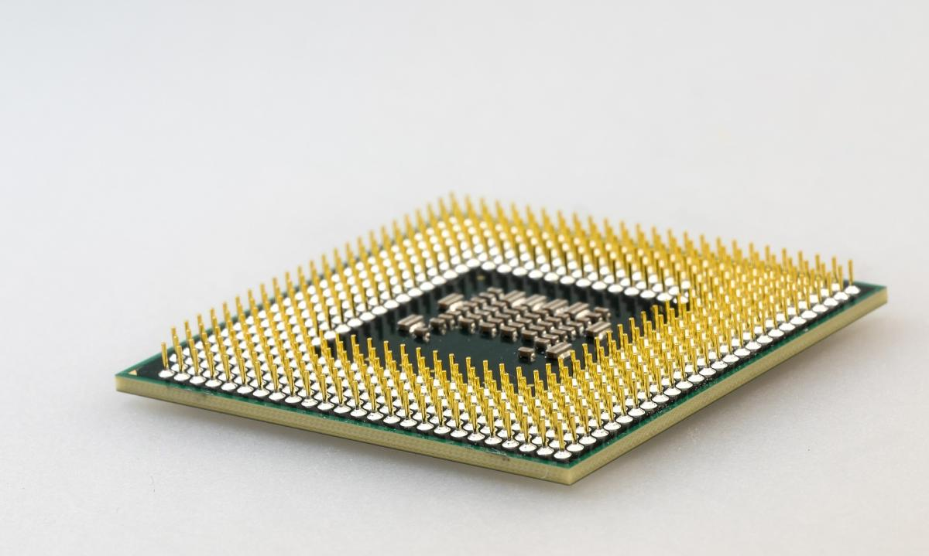
CPU
The heart of the system. Responsible for processing all data and controlling all other components of the system

Slide 4
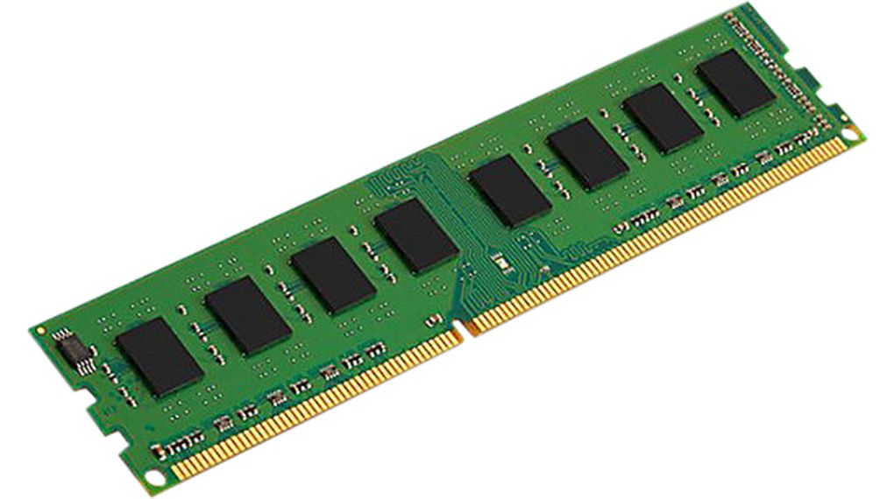
RAM
Working storage of the computer
Relatively quick, but not directly connected to the processor
Not persistent, erased when power is lost

Slide 5
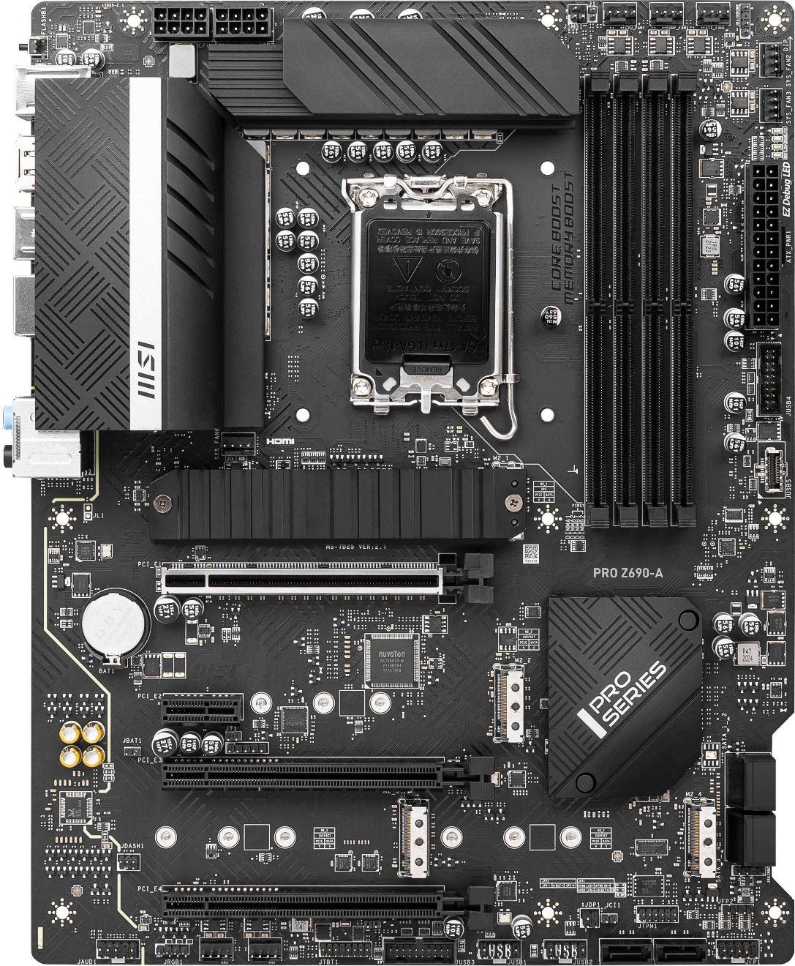
Motherboard
The motherboard ties the entire system together
It contains physical interconnects for all components
It also contains hardware to preform ancillary functions, like IO management, power delivery, and the chipset

Slide 6
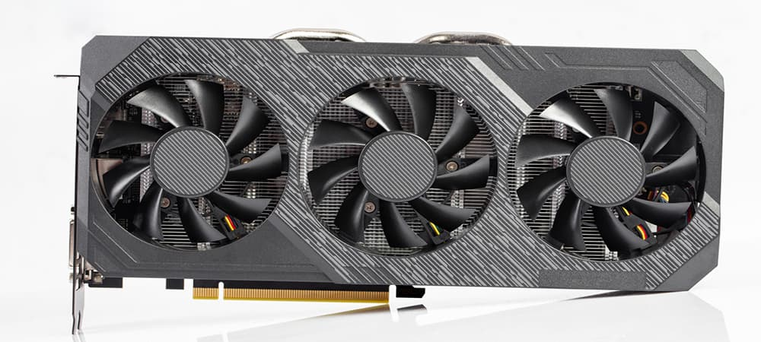
Graphics card
An add in coprocessor card, that is used for offloading certain workloads
Traditionally used to render graphics, but can also be used for some highly parallelized workloads

Slide 7
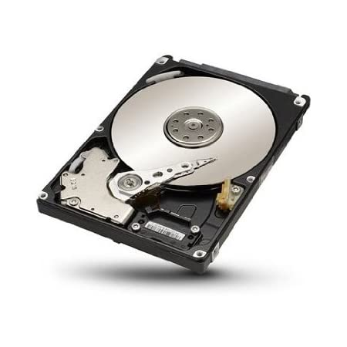
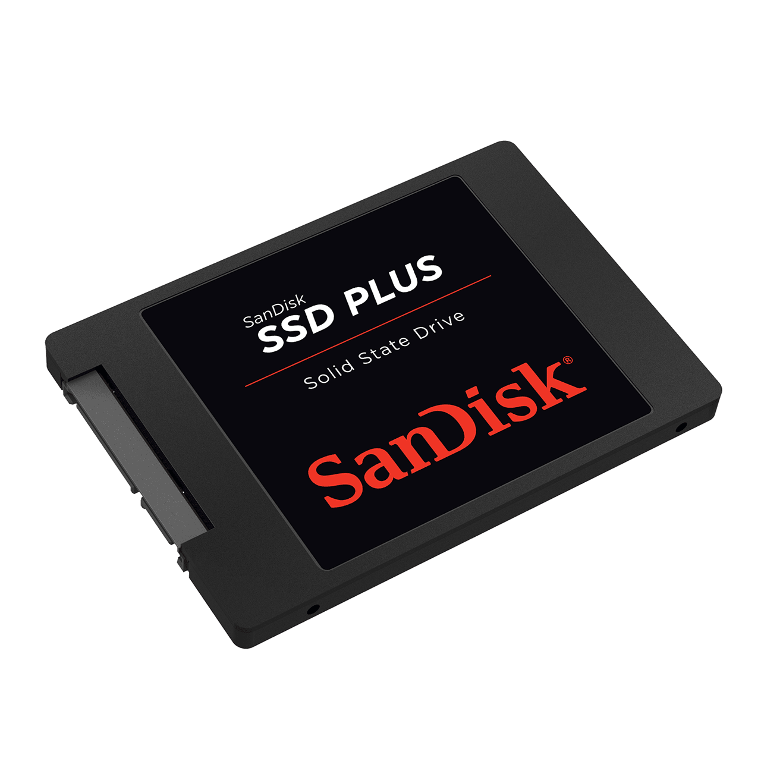
Storage
Mass storage comes in the form of solid state storage (faster) and hard disk storage (cheaper)
It stores large amounts of data, and persists after the computer is turned off

Slide 8
Binary numbers

Slide 9
The bit
As you may have guessed, a computer is an electrical device
A computer has to convert human readable numbers into machine readable numbers
The solution to this problem is the bit
The bit, or binary digit, represents the power state in a computer circuit

Slide 10
Binary introduction
Binary is a numbering system that has only two digits, as opposed to the 10 that our decimal system uses
These two digits, 0 and 1, represent the power state of an electrical circuit
Instead of each place value representing a power of 10, each value represents a value of 2
It’s almost always easier to go backwards through the number when assembling or converting

Slide 11
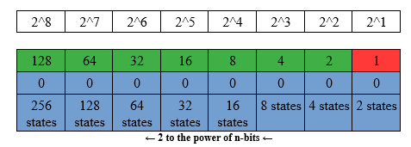
Diagram

Slide 12
Some examples
10 -> 2
101 -> 5
110 -> 6
1001 -> 9
1110 -> 14
10111 -> 23
11010 -> 26
100110 -> 38
101011 -> 43
0111000 -> 56
1001100 -> 76
01011010 -> 90
11010010 -> 210

Slide 13
Your turn
01000000
11100111
00000011
10101000
10101100
11010101
01110000
01011010
01011010
01101001

Slide 14
Answers
01000000 -> 64
11100111 -> 231
00000011 -> 3
10101000 -> 168
10101100 -> 172
11010101 -> 213
01110000 -> 112
01011010 -> 90
01100001 -> 98
01101001 -> 105

