Slide 1
Assembly and microcode

Slide 2
Processor architecture
A processor design, at its most basic level, has a processing segment (ALU), control unit, and a number of registers
The registers provide memory that the processor can directly access. They are insanely fast, and kept on the processor itself (called the die), but very limited in size. (In the case of the latest high-end CPUs, there are only 16 per core. Each register can only store one number)
The ALU preforms operations such as addition, subtraction and multiplication
The control unit detects each of the commands so that the system knows how to interpret them

Slide 3
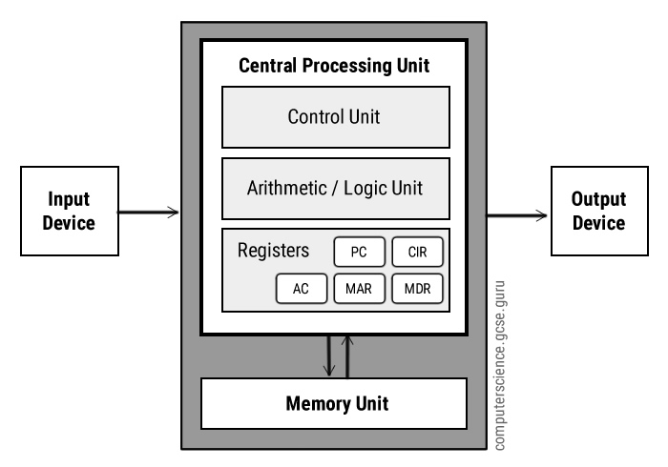
Processor example

Slide 4
Instructions
A processor is controlled by a series of simple commands called instructions
These instructions directly control the flow of electrons through the processor
These simple instructions make up a coding language called assembly
These instructions represent the simplest possible information that a processor can understand and work with

Slide 5
Assembly
These instructions provide extremely simple functions
As an example, the mov instruction moves data from memory to a register
The add instruction adds the data in two registers
These letter names actually represent hexadecimal values (which represent binary values, which the cpu processes directly)
The process of converting these friendly names into binary is called assembling
The source file in this process is called the source code, and the target file is called a binary

Slide 6
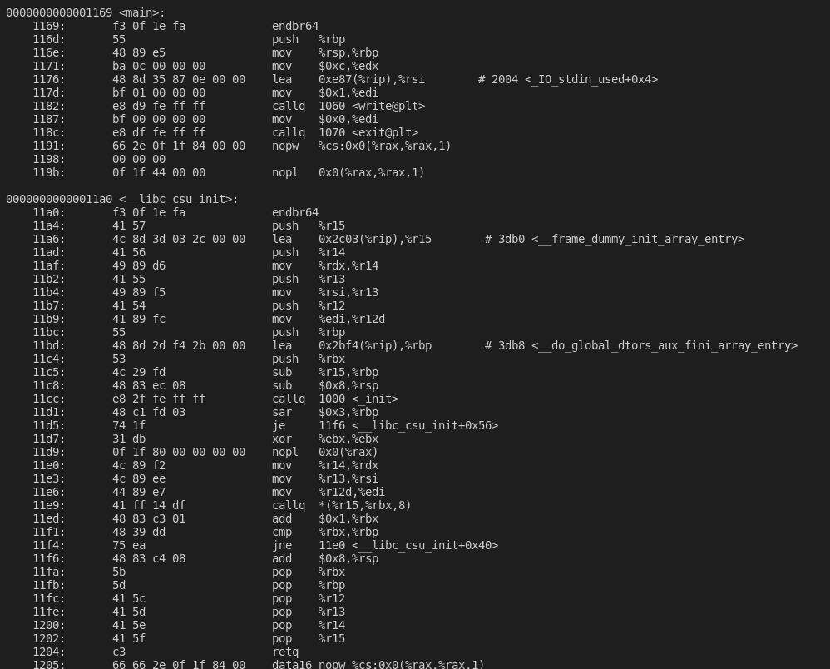
Just how low level is assembly
This assembly prints hello world
This python code does the same thing
print(“Hello World”)

Slide 7
cycles
So, what does the processor do when it receives an instruction?
Well, it executes it! (The exact spesifics of this are beyond the couse of this class)
The processor has a speed (normally in GHz), which represents the number of cycles that the processor proforms per second
Instructins can take a number of cycles to run (some only take one, others take up to a dozen)

Slide 8
Architectures
CISC
RISC
Many complex instructions available to programmer
Each instruction can take multiple cycles
Easier to write assembly for
Greater power consumption
Few instructions available, each one is simpler
Each instruction takes only one cycle
Harder to write assembly for
Lower power consumption
Which one of these is better preforming is highly dependent on processor design and implementation. They can both preform extremely well or poorly. RISC was originally created in the 1980s after compiler technology had advanced enough that manually writing assembly was rarely needed.

Slide 9
Compilers
Why do we not have to write assembly language ever?
How does a higher level programming language like C# or python work if a processor can only understand assembly
The answer is a compiler
A compiler is a special program that translates a higher level programming language into assembly code (or bytecode, or binary, or executable code depending on who you talk to)
All languages that are human readable in any sense are compiled in some way, shape or form

Slide 10
Static compilation
The traditional method of compilation is static compilation, where the enire program is compiled into a single iant file
This has the advantage of producing a program that will run on any computer, no matter what software it has installed
The downside is that the final executable file can be HUGE, and if your program relies on any other programs to work, they cannot be updated seperatly

Slide 11
Dynamic linking
In a dynamic linking configuration, instead of each required program being hoovered up into one giant file, links are inserted into the program describing the location of the required programs on the system
When the program is run, the operating system is responsible for providing the additional required programs that the main program needs to run
The upside for this is that the supplemental programs can be updated independently and executable files are smaller, while the downside is that the supplemental programs and the operating system must be installed on any system you want to run a program on

Slide 12
Interpreted code
There was still a major problem with these options however
What if you wanted code to modify itself while it is running?
This was the motive behind the creation of LISP, the first interpreted programming language
In an interpreted language, the code is never compiled into an executable, but is instead run dynamically, one line at a time
A program called an interpreter reads in the source code, converts it into bytecode, runs it, and then retrieves the next line

Slide 13
Pros and cons of interpreted
Pros
Cons
Easier to use (the interpreter has more freedom to support the programmer)
Ability to dynamically modify subsequent code (only in certain languages)
Easier to test and debug
Cross platform/OS
Can be run without direct hardware access
Much slower
Less ability to directly touch the hardware, completely unsitable for OS and driver development
Susceptible to weird structural errors (Position of code in file effecting outcome)
Cannot detect errors before runtime
Interpreter must be installed on the target computer before running

Slide 14
Intermediary or JIT
Some languages (Java, C#, and languages based on it mostly) use a hybrid approach
Programs are compiled to an intermediary bytecode which is then run by an interpreter
This allows you to take the cross-platform compatibility of interpreted languages, while gaining the speed of compiled languages
This comes at the cost of decreased ease of use and debugging and the necessity of installing the interpreter

Slide 15
Programming language speed comparison
Language | Time to complete | Memory Usage | Program size
C gcc #2 | 25.31 | 968 | 400
C gcc | 26.42 | 1,020 | 418
Go #2 | 26.64 | 1,608 | 494
Go | 27.28 | 1,140 | 462
Java | 40.89 | 35,696 | 439
C# .NET | 45.80 | 33,708 | 465
PHP #2 | 185.42 | 11,728 | 391
PHP | 195.57 | 11,792 | 384
Ruby #2 | 20 min | 285,356 | 307
Ruby | 21 min | 285,312 | 335
Python 3 #2 | 34 min | 7,132 | 330
Perl #2 | 43 min | 5,188 | 351
Perl | 50 min | 5,736 | 375
Python 3 | 1h 09 min | 7,736 | 373
Green languages are compiled
Blue languages are JIT
White languages are interpreted

Slide 16
Memory management
Programming languages further have two types of memory management: manual memory management and dynamic memory management
With dynamic memory management, the compiler/interpreter (from here on out, these words mean the same thing) automatically requests memory from the operating system, and releases it once finished
The compiler also removes no longer in use code automatically (This feature is called garbage collection)
Static memory management requires the programmer to manually request, clear, and return memory
Handled improperly this can lead to buffer overflows, segmentation faults, and memory leaks, where a program eats memory until the system crashes
All interpreted languages have dynamic memory management, but compiled languages can have either type

Slide 17
Static memory management Benefits
Why would anyone want to use static?
Because it allows your program to be more efficient
Dynamic memory management has to guestimate when you are finished with memory or need more from the OS
Since the program crashes if the manager underestimates the amount needed or clears memory too early, the manager is very generous and forgiving to avoid causing a problem
If you can management memory manually, you program can be much smaller and more efficient

Slide 18
High vs low level
 | Interpreted | Compiled
High Level | Maximum ease of use and debugging, may have weird runtime issues | Fast execution, decent hardware control, moderate ease of use
Low Level | Does not exit | Low level hardware control, fastest possible execution, hardest to use
The terms high and low level refer to a simple taxonomy for categorizing languages
Choose what works best FOR YOUR USE CASE, not what is most trendy, fashionable, or easy
Once you choose a language you are stuck with it to an extent
There are other things that effect this decision that you will learn later

