Slide 1
History of computing -1

Slide 2
Eras of computing
Computing history eras:
  Stone age (1943 – 1953)
  Bronze age (1953 – 1960)
  Iron age (1960 – 1971)
  Industrial age (1971 – 1981)
  Micro age (1981 – 1995)
  Information age (1995 – 2007)
  Mobile age (2007 – 2013)
  Cloud age (2013 – present)

Slide 3
Stone age

Slide 4
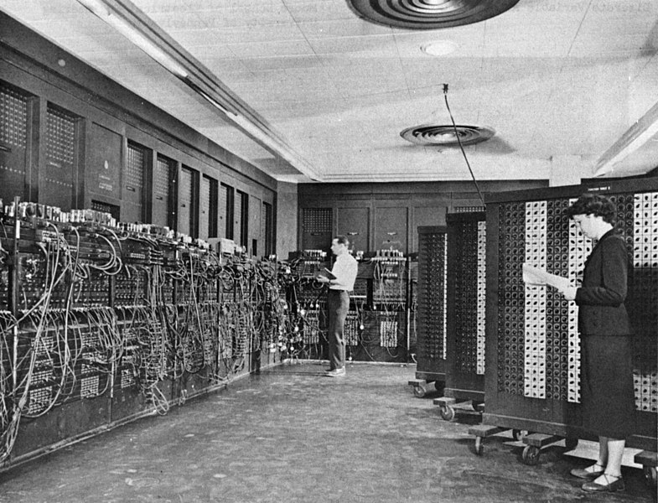
ENIAC
First “Real” computer, released in 1943. This would mark the start of modern computing history with the beginning of the Sone Age of computing. ENIAC stood for “Electronic Numerical Integrator And Computer”
Unlike modern computers, to program the ENIAC, you had to change the configuration of the plugboards and equipment manually.
This however, masks the great advance of the ENIAC: You could program it! Although the ENIAC could only do basic math and calculus, it was the first programmable computer.

Slide 5
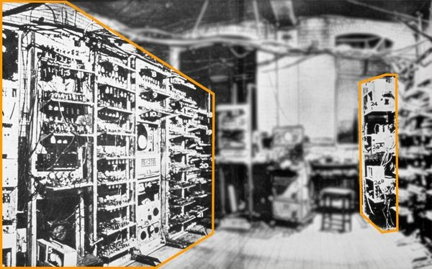
The baby
In 1948, there was a major breakthrough at Manchester University
There, they had developed the baby. The baby was the first computer that had memory, and could execute a stored program
A stored program is a series of instructions and data that is stored in the computer’s memory
A key functionality of a stored program computer is the ability to run any compatible program without major hardware changes

Slide 6
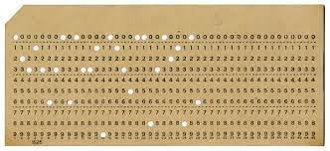
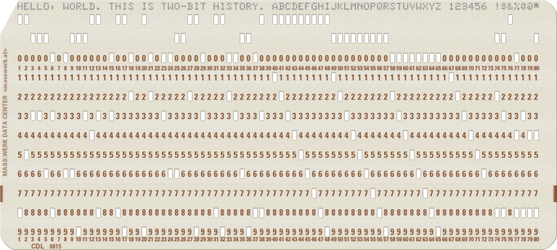
The punched card
As we review the history of processors, let us not forget the methods used for input and output to and from a computer
In this early pre-historic time, without digital input, keyboards, or even magnetic tape, how did computers read data from the user?
Using punched cards!
Each column in the card corresponded to a character, there were 80 characters on a card

Slide 7
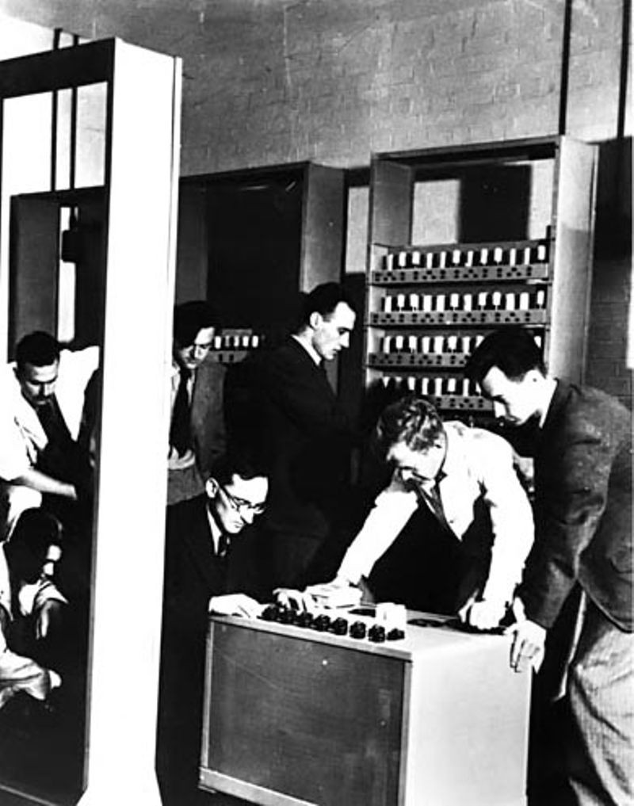
EDSAC
First computer to provide computing as a service, the EDSAC would mark the start of computers moving from experimental lab machines to machines that provided services to users

Slide 8
Stone age computers -1
After the baby, computer scientists had a general idea of what a computer was supposed to be, and what it’s features should include
They also had a baseline understanding of how a computer was supposed to work
Computers of this age did not have storage, operating systems, or user interfaces
If they were programmable at all, the programmer was responsible for doing everything from the moment the computer turned on
Programs were also exclusively written in binary or hex, with no programming languages of any kind
It would run a program, punch some output cards, then stop

Slide 9
Stone age computers - 2
Furthermore, there was no such thing as a computing industry
Every computer was homemade and designed by its users
There also were no types of computers: Every computer was giant, and the term mainframe had not been coined yet
Computers of this time were also electro-mechanical
They used vacuum tubes, and liquid mercury as memory
Computers of this time were also almost exclusively used for complex math, the idea of using computers for business was not common yet

Slide 10
Bronze age

Slide 11
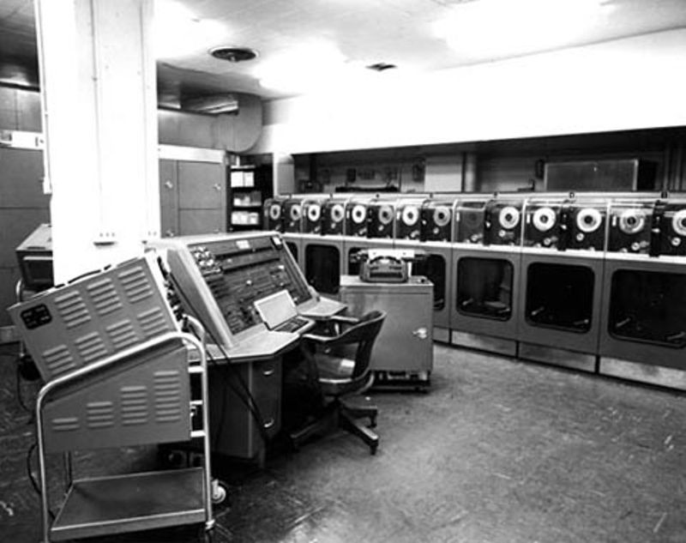
Univac 1
This computer, released in 1953 changed everything
Unlike every other model that came before, the Univac 1 was a commercial computer, with a standardized design, that was sold to do actual work
It also could be purchased with an optional tape drive, making it the first computer to have online, persistent storage
It also, critically, was the first computer to have any form of programming language
While it’s design was still that of a stone age computer, it would mark the transition to the start of the bronze age

Slide 12
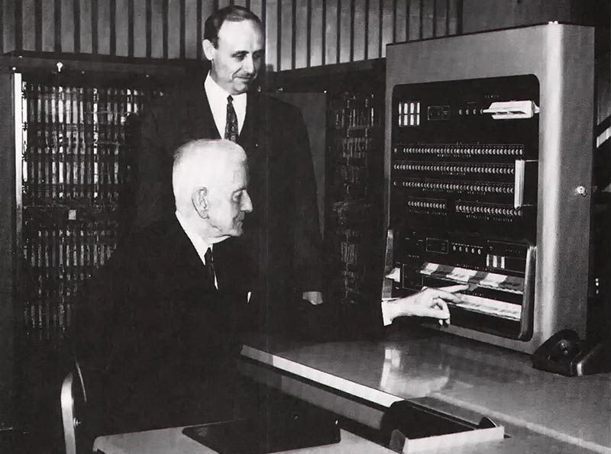
IBM 701
Although the IBM 701 was quite similar to the UNIVAC, it was the first large-scale IBM computer, marking IBM’s entry into the mainframe computer market, witch it would dominate for years to come
It was also the first computer to have a real programming language
This language, called speedcode was the first true higher-level, compiled language designed to make programming simpler

Slide 13
WHIRLWIND
1953 also marked the completion of the WHIRLWIND computer at IBM, hitting three major firsts
It was the first computer to be used for simulation work (as a flight simulator)
It was the first computer to have a keyboard
It was also the first computer to use ferrite core memory
Although ferrite core would not catch on for some time, it would be the dominant form of memory for many years to come

Slide 14
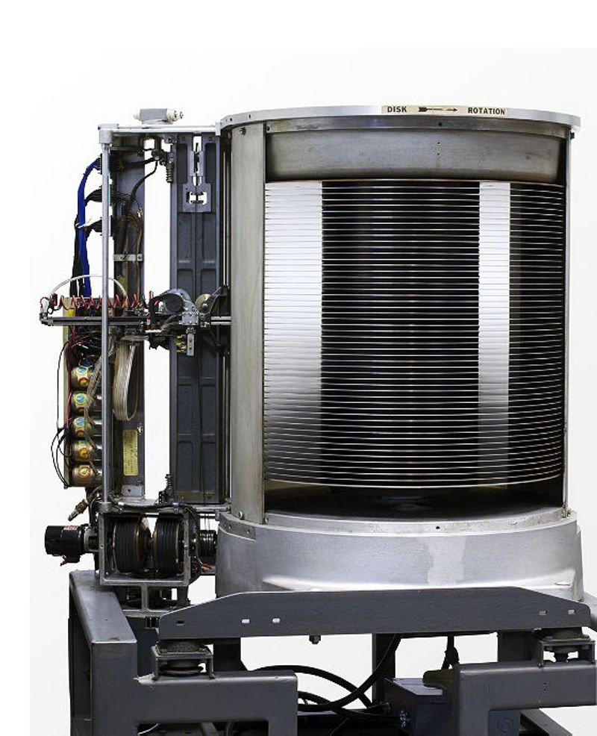
RAMAC
1965 marked the creation of the first hard drive
This drive was faster than tape, but could store more than RAM
More importantly, it also allowed direct access where the disk could access the part of data that was needed without having to traverse other data (sequential access)

Slide 15
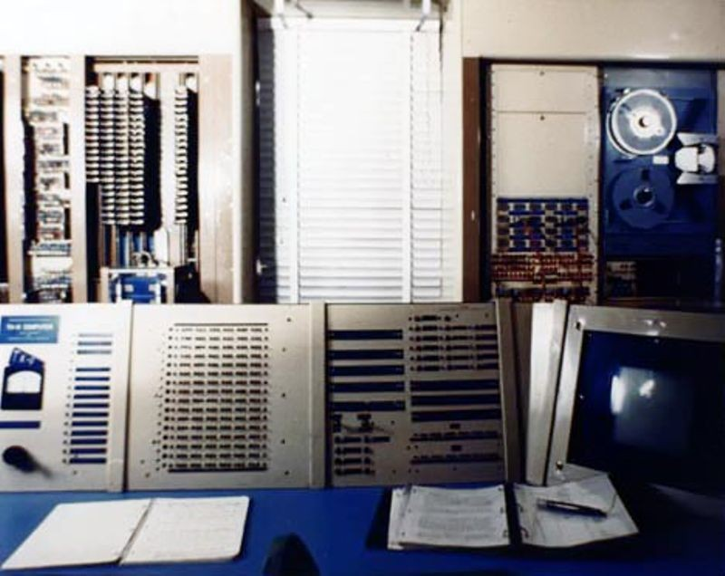
TX-1
Also in 1956, mit invented the TX-1, which was the first solid state computer
Unlike the other contemporary computers, there were no relays, vacuum tubes, or other moving parts
The inside of transistors were also solid, as opposed to vacuum tubes

Slide 16
GM-NAA I/O
The first operating system was also developed in 1956
Created by general motors, it was a simple job sequencer, running one program directly after it’s prediciessor finished
Nonetheless, it was a huge advancement over manually stopping the machine to load new programs
OSes like this would not become mainstream for a few more years, mainly relegated to very high-end computers

Slide 17
FORTRAN
The previous experimentation and work with computer programming had finally paid off and produced the first real, modern programming language
FORTRAN would become the language of choice in science and math for the next 30 years, and is still in use and popular among some programmers today
This language was entirely represented in words, and had structure, allowing programmers to define variables, functions, and other commonly used options

Slide 18
LISP
Also in 1958, LISP was invented at MIT
Lisp was the first interpreted language, that was run directly as code instead of being compiled first
It was very popular for machine learning and other similar applications
It spawned several computers called lisp machines which were designed to preform lisp code optimally

Slide 19
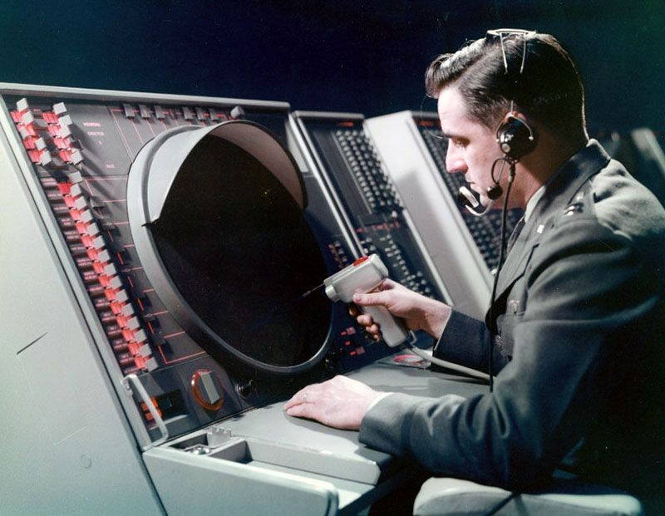
SAGE
While due to SAGE’s experimental nature it would not mark the end of the Bronze Age, it certainly would mark it’s greatest achievement
The SAGE system was the first fully networked, GUI system
It was also solid-state, meaning that the internals were made using transistors instead of vacuum tubes

Slide 20
Bronze age computers -1
The major characteristic of the bronze age was standardization and commercialization
The experimental lab machines of the last decade were shaken out into saleable machines, that could serve users, both business and scientific
This was the era when computers started to grow up
This time period was also characterized by the shaking out of new, important features that would be required for the move to transistorized computers later on

Slide 21
Bronze age computers - 2
In addition, bronze age computers were the first to be programmed by programming languages
These would make computers easier and more accessible to those who weren’t math majors
This was also an essential step to allowing computers to be used for business applications requiring text (almost all of them) as otherwise programming text-based processes is near impossible
Despite this, operating systems were still rare and experimental, developed by each customer. They had few of the features of modern operating systems, simply running one program after another

Slide 22
Solid state by ‘58
- Thomas J. Watson Jr, chairman of IBM
After the lessons of the 50s and the TX1, one thing was clear for the future: Computers had to ditch their tubes, and move to solid-state transistor logic. Although not the defining event, this would be one of the biggest transitions to the iron age

