Slide 1




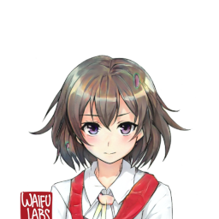
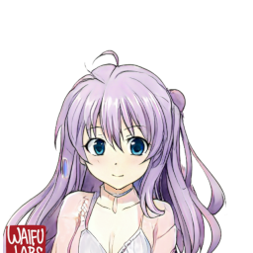
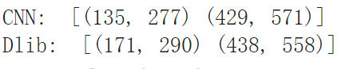
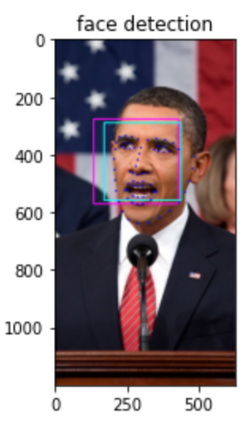
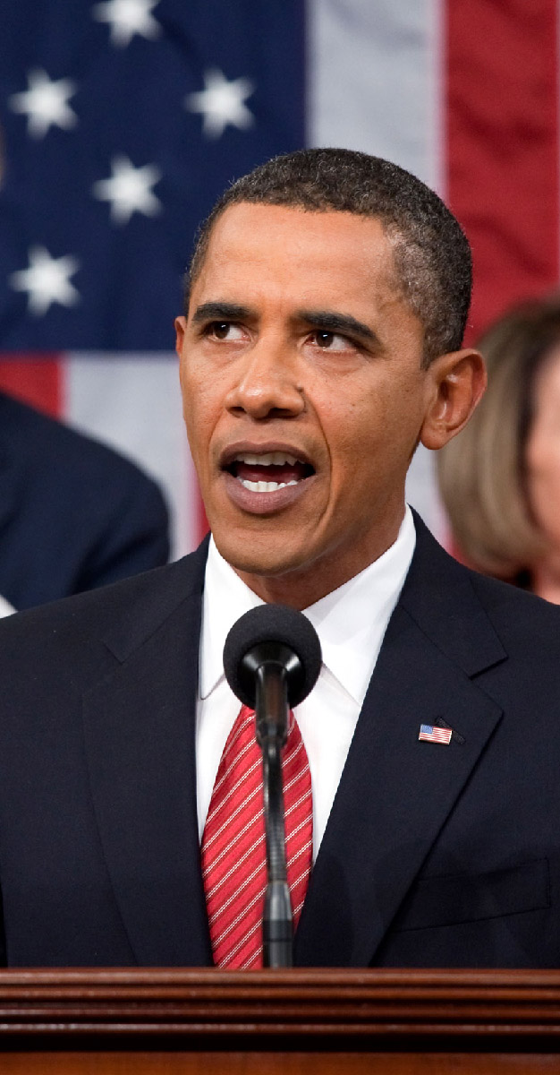
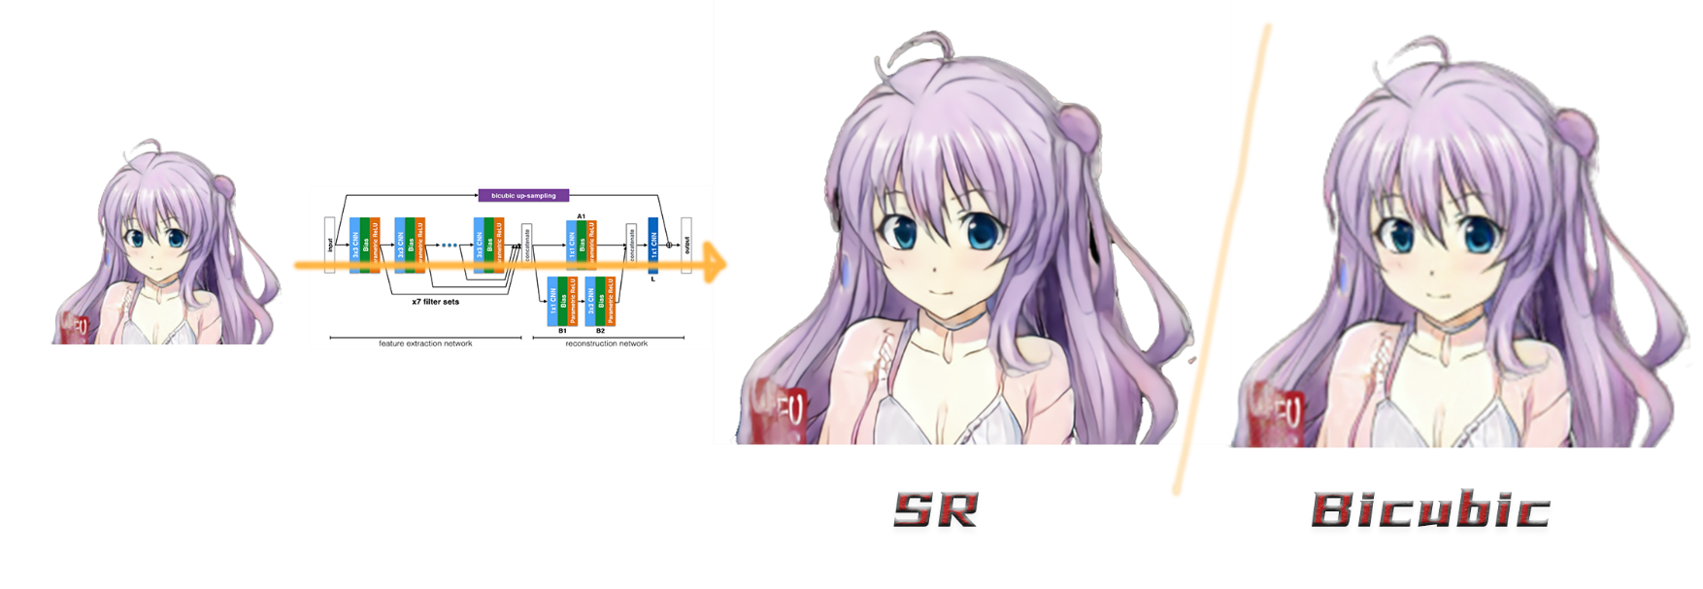
Enhanced Talking Head Anime from a Single Image towards a User-friendly Application
Keywords: Image processing, face detection, GAN, CNN, facial landmark detection, super-resolution
Authors: Huang Liu, Sun Weiran, Tan Zhenwei, Wang Yuxuan
CURRENT DEVELOPMENT AND LIMITATIONS TO BE RESOLVED
We developed our model based on a open source project, talking-head-anime, which supports us with fundamental structure of network and framework. We aim to perfect and improve its deficiencies, and hope to make it a user-friendly
landing project.
Thought the basic frame work has done many essential works, it still has many defect that need to be improved.
1. First is the input part, the frame work has a strict restriction on the size of the image. This restriction means that is impossible for a user to choose a random image, which hasn't been edited deliberately, as the input, causing a great inconvenience. Also some user may have the need to generate a random image instead of using any existing images.
2. Secondly, we find that the facial landmark detection supported by the original frame work is not accurate enough to recognize the features of a human face, which may lead to the failure of generating the corresponding changes to the image.
3. We also find that some images are in low resolution, which will greatly impact the user’s experience.
The content of our project is to input a facial picture of an animated character, combined with the camera to capture the expressions and actions made by a real person, so that the animated character can make expressions and actions consistent with the real person.
Below is part of the structure of our project.
ENHANCEMENT 1: BETTER INPUT IMAGE PROCESSING AND GENERATION
Detect anime character head in the input image and pre-process the head to fit input requirements
Generate anime characters using pre-trained GAN models and pre-process accordingly
Detect anime character face with lbpcascade model
Process the cropped head based on requirements
Traditional face detection models, e.g., MTCNN, do not work well with anime characters.
Extract head, resize to 128*128
Expand the picture to 256*256 with transparent pixels
Place the head at the centre
The model is integrated into the application to randomly generate anime characters. Generated images are processed in the same way as manual inputs automatically.
WaifuLabs is a world-class, state-of-the art GAN model for anime character generation
ENHANCEMENT 2: MORE ACCURATE FACIAL LANDMARK DETECTION
Use pretrained CNN model(mmod_human_face_detector.dat to better locate the 3D faces.
This is trained on this dataset: http://dlib.net/files/data/dlib_face_detection_dataset-2016-09-30.tar.gz. which is created by finding face images in many publicly available image datasets (excluding the FDDB dataset). In particular, there are images from ImageNet, AFLW, Pascal VOC, the VGG dataset, WIDER, and face scrub.
CNN model improve the accuracy of detecting faces compared to the original mode based on Histogram of oriented gradient and linear classifier
ENHANCEMENT 3: ANIMATED CHARACTERS WITH HIGHER RESOLUTION
We offer a post-processing super-resolution option for advanced users with better hardware want higher resolution.
For the backend, we use state-of-the-art SR model DCSCN, which is known for efficiency. The pretrained model is based on the anime character dataset and achieved excellent performance with real-time processing for video streaming on GTX 2070.
All post-processing is transparent to the user and switch-on can easily be done with a single button.

