Slide 1
State machines keys
James Barker
Kiefer Capps

Slide 2
Overview
State Machines
Keys

Slide 3
State Machines
Similar to switch case
Can transition between defined states
Dependant on output
Five Types:
Function
If/Else
Switch
Mealy
Hierarchical

Slide 4
SM: Functions
No global variable
Each state is a separate function

Slide 5
SM: If/Else
If/else statements
Route path to new “state”
Need a “state” variable

Slide 6
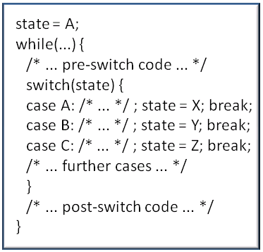
SM: Switch
Each case is a state
Entire case statement has to be looped
Allows compiler to find best path

Slide 7
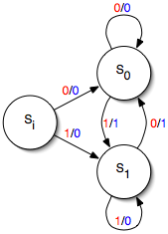
SM: Mealy (Finite)
Depend on two factors
Current state of machine
Triggering source

Slide 8
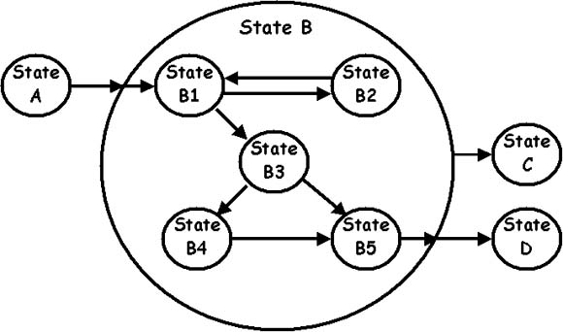
SM: Hierarchical
“Nested”
State machine within a state machine

Slide 9
Keys
Using switches to trigger an event in the software
Must consider:
Pull Up/ Pull Down Resistors
External Resistors
Internal Resistors
Proper Synchronization
Real time/Gadfly Synchronization
Interrupt Synchronization

Slide 10
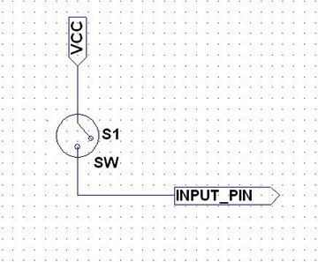
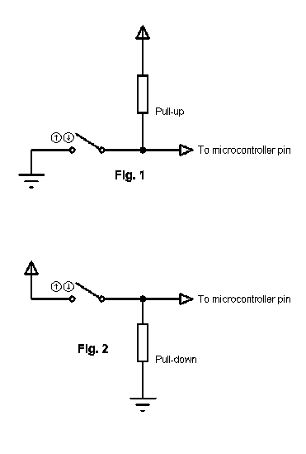
Keys: Pull Up/Down Resistors
No pull up/down = floating values
Floating values cause false triggers in the switch
By adding a resistor to ground or VCC we can always keep a defined state of HIGH or LOW, preventing false triggers

Slide 11
Internal vs External Resistors
External pull up/down resistors can be used to simplify programming.
Internal pull up/down resistors can lower cost, simplifies circuitry, and is convenient when parts are not readily available.

Slide 12
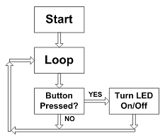
Gadfly Synchronization
The program continually “asks” the status of the switch, also called polling
Even when the switch is not pressed the program is checking the status

Slide 13
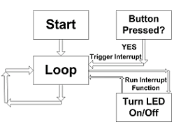
Interrupt Synchronization
The program runs other functions until the switch is pressed.
When the switch is pressed, it interrupts the program and runs it’s function.
Only certain pins can be interrupts. Lecture 5 shows detailed steps how to work around this.

Slide 14
Lab Questions
Q: Do you need to use internal pull-ups for the keys on the joystick shield?
A: Yes, looking at the schematic no external resistor is attached so an internal pull-up is required to avoid floating values.
Q:How would your code look like for switches which are connected to pull-down resistors instead of pull-up resistors?
A: PTAD = 0xFF; /// write 1‘s to prevent false interrupts
to set as pull-down instead of pull-up
PTAD = 0x00; /// write 0‘s to prevent false interrupts

Slide 15
Lab Questions: Continued
Q: What fundamental steps are required on the FRDM board to use the reset button as user button? What is the advantage of this? What is the disadvantage of this?
A: To turn the reset button to a user button the switch has to be reconfigured, eliminating the reset feature.
Advantage: A built in button allows more features to be added
Disadvantage: Must disconnect and reconnect power to restart

