Slide 1
State machines keys
James Barker
Kiefer Capps

Slide 2
State Machines
Similar to switch case
Can transition between defined states
Dependant on output

Slide 3
SM: Functions
No global variable
Each state is a separate function

Slide 4
SM: If/Else
If/else statements
Route path to new “state”
Need a “state” variable

Slide 5
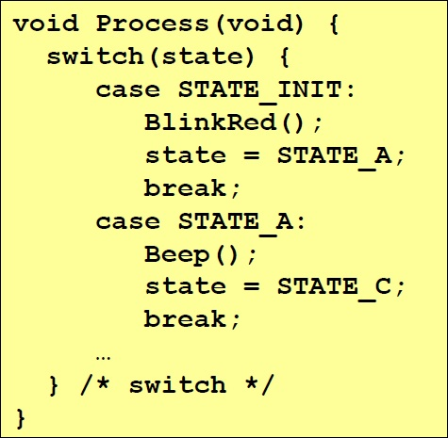
SM: Switch
Each case is a state
Entire case statement has to be looped
Allows compiler to find best path

Slide 6
SM: Mealy (Definite)

Slide 7
SM: Hierarchical
“Nested”
State machine within a state machine

Slide 8
Keys

