Slide 1
Energy Data Analysis
Koa Mahuna
Kiejstut Bunikiewicz
Jerry Gehrung

Slide 2

Predictive Question
Can we predict which countries will produce the highest carbon emissions per capita?
Notes:
We chose this question because global carbon dioxide emissions have been rising for decades, totaling over 5 billion metric tons in 2016. This is bad because carbon emissions get into our clean air and cause an invisible layer around the earth. This layer keeps the heat inside the earth, which causes global warming. This process is also called the Greenhouse effect. With polar caps melting and sea levels rising, it is time to make some changes in CO2 emissions.

Slide 3
Project Objectives
Determine which countries produce the highest carbon emission
Determine which variables have the greatest factor on carbon emission
Determine how to reduce carbon emission

Slide 4
Agenda
01
02
03
04
05
06
Data Cleaning and Preparation
Classification and Regression Tree
Gradient Boosting Classifier
Neural Network
Final Model
Key Takeaways

Slide 5
Data Cleaning and Preparation

Slide 6
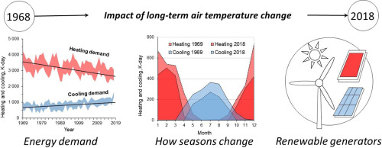
Literature Surveys
Random forest assessment of correlation between environmental factors and genetic differentiation of populations
The impact of long-term changes in air temperature on renewable energy in Poland
Climate change impacts on renewable energy generation
Notes:
Random forest assessment of correlation between environmental factors and genetic differentiation of populations
A study showing how random forest can be used to study the relationship between environmental factors such as nitrate and phosphate averages in water, geographic data, water salinity and velocity averages in geographic areas
This study used the biological diversity of various marine mussels in the Baltic Sea as their dependent variable
This study helps us because it shows how we can use environmental factors (in this case energy consumption types and rates over time) to study their impact on another variable. This shows us that random forest is a viable model for drawing conclusions from the information we have collected.
The impact of long-term changes in air temperature on renewable energy in Poland
Discusses how the renewable energy industry impacts temperature over time
Climate change impacts on renewable energy generation
Addresses the most relevant studies that project quantitative estimates from of climate change impacts on solar, wind, hydro, and other renewable generation technologies and calls for the development of public policies and private investment strategies

Slide 7
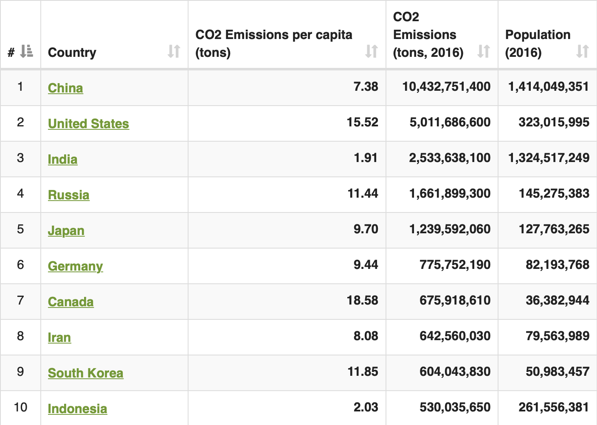
Data
Datasets
Countries of the World
CO2 Emissions per Capita

Slide 8
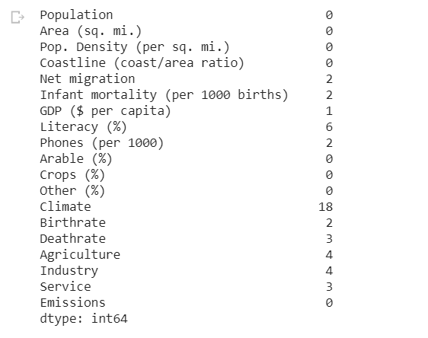
Data Quality Analysis
Initial Nulls:
No columns with more than 10% nulls
No nulls in dependent variable
Data Imputation
Used median to fill in missing values

Slide 9
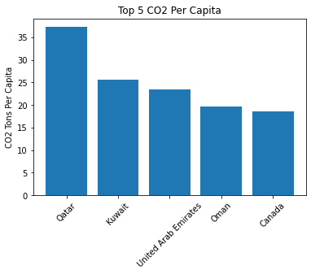
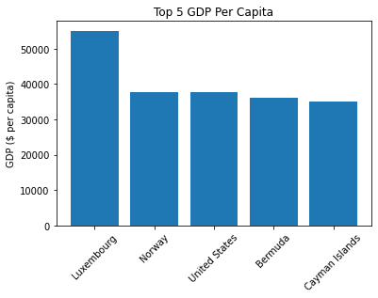
Exploratory Visualizations

Slide 10
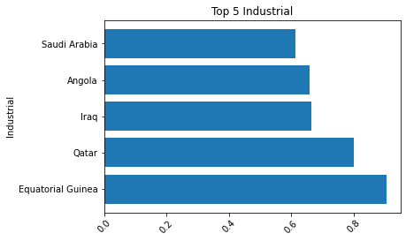
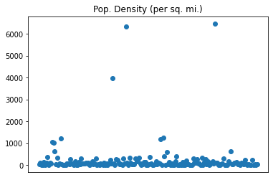
Exploratory Visualizations

Slide 11
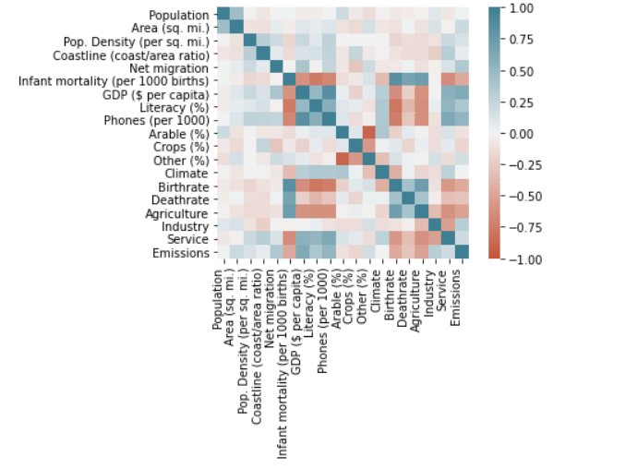
Exploratory Visualizations

Slide 12
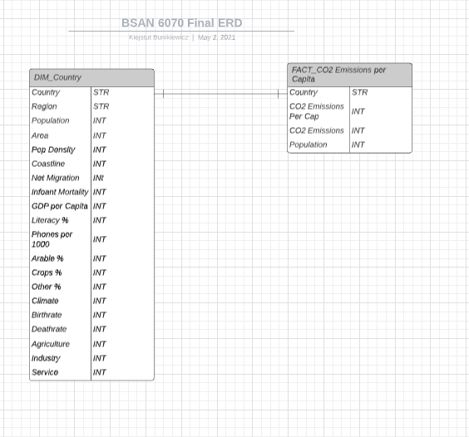
Feature Selection Process
Began with 24 Features
Features Removed:
Duplicate Country Column
Region Feature
Duplicate Population Feature
CO^2 Emissions Totals
Finished with 20 Features
Geographic (7)
Demographic (6)
Economic (6)
Dependent Variable (1)

Slide 13
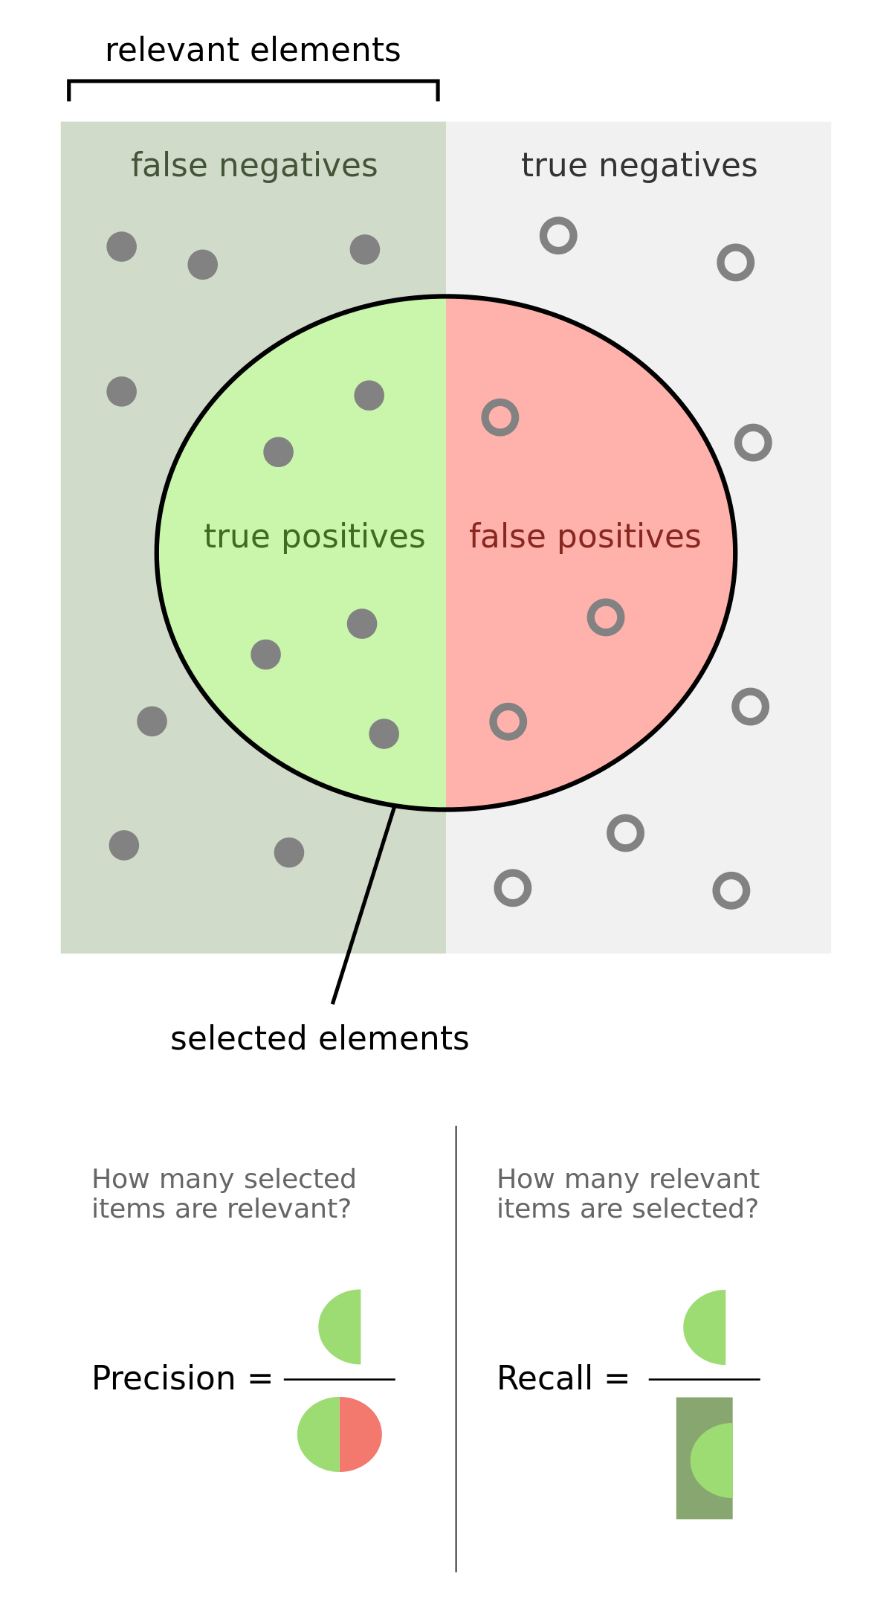
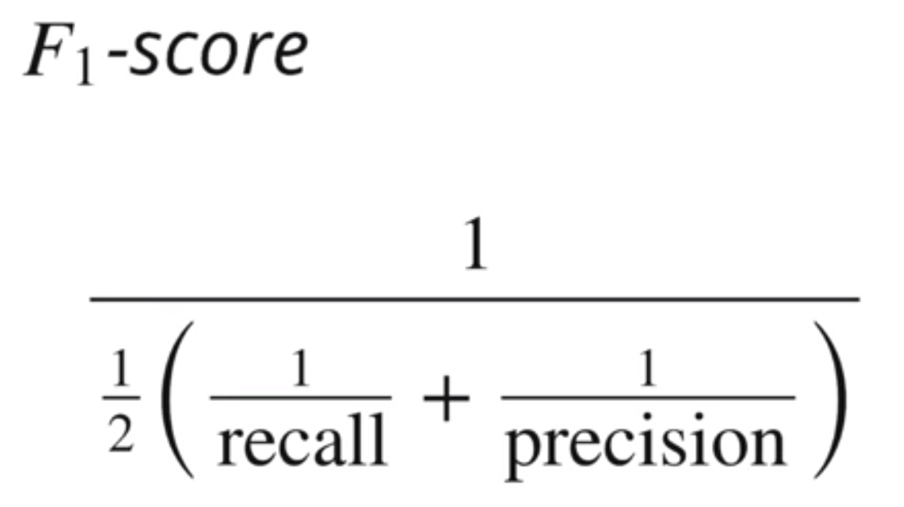
Performance Criteria
Predicting CO2 Emission Quantity Per Capita
R^2
Mean Square Error
Predicting CO2 Emission Per Capita Class
Accuracy
F1 Score
Precision
Recall

Slide 14
Classification and Regression Tree

Slide 15

CART
Strengths
Works for categorical as well as continuous Target Variable
Does not require normalization or scaling of data
Less considerable effect from null values
Limitations
Likely to overfit data
Low prediction accuracy compared to other ML algorithms
Assumptions
We don’t need to make any assumptions at all
Notes:
We chose CART because it works well for categorical as well as continuous Target Variables and requires neither normalization nor the scaling of data. Also, missing values in the data do not affect the process of building a decision tree to any considerable extent.
However, the drawbacks of using CART is that there is a high probability of overfitting the data. And generally, it gives low prediction accuracy for a dataset as compared to other machine learning algorithms. Also, calculations can become complex when there are many class labels.
As far as assumptions, we usually don’t need to make any assumptions at all. However, CART's lack of such assumptions is a double-edged sword. When those assumptions are not warranted, this gives the approach a relative advantage. On the other hand, when those assumptions hold, more information can be extracted from the data by taking those facts into account. That is, standard regression methods can be more informative than CART when the assumptions are true.
Overall, we just believed a CART analysis would be comprehensive, specific, easy to use, and versatile. Decision trees are easy to explain as they follow the same approach as humans generally follow while making decisions.

Slide 16
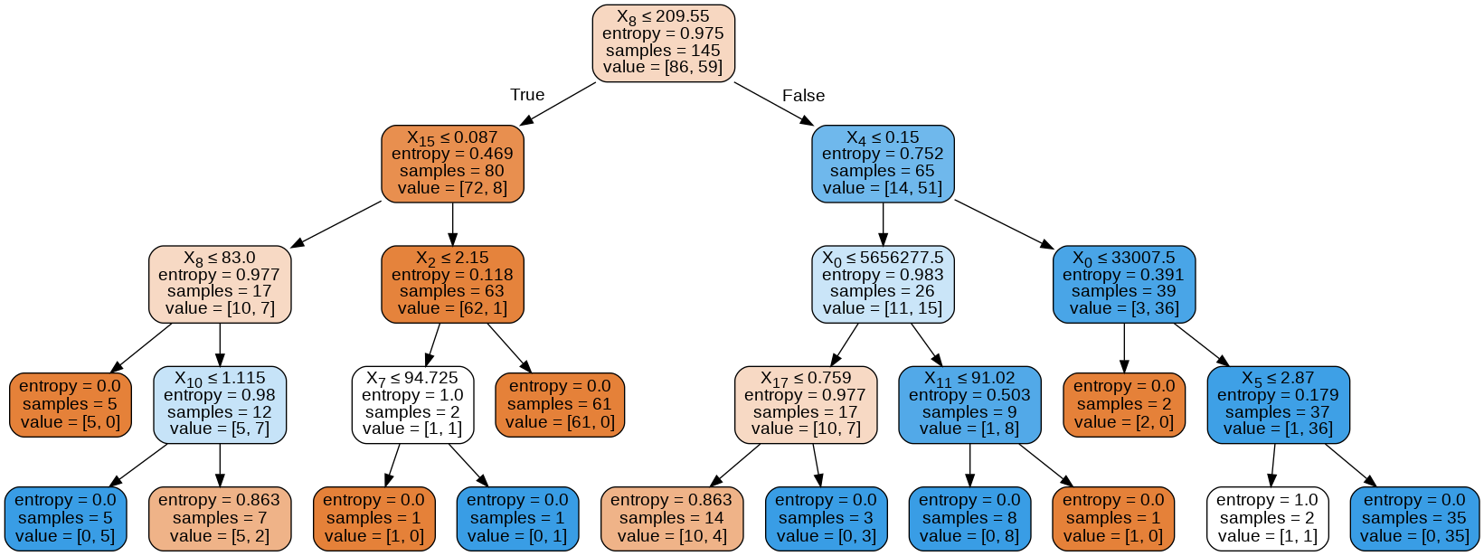
CART
Notes:
When splitting the dataset for our decision tree, we chose X to represent area, population and population density, coastline (which is the coastline to area ratio), net migration, infant mortality (per 100 deaths), GDP per capita, literacy percentage, the number of phones per 1000 people, arable percentage (or how much land is suitable for growing crops), crops percentage, other, climate, birth rate, death rate, agriculture, industry, and service, and y as the countries’ emission levels that were above the average. We then split the data with a test size of 0.2 and random_state of 44.
After that, we fit the data and ran the model using DecisionTreeClassifier and chose the entropy criterion. Entropy is a measure of the randomness in the information being processed. The higher the entropy, the harder it is to draw any conclusions from that information. This is the decision tree that we get.

Slide 17
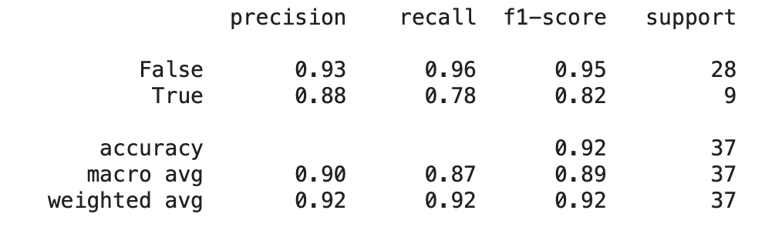
Model Performance
Model score of 0.92
Classification report:
Notes:
In terms of model performance, we received a model score of 0.92, which is pretty high
Additionally, we generated a classification table using classification_report, and received the following. Just as a brief refresher on how to read this table, the recall is the number of true positives divided by the number of true positives and false negatives (it means "how many of this class you find over the whole number of element of this class”), the precision is the number of true positives over the number of true positives and false positives (it tells us "how many are correctly classified among that class”), and F1 is the harmonic mean between the two.
The recall score could be higher, but generally we have pretty high scores, meaning our first model has performed well.

Slide 18
Gradient Boosting Classifier

Slide 19

Gradient Boosted Techniques

Slide 20
Gradient Boosted Techniques
Gradient Boosted Regressor
Assumptions
Uses Continuous Dependent Variable
Strengths
Strong Prediction Performance
Less risk of Overfitting
Limitations
Black Box & Time Consuming
Gradient Boosted Classifier
Assumptions
Requires Categorical Dependent Variable
Strengths
Strong Prediction Performance
Less Risk of Overfitting
Limitations
Black Box & Time Consuming

Slide 21
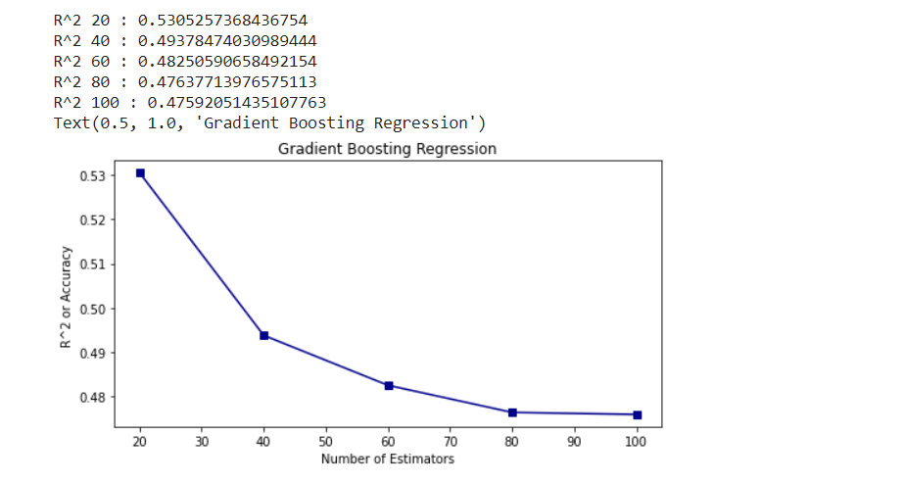

Gradient Boosted Regressor
Model Performance
Looped through estimators
Other Hyperparameters at Default
R^2: Peak at 0.531
Model Performance with Standard Scaler
R^2: 0.535

Slide 22
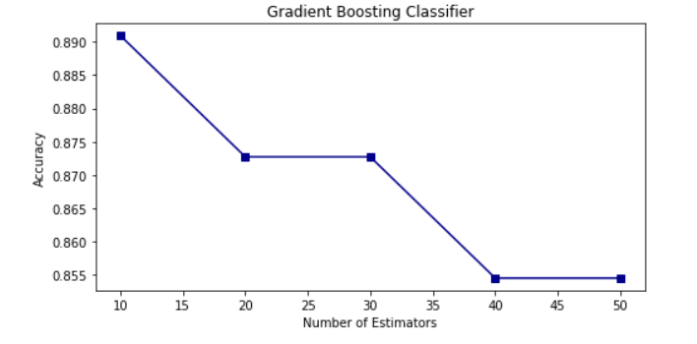
Gradient Boosted Classifier
Created New Dependent Variable
Class 0 if below global average, class 1 if above global average
Looped through number of Estimators
Model Performance:
Accuracy: Peaked at 0.89
F1-Score: 0.9 & 0.75
Recall: 0.95 & 0.67
Precision: 0.85 & 0.86

Slide 23
Neural
Network

Slide 24
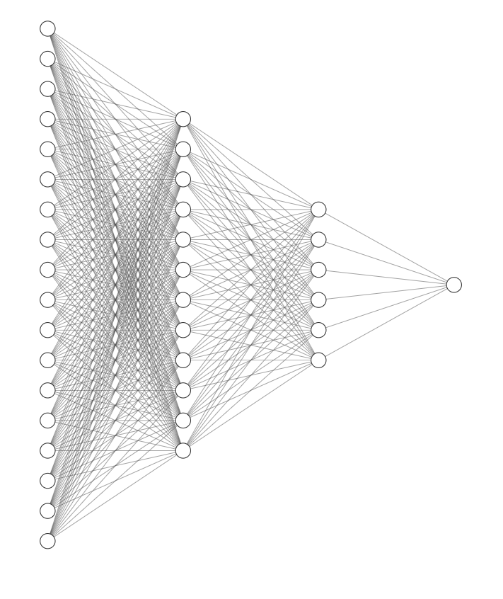
Neural Network: Model Choice
Classifier and regressor
Captures complex relationship between X and Y
Backpropagation can adapt to mistakes

Slide 25
Neural Network Architecture
4 layers
18 input nodes
1 output node

Slide 26
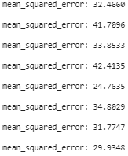
Model Performance
Regressor
MSE - Fell from 60,000,000 to ~30 over 50 epochs
Value range is 37
.00005% of initial MSE
Classifier
Accuracy - 65%
Average Loss - .63
SMOTE 57%
Epoch 1 vs. Epoch 43-50

Slide 28
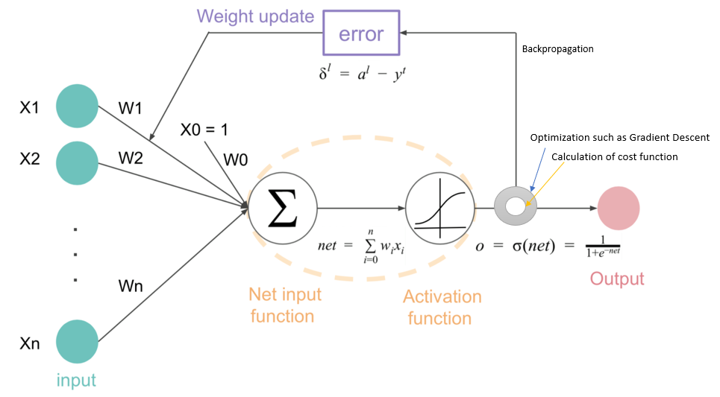
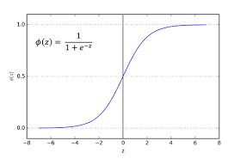
Input Nodes
Back Propagation
Hidden Layers
Output Nodes

Slide 29
Limitations
Inconsistent accuracy scores, random weight initialization
Small dataset
Not enough iterations to tune weights
Feature importance obscured

Slide 30
FINAL MODEL
Gradient Boosting Classifier

Slide 31
Gradient Boosted Classifier
Best performance of initial models
Feature importance
Error adjustments

Slide 32
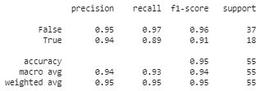
Hyperparameter Tuning
Good accuracy
No sacrifice to precision or recall

Slide 33
KEY TAKEAWAYS

Slide 34
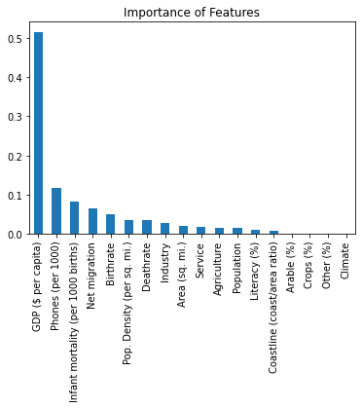
Insights
Observations
GDP and Phones indicative
Modernization of world
Actions
Restriction of use infeasible
Alter device power source

Slide 35
Model Limitations and Future Improvements
Limitations
Lack of data
Generalization of regions
Hyperparameter tuning
Improvements
More granular observations
More time allotted to tuning

Slide 36
THANK YOU

