Slide 1


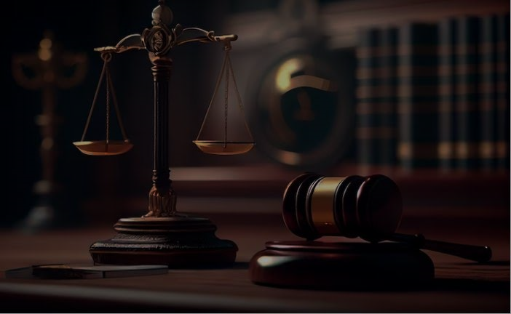
:: RA Philippines
M-F 9:00am – 5:00pm
+63 953-332-9065
Home
About us
RA 10630
Contact
Web Creator
REPUBLIC ACT 10630
Juvenile Justice and Welfare Act of 2013
View Details

Slide 2
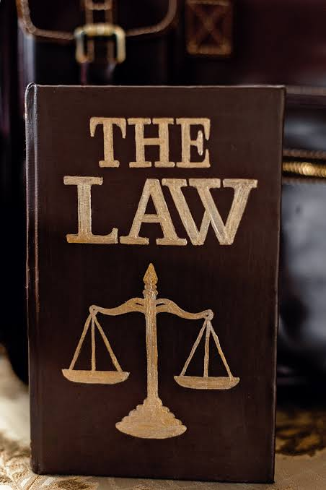
WHAT IS REPUBLIC ACT 10630?
Is a law in the Philippines that establishes a comprehensive juvenile justice and welfare system. It creates a Juvenile Justice and Welfare Council and appropriate funds for its implementation. This law also amends the definition of terms , the minimum age of criminal responsibility, and the exemption from criminal liability for children in conflict with the law.

Slide 3
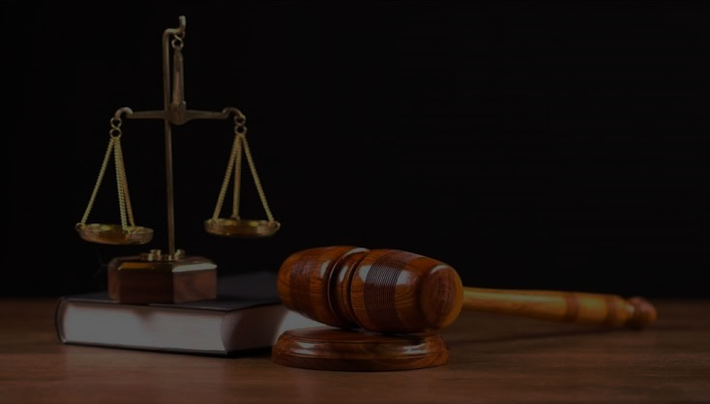
IMPORTANCE OF REPUBLIC ACT 10630
Protection of children: RA 10630 aims to protect the rights and welfare of children in conflict with the law. It recognizes that children are vulnerable and need special care and attention, focusing on their rehabilitation and reintegration into society rather than punishment.
Age-appropriate interventions: The law establishes a comprehensive juvenile justice system that promotes age-appropriate interventions for children in conflict with the law. It recognizes that children have different levels of maturity and understanding compared to adults, and therefore require specialized approaches in dealing with their offences.

Slide 4
Restorative justice: RA 10630 promotes the principles of restorative justice, which focuses on repairing the harm caused by the offense and addressing the needs of both the victim and the offender. It encourages the involvement of the community in the rehabilitation process and emphasizes the importance of accountability and responsibility.
Rehabilitation and reintegration: The law prioritizes the rehabilitation and reintegration of children in conflict with the law into their families and communities. It provides for the establishment of youth rehabilitation centers and programs that aim to address the underlying factors that contribute to their involvement in offenses.
International compliance: RA 10630 aligns with international standards and obligations, particularly the United Nations Convention on the Rights of the Child (UNCRC). It ensures that the Philippines fulfills its commitment to protect the rights and welfare of children in conflict with the law, in line with international norms.

Slide 5
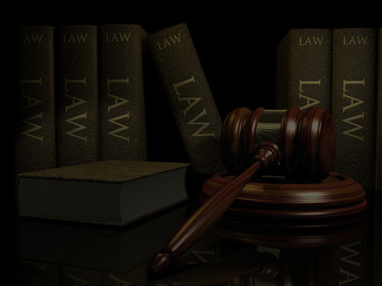
:: RA Philippines
M-F 9:00am – 5:00pm
+63 953-332-9065
Home
About
Explore
Contact
Web Creator
Home
About us
RA 10630
Contact
Web Creator
About us
Home RA 10630
We Provide Truthful Information about Law
This website aims to provide and share truthful information about government laws . This also built understand the law provided and implemented by the government and other organizations . It helps user to understand and learn every policy easily by viewing this sites.

Slide 6
:: RA Philippines
M-F 9:00am – 5:00pm
+63 953-332-9065
Home
About
Explore
Contact
Web Creator
Home
About us
RA 10630
Contact
Web Creator
RA 10630
About us Contact

Slide 7
:: RA Philippines
M-F 9:00am – 5:00pm
+63 953-332-9065
Home
Home
Home
About us
About us
About us
Contact
RA 10630
Contact
Web Creator
RA 10630
Web Creator
Contacts
Explore Creator
RA Philippines
Our Department will offer a perfect spot for vacation. It also contribute in preserving the environment in Paluan Occidental Mindoro, Philippines
OUR SERVICES
About us
RA 10630
CONTACT US
198 P. Mendiola St. Paluan Occ. Mindoro
9533329065
9456334073
cadahinkiel11@gmail.com
FOLLOW US
Your Email
Sign up

Slide 8

:: RA Philippines
M-F 9:00am – 5:00pm
+63 953-332-9065
Home
Home
Home
Home
About us
About us
About us
About us
Contact
RA 10630
Contact
Web Creator
RA 10630
Web Creator
The Creator
Contact
Name: Cadahin, Kiel T.
Gender: Male
Age: 19
Birthday: 06/11/2004
Nationality: Filipino
Status: Single
Address: Brgy3. Paluan, Occidental Mindoro
Contact: 09533329065
Skills:
Computer Literate
Web Designer
Programmer

