Slide 1
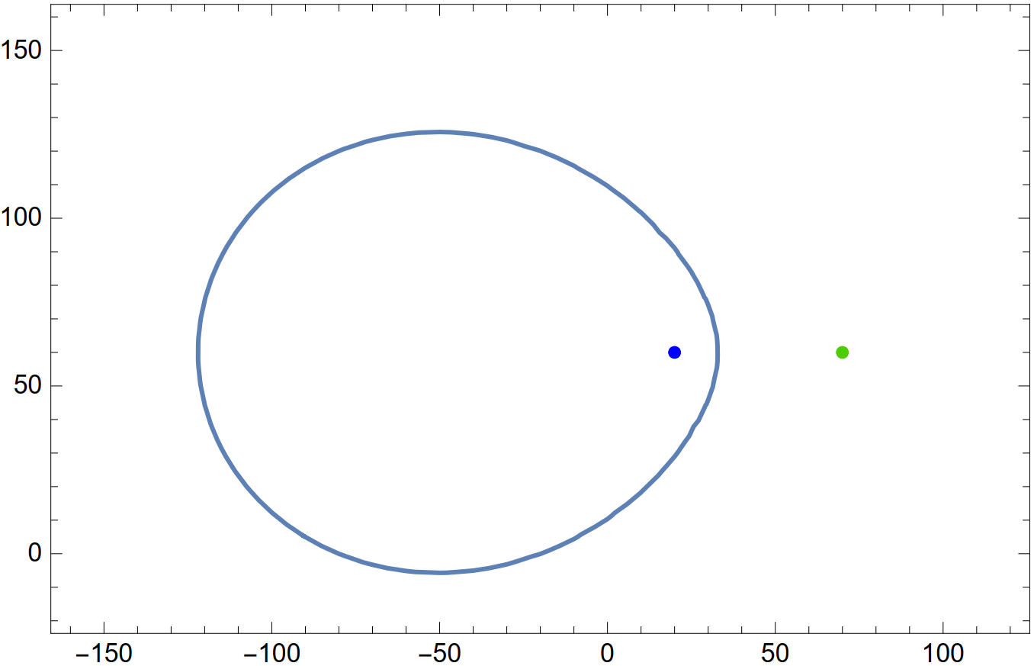










$$q_{n}$$
$$t_{2}$$
$$q_{1}$$
$$t_{0}+t_{1}$$
$$q_{0}$$
$$p_{1}$$
$$r_{01}$$
$$v_{0}$$
$$v_{1}$$
$$v_{0}<v_{1}$$

