Slide 1
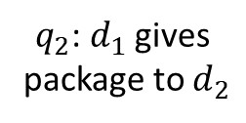










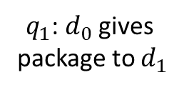





$$t_{0}+t_{1}+t_{2}$$
$d_{2}$ at $p_{2}$
$q_{2}$: $d_{1}$ gives
package to $d_{2}$
$$t_{3}$$
$$q_{n}$$
$q_{0}$: $d_{0}$ picks up package
$$t_{2}$$
$$t_{0}$$
$$t_{1}$$
$q_{1}$: $d_{0}$ gives
package to $d_{1}$
$d_{0}$ at $p_{0}$
$$t_{0}+t_{1}$$
$$v_{0}$$
$$v_{1}$$
$$v_{2}$$
$$v_{0}<v_{1}<v_{2}$$
$d_{1}$ at $p_{1}$

