Slide 1

IT3100E - 141117
Object-oriented Programming
Mini-Project
Interactive simulation of composition of forces

Slide 2
Assignment of member
Tran Duc Tuan Kien 20214908 | Pham Tuan Kiet 20214909 | Tran Le My Linh 20210535 | Bui Khanh Linh 20214910
Report Slide Controller Package View Controller Diagram Logic + Prototype | Report Slide Controller Package View UseCase diagram Video Demo | Report Slide Model Package Model diagram Test Model | Report Slide Controller Package View General diagram
ForceSimulation.java SliderController.java BackgroundController.java slider.fxml background.fxml | SceneController.java CheckboxController scene.fxml checkbox.fxml | MainObject.java CubeBox.java Cylinder.java Surface.java RotatingObject.java Model.java | InfoController.java ForceController.java RoadController.java info.fxml force.fxml road.fxml

Slide 3
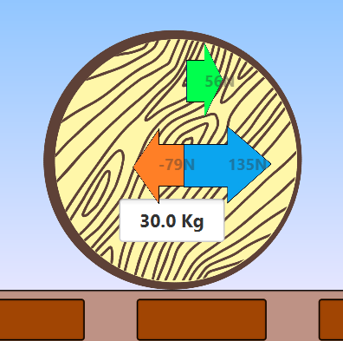
PROBLEM STATEMENT
Problem: Force Simulation with Newton's law of motions
User:
Control physical system
Change force applied on object to change its attributes: acceleration, velocity, position,…
Observe the motion of the main object
System:
Apply Newton's laws of motions to calculate object's attribute
Display motion

Slide 4
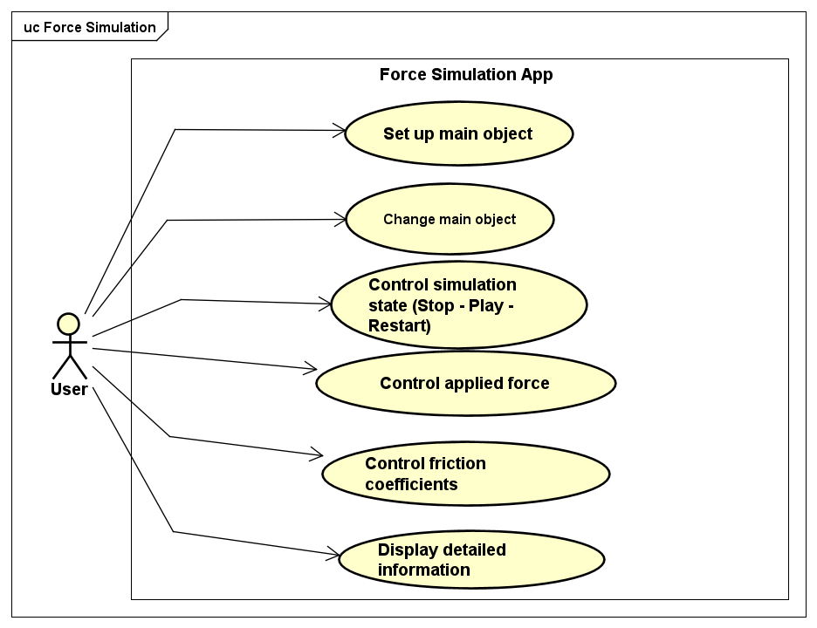
Use case diagram

Slide 5
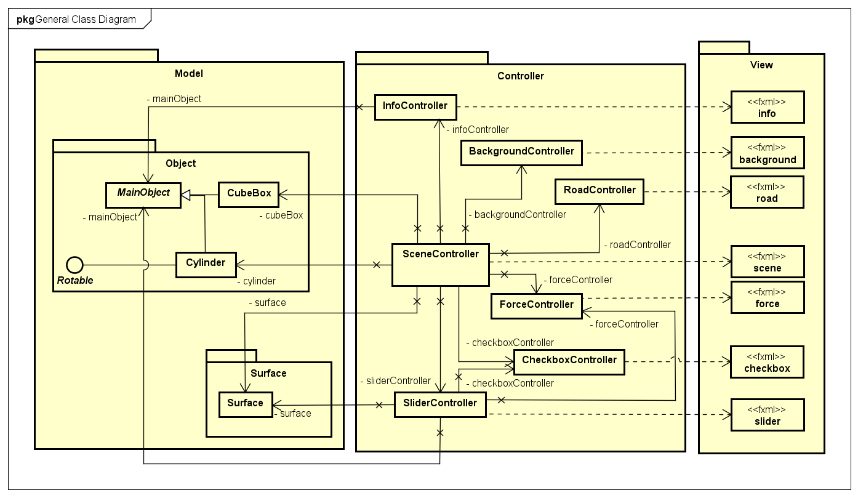
General class diagram

Slide 6
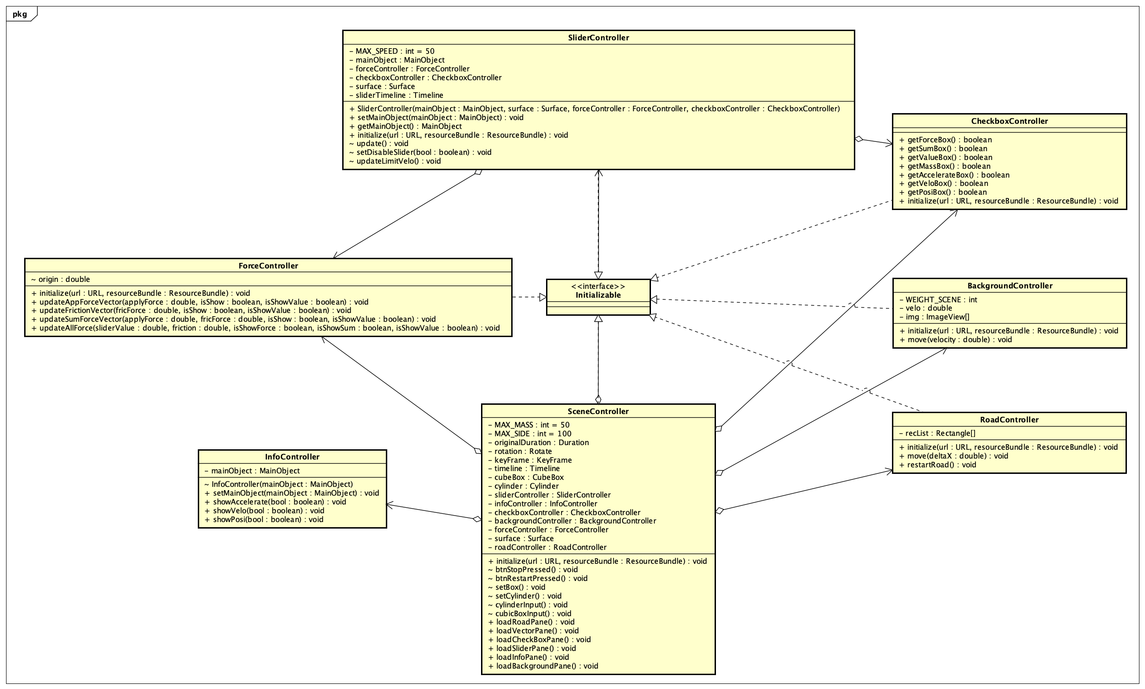
Class diagram for package Controller

Slide 7
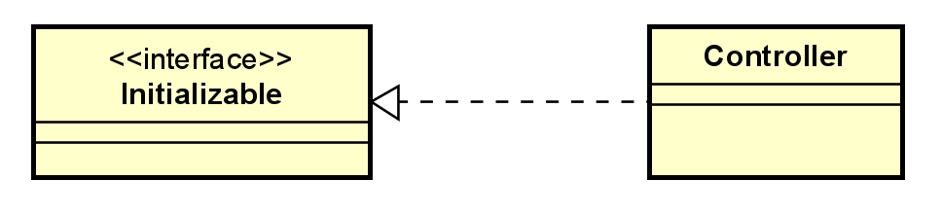
Class diagram for package Controller
OOP Techniques
Encapsulation: Attributes and methods are encapsulated in a class
Implementing interface: Classes implement interface initializable() to set up controller

Slide 8
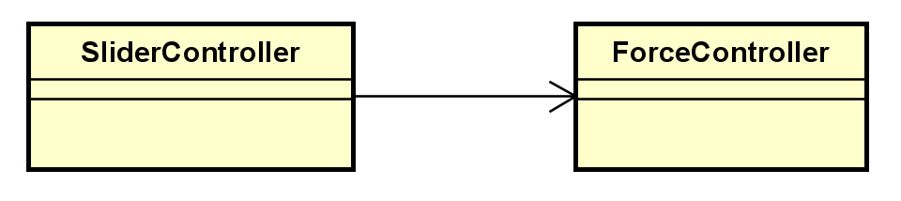
Class diagram for package Controller
OOP Techniques
Aggregation: SceneController, SliderController aggregates other controllers to control related wok
Example: ForceController is aggregated in SliderController to change magnitude of force when applied force change.

Slide 9
Class diagram for package Controller
OOP Techniques
Polymorphism: method with same signatures but difference in behavior.
Example: road.move() vs background.move(), initialize(),…
Upcasting/Downcasting: implicitly upcast cylinder/cubebox into
MainObject to pass into SliderController and downcast when using.

Slide 10
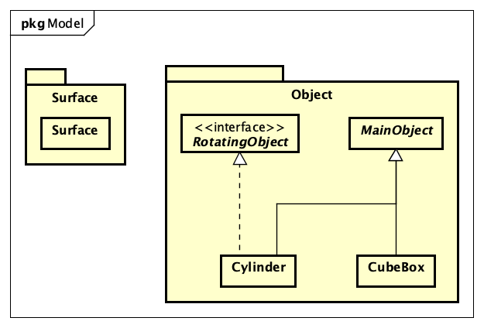
Class diagram for package Model

Slide 11
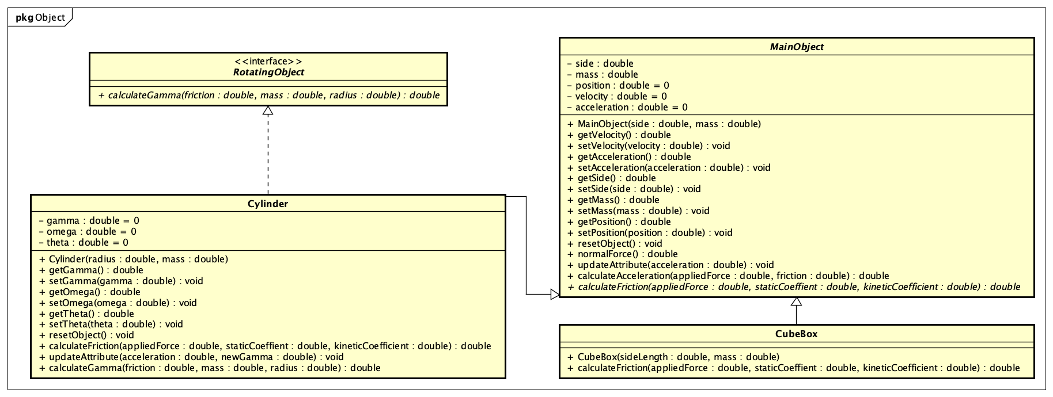
Class diagram for package Model
Encapsulation
Inheritance
Abstraction
Polymorphism
Basic OOP technique we use

Slide 12
Class diagram for package Model
-> interface
Superclass
Getter & setter
-> encapsulation
Supclass
Supclass
-> polymorphism
public abstract class MainObject {
…
public abstract double calculateFriction(double appliedForce, double staticCoeffient, double kineticCoefficient);}
-> abstraction

Slide 13
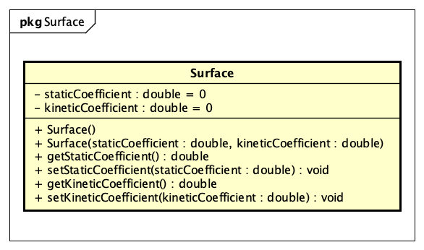
Class diagram for package Model
Getter & setter
-> encapsulation
Basic OOP technique we use
Encapsulation

Slide 14
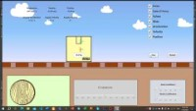
Video demo

