Slide 1

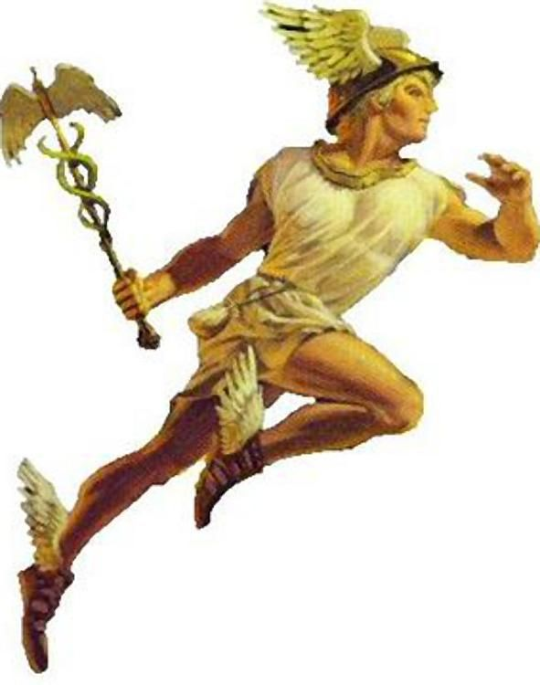

ETL model
Load
hermesql
Generate
Data soures
DWH
Data model
Report
ETL

