Slide 1
tabint

Slide 2
ML workflow
At very basic, ML workflow contains ML entities and theirs relationship
At programming perspective: We have class of entities and class that handle theirs relationship
Dataloader
Learner
data
load
yield
model
Hyperparameter
Learning rates
transform
…
callbacks
…

Slide 3
Deep learning workflow
Non-Deep learning workflow
Raw dataset: in file or memory
Dataset class:
contain raw data for trn/val/tst
or method to read, transform data
Data loader class:
use method to read and provide data when learner request
Model class: model architechture
Learner class: manage all things outsite model like hyper parameter, callbacks, learning rates….
Request dataloader to provide data
Dataset class:
Load all file in one time to memory
Data loader class:
Don’t need because data is provided one time to model
Model class: model architechture – all is specify by parameter of model
Learner class: Not too importance. Base on model parameter. All is compress to a single class.
In DL we need to handle all part in process. In non-DL, nearly all the things can be done by a specific library

Slide 4
What tabint focus on
- Flexible and convenient
- Tree base method:
Decision tree
Random tree (random forest)
Boosting tree
- Avoid common pitfall
- Interpretation, explaination
- Try to do things in parallel (dask, numba…) – in future

Slide 5
Flexible and convenient
Object-oriented programming
Function as a method to gerenate output
@classmethod
As a input
Class
Function as a method to change class init
init
Variable or method
@property as a property of class

Slide 6
Flexible
Avoid to create a nested class
Traditional approach
tabint appoarch
Class Dataset
Class Dataloader()
init: Dataset
Class Model
Class Learner
init: Dataloader, Model
Class Dataset
Class Model
Class Learner
input: Dataset, Model
So we have a big class Learner by
nested dataset, dataloader and model
Learner's input is dataset and model

Slide 7
Why we should use this approach
Raw data
All entity can be changed in developing circle!
Deployment
Preprocessing
EDA
Learner
Feature engineering
Interpretation
and explaination
Dataset
Model
Feature importance
Feature selection
Trn/val/tst
Partial dependence
Hyperparameter tuning
Feature correlation
Feature creatation
SHapley Additive exPlanations

Slide 8
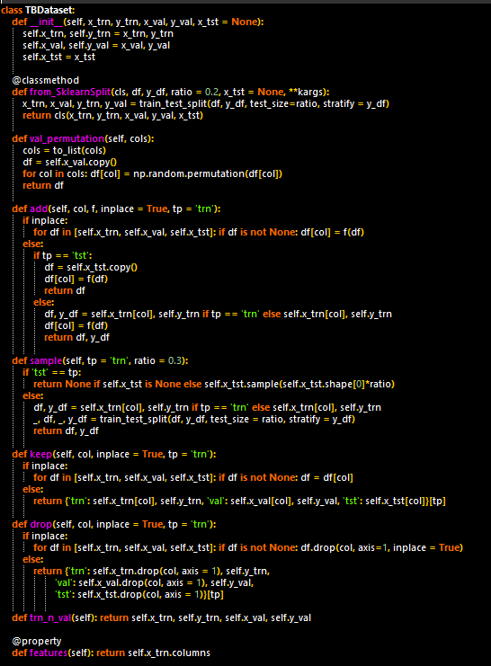
Convenient
If a method is used many time again and again
just define it as a function of related entity (class)

Slide 9
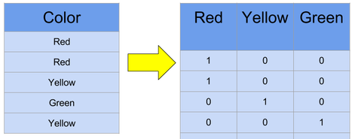
Focus on Tree base method
With excellent performance on all eight metrics, calibrated boosted trees were the best learning algorithm overall. Random forests are close second.
Caruana et al. made in empirical comparison of supervised learning algorithms
One hot encoding in pre-processing step -> Better for split with categorical variable

Slide 10
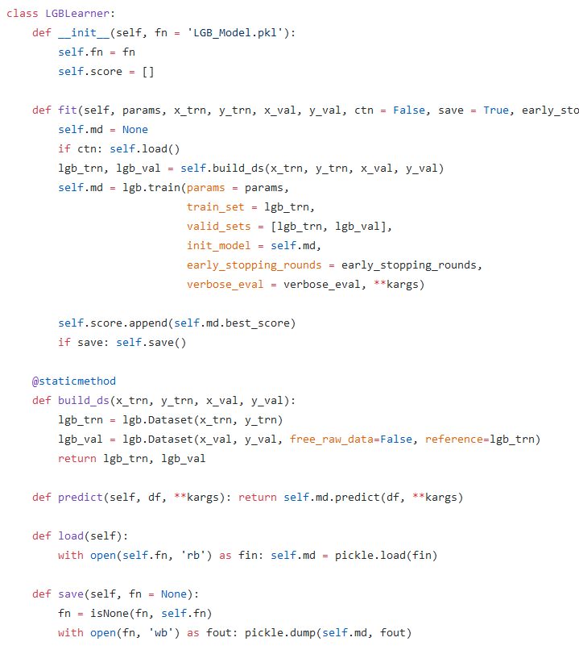
Focus on Tree base method
Learner for lighgbm
Randomforest
and xgboost is not done, yet!

Slide 11
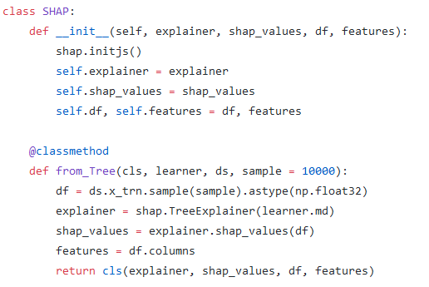
Focus on Tree base method
Interpretation and explaination for Tree base method

Slide 12
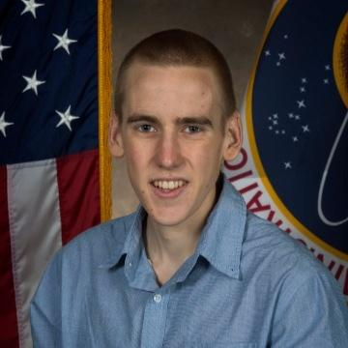
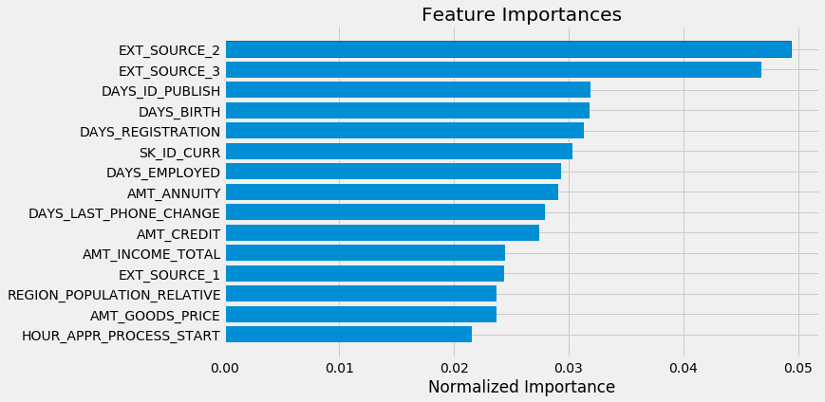
Avoid common pitfall
Feature importance
https://github.com/WillKoehrsen/kaggle-credit-data-science-competition/blob/master/notebooks/1-Getting%20Started.ipynb

Slide 13
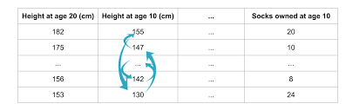
Avoid common pitfall
Feature importance
Feature importance method can be bias and wrong
-> Solution: permutation importance
See more at: https://medium.com/@kien.vu/8d60ed8ce314

Slide 14
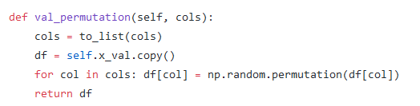
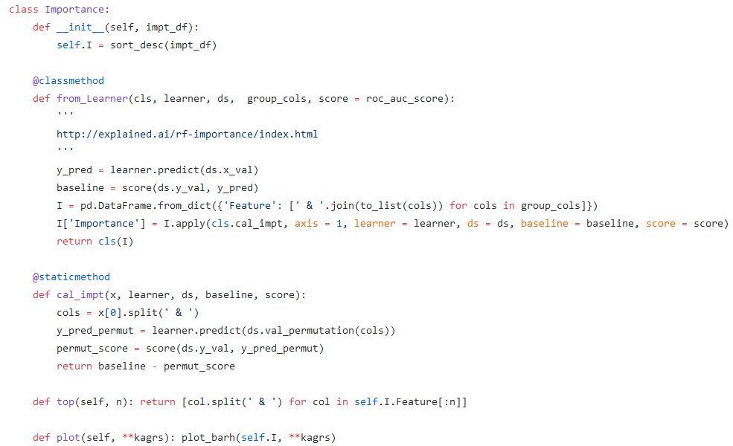
Avoid common pitfall
permutation importance. How it implemented in tabint
Method in dataset
Importance class
Don’t use nested class. Pls!

Slide 15
Avoid common pitfall
Split train/valid/test set. What is problem?
Model need to be good in both data it seen and not seen.
-> valid set need similar to test set and contain data that not in training set. See more at: https://medium.com/@kien.vu/d6b7a8dbaaf5

Slide 16
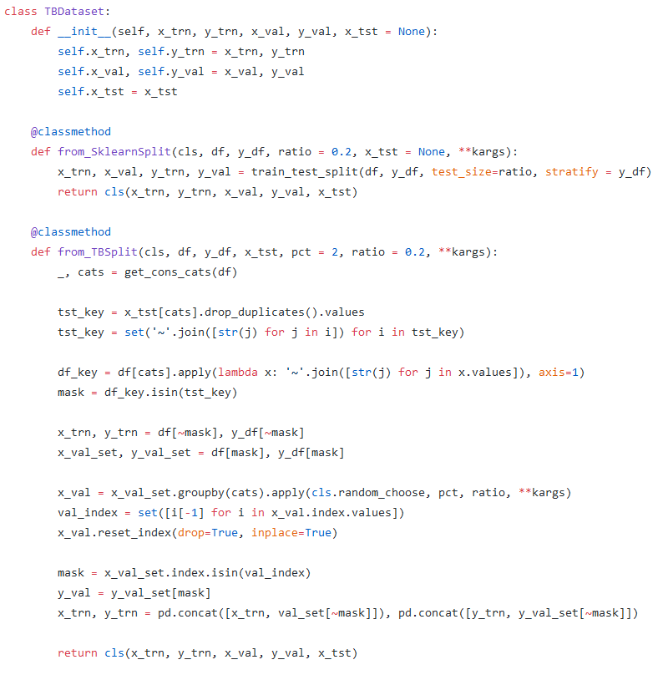
Avoid common pitfall
Split train/valid/test set.
How it implemented in tabint.
It is a input method of dataset!

Slide 17
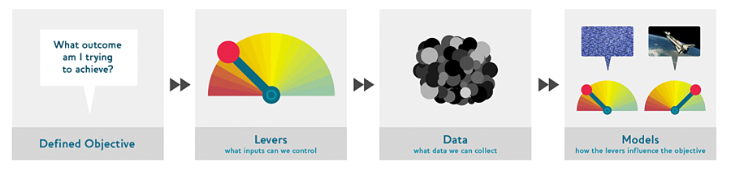
Focus on interpretation, explaination. Why?
Drivetrain approach
Prediction
Simulation
Optimization
Decision
Interpretation
https://www.oreilly.com/ideas/drivetrain-approach-data-products

Slide 18
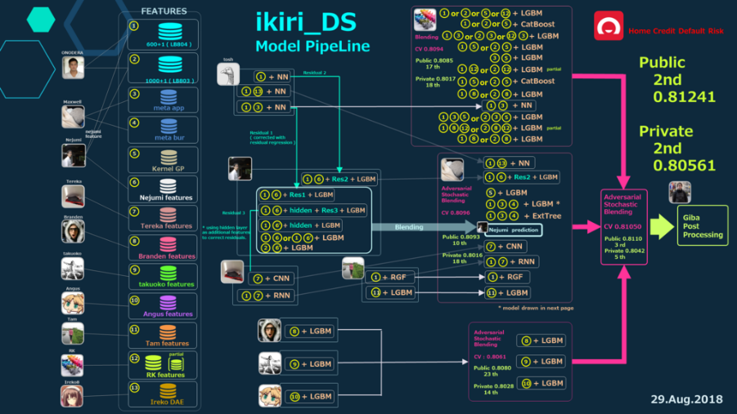
Focus on interpretation, explaination
They gone so far but in the wrong way
https://www.kaggle.com/c/home-credit-default-risk/discussion/64722

Slide 19
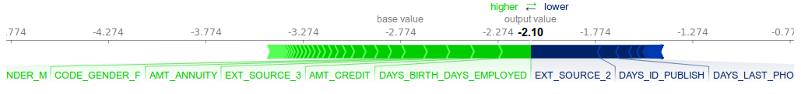
Focus on interpretation, explaination
Understanding better. Doing and acting better!

Slide 20
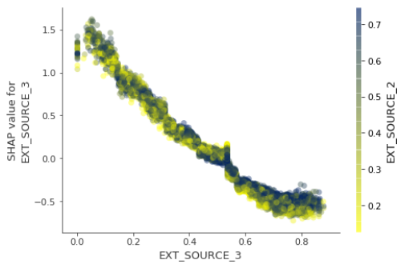
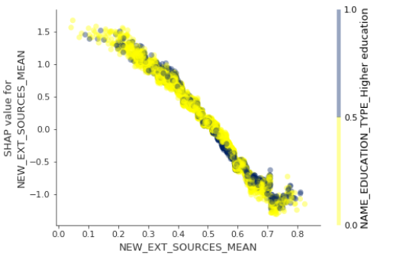
Focus on interpretation, explaination
Understanding better. Doing and acting better
Feature engineering. Why it works?

Slide 21
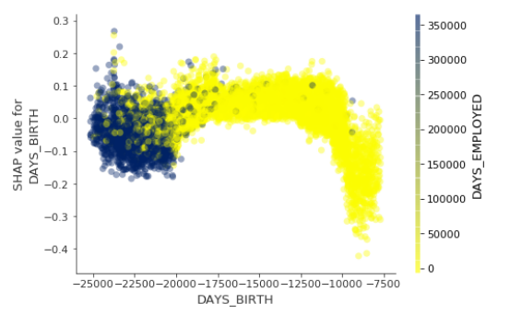
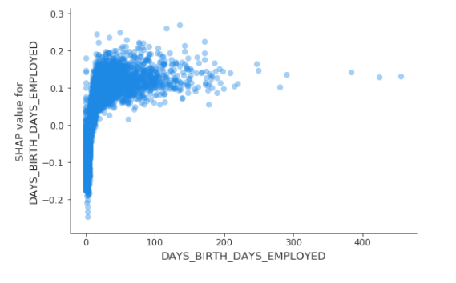
Focus on interpretation, explaination
Understanding better. Doing and acting better
Feature engineering. DAYS_BIRTH and DAYS_EMPLOYED.Why it works?

Slide 22
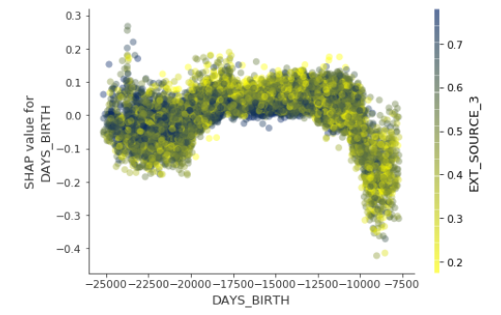
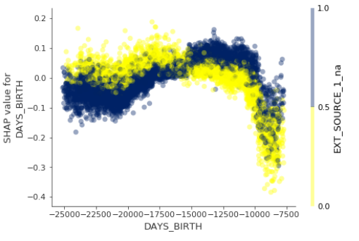
Focus on interpretation, explaination
Understanding better. Doing and acting better
Feature engineering. DAYS_BIRTH and EXT_SOURCE_3.
Why it does not work?
What is better?

Slide 23
How to start
Developing
Debuging

