Slide 1
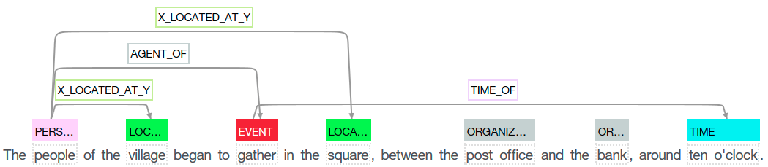
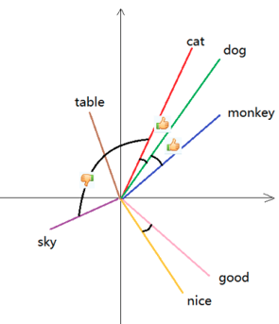
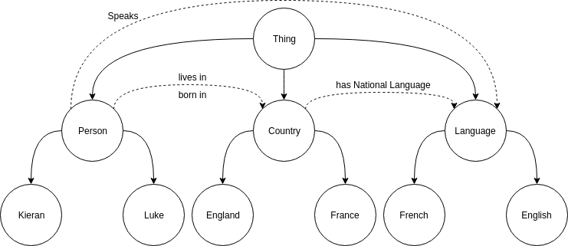
Supervised, ontology driven, semantic relation extraction via an ensemble of neural networks.
Kieran Bacon - 640041851
Relation extraction is an aspect of natural language processing aimed at automatically detecting and classifying semantic relationship mentions within natural language. A semantic relationship is expressed as a connection between two separate entities or concepts, that depict, that a process, action or dependence may exist. Native language conveys most of it is information in the form of a relationship between concepts, and it is the principal method by which human cognition is able to reason and inferrer additional information about the world. We build an internalised web of ideas and relations to encapsulate our impression of the world and the manner in which we interact with it. Take as an example, the scenario that one is trying to educate another about a previously unheard of concept, Melanoma. The first thing that one might say in an attempt to pass on their knowledge would be to indicate its relationship with some other well-known concepts. “Melanoma is a type of Cancer”, from this alone one can infer that its a medical disease, that is life-threatening and that chemotherapy will likely be the treatment choice. All of this information can be viewed as a series of relationships, that can cascade down onto the newly introduced idea.
Word and sentence embeddings
The skip-gram model used to generate word embeddings is one of the most popular methods for generating embeddings. For a vocabulary of 10,000 words, every word is converted into a one-hot vector to represent it. This forms the input to a neural network that maintains 10,000 inputs and 10,000 output nodes. The output nodes corresponds to a single word in the vocabulary and their value is the probability that this word is around a given input. Due to the nature of one hot vectors, the a single word input will activate only a subset of the connections within a Neural Network, as such, the we can used the weights of these connections to represent the word embedding for that input. The model is trained by using softmax classification on the output layer, and mapping a single input to the same input via the output. When training is complete, the softmax classifcation is removed and the nodes represent a probability distribution. By training the word embeddings via this method, the semantic information encapsulated within a word can be represented as a vector (convectionally 300 features long) that has similar embeddings to similar words.
Sentence embedding aims to embed a sentence in much the same way, but the problem is far greater due to the variability of sentences and their various lengths and styles. In my project I generate sentence embeddings by using learned worded embeddings to construct an embedding as a sum of the words. I use an exponential monotonic function to extend each word embedding within a sentence as a function of its position within the sentence, this helps include positional information within the embedding.
Ontology and Relation Extraction
The ontology object is fundamentally a programmatic implementation of the ontology concept expressed within philosophy. It is a form of Knowledge representation that encompasses the collection and organisation of world knowledge. This knowledge is the backbone of my relation extraction implementation as it guides the processing of input documents and the generation of relation classifiers. Similarly to the philosophical ontology, it expressed information by declaring what things exist (concepts), and how they interact(relationships).
As a semantic relationship is formed between two concepts that are referred within the text. With the assumption that semantic meaning originates from context, we can split the text around the concepts such that we can have three snippets of context. We can then embed the context according to our sentence embedding function and train a neural network to classifiy a relationship based on its context. The relation extractor maintains an ensemble of Neural network classifiers that aim to perform classification on a single relationship type, as concept semantics shouldn’t interfer, the classifer operates only on the context and therefore doesn’t discriminate between them. AKA (person → Kieran) speaks (language → English).
Relationships are extracted by pattern matching the various concepts that are present within the ontology and filtering the possible combinations down to those that can hold valid relationships. These relationships are then classified and those that are a duplication of an relation instance are removed.

