Slide 1





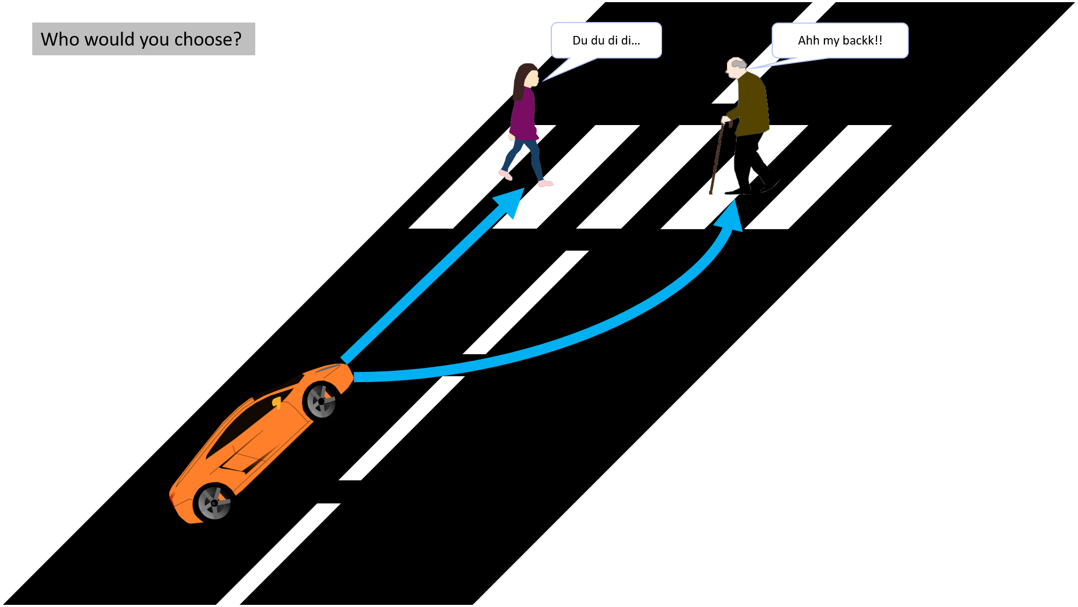
AUTONOMOUS
_{ETHlCS} A generator built for exploring varying moral and ethical dilemmas.
1 THE PROBLEM 2 THE GENERATOR 3
THE DESIGN
Autonomy in vehicles is becoming increasingly more common. It is expected that vehicles will be fully autonmous within the next decade. However, this is an innovation that comes with pitfalls:
Autonomous Ethics is a generator designed to explore the complex moral and ethical situations encountered in the world of autonomous vehicles. The generator has the following features:
To be as detailed and comprehensive as possible, the following has been used/applied to the generator:
A user account syctem for separation of results collected.
28 unique characters to be used in scenario generation.
Alternating conditions such as timers,
green-red light variance, and changing mortality chances.
Autonomous vehicles need to be able to make clear, justified decicions on a day-to-day basis.
Moral/Ethical dilemmas will be handled at the car's discretion.
Industry experts have made little progress in deciding an autonomous vehicle's ‘moral code'.
It is nearly impossible to localize morals and ethics. Most decisions made in this area are bound to be seen as controversial.
Capable of generating over 3.6trillion unique scenarios.
Varying environmentc/variables between each scenario.
A dynamic generator which adapts baced on your decision-making.
Collection of individual/aggregate results to further the quality of the research gained.
*With the exception of infants, all character types have several subclasses, ranging from entrepreneur, homeless, blind, and wheelchair-bound.
4 THE RESULTS
AUTONOMOUS ETHICS
*Statistics baced off individual users are readily available.
KIERAN D'ARCY
kd333
JAMES SCARRY
jc2056
TAYLOR MCNICOL
tm442
IBRAHEEM JHANJI
ij39
R. O. KAFALI

