Slide 1
Game Programming Fundamentals Portfolio
Kieran Rowntree (Q2006504)

Slide 2
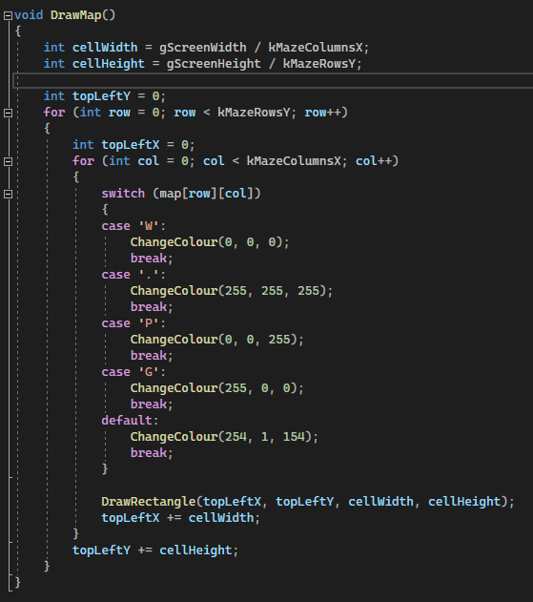
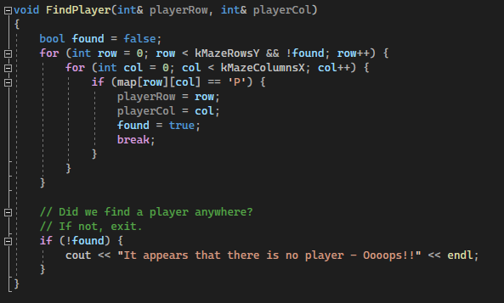
Weeks 6-9: Maze
I used the letter system to dictate to the maze what color each section would be and what they are. Like ‘w’ is the walls so it will be black and will later be told to have collisions
I made the program locate a valid player if there is one. If found it uses the code above to dictate the colour. Else it would return an error message

Slide 3
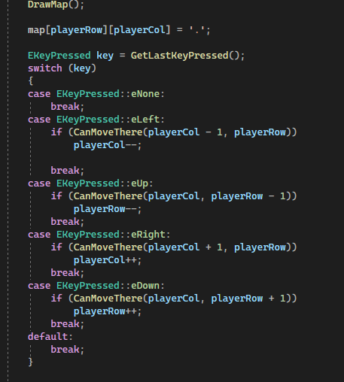
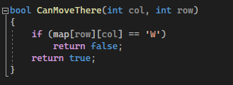
The right section of code is the player movement system. It added functionality to the directional buttons. It also checks if the space is a navigable tile.
The bottom image is the code which expands on the colour system telling ‘w’ that it is a wall, and therefore needs collision and is not a navigable tile.

Slide 4
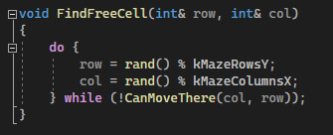
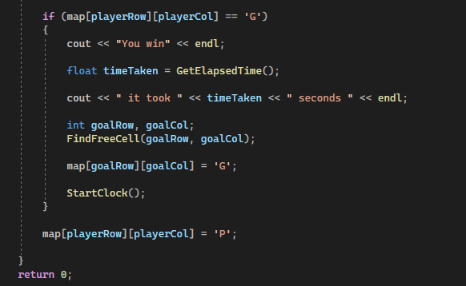
This code detects once the player has reached the goal ‘g’. It will then output the time taken in seconds into the terminal. Then it will find a free navigable tile and move the goal there, allowing the game to continue.

Slide 5
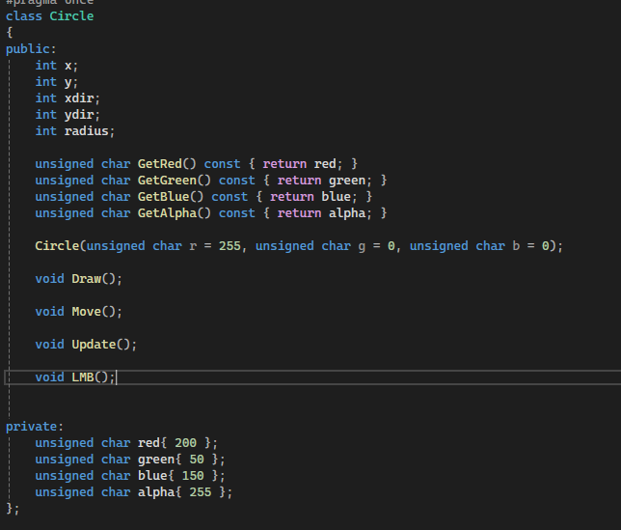
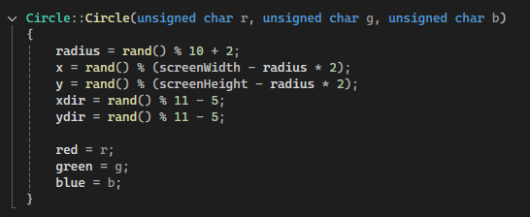
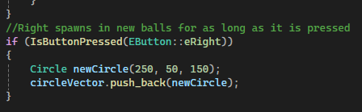
Week 10: Circle classes
I set up circles as their own public class, making the colours private and used getters for full encapsulation.
I also made use of constructors for the spawning of the circles.
I implemented the use of holding the right mouse button to spawn many circles

