Slide 1
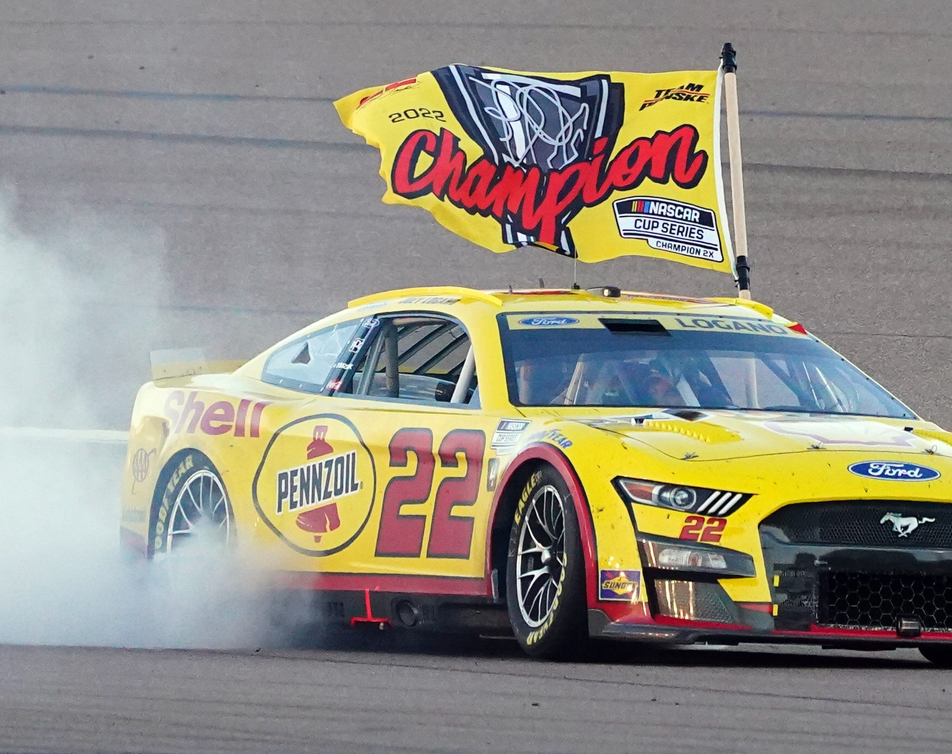
NASCAR Playoffs: a Step Forward or a Sacrifice of Awarding Good Seasons?
By Kieran Dettmar

Slide 2
Introduction
NASCAR has been around since 1948, and into the 21st century every season had been a battle across the full schedule of races to determine a champion
However, that changed in 2004 with the implementation of the “Chase” (now called the playoffs) where points would reset for the top X number of drivers after 26 races and would then battle across the final 10 for the championship
Further changed in 2014 with multiple rounds of elimination to reduce the playoff contenders from 16 to 4 for the season finale
Has been a key topic of debate practically every year since it was first implemented: were these new formats better or worse for the quality and integrity of the sport as a whole?

Slide 3

Data Acquisition and Explanation
Data was scraped from the final points standings page of every season from 1995-2022 on Racing-Reference.info (a website owned directly by NASCAR since 2017)
Most stats are explanatory, key stats in this instance include the first column (points position) and AvFn (average finish)
Year column added in dataset to differentiate years of stat lines for the same driver

Slide 4
Key Points of Analysis
Has the correlation between average finish and final points position weakened over time with new championship formats?
What variables were the most important towards winning a championship under the original full season format?
What interesting changes happen if the above variables in a model are used to predict the results from 2004-2022?

Slide 5
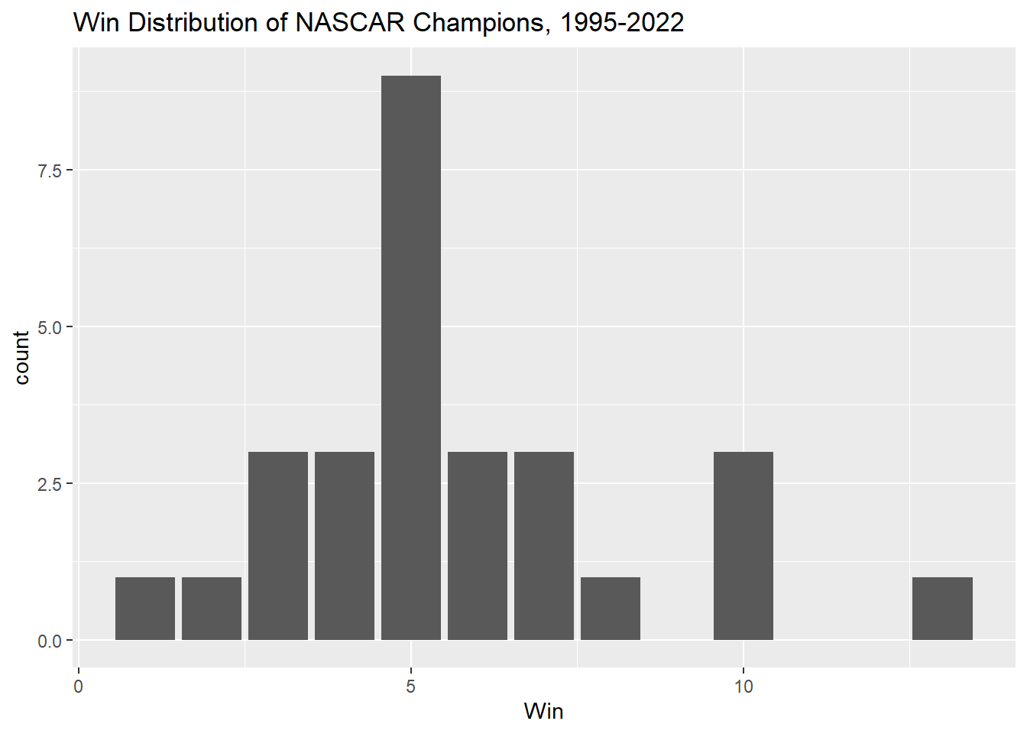
Initial Variable Analysis
One of the primary pieces of analysis was an analysis of race wins distribution across all champions included in the dataset. The count appears almost normally distributed between 0 and 9 wins, but we have a few outliers in the double digits:
Jeff Gordon, 1998 – 13 wins
Kyle Larson, 2021 – 10 wins
Jimmie Johnson, 2007 – 10 wins
Jeff Gordon, 1997 – 10 wins
While Larson is still a young driver, Gordon and Jimmie Johnson are widely considered two of the five best drivers in NASCAR history and were among the most consistent threats for championships, indicating a correlation between consistently contending and having a dominant championship season like they did.

Slide 6
Average Finish Correlation
Simple linear regression of average finish used to determine points position, split the data into three different sets based on the categories below
Coefficient increase means the same average finish producing an increased number to subtract by the regressions’ respective intercepts, t value decreasing means that while still very significant, the p-value is decreasing, and the large drops in the adjusted R-square indicate the clearest that the correlation is weaker now than it was before
Championship Format | Coefficient | T Value | Adj R-Square
Full season (1995-2003) | 1.99379 | 33.143 | 0.6295
“Chase” era (2004-2013) | 2.01608 | 29.5 | 0.5309
Elimination playoffs (2014-2022) | 2.3565 | 20.22 | 0.4063

Slide 7
Ideal Regression of Full Season Format
Every variable relating to the finish was initially included, then trimmed down as variables either had a p-value above 0.05 or had a coefficient going the opposite direction of how it would logistically impact points position (ex. more race wins = worse points position)
The final equation of the model was:
Predicted points position = 44.90253 - 0.7495(# of top 10 finishes) + 0.54519(average finish) - 0.93728(# of races started)
As all drivers contending are full time and thus starting the same number of races, this model indicates that the key to contending for championships under the full season format was keeping your average finish lower (minimizing crashes) and aiming for at least top 10 finishes
In short, consistency was more important than winning races

Slide 8
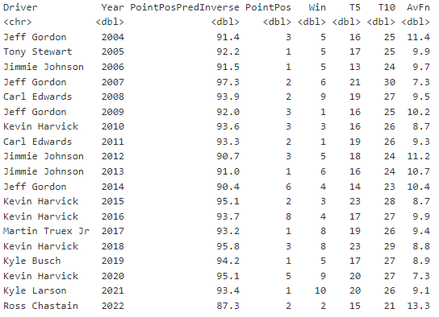
Predicting with Ideal Regression
As seen by the point position column in the left tibble, most seasons have different champions than what actually happened when the regression was used to predict those seasons
Some drivers gained quite a few total championships (Jeff Gordon 4 -> 8, Kevin Harvick 1 -> 5), while others lost some (Jimmie Johnson 7 -> 3)
However, rarely did the regression predict a driver that was not top 3 in the actual final standings to have won the championship

Slide 9
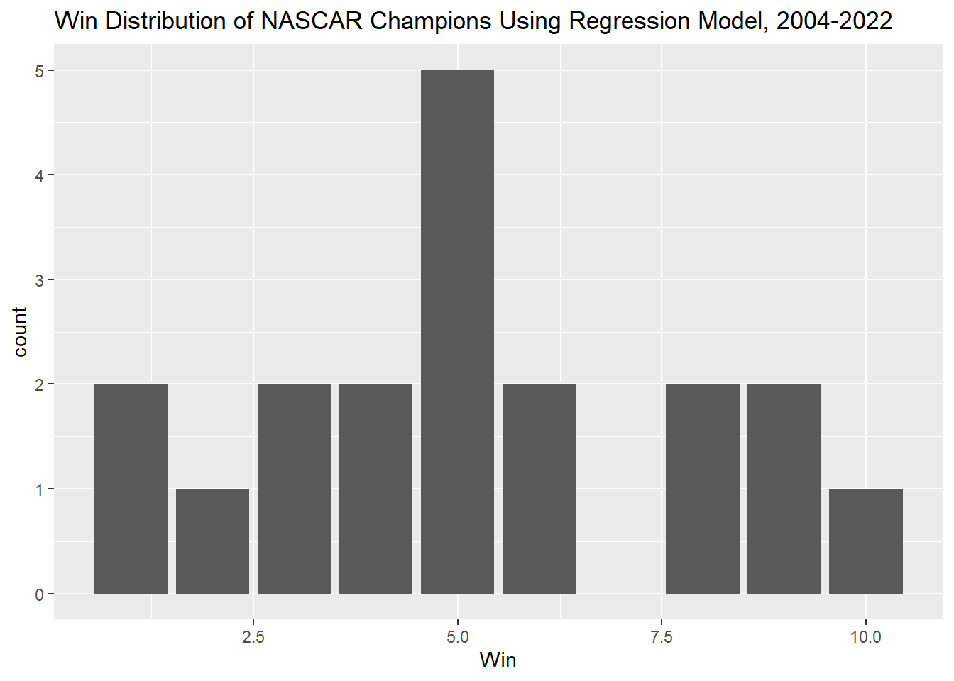
Revisiting Win Distribution
Looking at the race wins distribution with these predicted champions, it appears to be more evenly spread out across the board, from two one-win seasons to Kyle Larson’s 10-win season mentioned previously
The highest count is still firmly at 5 wins, however

Slide 10
Conclusions
The correlation between what was once an important determiner in average finish to the final points standings position has decreased under the new Chase/playoff formats
The original format of the championship is one that showed the importance of consistency rather than wins, showing a level of uniqueness that NASCAR once had from other American sports
Using alternate models to predict champions tends to favor drivers that were already contending for the championship in the actual format at the time already
Will NASCAR ever change back to a full season championship format? Likely not, but whether that means the digging of its own grave or a new era of entertainment over the past decades and into the future remains to be seen…

