Slide 2
API Page Integrations
By
Kieran Sweeney, Morcadium LLC

Slide 3



Agenda
Intro
Why API?
Legacy Web Services
API Pages/Queries
Bound –vs– Unbound Actions
Demo Time!
Resources/Q&A

Slide 4


Intro
Accounting since 2008
Consulting since 2016
⌂: MD/VA/WV → CO
Hobbies:
Biking
Hiking
Piano
Photography

Slide 5

Why API?
Application Programming Interface → Integrations
Dictates how external apps interact with your system
Markers of a good API:
Security
Stability
Scalability

Slide 6

Web Services: Legacy Connections
Originated from the before times (NAV).
Stability Concerns:
Can be renamed
Can be published/unpublished
Should only be used to deploy Codeunits (unbound actions)

Slide 7
Bound –vs– Unbound Actions
Bound Actions
Related to a specific Record.
Used from API Pages
Unbound Actions
Not related to a specific Record.
Used from Codeunits deployed over Web Services.
Support more complex JSON payloads/parameters

Slide 8
Demo Time!
AL: Code Review
Azure: App Registration/Client Secret
BC: Azure Applications
Example Usage:
Power Automate
HTTPS

Slide 9
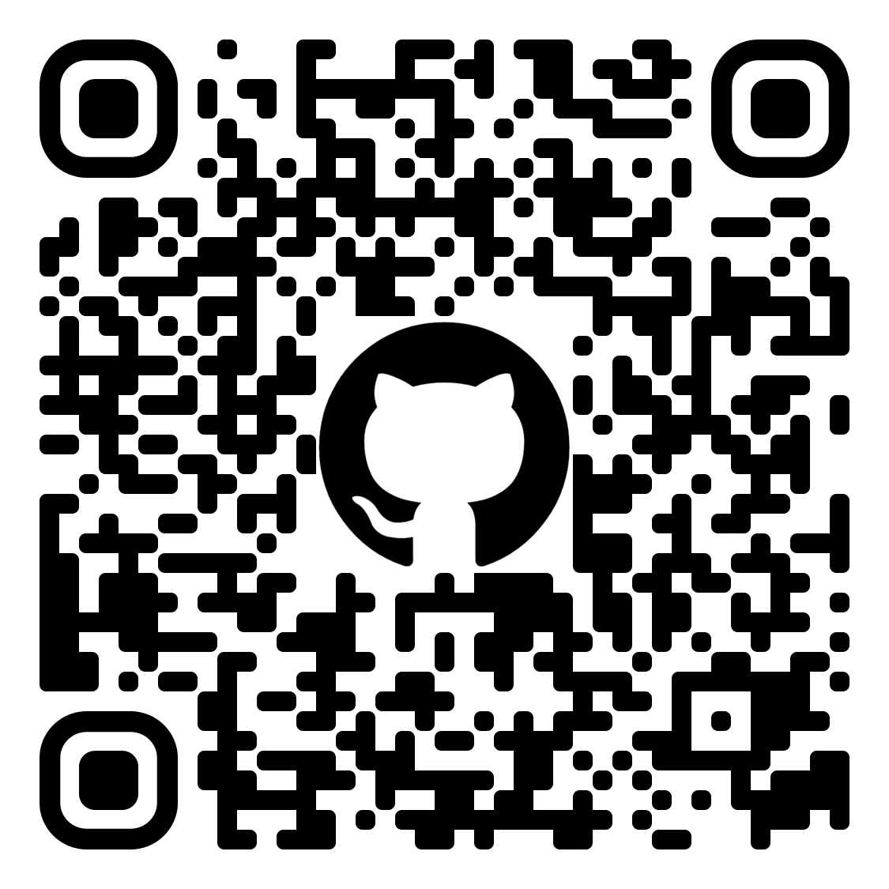

Resources/Q&A
Microsoft Learn:
API Development Overview
Creating and Interacting with an OData V4 Bound Action

