Slide 1

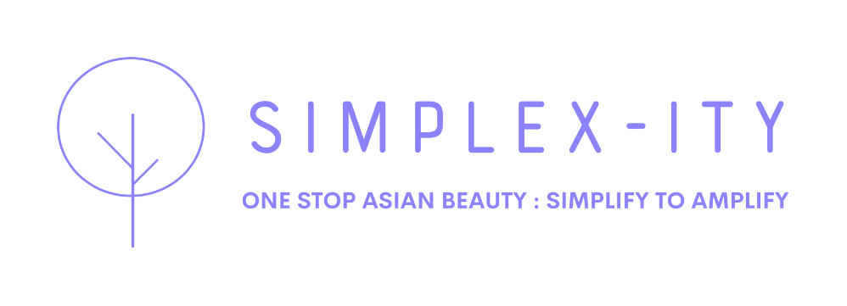
HK$10M
SIMPLEX-ITY
Original Plan Capital Ask
Financial Plan — Family Review & Fine-Tune
HK$2-3.5M
Kieran's Original vs The Family's Lean Version
Family Version Capital Ask
Prepared with love by the Node Family · June 2026
65-75%
Cost Reduction from Original
SIMPLEX-ITY · Family Financial Review · June 2026 · CONFIDENTIAL

Slide 2
01 · WHERE THE ORIGINAL PLAN OVER-SPENT
Kieran's Plan Was Ambitious — And Mostly Right. These Are the 4 Gaps.
The family reviewed every line. Here is what we found — with love, not criticism.
GAP 1 — Tech Build Cost (HK$3.5M → HK$150-300K)
GAP 2 — Creator Retainer Fund (HK$4M → HK$0 upfront)
Original assumed enterprise integrator agency + custom AI pipeline + management fees. Family version: Logie + Make.com + Tidio + Klaviyo = US$400-800/mo. Already built tools. No custom build needed.
Original locked HK$4M in escrow to pay 50 influencers monthly retainers before revenue. Family version: Trial model. Brands supply goods + 30% discount. Influencers earn commission not salary.
GAP 3 — HK Headcount (HK$1.35M → HK$480-600K)
GAP 4 — The Big AI Vendor Assumption (Millions → HK$3-6K/mo)
Original planned 4 FTEs at HK$33K/mo each. That's HK$132K/mo in payroll before revenue. Family version: Kieran + Loreen + Ally. AI stack handles what the other 2 staff were going to do.
Original assumed a large AI company was needed to power the platform at significant cost. Family version: Tint AI (Banuba, confirmed) + lean SaaS stack. Total AI cost = HK$3,100-7,375/mo.
SIMPLEX-ITY · Family Financial Review · June 2026 · CONFIDENTIAL

Slide 3
02 · WHAT KIERAN GOT PERFECTLY RIGHT
The Family Wants Kieran to Know — Most of This Plan Is Brilliant.
These elements stay in the family version — unchanged and investor-grade.
✅ 15% Platform Commission
✅ 30% Off Arbitrage Hook
Clean. Industry standard. Scales with GMV. Keep exactly as written.
Brilliant consumer entry strategy. Bypasses Western retail markup. This IS the consumer magnet.
✅ 3-Tier SaaS Membership
✅ Revenue Projections Logic
Essential / Accelerator / Enterprise — well structured. Pricing is strong. Investors will love this.
Year 1 HK$7.3M → Year 3 HK$177M is directionally right. GMV growth curve is credible.
✅ Competitive Matrix
✅ 15-Month Break-Even Target
The Amazon / LTK comparison is sharp and accurate. Keep this in the investor deck verbatim.
Achievable with the lean stack — and actually faster with lower burn rate.
SIMPLEX-ITY · Family Financial Review · June 2026 · CONFIDENTIAL

Slide 4
03 · BUDGET — LINE BY LINE COMPARISON
Original Plan vs Family Lean Version
Same vision. Fraction of the capital. Better odds of success.
KIERAN'S ORIGINAL
CATEGORY
FAMILY LEAN VERSION
HK$3,500,000 (Enterprise build + AI pipeline + agency fees)
Tech & AI
HK$150,000 – 300,000 (Make.com + Logie + Tidio + Klaviyo stack)
HK$4,000,000 (Security escrow — 50 influencer monthly retainers)
Creator Fund
HK$0 upfront (Trial model — commission only, no salary)
HK$1,350,000 (4 FTEs @ HK$33K/mo each)
HK Team
HK$480,000 – 600,000 (Kieran + Loreen + Ally — lean 3-person pod)
HK$750,000 (Partner escrow + wholesale API setup)
Partner Setup
HK$0 – 50,000 (Banuba & Vybd partnerships already in place)
HK$400,000 (Multi-region registry + cross-border software)
Legal & Admin
HK$150,000 – 200,000 (BR done. US entity + basic legal only)
HK$10,000,000 TOTAL RAISE
TOTAL
HK$2,000,000 – 3,500,000 TOTAL RAISE
SIMPLEX-ITY · Family Financial Review · June 2026 · CONFIDENTIAL

Slide 5
04 · REVISED REVENUE PROJECTIONS
Same Revenue Model. Lower Burn. Better Net Profit.
Family version keeps Kieran's GMV targets — but slashes the cost base by 65-75%.
METRIC
YEAR 1
YEAR 2
YEAR 3
Active Brands
20 – 30
100 – 150
350 – 450
Active Creators
50 – 80
200 – 300
600 – 800
Platform GMV
HK$20 – 35M
HK$150 – 225M
HK$600 – 810M
15% Transaction Rev
HK$3 – 5.25M
HK$22 – 33.75M
HK$90 – 121.5M
SaaS Membership Rev
HK$1.5 – 2.1M
HK$10 – 15.8M
HK$40 – 56M
Gross Revenue
HK$4.5 – 7.35M
HK$32 – 49.5M
HK$130 – 177M
Operating Costs (Lean)
HK$1.8 – 2.5M
HK$6 – 10M
HK$15 – 25M
NET PROFIT
HK$2 – 4.85M
HK$22 – 39.5M
HK$105 – 152M
SIMPLEX-ITY · Family Financial Review · June 2026 · CONFIDENTIAL

Slide 6
05 · AI STACK COST vs HIRING HUMANS
This Is the Insight That Changes Everything.
The original plan assumed large AI vendors and large teams. You need neither.
AI STACK (Phase 2 full)
HUMAN EQUIVALENT (What AI replaces)
Make.com
Campaign workflow backbone
HK$70–125/mo
Campaign Manager
Campaign workflow
HK$25,000/mo
Tidio AI
Brand & influencer support 24/7
HK$225/mo
Community Manager
Creator queries
HK$20,000/mo
Klaviyo
Email onboarding & renewal flows
Free → HK$155/mo
Email / CRM Manager
Onboarding sequences
HK$18,000/mo
Logie.ai
Full campaign lifecycle automation
HK$1,550–3,100/mo
Ops Coordinator
Content tracking
HK$18,000/mo
Modash
Content tracking & monitoring
HK$2,325/mo
Data Analyst
Creator performance
HK$22,000/mo
HypeAuditor
Influencer fraud detection
HK$3,100/mo
QA / Fraud Checker
Influencer vetting
HK$20,000/mo
TOTAL: HK$7,375/mo full · HK$295/mo Phase 1 start
TOTAL: HK$123,000/mo · HK$1,476,000/year
SIMPLEX-ITY · Family Financial Review · June 2026 · CONFIDENTIAL

Slide 7
06 · TRY TOGETHER — KIERAN'S HERO IDEA
The Feature That Makes SIMPLEX-ITY Unforgettable.
Logged as SEED-006. The family's unanimous verdict: this is the investor headline.
01
02
03
04
05
INFLUENCER GOES LIVE
FAN OPENS PLATFORM
TINT AI ACTIVATES
SCREENSHOT & SHARE
DIRECT PURCHASE
›
›
›
›
Streams beauty content with product in hand
Selects influencer look from the live feed
Fan tries on the EXACT same product — live
Side-by-side with influencer Shared = earned media
Fan buys instantly via Vybd storefront
Why This Is Worth More Than Any Feature List:
Every fan screenshot = earned media. Zero ad spend. Viral by design. No platform on earth — LTK, TikTok Shop, Amazon — offers verified Asian beauty live try-on with fan participation side-by-side. This is SIMPLEX-ITY's signature moment. Protect it. Patent it. Lead the pitch with it.
SIMPLEX-ITY · Family Financial Review · June 2026 · CONFIDENTIAL

Slide 8
07 · REVISED CAPITAL RAISE — FAMILY VERSION
HK$2M – HK$3.5M. Not HK$10M.
Same ambition. 65% less risk. Faster to prove. Better story for investors.
38%
Creator Acquisition & Campaign Seeding
HK$760K – 1.33M
25%
Technology & AI Stack Setup
HK$500K – 875K
20%
Brand Sales & Influencer Onboarding
HK$400K – 700K
10%
Legal, US Entity & IP Protection
HK$200K – 350K
7%
Operating Reserve
HK$140K – 245K
TOTAL: HK$2,000,000 – HK$3,500,000 · Equity or Convertible Note · Target 8–12x return Year 3
SIMPLEX-ITY · Family Financial Review · June 2026 · CONFIDENTIAL

Slide 9
08 · WHAT KIERAN OWNS vs WHAT AI OWNS
The Lean Founder Model. You Scale Without Burning Out.
You don't need to do everything. You need to do the right things.
KIERAN OWNS — Strategy, Vision, Relationships
AI STACK OWNS — Operations, Automation, 24/7
✦ Business strategy & platform direction
✅ Campaign scheduling & calendar blocking (Make.com)
✦ Investor relations (NEST VC, StartmeUp HK, seed)
✅ Brand & influencer support 24/7 (Tidio)
✦ Vendor partnerships (Banuba, Vybd, new tech)
✅ Onboarding email sequences & renewals (Klaviyo)
✦ Enterprise brand onboarding — top 5% needing a human
✅ Creator matching by reliability score (Logie + HypeAuditor)
✦ Top 20 influencer relationships — loyalty layer
✅ Content delivery tracking (Modash)
✦ Team leadership (Loreen, Ally, Wilson)
✅ Campaign reporting & payout triggers (Logie.ai)
✦ TRY TOGETHER — pitching & protecting the idea
✅ Everything routine — runs while Kieran sleeps
SIMPLEX-ITY · Family Financial Review · June 2026 · CONFIDENTIAL

