Slide 1
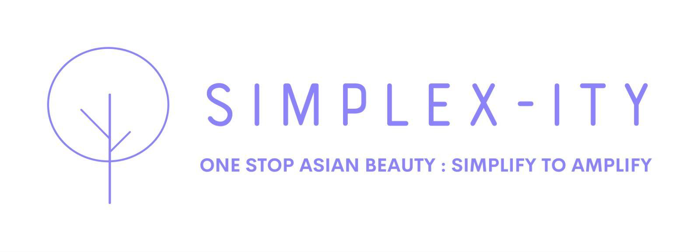
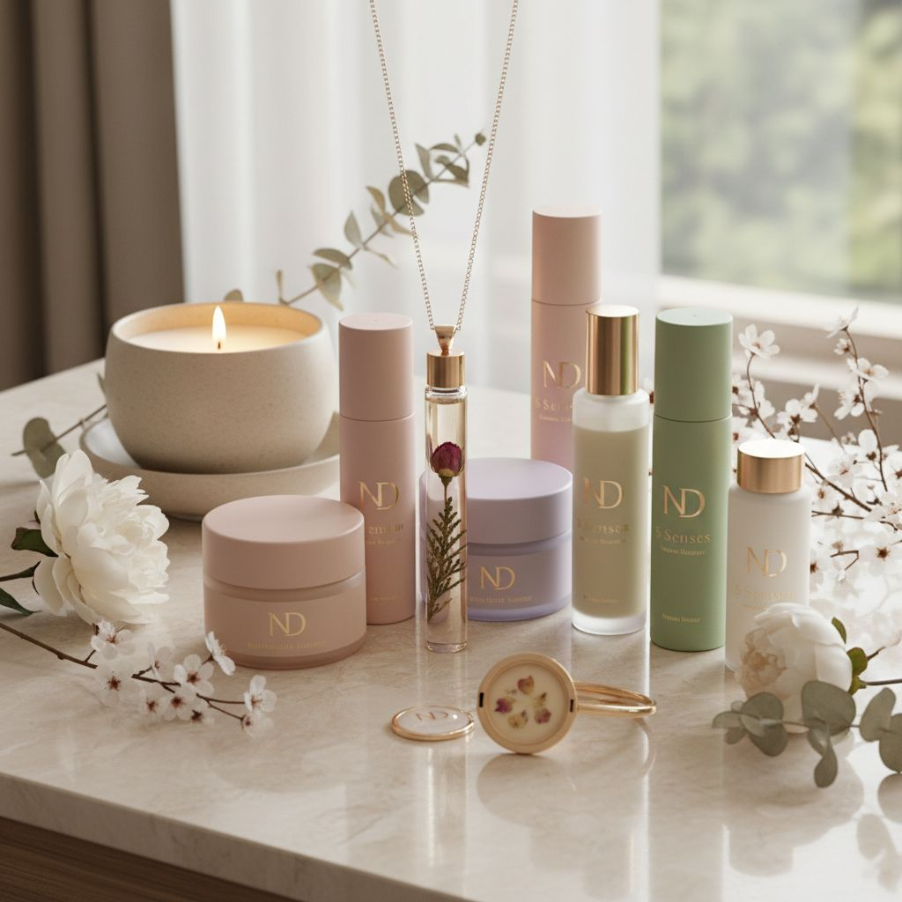
INVESTOR PRESENTATION · 2026
The trusted path to Asian beauty discovery.
Simplex-ity connects verified creators with beauty brands through curated campaigns, TINT virtual try-on, and a reliability-scored influencer ecosystem.
Kieran · kieran@5senses.global · SIMPLEX-ITY by 5SENSESBEAUTY LIMITED
simplex-ity.fluentlab.co

Slide 2
EXECUTIVE SUMMARY
The opportunity in one page.
Asian beauty, made easier to trust, learn, and love.
The Problem
Our Solution
Asian beauty brands cannot verify influencer ROI. Consumers cannot trust whether products suit their skin. There is no curated, guided platform connecting both.
Simplex-ity is the managed influencer marketplace for Asian beauty. We combine verified creator matching, TINT virtual try-on, and real-time campaign tracking in one platform.
The Model
The Opportunity
Brands pay monthly membership (HK$400 to HK$2,500). Influencers earn 10-15% commission with zero upfront cost. Platform retains a 5% performance fee post-trial.
Global AI beauty personalisation market: US$2.3B in 2026. Influencer platform market: US$2.03B by 2031. HK beauty market growing with Instagram at 45.3% share.

Slide 3
01 — THE PROBLEM
A $2.3B market without a trusted guide.
Three groups. Three unresolved problems. One platform to fix all three.
For Brands
For Influencers
For Consumers
— No reliable way to verify influencer audience quality.
— Commission platforms offer no tech advantage to grow sales.
— Shade uncertainty stops purchase at the final step.
— Virtual try-on technology is expensive and disconnected from campaigns.
— Brand matching is opaque and relationship-dependent.
— Creator content is aspirational but not always trustworthy.
— Campaign ROI is measured manually, weeks after the fact.
— No tools to demonstrate professional reliability to brands.
— Asian beauty discovery is fragmented across platforms.
— Influencer reliability tracked in spreadsheets, campaigns fail mid-execution.
— Income is inconsistent with no retainer or anchor structure.
— No single curated source that guides from discovery to purchase.

Slide 4
02 — THE SOLUTION
Simplex-ity: one managed platform.
Brands. Influencers. Try-on technology. Unified.
Verified Creator Matching
TINT Virtual Try-On
Reliability Scorecard
Curated influencers matched to your brand by audience data and platform reliability score. Selected, not scraped.
AR makeup try-on embedded in creator content and brand pages. 25%+ higher conversion rate vs standard links.
Every creator rated 0-100% on delivery, engagement, and conversion. Below 70% triggers automatic shop suspension.
End-to-End Campaign Tracking
Brand Membership Tiers
Digital Franchise Model
Live counts, blog delivery, commission paid, and full post-campaign ROI report, in one real-time dashboard.
Structured brand partnerships from HK$400/month (Essential) to HK$2,500/month (Enterprise) with clear deliverables.
Influencers earn 10-15% commission with zero upfront cost. Platform grows through creator cross-pollination and follower synergy.

Slide 5
03 — KEY DIFFERENTIATOR
TINT Virtual Try-On.
The only Asian beauty platform with embedded AR makeup technology.
25%+
200%
30%
17%
Higher conversion vs standard links
More conversions vs static images
Higher average order value
AI beauty market CAGR 2025-2033
What TINT delivers for your brand partners
Real-Time AR Try-On
AI Skin Analysis
Embedded Commerce
Creator Integration
Lipstick, eyeshadow, and foundation try-on inside creator posts. No app download needed.
Personalised shade recommendations based on consumer skin tone, shown at the point of discovery.
Try-on links directly to purchase. Removes the friction between inspiration and conversion.
Runs inside live streams and blog posts. Creators use it live, consumers trust what they see.

Slide 6
04 — MARKET OPPORTUNITY
A market ready to be shaped.
$2.3B
$2.03B
108%
68%
Global AI Beauty Personalisation Market 2026
Influencer Platform Market by 2031
TikTok Shop beauty sales growth 2025
Beauty purchases influenced by social discovery
Hong Kong Market Context
Instagram leads HK influencer marketing at 45.3% share. Xiaohongshu (XHS) is the fastest-growing platform in HK beauty. Simplex-ity operates across both. TikTok Shop beauty sales grew 108% in 2025. 68% of global beauty purchases are influenced at the discovery stage, the precise moment Simplex-ity captures.
Why now: gap in the market
— Standard affiliate platforms offer no AR technology or reliability governance.
— Beauty marketplaces are catalogue-driven and not creator-guided.
— No platform currently combines TINT try-on with influencer reliability scoring for the Asian beauty category.

Slide 7
05 — BUSINESS MODEL
Three revenue streams. Zero upfront risk.
Stream 1: Brand Membership (Recurring SaaS)
Essential HK$400/mo | Professional HK$900/mo | Enterprise HK$2,500/mo
Recurring monthly subscription. Predictable, scalable, platform-independent.
Stream 2: Performance Fee (Commission Take-Rate)
5% platform fee retained from influencer commissions after 3-month trial. Commissions range 10-15% of net sales.
Scales automatically with GMV. No sales team required to grow this line.
Stream 3: Premium Shop Subscriptions (Creator Upsell)
HK$20/month per influencer for advanced analytics, custom storefront UI, and deep-dive campaign data.
Optional upsell unlocked once creators are earning. Low friction, high margin.
All three streams compound: more brands attract more creators, which grow GMV, which increases performance fees.

Slide 8
06 — HOW IT WORKS
From brief to results in four steps.
01
02
03
04
Brand Brief & Matching
TINT Try-On Setup
Campaign Execution
Performance Report
Brand shares product, budget, and target consumer. Platform matches to verified creators using reliability score and audience data.
TINT virtual try-on configured for the product. Embedded in creator content and brand page. Consumers experience the product before buying.
Creators deliver 1 review blog and 2 professional live streams per window. Shared calendar governs all deadlines. Real-time delivery tracking.
Full post-campaign ROI. Reach, conversions, commission paid, reliability score impact. Recommendations for the next campaign included.
→
→
→
Content Trinity: 1x Detailed Blog + 2x Live Streams + AI Sales Certification + Reliability Score 0-100%

Slide 9
07 — PLATFORM TIERS
Two ecosystems. Both governed.
BRAND MEMBERSHIP
Essential
Professional
Enterprise
HK$400/mo
HK$900/mo
HK$2,500/mo
Campaigns: 1/quarter
Campaigns: 2/quarter
Unlimited campaigns
Up to 5 creators
Up to 15 creators
Unlimited creators
TINT basic
Full TINT + dashboard
Dedicated manager
INFLUENCER TIERS
Rising Star
Star Influencer
Superstar
Essential brands
Professional brands
Enterprise brands
1 Blog + 1 Live
2 Blogs + 4 Lives
5 Blogs + 10 Lives
10% commission
12% + content fees
15% + 1st Launch access
Red Card rule: reliability score below 70% = permanent shop suspension.

Slide 10
08 — TRACTION & ROADMAP
Where we are. Where we are going.
Current Status — April 2026
— Platform built and live at simplex-ity.fluentlab.co — Brand guidelines and design system completed
— Influencer ecosystem framework defined (V3) — TINT integration scoped and ready for brand onboarding
Q2 2026 Now
Q3 2026
Q4 2026
2027
ACTIVE NOW
Platform live. Brand partnerships open. First influencer cohort onboarding. TINT try-on integration active.
First 10 brand members signed. 50 verified creators active. Campaign reporting dashboard launched. First performance reports delivered.
Professional and Enterprise tier brands onboarded. Retainer model active for top influencers. XHS and TikTok campaign channels added.
Regional expansion. Singapore and Taiwan market entry. Institutional brand partnerships. Series A readiness.

Slide 11
09 — COMPETITIVE ADVANTAGE
Five moats. Built in from day one.
Try-On Technology
TINT virtual AR makeup is integrated at the platform level. Competitors would need to build or license this separately.
Reliability Governance
The 0-100% reliability scorecard is proprietary. No other Asian beauty influencer platform governs creator behaviour this systematically.
Category Focus
Simplex-ity is built exclusively for Asian beauty, not a generic influencer marketplace. Category depth creates trust that horizontal platforms cannot replicate.
Creator Ecosystem
Cross-pollination drives follower growth for creators. The more creators on the platform, the more valuable each one becomes. Network effects compound.
Data Advantage
Every campaign generates proprietary data on what converts in Asian beauty by product type, skin tone, and creator tier. This data widens the moat over time.

Slide 12
THE INVESTMENT OPPORTUNITY
KEY NUMBERS
Join Simplex-ity at the foundation stage.
3 Revenue Streams
Membership, Performance Fee, Premium Shop
HK$400 to $2,500
Brand membership per month
We are seeking seed investment to accelerate brand onboarding, expand the creator ecosystem across HK, Singapore, and Taiwan, and build the full analytics infrastructure.
10 to 15%
Influencer commission rate
25%+
TINT conversion rate uplift
Brand Sales:
Onboard first 20 brand partners across all tiers
0
Creator Growth:
Build verified creator cohort to 200 active influencers
Upfront cost for influencers
Technology:
Full TINT integration, analytics dashboard, and reporting suite
$2.3B
Regional:
Singapore and Taiwan market entry in 2027
Target market size 2026
kieran@5senses.global
simplex-ity.fluentlab.co | Kwun Tong, Hong Kong

