Slide 1
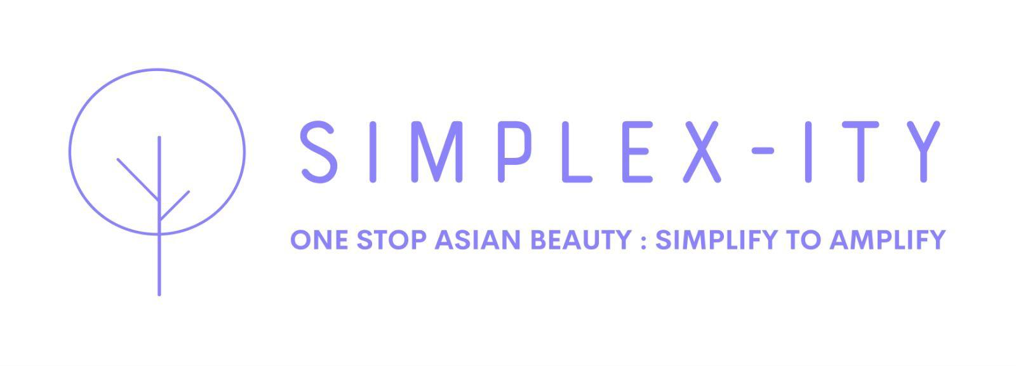
SIMPLEX-ITY
INVESTOR PRESENTATION · 2026
The trusted path to
Asian beauty discovery.
Asian beauty, made easier to trust, learn, and love.
Simplex-ity connects verified creators with beauty brands through curated campaigns, TINT virtual try-on, and a reliability-scored influencer ecosystem.
SIMPLIFY TO AMPLIFY
Kieran · kieran@5senses.global SIMPLEX-ITY by 5SENSESBEAUTY LIMITED · Hong Kong
simplex-ity.fluentlab.co

Slide 2
EXECUTIVE SUMMARY
The opportunity in one page.
Three markets. One platform. Built for trust.
Asian beauty, made easier to trust, learn, and love.
The Problem
Our Solution
Brands cannot verify influencer ROI. Consumers cannot trust shade fit. No curated, guided platform connects both.
Simplex-ity is the managed influencer marketplace for Asian beauty — creator matching, TINT try-on, and real-time campaign tracking.
The Business Model
The Market
Brands pay HK$400-$2,500/month membership. Influencers earn 10-15% commission. Platform retains 5% performance fee post-trial.
$2.3B AI beauty market. $2.03B influencer platform market by 2031. HK Instagram at 45.3% share. TikTok Shop beauty up 108%.

Slide 3
01 — THE PROBLEM
A $2.3B market without a trusted guide.
Three groups. Three unresolved problems. One platform to fix all three.
For Brands
For Influencers
For Consumers
— No reliable way to verify influencer audience quality.
— Commission platforms offer no tech advantage.
— Shade uncertainty stops purchase at the final step.
— Virtual try-on is expensive and disconnected from campaigns.
— Brand matching is opaque and relationship-dependent.
— Creator content is aspirational but not always verified.
— Campaign ROI is measured manually, weeks after the fact.
— No tools to demonstrate professional reliability.
— Asian beauty discovery is fragmented across platforms.
— Influencer reliability tracked in spreadsheets.
— Income inconsistent with no retainer structure.
— No curated source guiding from discovery to purchase.

Slide 4
02 — THE SOLUTION
Simplex-ity: one managed platform.
Brands. Influencers. Try-on technology. Unified.
Verified Creator Matching
TINT Virtual Try-On
Reliability Scorecard
Curated influencers matched by audience data and platform reliability score. Selected, not scraped.
AR makeup try-on embedded in creator content and brand pages. 25%+ higher conversion rate vs standard links.
Every creator rated 0-100% on delivery and conversion. Below 70% triggers automatic shop suspension.
End-to-End Tracking
Brand Membership Tiers
Digital Franchise Model
Live counts, blog delivery, commission paid, and full post-campaign ROI in one real-time dashboard.
Structured brand partnerships from HK$400/month (Essential) to HK$2,500/month (Enterprise).
Influencers earn 10-15% commission with zero upfront cost. Platform grows through creator cross-pollination.

Slide 5
03 — KEY DIFFERENTIATOR
TINT Virtual Try-On.
The only Asian beauty platform with embedded AR makeup technology.
25%+
200%
30%
17%
Higher conversion vs standard links
More conversions vs static images
Higher average order value
AI beauty market CAGR 2025-2033
What TINT delivers for your brand partners
Real-Time AR Try-On
AI Skin Analysis
Embedded Commerce
Creator Integration
Lipstick, eyeshadow, foundation try-on inside creator posts. No app download needed.
Personalised shade recommendations at point of discovery, based on consumer skin tone.
Try-on links directly to purchase. Removes friction between inspiration and conversion.
Runs live inside streams and blog posts. Creators use it live; consumers trust what they see.

Slide 6
04 — MARKET OPPORTUNITY
A market ready to be shaped.
Sized. Validated. Underserved.
$2.3B
$2.03B
108%
68%
Global AI Beauty Personalisation Market 2026
Influencer Platform Market by 2031
TikTok Shop beauty sales growth 2025
Beauty purchases influenced by social discovery
Hong Kong Market Context
Instagram leads HK influencer marketing at 45.3% share. Xiaohongshu is the fastest-growing platform in HK beauty. Simplex-ity operates across both. 68% of global beauty purchases are influenced at the discovery stage — the moment Simplex-ity captures.
Why now: the gap in the market
— Standard affiliate platforms offer no AR technology or reliability governance.
— Beauty marketplaces are catalogue-driven and not creator-guided.
— No platform combines TINT try-on with influencer reliability scoring for the Asian beauty category.

Slide 7
05 — BUSINESS MODEL
Three revenue streams. Zero upfront risk.
Stream 1: Brand Membership (Recurring SaaS)
Essential HK$400/mo | Professional HK$900/mo | Enterprise HK$2,500/mo
Recurring monthly subscription. Predictable, scalable, platform-independent.
Stream 2: Performance Fee (Commission Take-Rate)
5% platform fee retained from influencer commissions after 3-month trial. Influencer commissions range 10-15% of net sales.
Scales automatically with GMV. No sales team required to grow this line.
Stream 3: Premium Shop Subscriptions (Creator Upsell)
HK$20/month per influencer for advanced analytics, custom storefront UI, and deep-dive campaign data.
Optional upsell unlocked once creators are earning. Low friction, high margin.
All three streams compound: more brands attract more creators, which grow GMV, which increases performance fees.

Slide 8
06 — HOW IT WORKS
From brief to results in four steps.
01
02
03
04
Brand Brief and Matching
TINT Try-On Setup
Campaign Execution
Performance Report
Brand shares product, budget, and target consumer. Platform matches to verified creators using reliability score and audience data.
TINT virtual try-on configured for the product and embedded in creator content. Consumers experience the product before buying.
Creators deliver 1 review blog and 2 professional live streams per campaign window. Shared calendar governs all deadlines.
Full post-campaign ROI: reach, conversions, commission paid, reliability score impact, and next-campaign recommendations.
→
→
→
Content Trinity: 1x Detailed Blog + 2x Professional Live Streams + AI Sales Certification + Reliability Score 0-100%

Slide 9
07 — PLATFORM TIERS
Two ecosystems. Both governed.
BRAND MEMBERSHIP
Essential
Professional
Enterprise
HK$400/mo
HK$900/mo
HK$2,500/mo
1 campaign/quarter
2 campaigns/quarter
Unlimited campaigns
Up to 5 creators
Up to 15 creators
Unlimited creators
TINT basic
Full TINT + dashboard
Dedicated manager
INFLUENCER TIERS
Rising Star
Star Influencer
Superstar
Essential brands
Professional brands
Enterprise brands
1 Blog + 1 Live/month
2 Blogs + 4 Lives/month
5 Blogs + 10 Lives/month
10% commission
12% + content fees
15% + 1st Launch access
Red Card rule: reliability score below 70% = permanent shop suspension.

Slide 10
08 — COMPETITIVE ADVANTAGE
Five moats. Built in from day one.
Curated by design. Not replicable by horizontal platforms.
Try-On Technology
TINT virtual AR makeup integrated at platform level. Competitors must build or license this separately.
Reliability Governance
The 0-100% scorecard is proprietary. No other Asian beauty platform governs creator behaviour this systematically.
Category Focus
Built exclusively for Asian beauty. Category depth creates trust that horizontal affiliate platforms cannot replicate.
Network Effects
Cross-pollination drives follower growth for every creator. The more creators on platform, the more valuable each one becomes.
Data Advantage
Every campaign generates proprietary data on what converts in Asian beauty by product type, skin tone, and creator tier.

Slide 11
09 — ROADMAP
Where we are. Where we are going.
Q2 2026 Now
Q3 2026
Q4 2026
2027
ACTIVE NOW
Platform live. Brand partnerships open. First influencer cohort onboarding. TINT integration active.
First 10 brand members signed. 50 verified creators active. Campaign dashboard launched. First ROI reports delivered.
Professional and Enterprise brands onboarded. Retainer model active for top creators. XHS and TikTok channels added.
Regional expansion: Singapore and Taiwan. Institutional brand partnerships. Series A readiness achieved.

Slide 12
THE INVESTMENT OPPORTUNITY
KEY NUMBERS
Join Simplex-ity at the foundation stage.
3 Revenue Streams
Membership, Performance Fee, Premium Shop
HK$400 to $2,500
Brand membership per month
We are seeking seed investment to accelerate brand onboarding, expand the creator ecosystem across HK, Singapore, and Taiwan, and build the full analytics infrastructure.
10-15%
Influencer commission rate
25%+
TINT conversion rate uplift
Brand Sales:
Onboard first 20 brand partners across all tiers
$0
Creator Growth:
Build verified creator cohort to 200 active influencers
Upfront cost for influencers
Technology:
Full TINT integration, analytics dashboard, reporting suite
$2.3B
Regional:
Singapore and Taiwan market entry in 2027
Target market size 2026
kieran@5senses.global
simplex-ity.fluentlab.co | Kwun Tong, Hong Kong

