Slide 1
Intelligent Stock Trader
Kieron Gillingham
BSc Software Engineering 2021
Solent University
Faculty of Business, Law and Digital Technologies
Notes:
This is a description and demonstration of an intelligent stock trader application created as part of a Software Engineering course at Solent University.

Slide 2
Stock Trading
Profitable
Risky
Lots of data
Machine Learning
Notes:
Stock trading is a profitable endeavor
Carries high risk
As it is profitable and there is a large amount of stock market data available
It is a common topic for machine learning

Slide 3
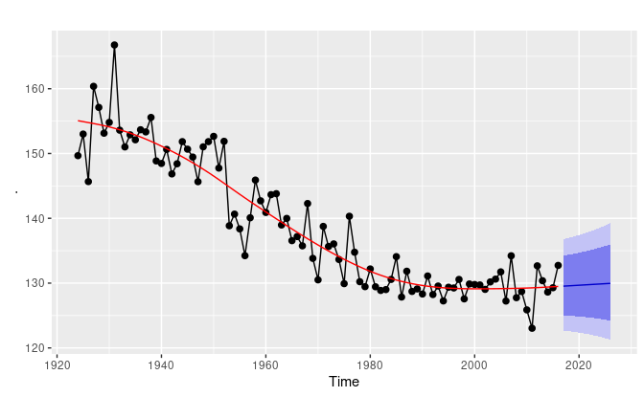
Problem Analysis
Regression - Time-series
Difficulties
Volatility / High variance
High dimensionality
External factors
(Hyndman and Athanasopoulos 2018)
Notes:
Predicting stock prices is a regression problem against time-series data.
Principal difficulties are:
The volatility and high variance of the data. The data is noisy. Subject to rapid changes that are hard to anticipate.
A large number of variables involved. Including different stocks, different statistics.
External influences that are not present in the stock data itself, such as world events.

Slide 4

Data Processing
Cleaning
Missing values replaced
Scaling
Generated Inputs
Momentum
Differencing
Moving averages
(Verizon Media 2021)
Notes:
For this project the stock market data was gathered from Yahoo Finance.
Missing values were substituted with the last known values.
Data was also scaled into a uniform range to reduce bias
Some new features were generated including a daily rate-of-change and moving averages to reduce noise.
Data regarding external factors is not used.

Slide 5
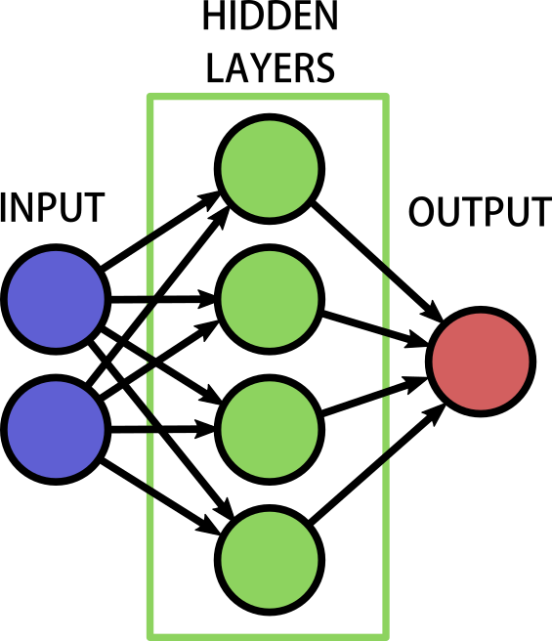
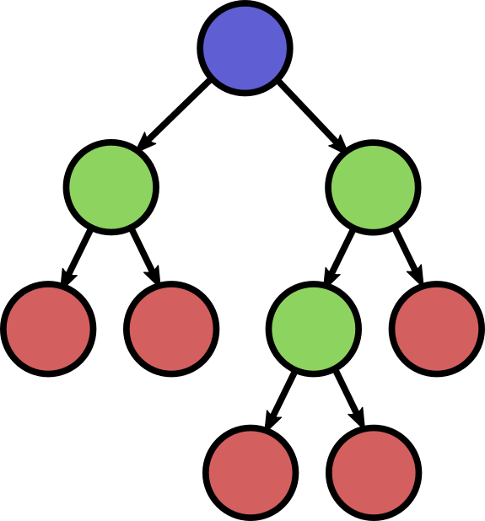
Models
Neural networks
Multi-layer perceptron
Decision trees
Random forest
Hyper-parameter tuning
Notes:
Neural Networks are consistently shown to be successful in forecasting financial data.
MLPs were chosen for this system.
And a random forest regressor for comparison.
Each of these models is tuned
These models were trained

Slide 6
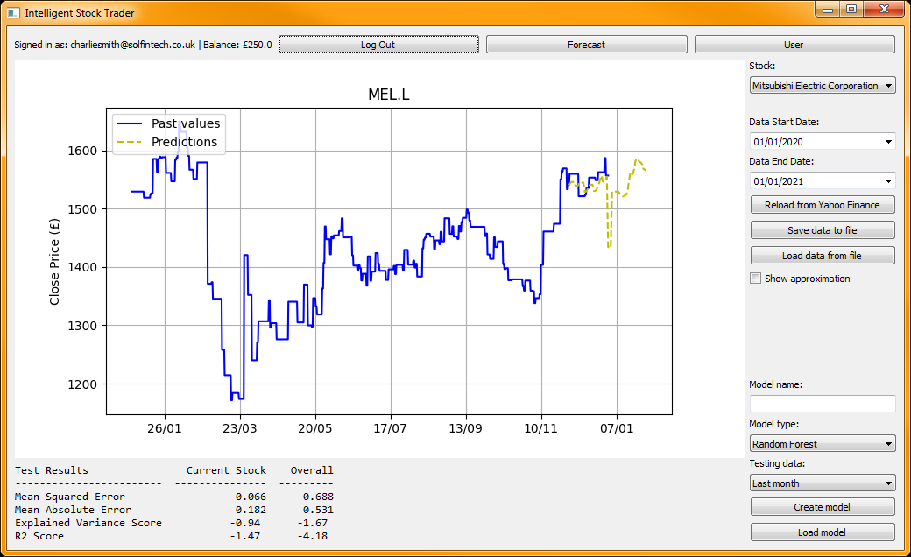



The Software
Python
Threading
PyQt5
(Riverbank Computing 2021)
(Pedregosa et al. 2011)
Data Access / Persistence
Model Training / Persistence
Graphical Display
Investment Calculations
Investment Suggestions
(Hunter 2007)
(Hunter 2007)
Notes:
The piece of software was developed to test these models.
Written in Python, using PyQt for the interface
The interface is threaded
Sklearn was used for the machine learning models, with pandas for data manipulation

Slide 7
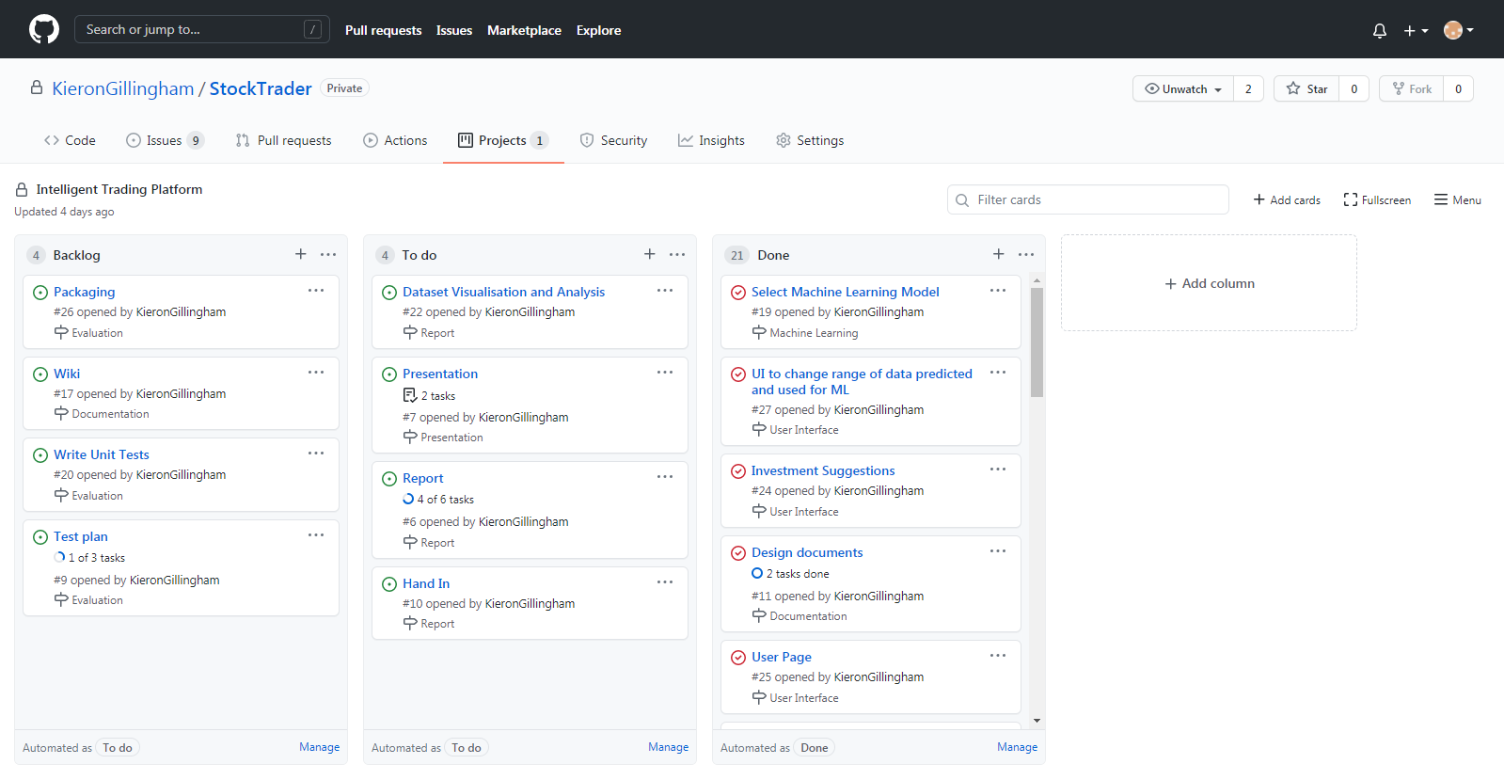
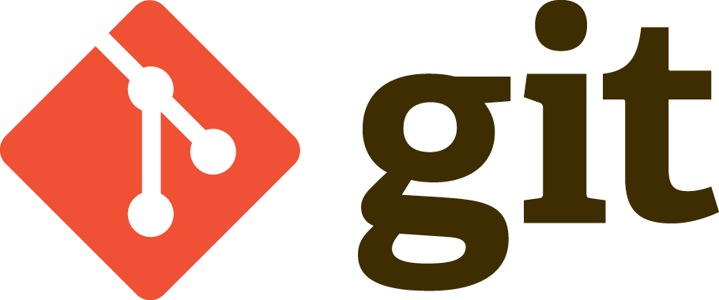

Development Process
Agile
Scrum / Kanban
Milestones
(Software Freedom Conservancy, Inc. n.d.)
(GitHub, Inc. 2021)
Notes:
The application was developed following an agile method, using a kanban board for task management and milestones for prioritisation.
The code for the project was version controlled through git and stored on GitHub, which was also used for management.

Slide 8

Demonstration

Slide 9
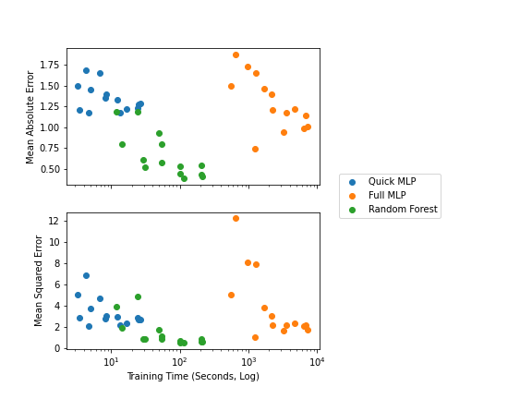
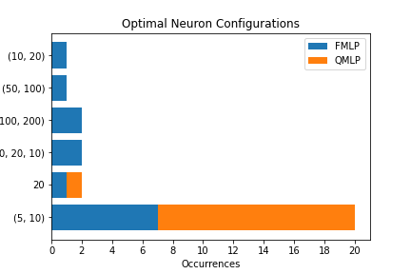
Model Evaluation
Varied training data (1 month, 3 months, 6 months, 1 year, 2 years)
Varied testing data (1 week, 2 weeks, 1 month)
Mean Absolute Error, Mean Squared Error, Explained Variance Score, R² Score
Notes:
The implemented models were tested on different ranges of training and testing data, and error metrics were recorded.
Random Forest gave the lowest error rates of the three models.
Full MLP model had the largest search space for hyper-parameters and took the longest time to train
The second graph shows that it still found the same optimal neuron configuration of (5, 10) most frequently.

Slide 10
Challenges
Inexperience with PyQt
Limited input features; multiple outputs
Notes:
Unfamiliarty with PyQt
Timestamps were deconstructed into raw elements: Day, Month, Year, Day of Week, Week of Year and Day of Year
Less general hybrid model may be more successful, using one model such as random forest to forecast the prices of competitor stocks to be used as inputs to another model specific to a single stock.

Slide 11
Conclusion
⦁ Feature-rich ⦁
⦁ Poor accuracy from MLP models ⦁
⦁ Better accuracy from Random Forest ⦁
⦁ Application is extendable ⦁

Slide 12
References
GITHUB, INC., 2021. GitHub logo Available from: https://github.com/logos
HUNTER, J.D., 2007. Matplotlib: A 2D graphics environment. Computing in Science \& Engineering, 9(3), pp.90-95 DOI: https://doi.org/10.1109/MCSE.2007.55
HYNDMAN, R.J. and ATHANASOPOULOS, G., 2021. Forecasting: Principles and Practice, 2nd Edition [viewed 29/05/ 2021]. Available from: https://otexts.com/fpp2/
PEDREGOSA, F. et al., 2011. Scikit-learn: Machine Learning in Python. Journal of Machine Learning Research, 12, pp.2825-2830
RIVERBANK COMPUTING, 2021. PyQt5 Documentation Available from: https://www.riverbankcomputing.com/static/Docs/PyQt5/introduction.html
SOFTWARE FREEDOM CONSERVANCY, INC., n.d. Git logo Available from: https://git-scm.com/downloads/logos
THE PANDAS DEVELOPMENT TEAM, 2020. pandas-dev/pandas: Pandas. DOI: https://doi.org/10.5281/zenodo.3509134
VERIZON MEDIA, 2021. Yahoo Finance Homepage Available from: https://uk.finance.yahoo.com/
Notes:
Thank you.

Slide 13
End
Notes:
End.

