Slide 1





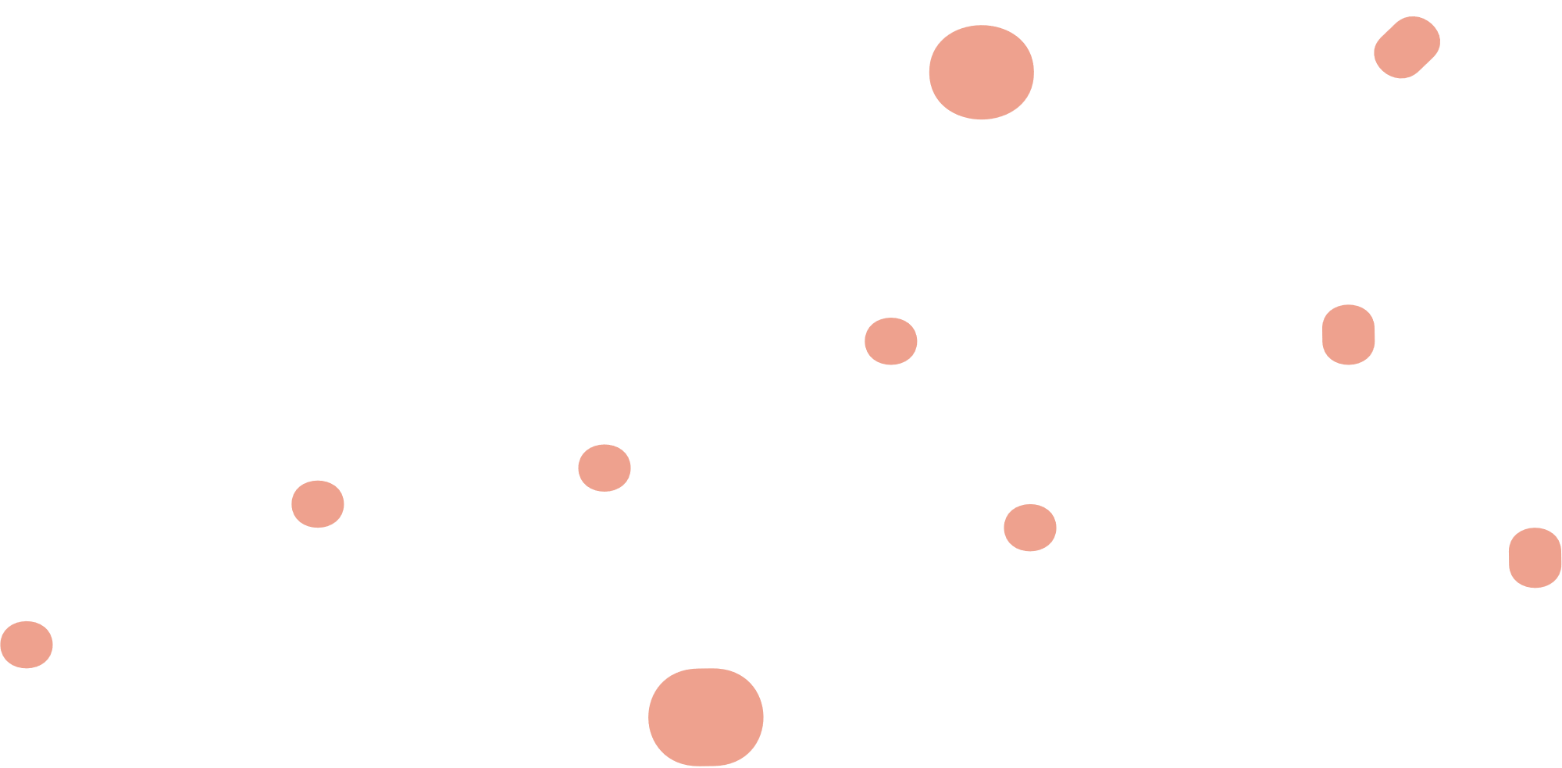



Disjoint set union
Presented by Group 57

Slide 2


our team
Kiet Phan
-23APCS2-
Vu Hoang
-23APCS2-

Slide 3
Abstraction
(critical thinking)
Imagine there are two classes, 23TT1 and 23TT2. Mr. Thanh and his students are going to go to the park for relaxation after a hard-working summer. He wants to separate the students into different subsets. How can he do that effectively, and which strategy he should use to decide whether he can merge two different subsets?

Slide 4

1) Introduction
In computer science, a disjoint-set data structure, also known as a union–find or merge–find set, efficiently manages a partition of a set into disjoint subsets. It supports operations for adding new sets, merging existing sets, and finding a representative member to determine if any two elements belong to the same set.

Slide 5
1.1) history
1.
Disjoint-set forests were first described by Bernard A. Galler and Michael J. Fischer in 1964.
2.
In 1975, Robert Tarjan first proved the O(m(a(n))) (inverse Ackermann function) upper bound on the algorithm's time complexity.
3.
4.
In 1989, Fredman and Saks showed that any disjoint-set data structure must access an optimal number of words of logarithmic bits per operation.
In 2007, Sylvain Conchon and Jean-Christophe Filliâtre developed a semi-persistent disjoint-set forest and formalized its correctness using the function Coq.

Slide 6
1.2) Main operations
1.
Adding new sets
2.
Merging sets (combining two sets)
3.
Finding a representative member of a set

Slide 7
2) Main Algorithms
make_set(v)
union_sets(u, v)
find_set(v)
path compression
union by size / rank
linking by index / coin - flip linking

Slide 8
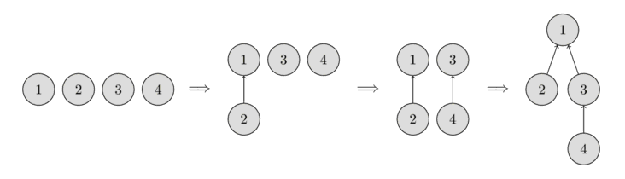
2.1) initialization
Store the sets in form of tree
Maintain parent that stores a reference to its immediate ancestor

Slide 9
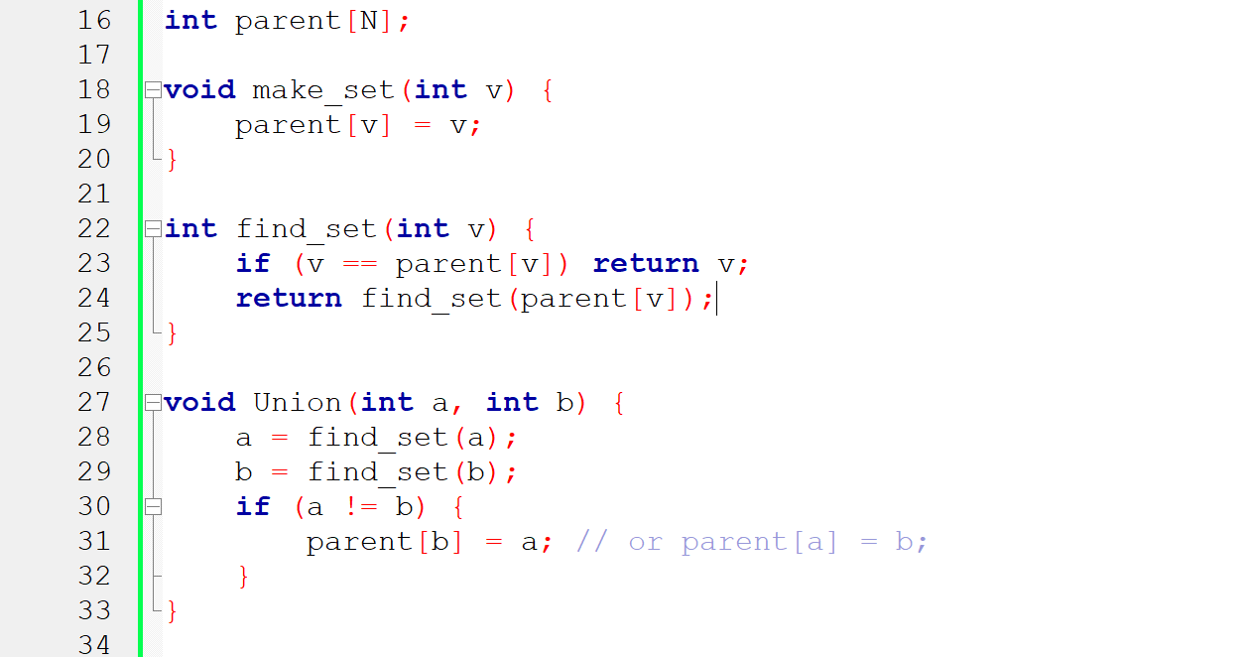
2.2) Naive approach

Slide 10
Comments
However this implementation is inefficient. It is easy to construct an example, so that the trees degenerate into long chains. In that case each call find_set(v) can take O(n) time complexity.
This is not our expectation! We want linear constant time! Therefore we will consider two optimizations that will allow to significantly accelerate the work.

Slide 11
2.3) path compression
This is the optimization for speeding up the function find_set(v)
When we call find_set(v) for a vertex v, we are essentially finding the representative p of the set containing v!
The trick is to make the paths for all those nodes shorter, by setting the parent of each visited vertex directly to p.
This simple modification of the operation already achieves the time complexity O(log(n)) on average!

Slide 12
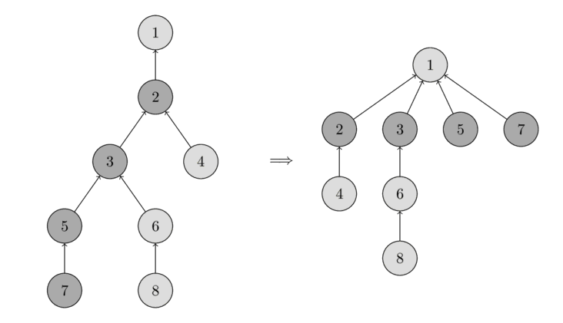
visualization

Slide 13
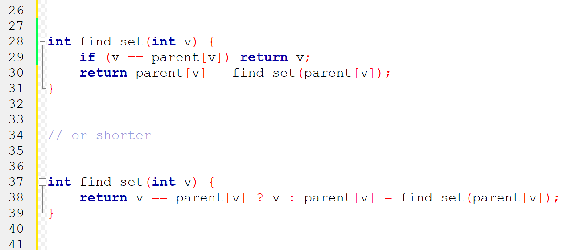
Code

Slide 14
2.4) union by size/rank
This is the optimization for speeding up the function Union(a,b). To be precise, we will change which tree gets attached to the other one.
In the naive implementation, the second tree always attaches to the first, which can create long chains of length O(n). This optimization prevents that by carefully choosing which tree to attach.
There are two heuristic approaches for this: union by size and union by rank. However, in both methods, we will attach the lower one to the bigger one! Think why?

Slide 15
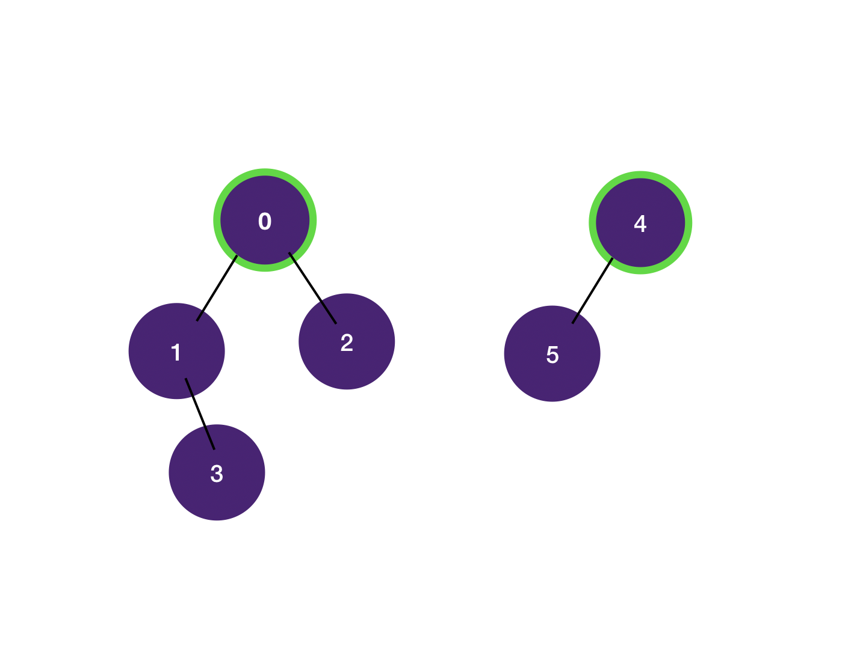
visualization

Slide 16
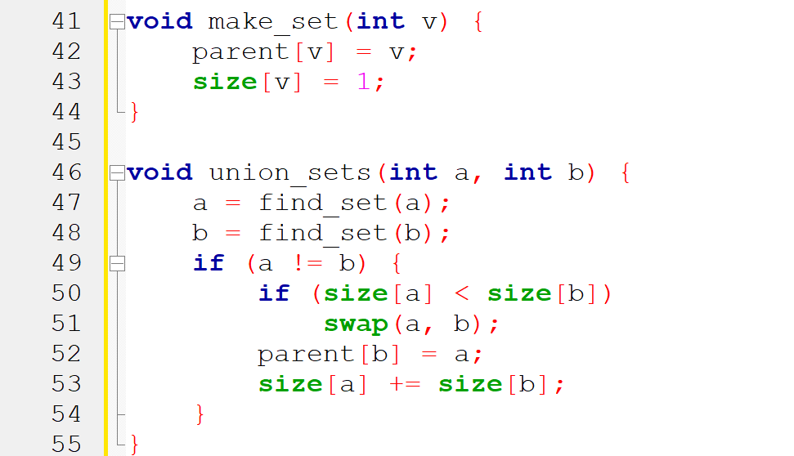
union by size

Slide 17
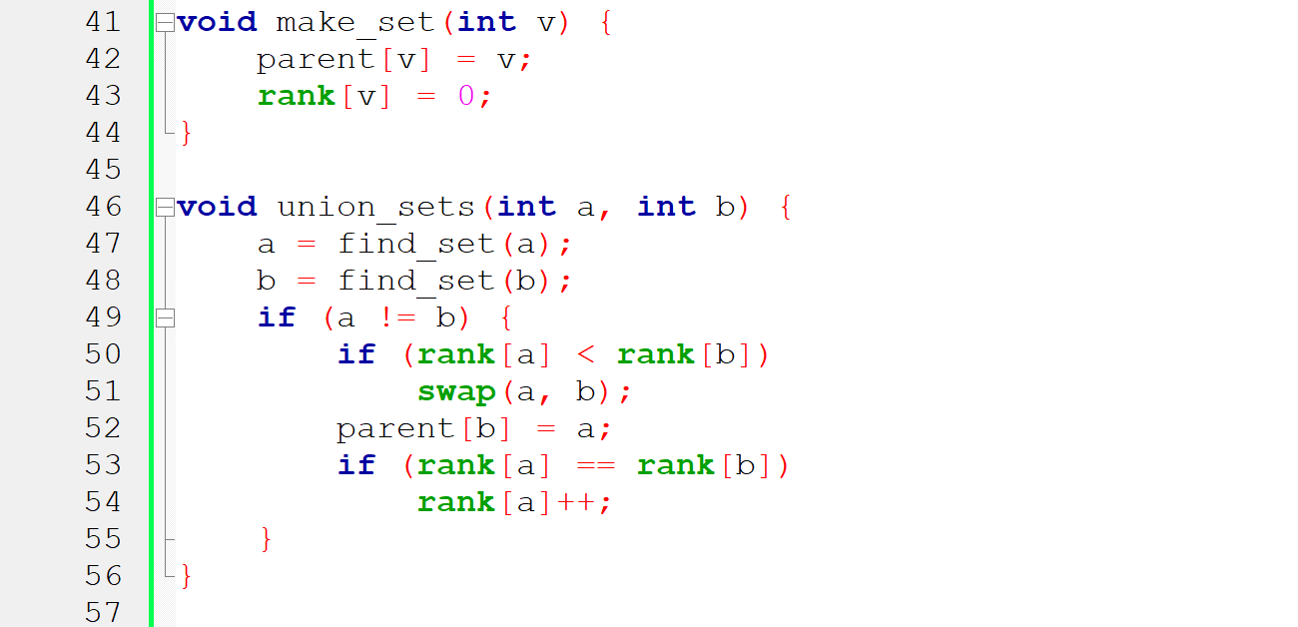
union by rank

Slide 18
2.5) Coin-Flip linking
Both union by rank and union by size need extra data for each set and must update these values with each union. An alternative is a simpler randomized algorithm called linking by index.
We assign a random index to each set and attach the set with the smaller index to the one with the larger index. This approach, similar to union by size, has the same time complexity but is slightly slower in practice.

Slide 19
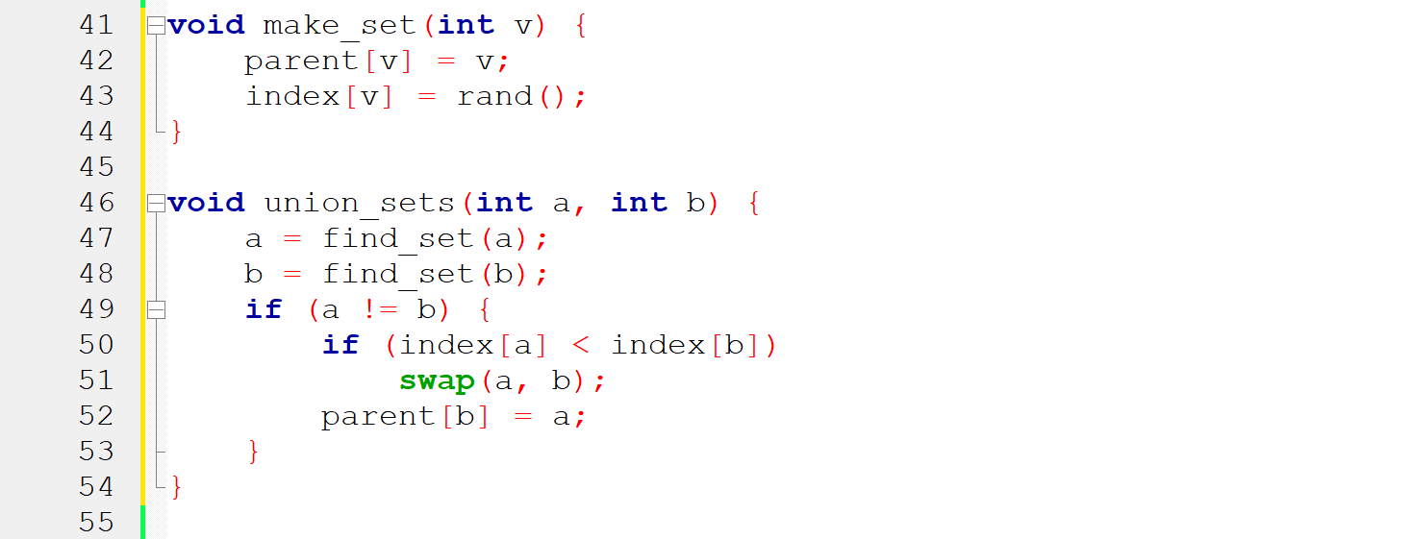
Code

Slide 20

misconception
It's a common misconception that just flipping a coin, to decide which set we attach to the other, has the same complexity. However that's not true.
People has proved that coin-flip linking combined with path compression has complexity
In benchmark, it performs a lot worse than union by size/rank or linking by index.

Slide 21
3) Time complexity
Combining path compression with union by size or rank results in nearly constant time queries. The final amortized time complexity is O(alpha(n)), where alpha(n) is the inverse Ackermann function, which grows very slowly. For all practical purposes, it doesn't exceed 4 for any reasonable n (approximately n < 10^600).
Additionally, DSU with union by size or rank but without path compression operates in O(log n) time per query.

Slide 22
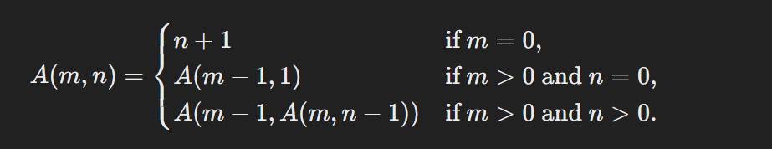
inverse ackermann function
An algorithm with O(α(n)) time complexity, where α(n) is the inverse Ackermann function, is an algorithm that has a time complexity that is bounded by the inverse Ackermann function. This means that the running time of the algorithm is always less than or equal to the value of the inverse Ackermann function for the input size n.

Slide 23
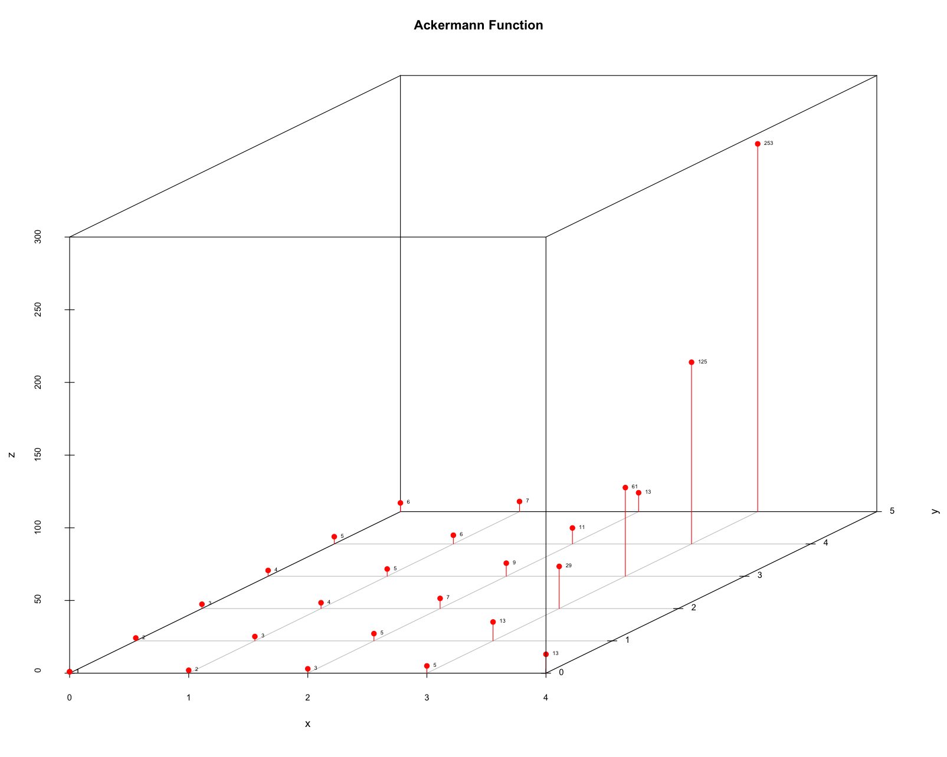

Slide 24
4) applications
Connected components in a graph - Kruskal’s algorithm
Search for connected components in an image
Store additional information for each set
Compress jumps along a segment
Support distances up to representative
Support the parity of the path length
Offline RMQ (range minimum query)
Offline LCA (lowest common ancestor in a tree)
Storing the DSU explicitly in a set list
Storing the DSU by maintaining a clear tree structure

Slide 25
4.1) connected components
This is one of the obvious applications of DSU.
The problem is defined as follows: Starting with an empty graph, we add vertices and undirected edges, then answer queries asking if two vertices are in the same connected component.
We can use a DSU to handle vertex and edge additions and queries in nearly constant average time.
This approach is crucial because a similar problem occurs in Kruskal's algorithm for finding a minimum spanning tree. By using DSU, we can improve the complexity from O(m log n + n^2) to O(m log n).

Slide 26
4.2) Search images
There is an image of n x m pixels. Originally all are white, but then a few black pixels are drawn. You want to determine the size of each white connected component in the final image.
To solve this, we iterate over all white pixels in the image. For each cell, we check its four neighbors, and if a neighbor is white, we call union sets. This creates a DSU with nodes corresponding to image pixels, where the resulting trees are the desired connected components.

Slide 27
4.3) Store information
DSU lets you store extra information in sets. For example, you can store the size of sets at the representative nodes, as described in the Union by size section. Similarly, you can store any other information about the sets at these nodes:
Sum of Elements
Minimum or Maximum Value
Rank
Metadata

Slide 28
4.4) Compress jumps
An example of this is the problem of Painting subarrays offline.
We have a segment of length L, where each element initially has the color zero. For each query (l, r, c), we need to repaint the subarray from index l to r with the color c. At the end, we want to find the final color of each cell. We assume that all queries are known in advance, meaning the task is offline.

Slide 29
4.4.1) painting subarrays
What are your ideas? Of course, we have to do the painting in reverse as follow the initial traversal would be inefficient.
We first make the parent of a cell the next unpainted cell. While traversing in reverse order, we will find the left-most unpainted cell and color it, make the pointer of it to the right then move to its parent.
We will use path compression in DSU, therefore, each query will take O(log(n)).

Slide 30
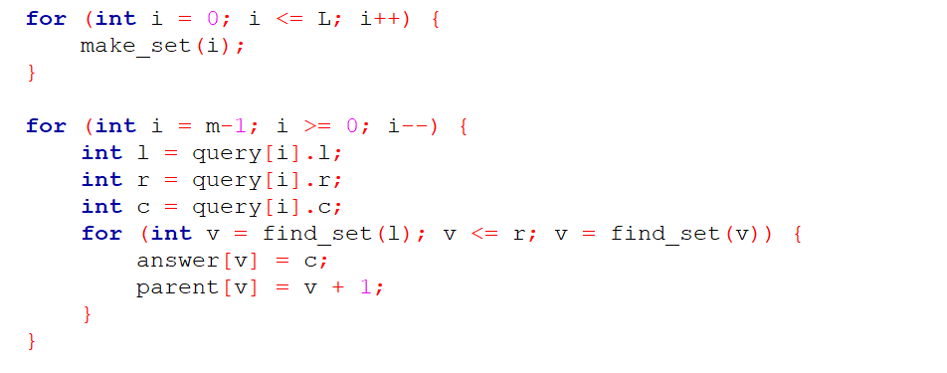
4.4.1) painting subarrays

Slide 31
4.5) support distances
We can use DSU to count the total distances of a vertex to its representation (i.e. the path length in the tree from the current node to the root of the tree).
If we don't use path compression, the distance is just the number of recursive calls. But this will be inefficient.
However it is possible to do path compression, if we store the distance to the parent as additional information for each node.

Slide 32
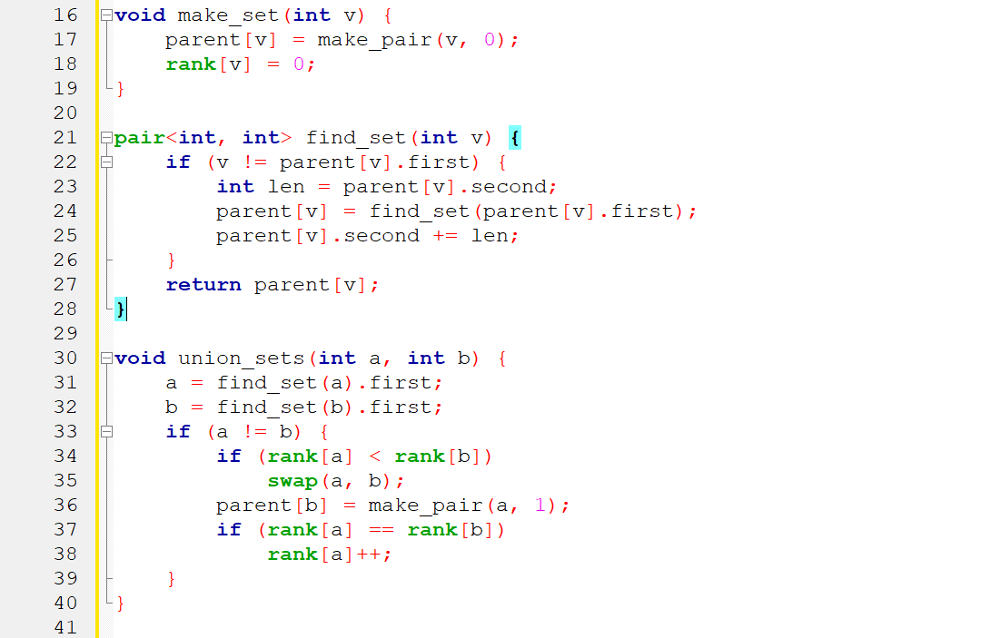

Slide 33
4.6) Offline RMQ (range minimum query)
We are given an array a[] and we have to compute some minima in given segments of the array.
To solve this with DSU, iterate over the array and for each ith element, answer all queries (L, R) where R equals i. Maintain a DSU for the first i elements where each element's parent is the next smaller element to its right. The answer to a query is then a[find_set(L)], the smallest number to the right of L.

Slide 34
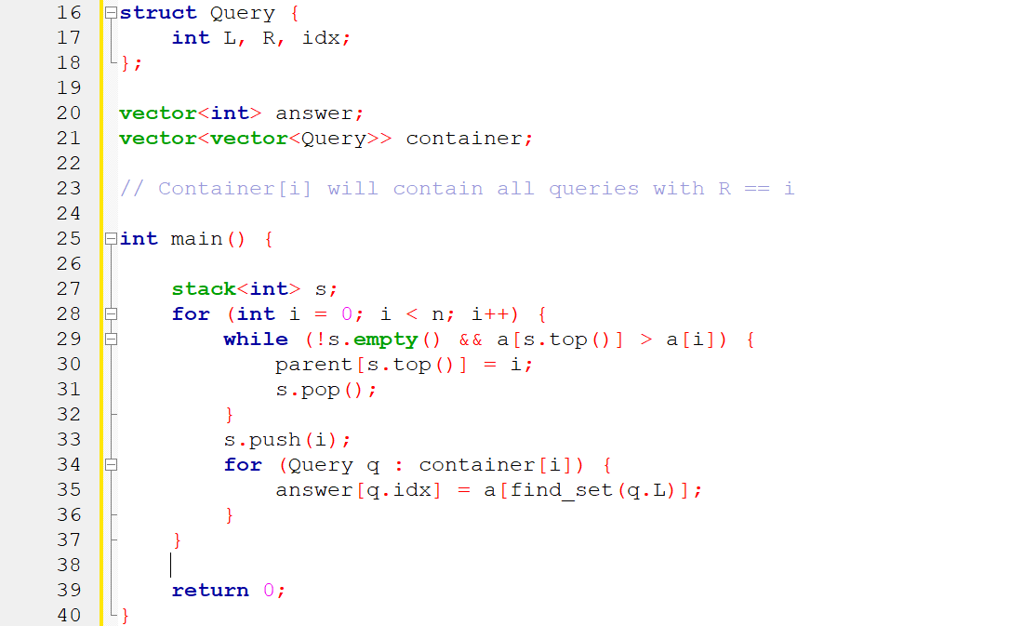

Slide 35
4.7) Storing the DSU in a set list
One alternative way to store a DSU is to explicitly store each set as a list of its elements, with each element also referencing its set's representative.
At first, this seems inefficient: merging two sets requires appending one list to another and updating the representative for each element in one list.
However, using a weighting heuristic (similar to Union by size) can reduce the complexity to O(m + nlogn) for m queries on n elements.

Slide 36
4.8) Storing the DSU in a Clear tree
One powerful application of DSU (Disjoint Set Union) is its ability to store trees in both compressed and uncompressed forms. The compressed form is useful for merging trees and checking if two vertices are in the same tree. The uncompressed form is useful for tasks like finding paths between two vertices or other tree traversals.

Slide 37
4.9.1) Support the parity of the path length / Checking bipartiteness online
For example, you receive a problem. You are asked to connect two vertices u and v together, and then asked whether the connected component containing these two vertices can be colored with two different colors such that any two vertices connected by an edge always have different colors.

Slide 38
4.9.1) Support the parity of the path length / Checking bipartiteness online
To solve this problem, I will manage the parity of the path lengths between any pair of vertices. This is because when the vertices form an odd cycle, it is always impossible to color them properly

Slide 39
4.9.2) Support the parity of the path length / Checking bipartiteness online
I will apply DSU to this problem by maintaining an additional variable for each vertex to indicate whether the path from that vertex to the representative vertex is even or odd.
Then, I can determine the parity of the path between any two vertices (imagine it like the paths from the two vertices going up to the LCA of the tree).
Follow the code to understand better

Slide 40
Root
0
1
1
0
0
1

Slide 41
Root
0
1
1
0
0
1

Slide 42
Root
0
1
1
0
0
1

Slide 43
Root
0
1
1
0
0
1

Slide 44
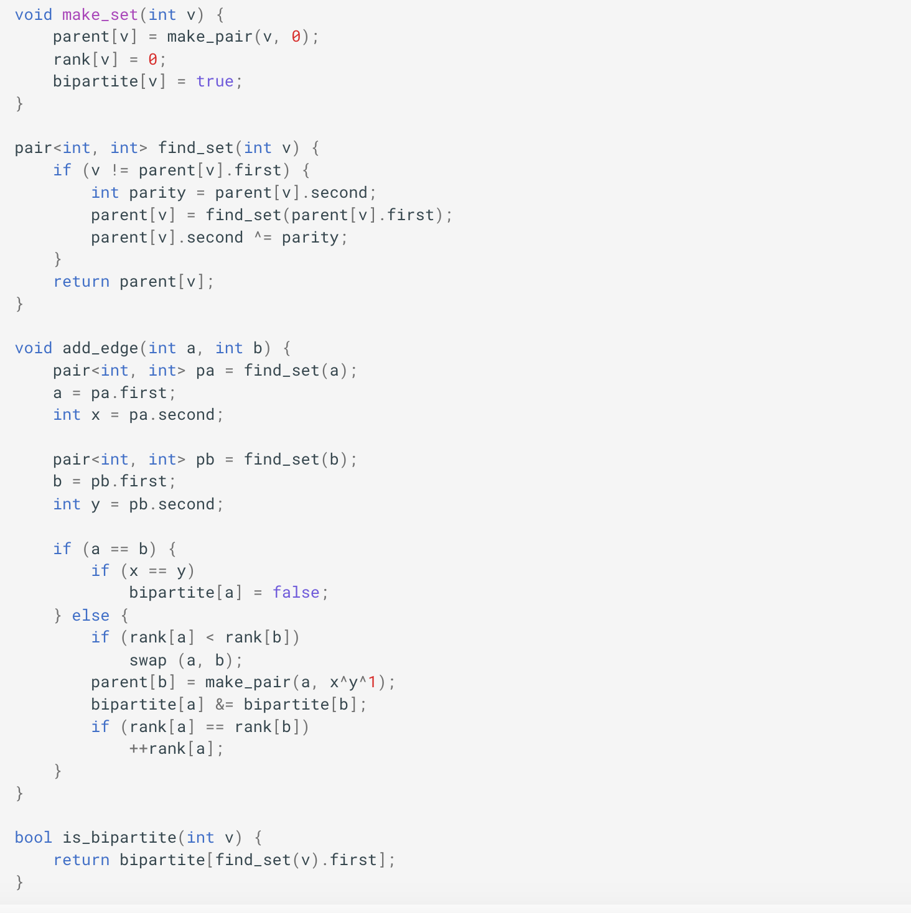
4.9.3) code

Slide 45
4.10.1) Offline LCA
You need to answer queries about finding the LCA of any two vertices u and v regardless of the order of the questions. This is the optimal solution for you as the complexity for each query approaches O(1).
To solve this problem,for the representative vertices, maintain an ancestor variable to know the vertex with the lowest rank that the same connected component with it when performing DSU.
I traverse using DFS according to Tarjan's algorithm. When visiting a vertex, mark it as visited and union_sets itself with its child vertices.
Finally, check if the queries contain it. If the other vertex has been visited, then the LCA is ancestor[find_set[v]]

Slide 46
Root
4
1

Slide 47
Root
4
1

Slide 48
Root
4
1

Slide 49
Root
7
6
3
4
2
1

Slide 50
Root
7
6
3
4
2
1

Slide 51
Root
7
6
3
4
2
1

Slide 52
Root
7
6
3
4
2
1

Slide 53
Query: 2 4, 2 6
Root
7
6
3
4
2
1

Slide 54
Root
7
6
3
4
2
1

Slide 55
Root
7
6
9
3
4
8
2
1

Slide 56
Root
7
6
9
3
4
8
2
1

Slide 57
Query: 1 8, 1 2, 1 3
Root
7
6
9
3
4
8
2
1

Slide 58
Root
7
6
9
3
4
8
2
1

Slide 59
Root
7
6
9
3
4
8
2
1

Slide 60
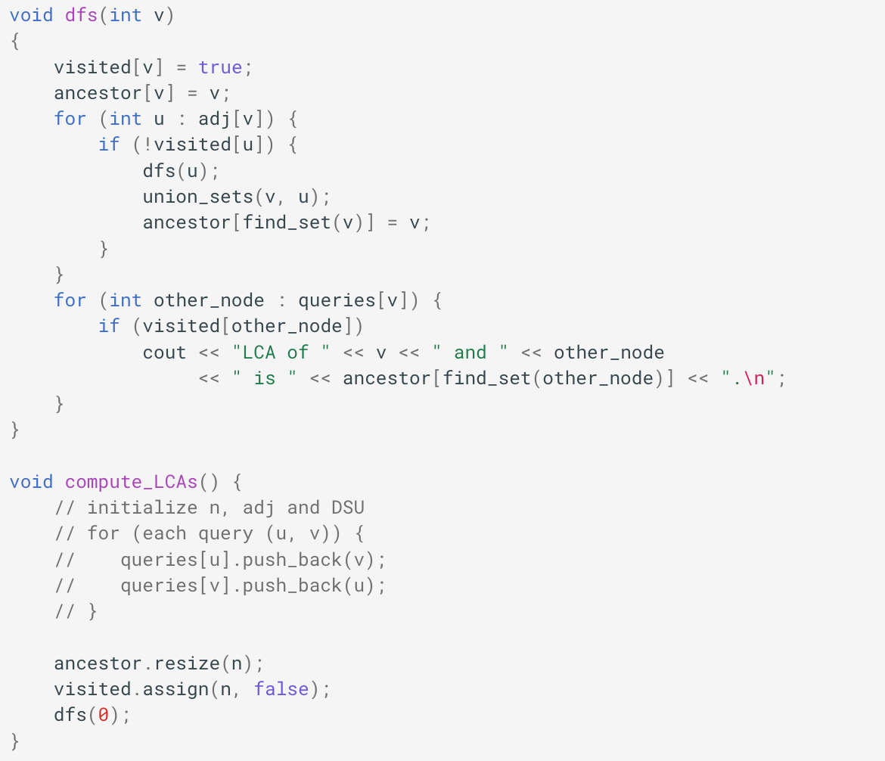
4.10.2) code

Slide 61
Application in TST 2023 - problem 1
You are given a tree with n vertices and weighted edges. A limited number c is also given.
You are asked to answer the following query: For a vertex u, how many vertices v are there such that the weight of the minimum edge between u and v is less than or equal to c?
How can this query be answered in O(log n) time?

Slide 62
Application in TST 2023 - problem 1
Let's discuss the concept of a DSU tree. I will construct a complete binary tree where the leaf nodes are the vertices of the original tree, and the remaining nodes represent the edge weights of the original tree. We need to ensure that every descendant v of u (except the leaves) satisfies v greater than or equal to u.
From this tree, the smallest weight on the path from u to v will be the LCA of the two leaf nodes u and v.
To construct this tree, I will apply DSU in the following way: (edit video animation).

Slide 63
Video link: DSU - Seminar - Bài thuyết trình (canva.com)
Slide: 63

Slide 64
QnA
Session 1

Slide 65
Quiz 1
What is the primary purpose of the Disjoint Set Union (DSU) data structure?
A) To perform fast addition of elements to a set
B) To quickly find and merge disjoint sets
C) To sort elements in a set
D) To search for an element in a sorted array

Slide 66
b) To quickly find and merge disjoint sets

Slide 67
Quiz 2
Which technique is used in DSU to keep the tree flat and optimize the union operation?
A) Path compression
B) Depth-first search
C) Breadth-first search
D) Binary search

Slide 68
a) pATH COMPRESSION

Slide 69
Quiz 3
In the union by size heuristic, when joining two sets, which set is merged into which?
A) The larger set is merged into the smaller set
B) The sets are always of equal size
C) The smaller set is merged into the larger set
D) The sets are merged based on alphabetical order

Slide 70
C) The smaller set is merged into the larger set

Slide 71
QnA
Session 2

Slide 72
Quiz 1
In the set union technique, when performing the union operation in the disjoint set union (DSU) problem, if we ignore the condition of merging the smaller set into the larger set, what is the time complexity in the worst-case scenario? What is an example of such a case?

Slide 73
Quiz 1 - Answer
The worst-case scenario is a path tree.
Worst-case time complexity: O((n*(n - 1))/2*log(n)).

Slide 74
Quiz 2
Describe the idea to solve the following problem:
Given a tree with n vertices, you receive q queries. For the i-th query, you are given two vertices u and v that are always directly connected by an edge, and you remove that edge from the tree. After this operation, what is the size of the largest connected component?

Slide 75
Quiz 2 - answer
We will review the queries from the end to the beginning, and perform the join_set of the two edge pairs u v of i - 1 to update the answer for i, and only need to use one variable to manage the largest size of the connected components. (Note that you must join_set the edges that are not in the previous queries).

Slide 76
Quiz 3
Describe the idea to solve the following problem:
You are given a tree with n vertices where each vertex u has a color color[u]. For q queries, each query i asks for the number of distinct colors in the subtree rooted at vertex u.

Slide 77
Quiz 3 - answer
Using the set union technique, each set of connected components stores a set of different colors. When joining two sets, the smaller set is merged into the larger set.

Slide 78
Thank
You
- apcs k23 -

