Slide 1

INTERNATIONAL UNIVERSITY
VIETNAM NATIONAL UNIVERSITY OF HO CHI MINH CITY
PROJECT PRESENTATION
Splat Editor:
A Viewer and Editor for
3D Gaussian Splatting Scenes
LE ANH KIET ITCSIU24047
Contacts: itcsiu24047@student.hcmiu.edu.vn
1

Slide 2
Contents
0. Introduction
1. Transformation & Hierarchy
2.Camera and Projection
3. Texture
4. Lighting & Shadows
5. Animation
6. GUI
7. Conclusion
2

Slide 3



Introduction
3D Gaussian Splatting (3DGS) shows a 3D scene with millions of soft ellipsoids, called gaussians. The scene is trained from photos taken around an object.
The resulting .ply file always has floating gaussians, so we need a program to view and clean it. I wrote Splat Editor in Python and OpenGL 3.3.
COLMAP
(point cloud)
Train the
3DGS model
.ply
file
Splat Editor
Train the
3DGS Model
Photos around
the object
My interest topic research
Computer Graphic’s Project
3

Slide 4

Program structure and technique groups
SplatOpenGL/
|-- main.py # python main.py [scene.ply]
|-- requirements.txt # numpy, PyOpenGL, glfw, imgui-bundle
|-- report/ # LaTeX report
`-- splat_editor/
|-- app.py # main loop, ties all together
|-- core/ # data and math, no OpenGL
| |-- splats.py, layer.py, scene.py
| |-- math3d.py # V, P, Euler, quaternions
| |-- lighting.py # sun, lamps, day-night
| |-- physics.py # voxel collision, jumping
| |-- avatar_pose.py # character joint angles
| |-- lod.py # level-of-detail
| `-- history.py # undo
|-- io/ # ply.py, codec.py
|-- editor/ # editor.py, brush.py
|-- render/ # OpenGL
| |-- splat_renderer.py # 2 passes
| |-- sorter.py # depth sort (thread)
| |-- camera.py # orbit / fly camera
| |-- avatar_renderer.py, shader.py
| |-- shaders/ # splat_prep.vert, ...
| `-- textures/ # skinzom.png
`-- ui/ # window.py, input.py, sections.py
Group | Main content
T1 | layers, matrix M, character skeleton
T2 | view/projection matrices, EWA, blending, cameras
T3 | character skin texture
T4 | SH colour, Phong, shadow map
T5 | day–night, collision, character animation
T6 | selection brush, delete/undo, ImGui, HUD
core holds only data and math. render holds all OpenGL calls and shaders. ui builds the interface; app.py ties the parts together.
4

Slide 5
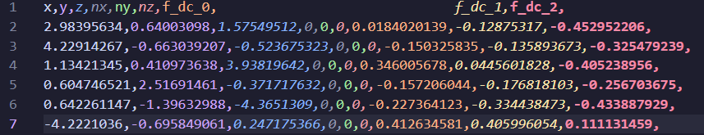
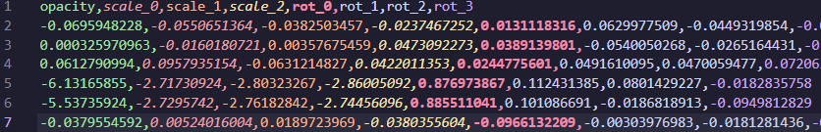
Input data: the PLY file
Training starts from the COLMAP point cloud, one gaussian per point. It repeats: render, compare with the photo, update every gaussian; useless gaussians are removed and large ones split.
Ảnh 1: Ví dụ về thông tin về vị trí, màu sắc , độ mờ, hướng của 6 Gaussian
5

Slide 6
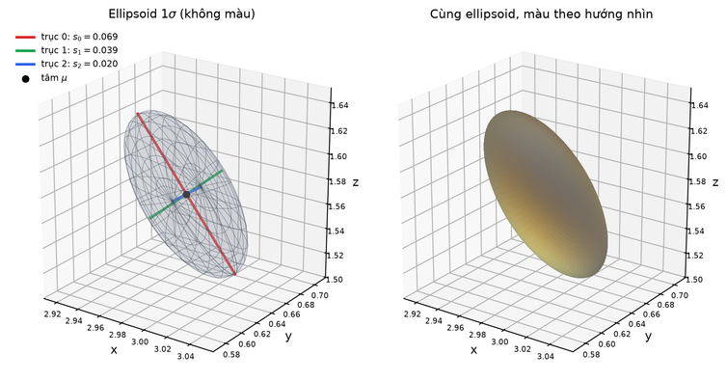
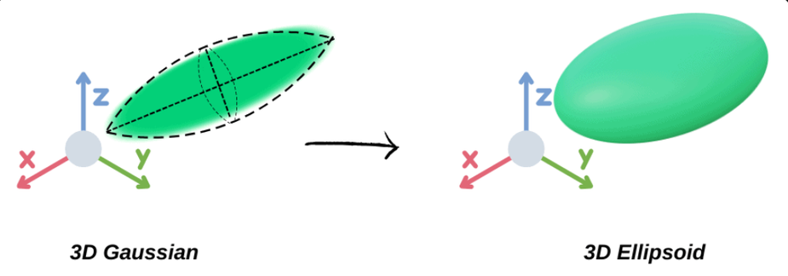
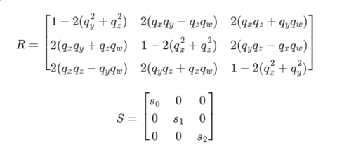

Gaussians and the covariance matrix
A 3D gaussian is a soft blob; its 1σ surface is an ellipsoid.
6

Slide 7
T1 – Transformations and hierarchical models
Part 1: Layer transformation
Each .ply file is a layer. A translation t, three Euler angles and a scale s form the matrix M (file space → world space):
A = RzRyRxF, with F = diag(−1,−1,1) an optional flip for COLMAP files. The gaussian data does not change, only M, so moving, rotating or scaling a layer is instant. On save, the transform is written into every gaussian and the SH coefficients are rotated.
Part 2: Rotation about a point
A layer rotates about a point c with a matrix Δ:
7

Slide 8
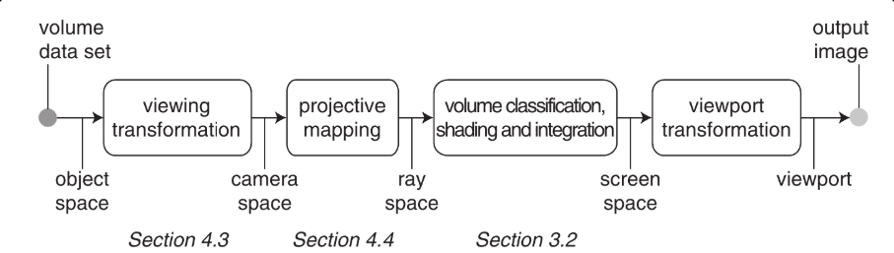
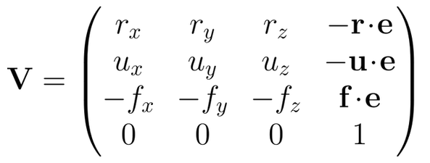
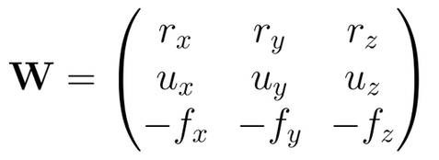
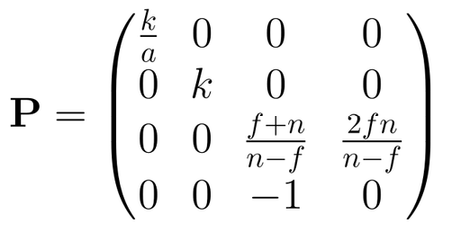
T2 – Viewing transformation and projection matrix
Part 1, viewing transformation: object → camera space.
Part 2, projective mapping: 3D ellipsoid → 2D ellipse.
Part 3, shading and integration: opacity, blending.
Part 4, viewport transformation: to the window.
Part 5, three cameras: input of part 1.
EWA splatting pipeline: viewing W, projective mapping J.
View matrix V
Rotation block W
Perspective matrix P
look_at builds right r, up u, forward f from the eye e and the target. The camera is at the origin, looking along −z.
Centre × V gives (vx, vy, vz). The shape is only rotated: the top-left 3×3 block W, so the ellipsoid is W Σ Wᵀ.
Vertical fov φ, k = 1/tan(φ/2), aspect a, near n, far f. Point × P, ÷ cw: far objects look smaller.
8

Slide 9
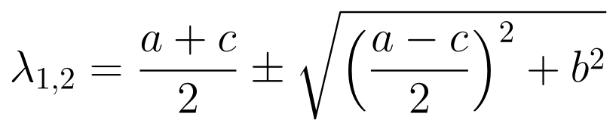
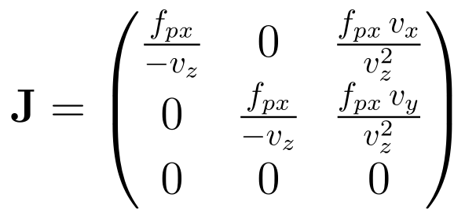

T2 – Projective mapping (EWA)
A gaussian is not a point: its ellipsoid must become an ellipse. The division by cw is not linear, so EWA replaces the projection by its derivative (Jacobian) at the gaussian centre, with fpx = kH/2 the focal length in pixels:
Let the top-left 2×2 block of Σ′ be [[a, b],[b, c]]. Its eigenvalues:
The semi-axes of the ellipse are proportional to √λ₁ and √λ₂. The shader draws each gaussian as a quad covering at most 3σ and drops gaussians behind the camera or more than 1.3× outside the screen.
Joining step 1 and step 2, the 2D covariance is
9

Slide 10
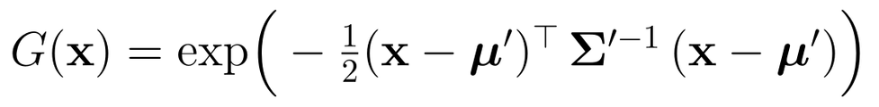

T2 – Shading, blending, viewport and cameras
Part 3: Shading and alpha blending
Part 4: Viewport transformation
The fragment shader evaluates the 2D gaussian at each pixel x of the quad; opacity of gaussian i is ai = αi Gi(x):
OpenGL does this itself; the program also uses it for brush selection.
Part 5: Three cameras
Blended colour, Ti = transmittance (light left after the gaussians nearer than i):
Orbit. Looks at t; yaw θ, pitch φ (≈ ±89°), distance d:
Drawn far to near, the same result is the blend
Fly. Velocity eases to the wanted v* (inertia):
The order matters, so depth is sorted (16-bit keys, NumPy, background thread; the previous order is used until done). Depth test is off so a transparent gaussian never hides those behind it.
Third person. A ray from the eye to the camera in the voxel map: on a wall hit the camera pulls in at once, then moves back gradually.
10

Slide 11

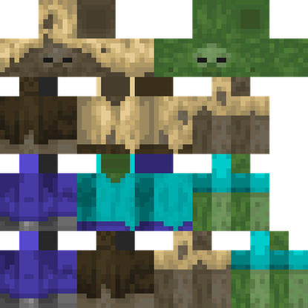
T3 – Texture mapping
A texture paints the six-box character with a 64×64 skin that holds the unfolded faces of all boxes (Minecraft cross layout). Each face takes its own cell.
1) Load image
load_png, GL_NEAREST
2) Build boxes
vertices + UV per face
3) Draw
sample, discard
1) Build the box. Centre c, size (w,h,d), inflation δ: each corner is p = c + (sx(w/2+δ), sy(h/2+δ), sz(d/2+δ)), s ∈ {±1}. Built twice: base (δ=0) and overlay (δ=0.25 body/limbs, 0.5 hat), so the overlay does not stick to the base.
+Y
−Y
+X
front
+Z
−X
back
−Z
2) Pick the cell. A box has origin (ox,oy). Example: head origin (0,0), w=h=d=8, front face = cell (8,8,8,8). A cell (rx,ry,rw,rh) gives:
(ox, oy) = top-left; widths d, w, d, w; height h
64×64 skin
Face +Z: cell (ox+d, oy+d, w, h). Face +Y: cell (ox+d, oy, w, d). Corners 1–4 of each face get (k,l) in the UV formula.
3) Draw. GL_NEAREST keeps pixels sharp; α < 0.5 is discarded; colour = texel × (0.62 + 0.38 max(n·l, 0)). Each box has its own model matrix.
11

Slide 12

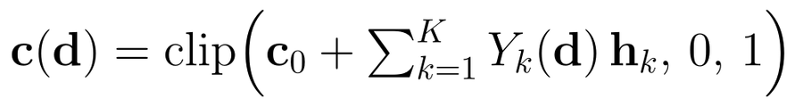
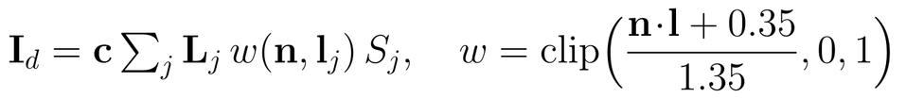
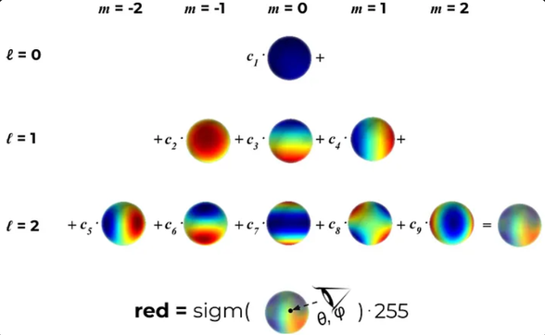


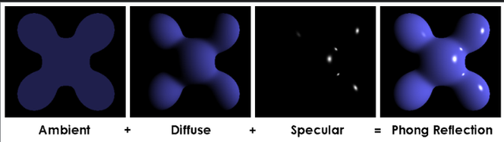
T4 – View-dependent colour and Phong lighting
Part 1: View-dependent colour
Part 2: Phong lighting
The colour changes with the view direction d. 3DGS stores it with spherical harmonics (SH):
Per gaussian. Normal n = shortest ellipsoid axis, flipped to the camera.
Ambient
Diffuse (w = softened n·l, Sj = shadow / falloff)
c₀ is the base colour, hk the file coefficients, Yk the basis functions. The shader rotates the view direction into file space: d = norm(Aᵀ(pw − e)).
Specular (ks strength, m shininess)
Sum
SH up to degree 2: nine basis functions weighted by c₁..c₉.
Phong: one sun, up to 8 point lights.
12

Slide 13
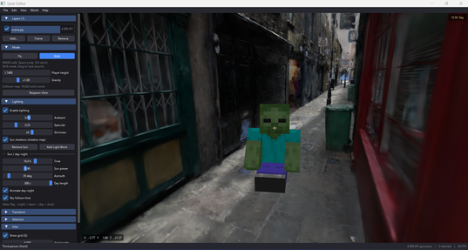
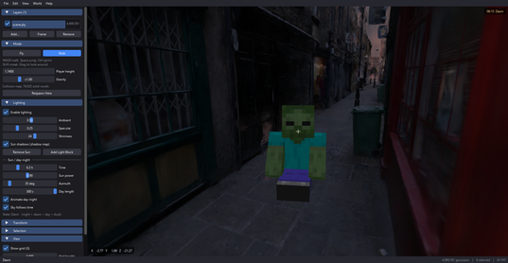
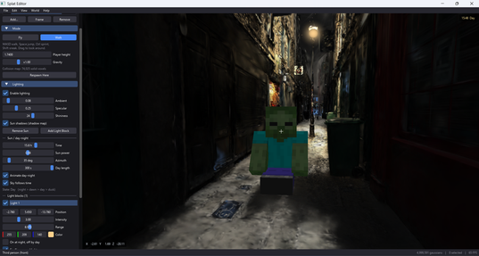
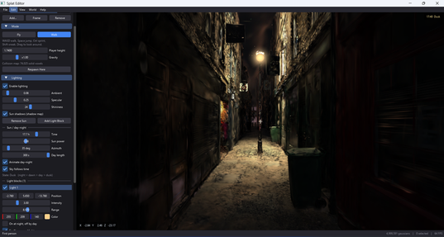
T4 – The sun and shadows
Part 3: The sun
The sun direction is computed from the hour h. It rises at 6, is highest at 12 and sets at 18. Sky colour and ambient light change gradually between day and night, slightly orange at dusk.
(a) Day, 15:59
(b) Dawn, 06:15
Part 4: Shadows
The centres of solid gaussians are drawn into a 2048² depth map seen from the sun. Each gaussian is projected into the map and its depth compared; if something is closer to the sun, it is in shadow. A 3×3 average softens the edge (PCF):
(c) Ambient 0.08 and a lamp
(d) Dusk, 17:40
(us,vs,zs): coordinates in the map, Ds: stored depth, τ: texel step, b: bias (stops self-shadowing).
13

Slide 14

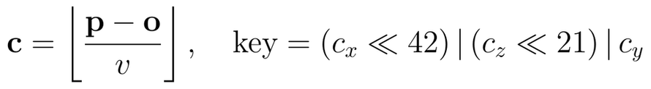

T5 – Animation and simulation
Every motion is multiplied by the frame time Δt, so speed depends little on the machine.
Part 1: Day–night cycle
Part 2: Voxel collision
4 states: NIGHT → DAWN → DAY → DUSK, starting at hours 5, 7, 17, 19. One day = 36 s, Δh = 24Δt/Tday. Lights set to “on at night” turn on at dusk.
Space is divided into voxels of edge v; a voxel with enough gaussians is solid, stored as one 64-bit key. Keys are sorted; ground search = one np.searchsorted.
Daylight D = smoothstep(−0.08, 0.3, sy); ambient & sky mix by D.
Part 3: The player
A cylinder: slides at walls, climbs low steps, jumps. All sizes scale with height H: v = H/8, radius 0.14H, g = 12H, walk 2.5H/s. Euler steps:
Jump height 0.75H; eye height smoothed on ground.
14

Slide 15
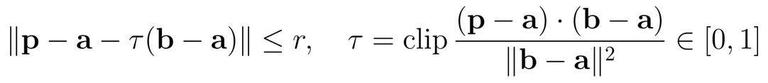
T6 – Interaction and GUI
Part 1: Brush selection
Press B and paint to select (yellow). Each centre is projected to a pixel p. A stroke a→b is a capsule of radius r:
It tests only the centre, not depth, so it selects through the scene like SuperSplat. Blocks of 1024 gaussians are rejected by bounding box for speed.
15

Slide 16

Limitations and future work
Limitations
Future work
Speed depends on the CPU. Depth is sorted with NumPy in a background thread. When the camera turns fast the image can flicker, and large scenes must limit the number of drawn gaussians (LOD).
Approximate geometry. A gaussian has no real surface. Brush, collision, normals and shadows use gaussian centres, so the brush also selects hidden objects, collision can have holes and lighting is rough.
Support for simulation. Use the voxel map and physics to simulate motion in a real captured scene, e.g. the path of a person, a robot or a vehicle. Needs more accurate collision and moving objects.
Use in games. Turn a 3DGS scene into a game level: NPCs, items, quests, keep day–night and lights; export the cleaned scene to Unity or Unreal.
16

Slide 17
AI usage and conclusion
AI usage
Learning concepts: 3DGS, EWA, spherical harmonics, shadow maps (ChatGPT, Gemini).
Debugging and improving code.
I read, checked and tested everything suggested by AI, and I am responsible for all the code and for this report.
Conclusion
Splat Editor can read, display, edit and save 3DGS files, and uses all six technique groups of the course.
17

Slide 18
Thanks for Listening
18

