Slide 1
WELCOME TO BATTLE PERCENT 2.0

Slide 2
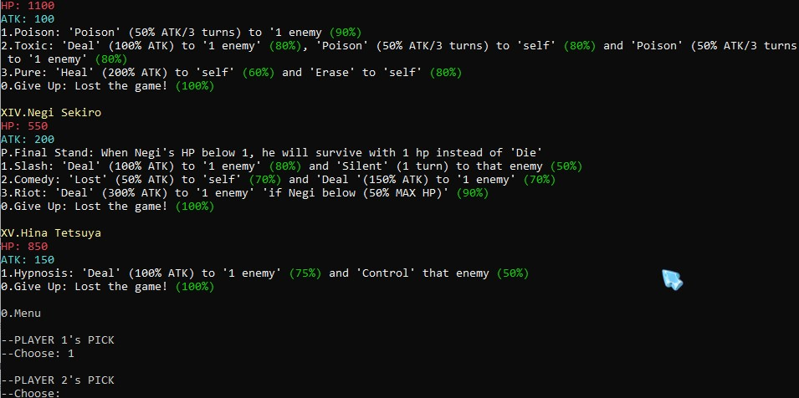
PICK CHARACTER

Slide 3
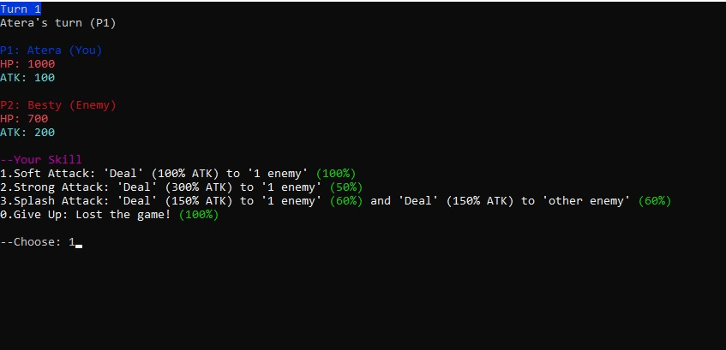
PLAY WITH FRIENDS

Slide 4
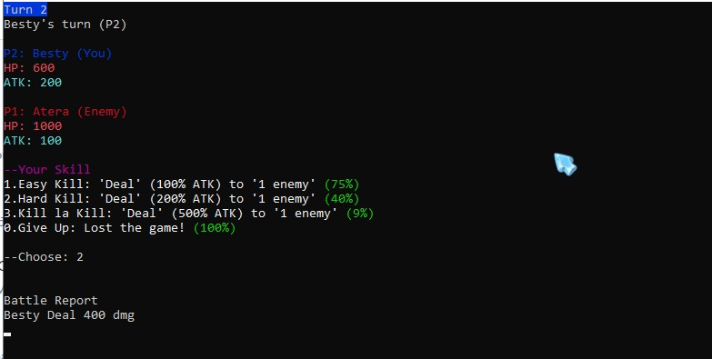
Using skill and luck

Slide 5
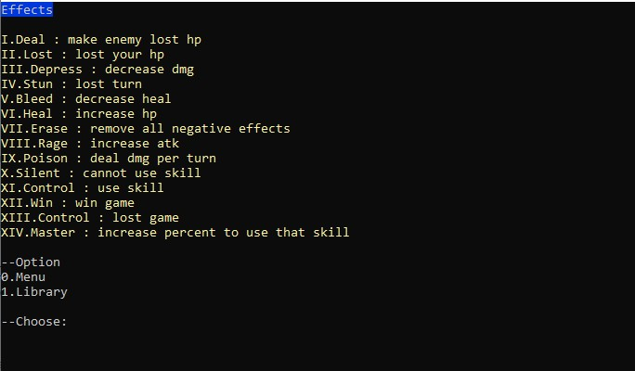
Many effects

Slide 6
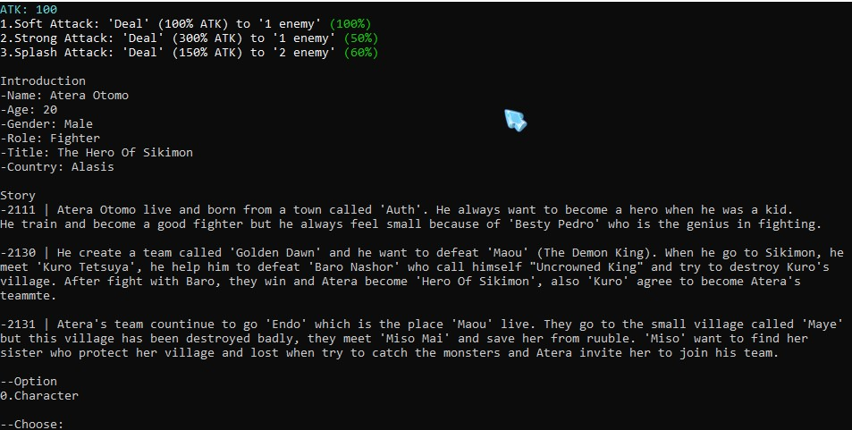
Story of characters

Slide 7
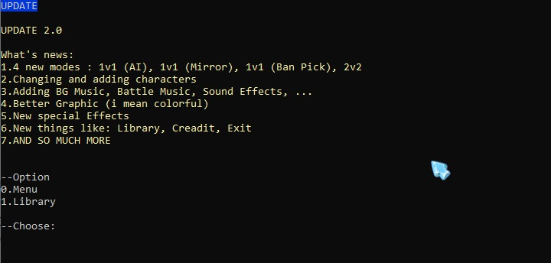
Biggest update

