Slide 1
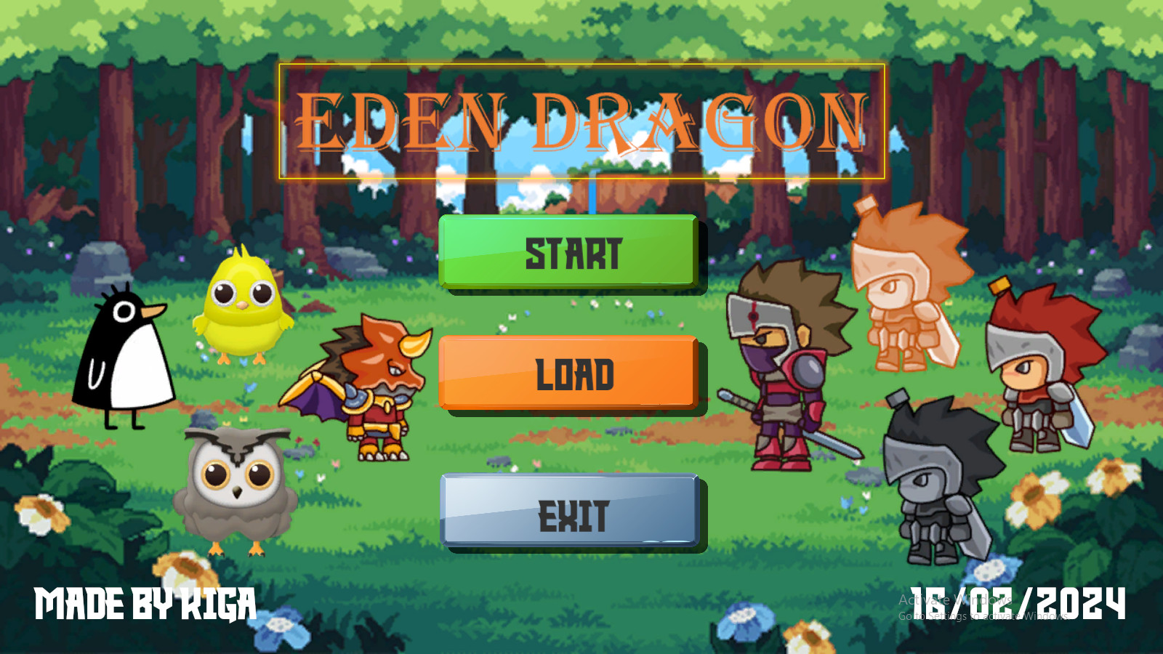

Slide 2
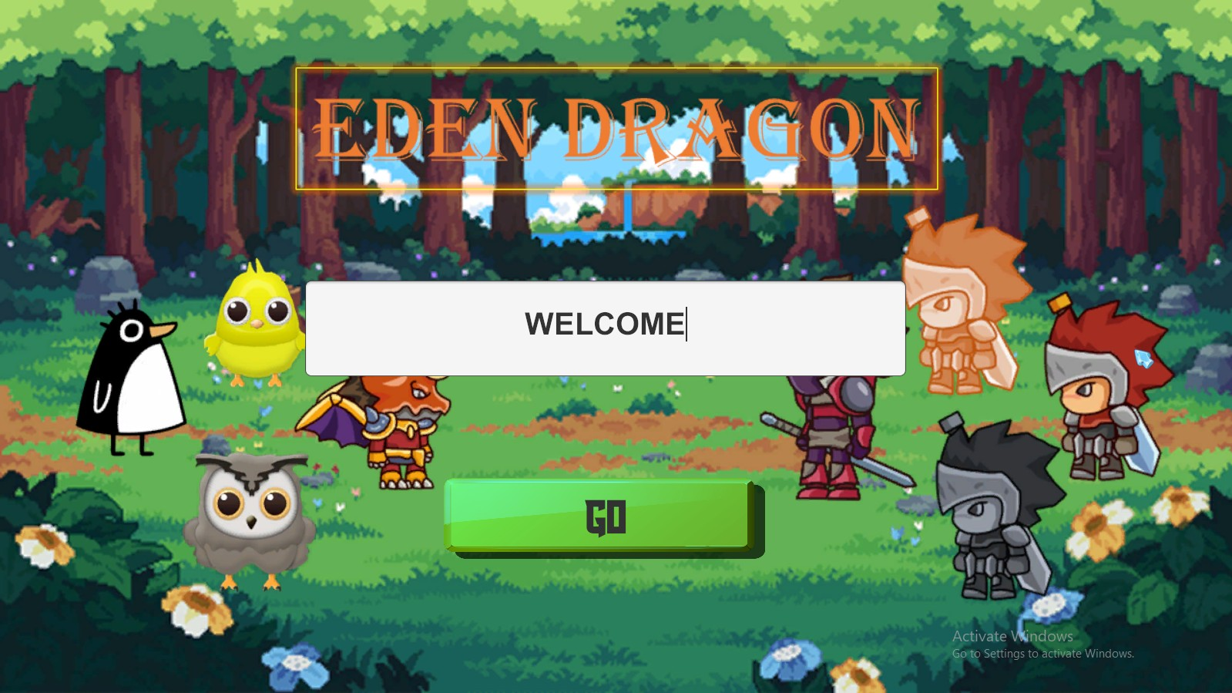

Slide 3
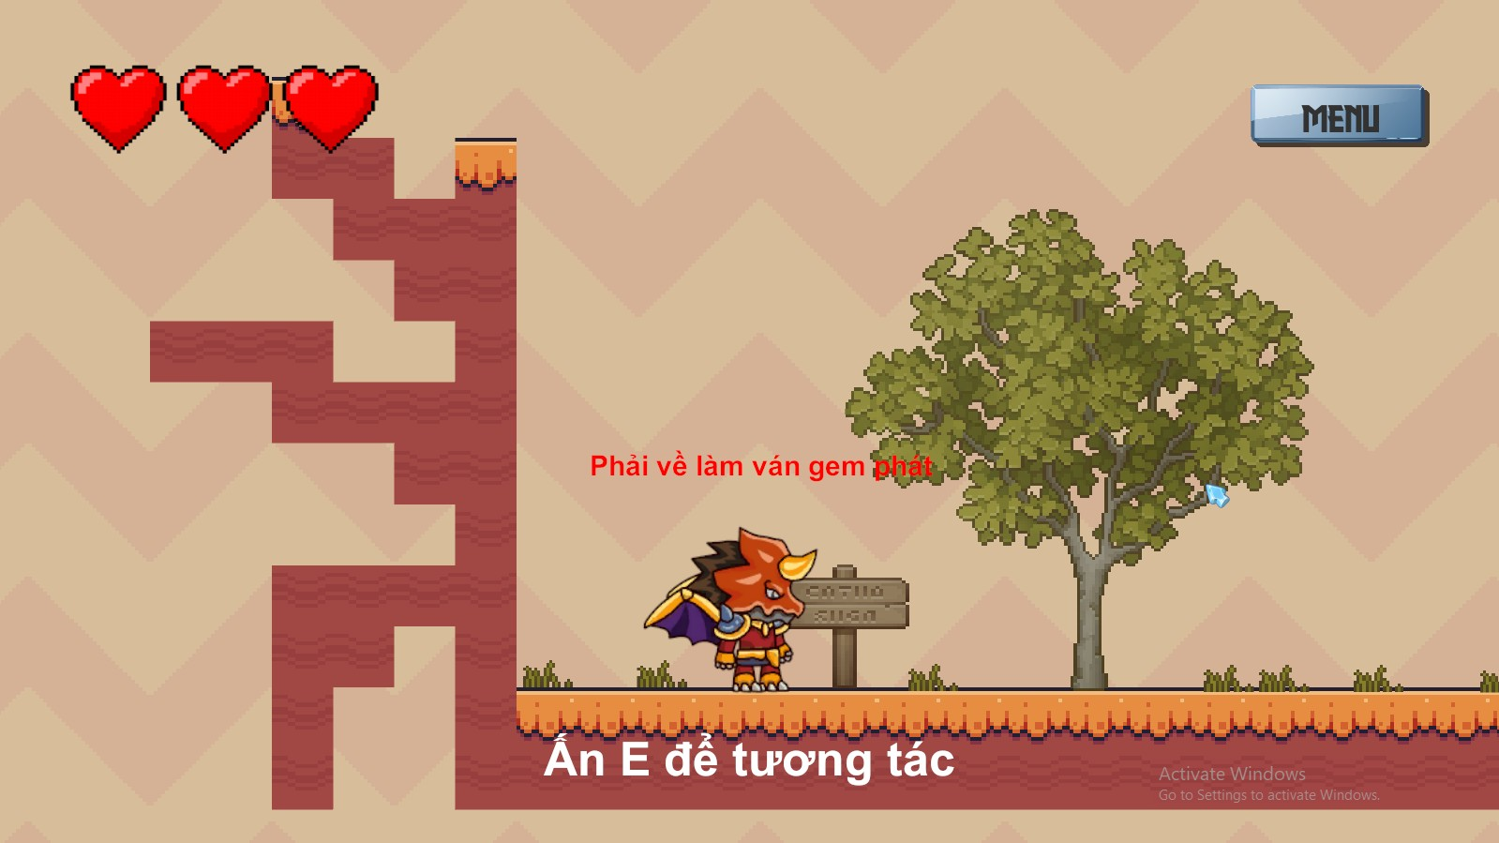
A NEW ADVENTURE

Slide 4
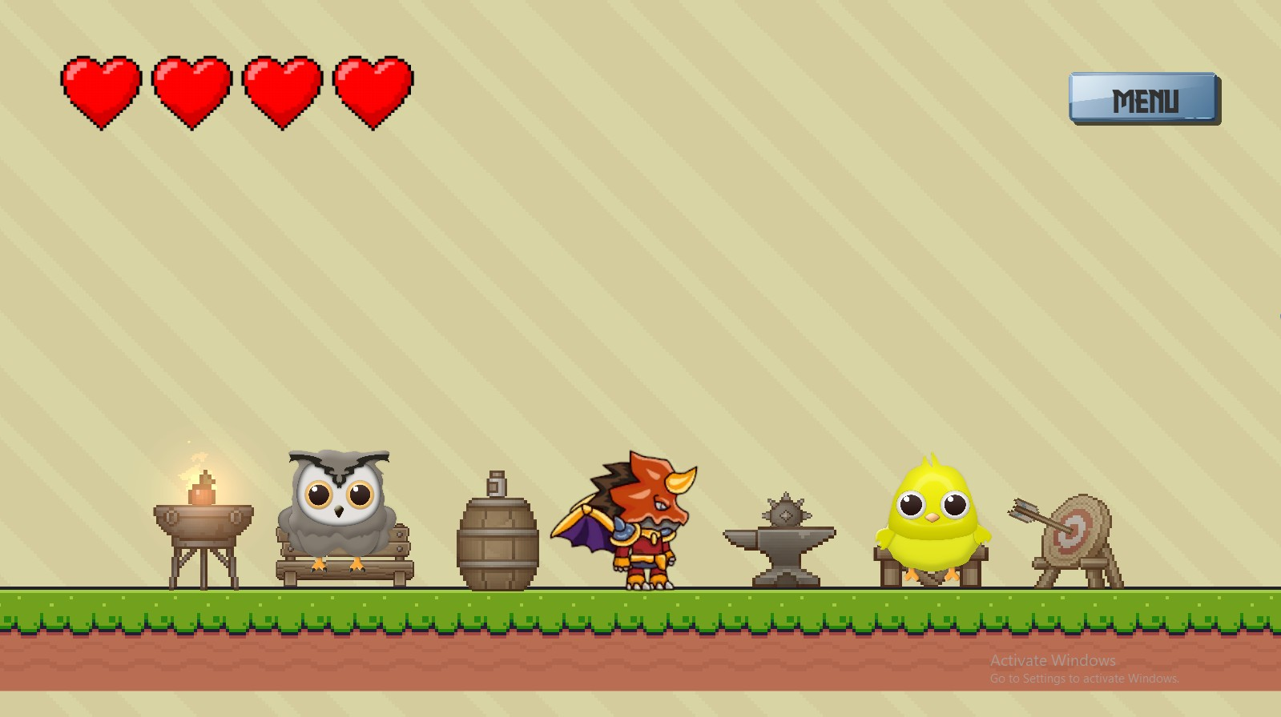
HAVE A REAL STORY

Slide 5
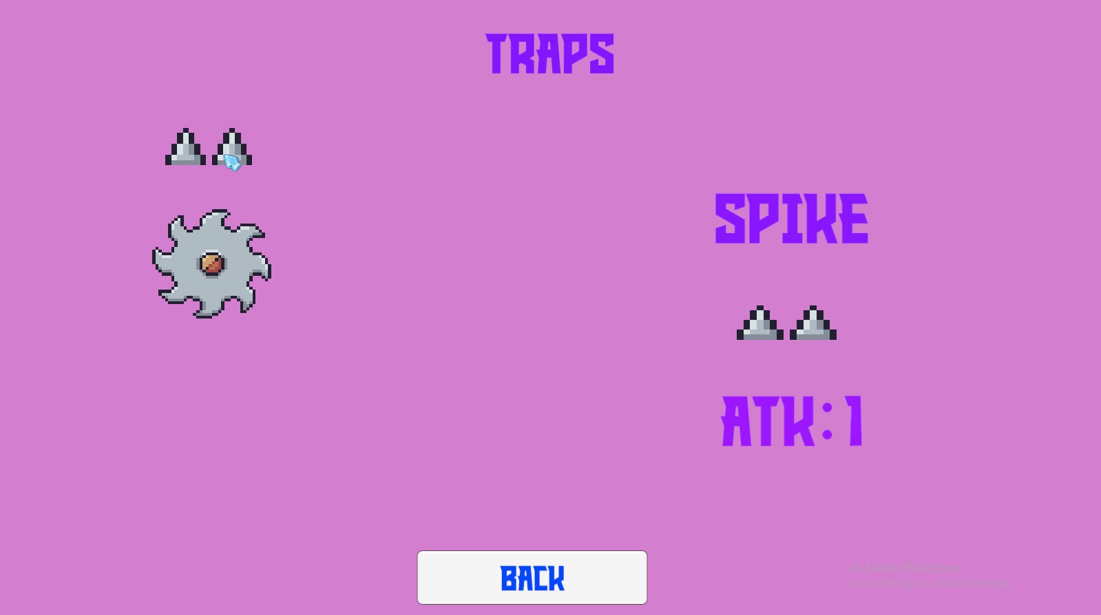
DIFFIRENT TRAPS&ENEMIES

Slide 6
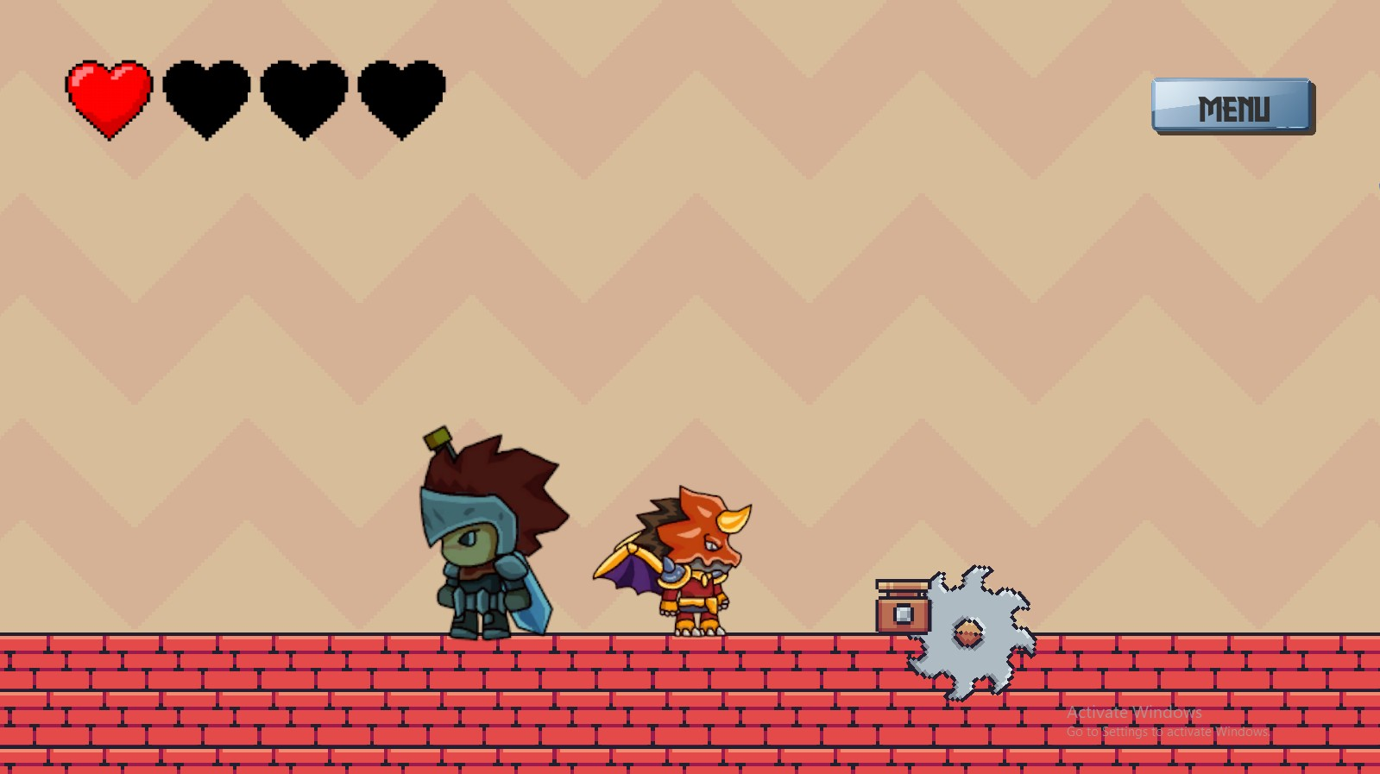
6 DIFFIRENT LEVELS

Slide 7
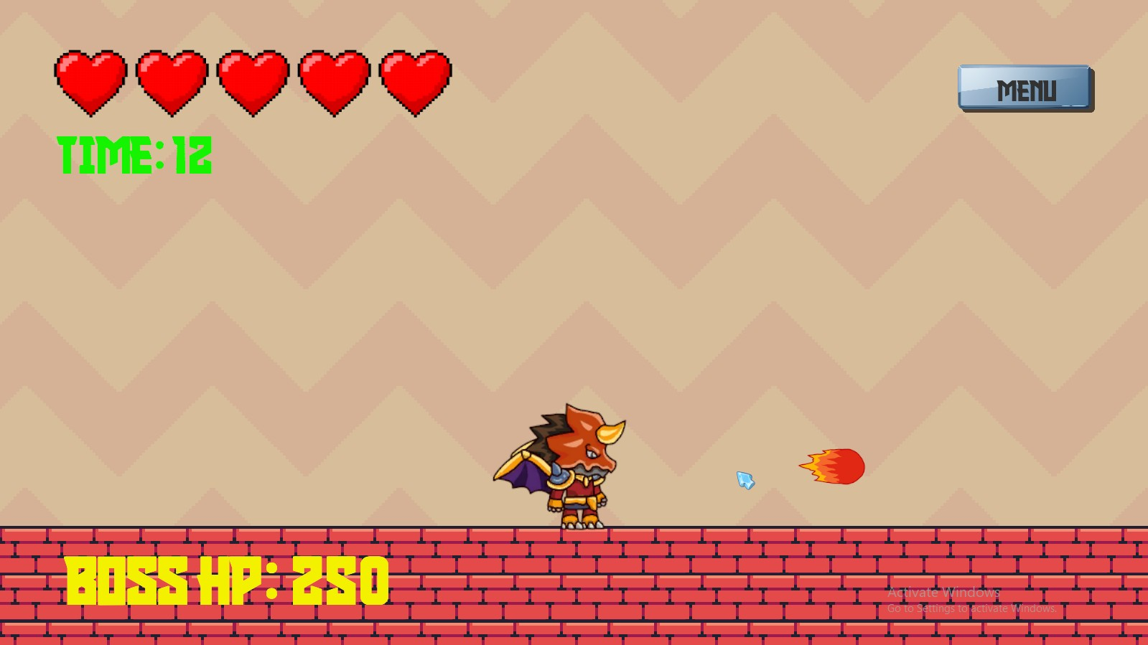
BOSS?!

Slide 8
