Slide 1


Slide 2
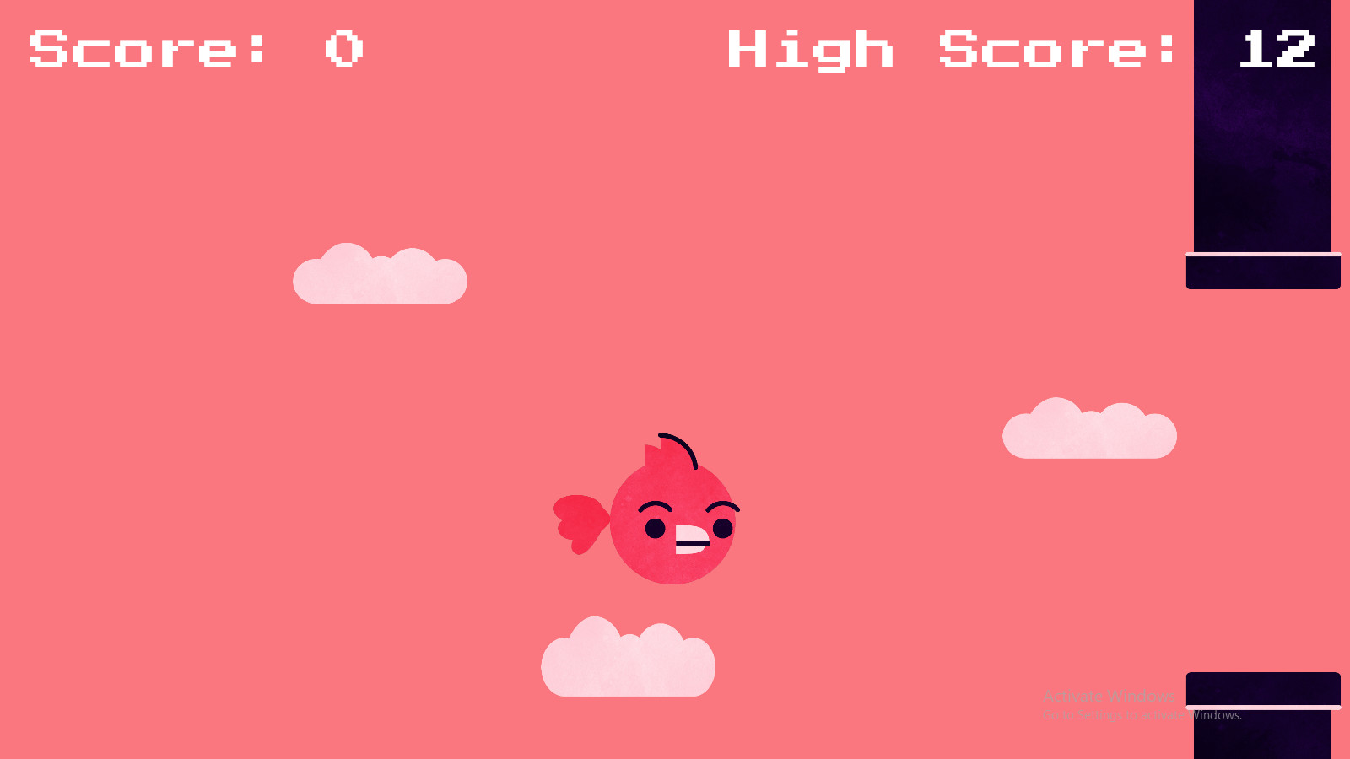
Easy To Play

Slide 3
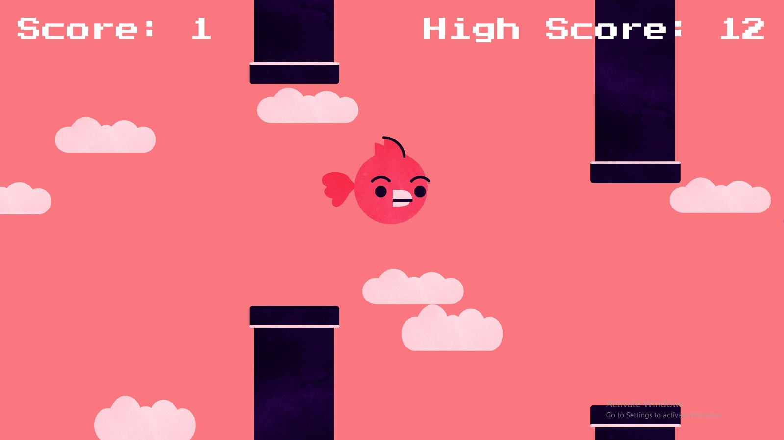
But Hard To Pass

Slide 4
