Slide 1




TONE-AWARE LORA ADAPTATION OF PHOWHISPER FOR NOISE-ROBUST VIETNAMESE ASR UNDER CONTROLLED ACOUSTIC NOISE
Nguyen Xuan Trung | SE193716
Trinh Vy Kiet | SE192636
Nguyen Thanh Phat | SE192617
Pham Hoang Phuc | SE192874

Slide 2


01
Motivation & Problem Statement
02
TABLE OF CONTENTS
03
Research Gap & Question
Proposed Method
04
05
Dataset & Evaluation
Midterm Results & Next Steps

Slide 3
MOTIVATION & PROBLEM STATEMENT
Vietnamese ASR must preserve both words and tones.
Real-world noise weakens tone-related acoustic cues.
WER/CER cannot isolate tone, diacritic, and final-coda errors.
Problem: How can we adapt PhoWhisper to noisy Vietnamese speech while preserving tonal correctness?
Hypothesis: explicit tone supervision can improve Vietnamese-specific robustness under noise.
Refs: Radford et al. 2023; Le et al. 2024; Kirby 2010

Slide 4


RESEARCH GAP & QUESTION
Model Gap
Evaluation Gap
Benchmark Gap
Strong ASR models, but no explicit tone objective.
WER/CER miss Vietnamese-specific errors.
Limited controlled noisy-ASR analysis.
Research Question
Does explicit tone supervision improve Vietnamese ASR robustness under controlled acoustic noise beyond ordinary noisy LoRA fine-tuning?
Direction: PhoWhisper + LoRA + decoder-side tone head + Vietnamese-specific metrics.
Refs: Radford’23; Le’24; Hu’21; Snyder’15; Conneau’22

Slide 5


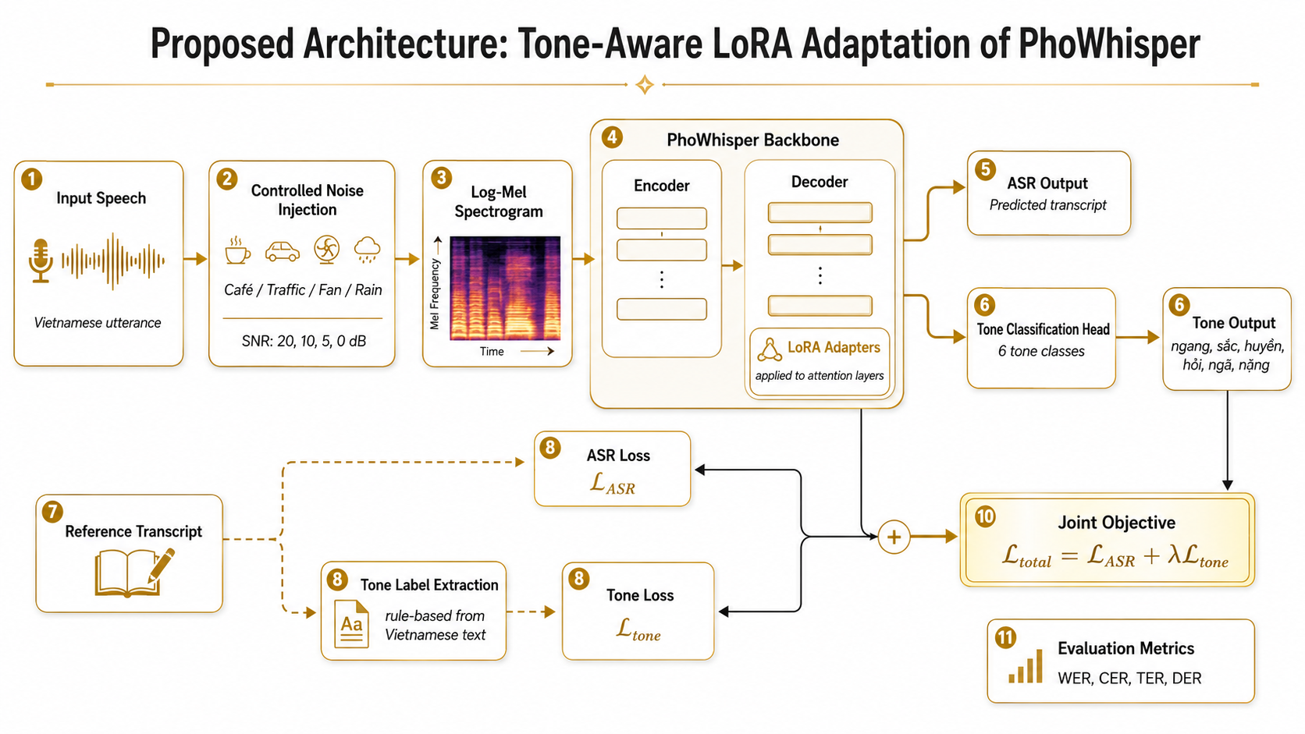


PROPOSED METHOD

Slide 6




DATASET & EVALUATION
Data & Model Sources
Noise Benchmark
S
T
VIVOS
MUSAN
VIVOS test mixed with MUSAN noise
SNR: 20 / 10 / 5 / 0 dB
50 utt/SNR generated, 30 utt/SNR evaluated
Vietnamese clean ASR speech
Noise for controlled SNR mixing
Evaluation Metrics
P
FLEURS Vietnamese
PhoWhisper-base
WER: Word Error Rate
CER: Character Error Rate
TER-simple: Tone Error Rate
DER-simple: Diacritic Error Rate
Lower is better
Optional external eval
fine-tuning base model
Refs: AILAB/VIVOS; Conneau et al. 2022; Snyder et al. 2015

Slide 7
MIDTERM RESULTS
DER-simple ↓ | TER-simple ↓ | CER ↓ | Condition | N | WER ↓
12.22% | 23.13% | 19.61% | Clean | 30 | 43.06%
10.82% | 25.98% | 23.55% | Noisy all | 120 | 47.95%
DER-simple ↓ | TER-simple ↓ | CER ↓ | SNR | N | WER ↓
10.17% | 21.00% | 20.02% | 20 dB | 30 | 43.42%
9.62% | 25.62% | 24.02% | 10 dB | 30 | 49.82%
11.24% | 25.62% | 22.39% | 5 dB | 30 | 45.55%
12.41% | 31.67% | 27.78% | 0 dB | 30 | 53.02%
Noise increases WER/CER compared with clean speech.
The hardest setting is 0 dB, with WER = 53.02% and CER = 27.78%.
Forced Vietnamese decoding gives only small gains, so the next step is LoRA fine-tuning and tone-aware MTL.
Baseline: Whisper-base + forced Vietnamese decoding

Slide 8

NEXT STEPS
5%
10%
15%
25%

Slide 9

THANK
You

Slide 10
REFERENCES
[1] A. Radford et al., “Robust Speech Recognition via Large-Scale Weak Supervision,” ICML, 2023.
[2] T. T. Le et al., “PhoWhisper: Automatic Speech Recognition for Vietnamese,” 2024.
[3] E. J. Hu et al., “LoRA: Low-Rank Adaptation of Large Language Models,” 2021.
[4] D. Snyder, G. Chen, and D. Povey, “MUSAN: A Music, Speech, and Noise Corpus,” 2015.
[5] A. Conneau et al., “FLEURS: Few-shot Learning Evaluation of Universal Representations of Speech,” 2022.
[6] AILAB, VNUHCM-University of Science, “VIVOS: Vietnamese Speech Corpus for ASR.”
[7] D. S. Park et al., “SpecAugment: A Simple Data Augmentation Method for Automatic Speech Recognition,” Interspeech, 2019.
[8] J. Kirby, “Dialect experience in Vietnamese tone perception,” JASA, 2010.
[9] AILAB, VNUHCM-University of Science, “VIVOS: Vietnamese Speech Corpus for ASR.”
[10] A. Conneau et al., “FLEURS: Few-shot Learning Evaluation of Universal Representations of Speech,” 2022.
[11] D. Snyder, G. Chen, and D. Povey, “MUSAN: A Music, Speech, and Noise Corpus,” 2015.
[12] L. Do et al., “VietSuperSpeech: A Large-Scale Vietnamese Conversational Speech Dataset,” 2026. Optional.

