Slide 1
Building Java Programs
Chapter 3
Lecture 3-1: Parameters
reading: 3.1

Slide 2
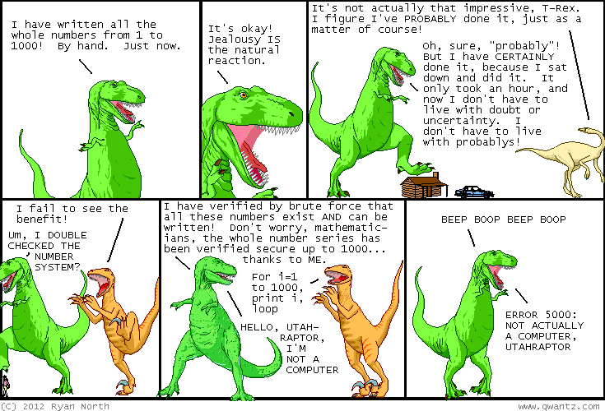
(I think this is a made up language like Visual Basic but not quite.)

Slide 3
Promoting reuse
Programmers build increasingly complex applications
  Enabled by existing building blocks, e.g. methods
The more general a building block, the easier to reuse
Abstraction: focusing on essential properties rather than implementation details
Algebra is all about abstraction
  Functions solve an entire class of similar problems

Slide 4
Redundant recipes
Recipe for baking 20 cookies:
  Mix the following ingredients in a bowl:
    4 cups flour
    1 cup butter
    1 cup sugar
    2 eggs
    40 oz. chocolate chips ...
  Place on sheet and Bake for about 10 minutes.
Recipe for baking 40 cookies:
  Mix the following ingredients in a bowl:
    8 cups flour
    2 cups butter
    2 cups sugar
    4 eggs
    80 oz. chocolate chips ...
  Place on sheet and Bake for about 10 minutes.

Slide 5
Parameterized recipe
Recipe for baking 20 cookies:
  Mix the following ingredients in a bowl:
    4 cups flour
    1 cup sugar
    2 eggs
    ...
Recipe for baking N cookies:
  Mix the following ingredients in a bowl:
    N/5 cups flour
    N/20 cups butter
    N/20 cups sugar
    N/10 eggs
    2N oz. chocolate chips ...
  Place on sheet and Bake for about 10 minutes.
parameter: A value that distinguishes similar tasks.

Slide 6
Redundant figures
Consider the task of printing the following lines/boxes:
  *************
  *******
  ***********************************

Slide 7
A redundant solution
public class Stars1 {
public static void main(String[] args) {
lineOf13();
lineOf7();
lineOf35();
}
public static void lineOf13() {
for (int i = 1; i <= 13; i++) {
System.out.print("*");
}
System.out.println();
}
public static void lineOf7() {
for (int i = 1; i <= 7; i++) {
System.out.print("*");
}
System.out.println();
}
public static void lineOf35() {
for (int i = 1; i <= 35; i++) {
System.out.print("*");
}
System.out.println();
}
...
This code is redundant.
Would variables help?
Would constants help?
What is a better solution?
  line - A method to draw a line of any number of stars.
  box - A method to draw a box of any size.

Slide 8
Parameterization
parameter: A value passed to a method by its caller.
  Instead of lineOf7, lineOf13, write line to draw any length.
    When declaring the method, we will state that it requires a parameter for the number of stars.
    When calling the method, we will specify how many stars to draw.
7
main
line
*******
13
line
*************

Slide 9
Declaring a parameter
Stating that a method requires a parameter in order to run
  public static void <name> (<type> <name>) {
  <statement>(s);
  }
Example:
  public static void sayPassword(int code) {
  System.out.println("The password is: " + code);
  }
  When sayPassword is called, the caller must specify
  the integer code to print.

Slide 10
Passing a parameter
Calling a method and specifying values for its parameters
  <name>(<expression>);
Example:
  public static void main(String[] args) {
  sayPassword(42);
  sayPassword(12345);
  }
  Output:
  The password is 42
  The password is 12345

Slide 11
Parameters and loops
A parameter can guide the number of repetitions of a loop.
  public static void main(String[] args) {
  chant(3);
  }
  public static void chant(int times) {
  for (int i = 1; i <= times; i++) {
  System.out.println("Just a salad...");
  }
  }
  Output:
  Just a salad...
  Just a salad...
  Just a salad...

Slide 12
How parameters are passed
When the method is called:
  The value is stored into the parameter variable.
  The method's code executes using that value.
  public static void main(String[] args) {
  chant(3);
  chant(7);
  }
  public static void chant(int times) {
  for (int i = 1; i <= times; i++) {
  System.out.println("Just a salad...");
  }
  }
3
7

Slide 13
Common errors
If a method accepts a parameter, it is illegal to call it without passing any value for that parameter.
  chant(); // ERROR: parameter value required
The value passed to a method must be of the correct type.
  chant(3.7); // ERROR: must be of type int
Exercise: Change the Stars program to use a parameterized method for drawing lines of stars.

