Slide 1
LA-Net: Layer Attention Network for 3D-to-2D Retinal Vessel Segmentation
Auto-generated presentation

Slide 2

Clinical Significance of Retinal Vessel Segmentation
Vital for diagnosing Diabetic Retinopathy and other ocular conditions
Vessel density and curvature serve as biomarkers for Alzheimer’s disease
Automatic segmentation reduces workload and minimizes diagnostic errors
Enables quantitative analysis of the retinal vascular system at micrometer resolution

Slide 3
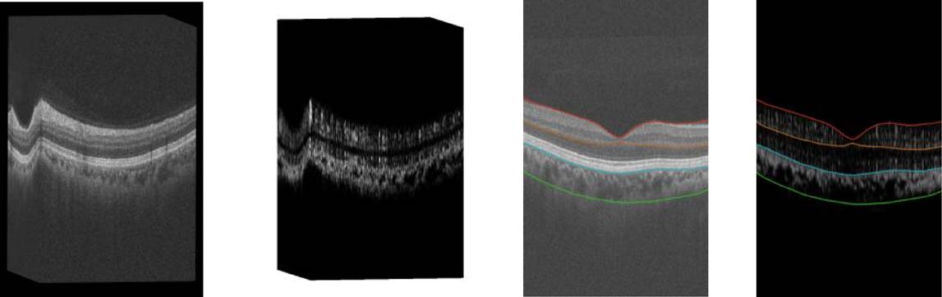
Challenges in Existing Segmentation Methods
Manual segmentation is laborious and depends heavily on expert knowledge
2D-to-2D methods require complex prior layer segmentation algorithms
Choroidal blood flow signals often interfere with retinal vessel visibility
Scattering noise in OCTA projection maps leads to significant errors

Slide 4
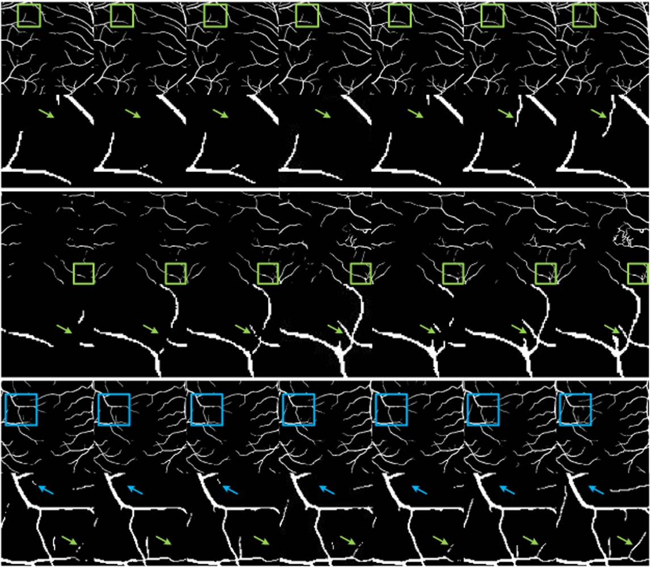
The LA-Net Framework Overview
A dual-path architecture: 3D Projection Path and 2D Segmentation Path
Directly utilizes 3D OCTA volumes without requiring manual layer segmentation
Fuses OCT microstructure with OCTA blood flow information
Introduces specialized attention modules to enhance feature extraction

Slide 5
The 3D Projection Path
Fuses OCT and OCTA input data using 3D convolution blocks
Employs Unidirectional Pooling (UP) for feature selection and dimensionality reduction
Captures deep structural features before projecting to a 2D map
Optimizes network parameter count for enhanced inference efficiency

Slide 6
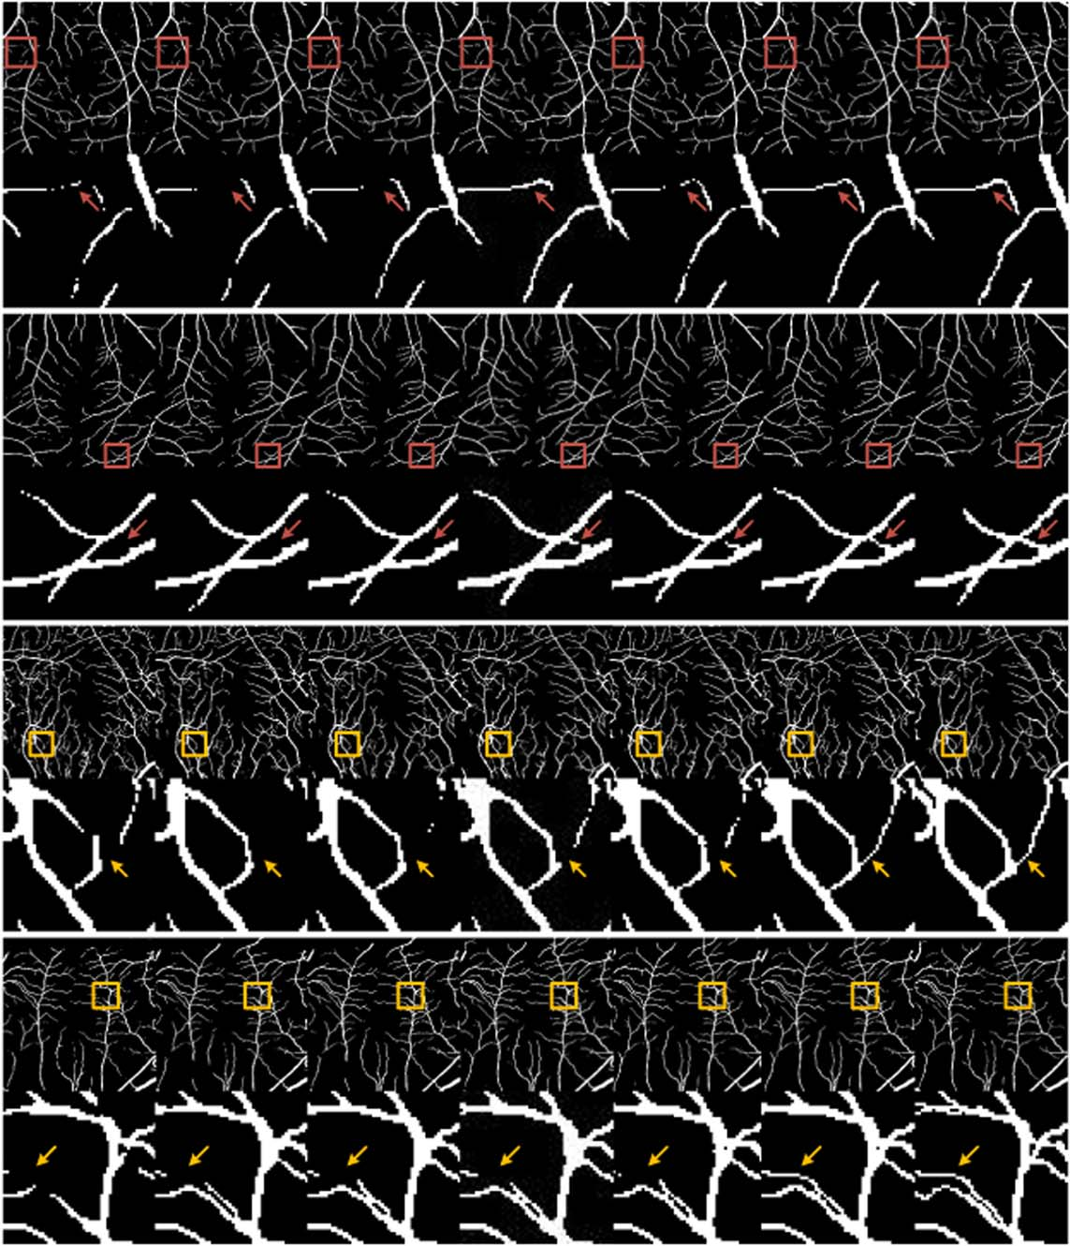
Multi-Scale Layer Attention (MSLA) Module
Core component of the 3D path to mitigate choroidal interference
Uses varied dilation rates to expand the receptive field for 3D information
Leverages OCT layer features to attend to retinal vessels specifically
Effectively suppresses unwanted signals from the choroidal vessel layer

Slide 7
The 2D Segmentation Path
Refines the 2D projection maps generated by the 3D path
Compensates for vessel boundary information lost during downscaling
Uses a decoder structure to output the final retinal vessel prediction
Integrates boundary features to improve semantic understanding

Slide 8
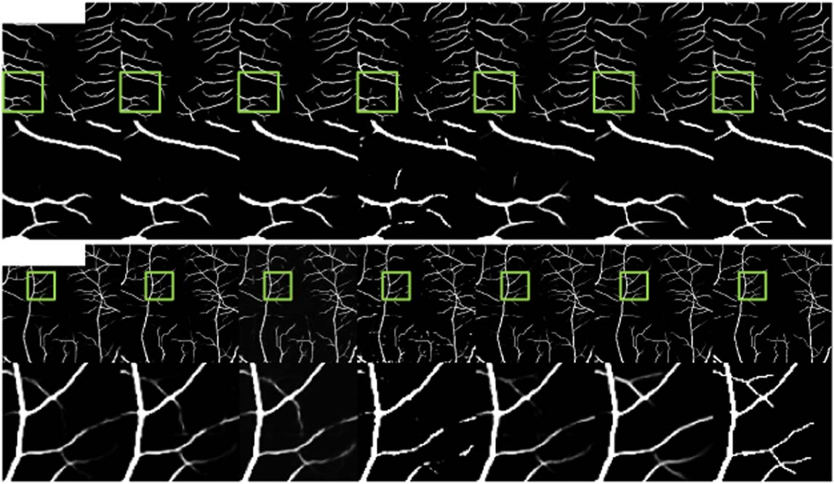
Reverse Boundary Attention (RBA) Module
Designed to discover and preserve boundary and shape details
Focuses on non-salient regions in deep features to locate edges
Addresses the loss of detail caused by cascading convolutions
Enhances the precision of thin-and-small vascular structures

Slide 9
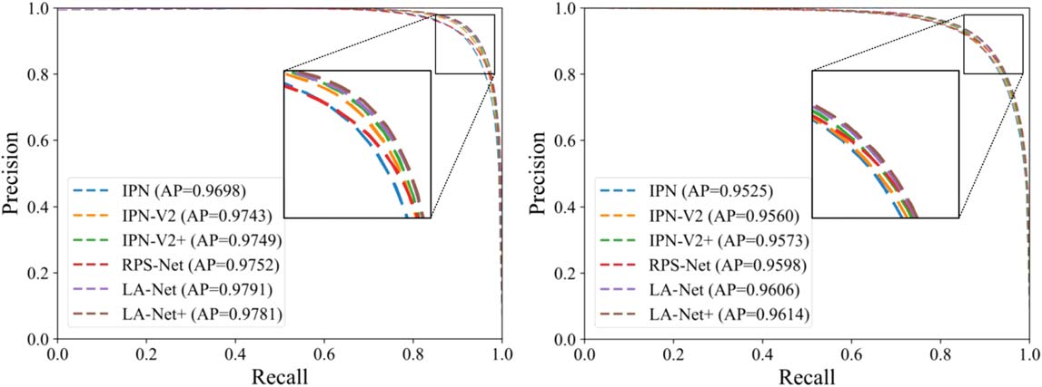
Experimental Results and Performance
Evaluated on two subsets of the public OCTA-500 dataset
Achieved impressive Dice similarity coefficients of 93.04% and 89.74%
Outperformed state-of-the-art methods like IPN, IPN-V2, and PAENet
Demonstrated superior capability in handling complex retinal structures

Slide 10
Conclusion and Future Significance
LA-Net provides a reliable and automatic 3D-to-2D segmentation solution
MSLA and RBA modules successfully tackle depth and boundary challenges
Potential for application in various medical imaging projection tasks
Open-source implementation available for further research development

