Slide 1


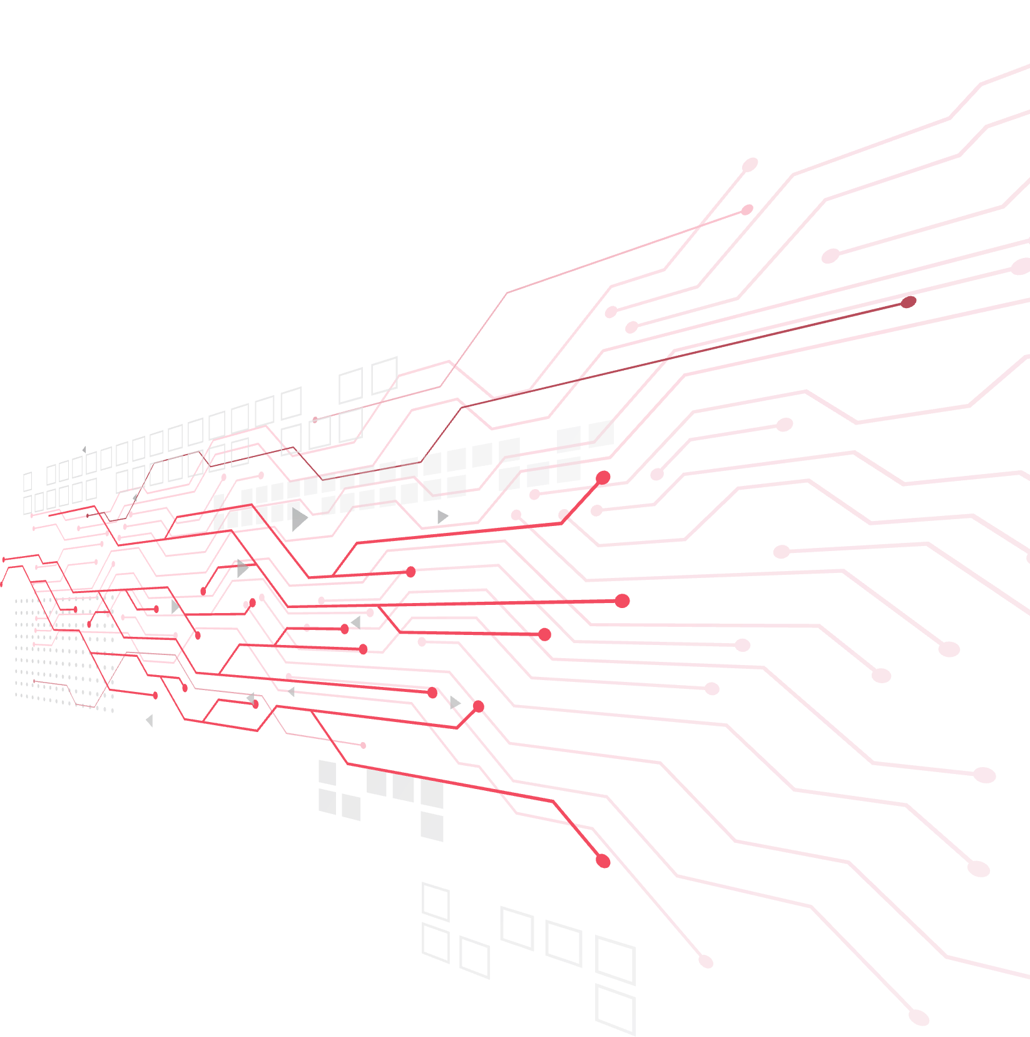

BANK ACCOUNT OPENING FRAUD DETECTION

Slide 2
Appendix
Introduction
Business Understanding
Data Understanding
Data Preparation
Deployment

Slide 3
01- Introduction
Notes:
Note: Please after inserting your picture, “Right Click” on the picture and “Send it to Back” to get the “Gradient” effect.

Slide 4
Introduction
Dataset is provided by feedzai - the market leader in fighting financial crime with AI
Contains 1 million rows, 31 features

Slide 5
02- Business
Understanding
Notes:
Note: Please after inserting your picture, “Right Click” on the picture and “Send it to Back” to get the “Gradient” effect.

Slide 6
03- Data Understanding
Notes:
Note: Please after inserting your picture, “Right Click” on the picture and “Send it to Back” to get the “Gradient” effect.

Slide 7
Data Understanding
No. | Variable | Definition/Descriptions | Data Type | Values | Values
0 | fraud_bool | Fraud label (1 if fraud, 0 if legit) | int64 | 0; 1 | [-1, 31]
1 | income | Annual income of the applicant in quantiles | float64 | [0, 1] | 0; 1
2 | name_email_similarity | Metric of similarity between email and applicant’s name. Higher values represent higher similarity. | float64 | [0, 1] | [200, 2000]
3 | prev_address_months_count | Number of months in previous registered address of the applicant, i.e., the applicant’s previous residence, if applicable (-1 is a missing value) | int64 | [-1, 380] | 0; 1
4 | payment_type | Credit payment plan type: 5 possible (annonymized) values | int64 | [-1, 406] | INTERNET, TELEAPP
5 | customer_age | Applicant’s age in bins per decade (e.g, 20-29 is represented as 20) | int64 | [10, 90] | [-1, 107]
6 | days_since_request | Number of days passed since application was done | float64 | [0, 78] | Windows, Macintox, Linux, X11, other
7 | intended_balcon_amount | Initial transferred amount for application | float64 | [-1, 108] | 0; 1
8 | credit_risk_score | Internal score of application risk | Int64 | [-176, 387] | [0, 3]
9 | session_length_in_minutes | Length of user session in banking website in minutes. | float64 | [-1, 107] | [0, 1]
10 | has_other_cards | If applicant has other cards from the same banking company | int64 | 0; 1 | [0, 7]
Data Understanding Table

Slide 8
Data Quality Assessment
Features | Data type | No, unique values | Distribution |  |  |  |  | % missing values | % outliers
 |  |  | min | p25 | p50 | p75 | max
income | float64 | 9 | 0,10 | 0,30 | 0,60 | 0,80 | 0,90
name_email_similarity | float64 | 998687 | 0,00 | 0,21 | 0,49 | 0,75 | 1,00
prev_address_months_count | int64 | 374 | -1,00 | -1,00 | -1,00 | -1,00 | 399,00 | 76,2%
payment_type | object | 5
customer_age | int64 | 9 | 10,00 | 30,00 | 50,00 | 50,00 | 90,00 |  | 0,4%
days_since_request | float64 | 988853 | 0,00 | 0,01 | 0,02 | 0,03 | 76,58 |  | 9,1%
intended_balcon_amount | float64 | 994836 | -15,74 | -1,18 | -0,83 | -0,07 | 112,70 |  | 24,7%
credit_risk_score | int64 | 545 | -177,00 | 90,00 | 130,00 | 188,00 | 388,00 |  | 0,7%
session_length_in_minutes | float64 | 994951 | -1,00 | 3,15 | 5,25 | 9,37 | 85,57 | 0,2% | 7,4%
has_other_cards | int64 | 2 | 0,00 | 0,00 | 0,00 | 0,00 | 1,00
Data Quality Assessment

Slide 9
EDA

Slide 10
04- Data Preparation
Notes:
Note: Please after inserting your picture, “Right Click” on the picture and “Send it to Back” to get the “Gradient” effect.

Slide 11
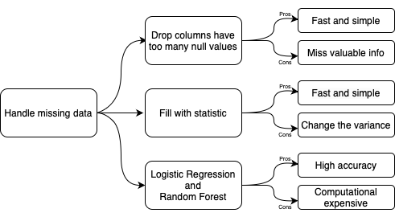
Handle Missing Data
Handle Missing Data Methods
In this usecase, outliers are not processed because:
Tree-based models are robust to outliers
Data is reasonable
Handle Outliers
One-hot Encoding
Label Encoding
Handle Categorical Features

Slide 12
05- Model
Notes:
Note: Please after inserting your picture, “Right Click” on the picture and “Send it to Back” to get the “Gradient” effect.

Slide 13
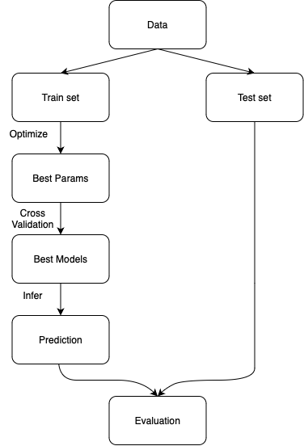
Models:
LightGBM
XGBoost
Random Forest
Pros:
Can easily handle categorical features
Explainable
Robust to missing data
Best models among others
Model Flow Diagram

Slide 14

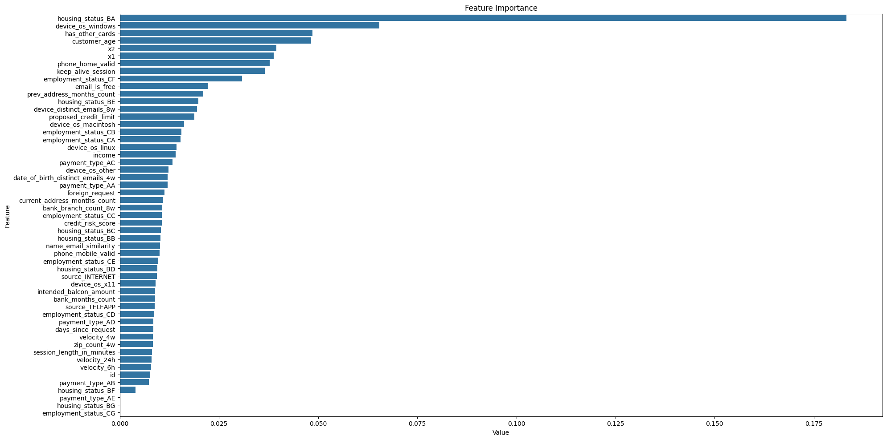
Evaluation
Metric: Recall @5% FPR
Reason: With imbalanced class,
accuracy is not an adequate metric
(as recommended in the paper)
However, the metric can be changed
due to different purposes.
E.g. maximize Recall for lower risk,
maximize Precision for higher risk.
Feature Importance
Model | Recall @5% FPR
LightGBM | 0.76
XGBoost | 0.77
Random Forest
Evaluation table

Slide 15
06- Deployment
Notes:
Note: Please after inserting your picture, “Right Click” on the picture and “Send it to Back” to get the “Gradient” effect.

Slide 16
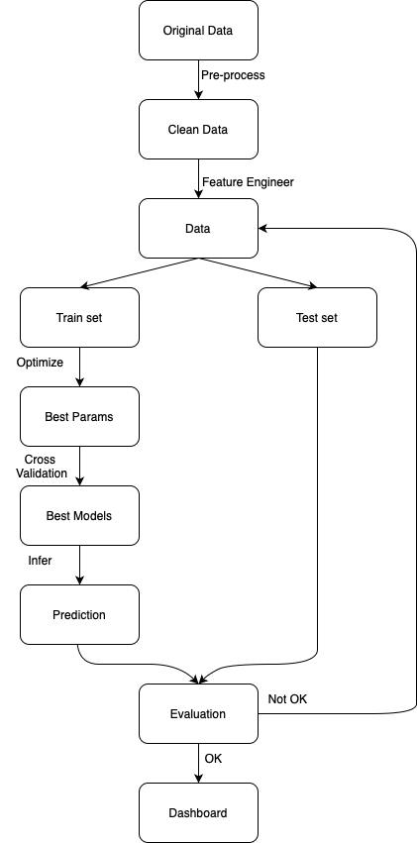
Workflow

Slide 17
Dashboard

