Slide 1
E GAS SeVA

Slide 2
Team Members
Krithika S Udupa
Diana Dsouza
Karunya Konde
Kavya S Kumar
Deepraj Pednekar
Ashish Kotian

Slide 3
Introduction
​​E Gas Seva is an application that allows user to book Gas cylinder
This Application has three entities Admin ,Dealer, User
Admin manages user interaction and dealers
Dealer gets notified when new booking is done
User can register for new connection and also book a cylinder
User can access shopping cart to buy products

Slide 4
Problem Statement
To Provide an in-depth services for gas agency of Indian company highly benefiting their customers in vast area of company services providing to them, making the path for LPG Gas Connection and other services a smooth one.

Slide 5
Technology Used
Front End
HTML
CSS
JavaScript
TypeScript
Bootstrap 4
Angular 8
Middleware
Java 8.x
Spring Boot
Eureka Discovery Client
Jpa
Lombok
Back End
MySQL
Mongodb

Slide 6
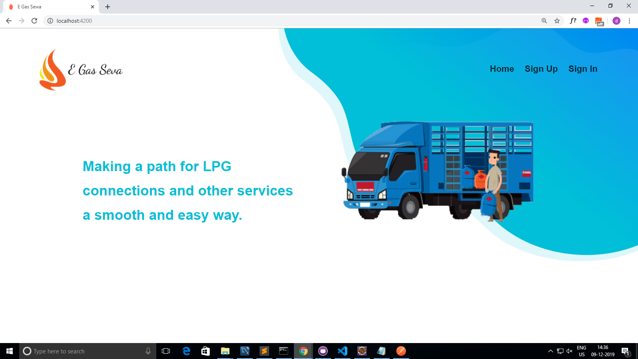
Demo

Slide 7
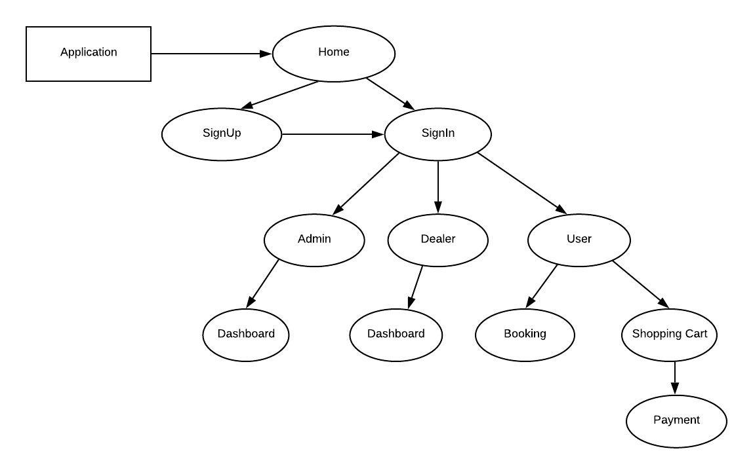
Application Flow Diagram

Slide 8
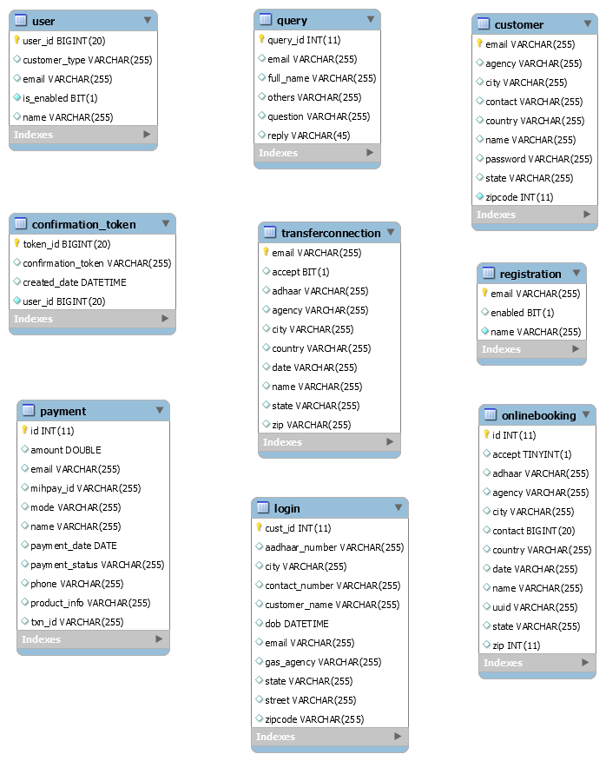
Database ARCHITECTURE

Slide 9
Thank you

