Slide 1


Medical Image classifier
(Med-AI)
Aleksander Kijewski
G00396018
MY LINKS:
GITHUB | LINKEDIN | PROJECT | VIDEO
Notes:
Hi and welcome to my presentation on my final year project about my medical image classifier. My name is Aleksander Kijewski and I will explain to you how it started from being just an idea to becoming a fully functional neural network. Which can be used

Slide 2
Purpose
Demonstrate how powerful AI can be.
How AI can impact and save lives
How AI can improve diagnosis with accuracy

Slide 3
Table of Contents
Research
Model
Training
Organisation
Demo

Slide 4
Research
F
Frameworks
L
Layers
Tensorflow and Keras
Purpose of Layers in models
A
Activation
E
Evaluation
Sigmoid, Softmax, ReLU
How is a model evaluated
Notes:
TensorFlow is an open source framework used for designing and developing machine learning models, which is especially useful in fields like medical imaging.
Built to be TensorFlow-compatible, Keras allows for easier working with complex operations in deep learning such as defining layers, compiling models and fitting models.
Different types of layers such as the input layer which processes the input data, hidden layers which extract features in the data or output layer which allows for prediction. Data arrives at the input layers which then passes the data onto hidden layers a neural net carries it forward to the output layer which predicts the outcome. Activation functions including Sigmoid (for binary classification), Softmax (for multiclass classification) and ReLU which introduces non-linearity essential for more complex learning
During binary classification Sigmoid activation binds probabilities between 0 and 1 in the case of 2 classes. In case of multiclass classification Softmax disperses out probabilities over several classes. ReLU activation sets negative inputs to zero causing the model to learn better by suppressing inaccuracies In neuron responses.
In machine learning evaluation can be done using indicators like accuracy, precision, recall which all contribute in measuring how well the model makes predictions. Cross-validation ensures accurate performance assessment across various sets of data.

Slide 5
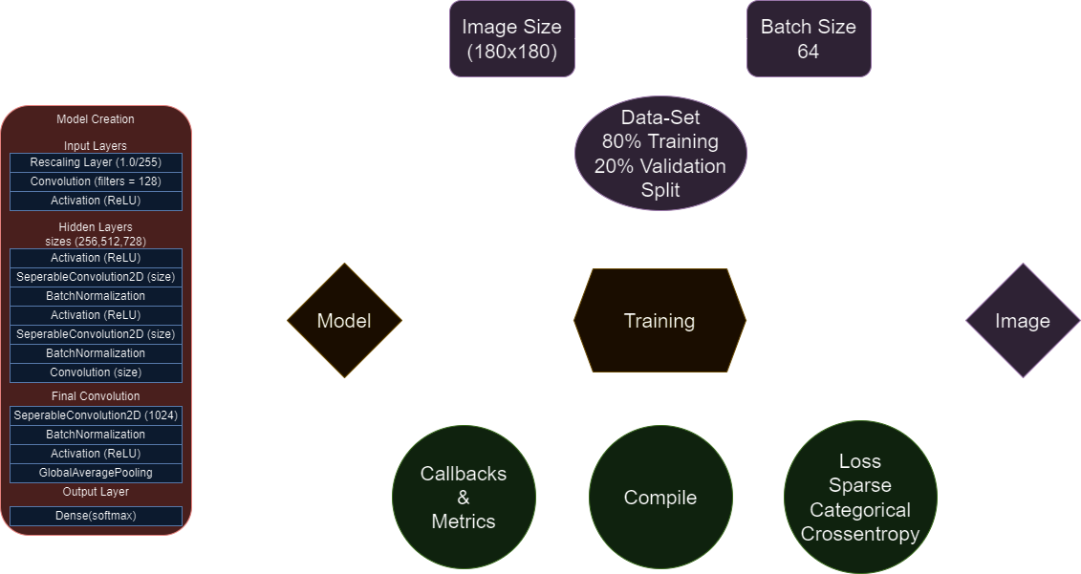

Slide 6
Model
Input Layers
Hidden Layers
Output Layer
Xception
Notes:
In total my model has 31 layers while of those 31 only 20 of those layers I am creating myself as seen in the diagram.
The input layer is the initial layer for the Neural network.
This layer rescales the image to normalise the pixel values so the images aren’t different from each other. This helps with stabilizing and speeding up the training process.
Hidden Layers are “hidden” as they are not input or output therefore the user doesn’t see what is happening.
The hidden layers are what perform the computations required for the network to learn.
This model includes activations like ReLU which introduce non-linearity as the model cannot learn if it’s linear.
It also has separable convolutions which are more efficient variants of a normal convolutional layer.
Output Layer is the final layer of the network which is where the actual prediction is made.
In this layer, the GlobalAveragePooling gets all the possible features and maps them to a single number by taking the average of the elements
Then the Dense layer uses these features to make a prediction which gets distributed amongst all the possible classes which sum up to 1.
Xception which is the model you see in front of you just simplified is a model provided by google which is great at learning shapes, object detection and the classification of images
This is because of the use of Seperable convolutions. These Seperable convolutions allow for reduces computations as normal Convolutions apply filters across all input channels, these Convolutions
Split this process into two separating the filters and applying the filter into only the channels needed.

Slide 7

Training
Process
Data | Compile | Image
All images are preprocessed to ensure the highest quality of image is present then it gets resized to 180x180 pixels Batch size of 64 Dataset gets split into 80% Training and 20% Validation. | The data gets then compiled a loss called Sparse Categorical Crossentropy. It uses callbacks such as early stopping to determine when the model is fully trained. These callbacks use Metrics to determine how well the model is learning. | The Model then gets brought through epochs which are run-throughs of the data. Once the early stopping function determines the model is satisfactory. This model then gets saved which can be used to predict images.
Notes:
In the training process the data needs to be prepared or preprocessed to ensure the highest quality of image which are then resized to 180 pixels by 180 pixels.
These images then get sorted into batches of 64 as the more images in a batch the more power you will need.
The images I used were split into 80% validation and 20% training.
This then brings me to the compiling of the model where I use a loss function called Categorical Crossentropy this is to allow me to see how well the model is performing.
This provides valuable information like accuracy, validation accuracy and other metrics.
I use callbacks which can monitor these metrics provided by the loss function, I use an early stopping callback which monitors the val_loss metric
This val_loss metric shows how much data the model is either losing or gaining.
Once the callback determines the model is satisfactory with the values ive given it, it is then saved and I can preform tests on it like a prediction matrix.
Which provides me with information of how well the image can predict images.
This image can then be used to predict user images.

Slide 8
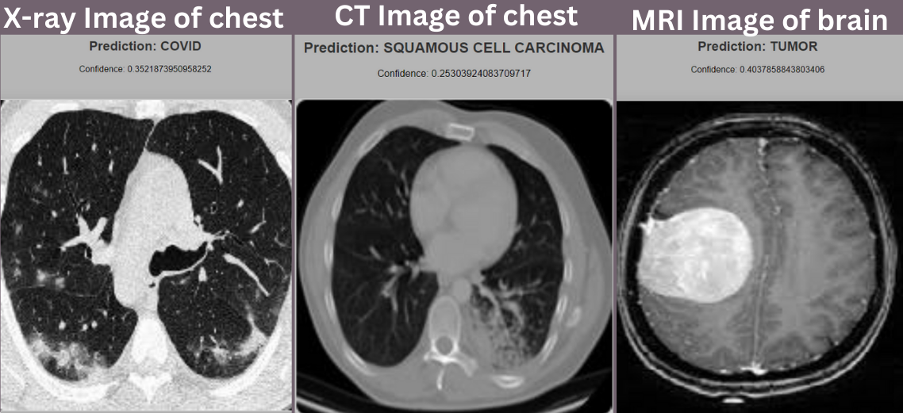
Results

Slide 9
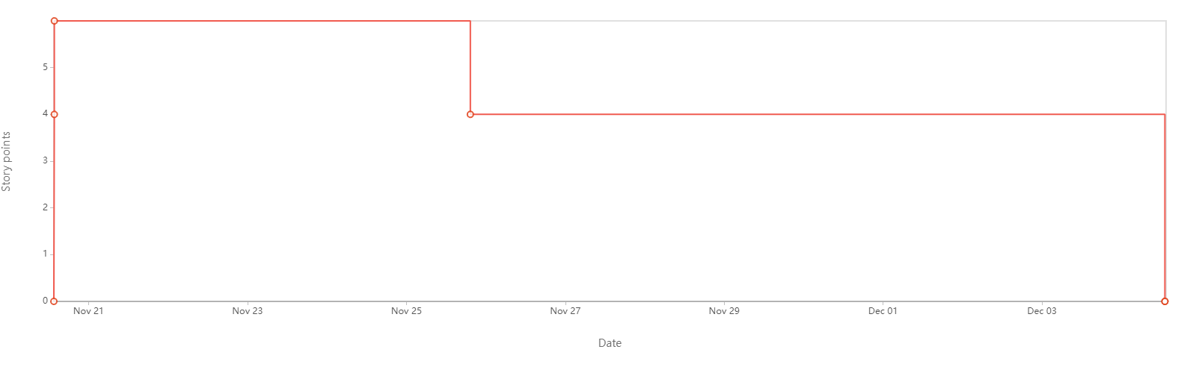
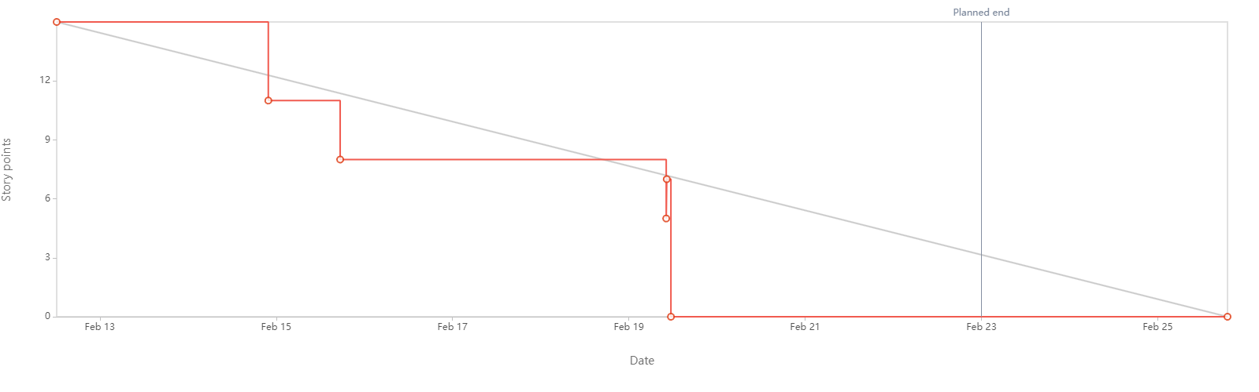
Organisation
First Burndown
Final Burndown
Notes:
This shows my progress in using Scrum to complete my project as you can see my
The initial burndown from the first week I began using it wasn’t great as I didn’t have a schedule put in for working on my project
As time went on my Burndown reports became better and better.
This is my final Burndown from a few weeks ago where I had a schedule planned throughout the week putting in
A certain amount of hours to work on my project and final presentation, report, and rest of the deliverables.

Slide 10
DEMO

Slide 11
Thank you
CREDITS: This presentation template was created by Slidesgo, and includes infographics & images by Freepik.

