Slide 1
Novel Virus Discovery Pipeline
Pipeline : a set of data processing elements connected in series
output of one element is the input of the next one - Wikipedia
Virus Discovery Pipeline : pipeline that is for identifying
known or unknown virus using deep sequencing data
Several pipelines are available online
Name | Author | Development organization, Nation | No. of citation
VirFind | Thien Ho, et al. | University of Arkansas System, USA | 51
VirusSeeker | Guoyan Zhao, et al. | Washington University School of Medicine, USA | 9
VirusDetect | Yi Zheng, et al. | Boyce Thompson Institute, USA | 13
VIP | Yang Li, et al. | China CDC, China | 14

Slide 2
But, There are some drawbacks
Hard to Use : Need to install many of prerequisite programs and understand decades of options
Complex to modify : Having complicated dependency structure, too complex to modify and optimize
Need to develop handy and simple Virus discovery pipeline

Slide 3

Input raw
sequence reads
5. Screening
Novel Virus
Discovery Pipeline
(adapted from
USAMRIID pipeline)
4. De novo
Assembly of reads
1. Adapter
Clipping
3. Quality
Filter
2. Host
Removal

Slide 4
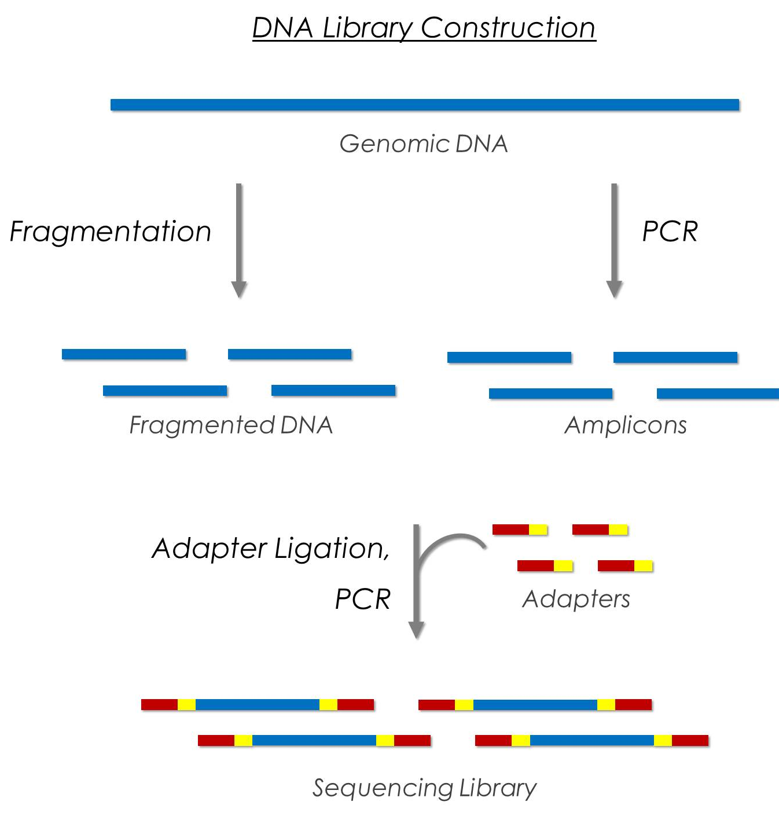
1. Adapter Clipping
Objective | Removing adapter sequences which are used for NGS process
Program | Trimmomatic (2014)
“There are slight differences between trimming programs”
- An Extensive Evaluation of Read Trimming Effects on Illumina NGS Data Analysis (2013)
AND
Good quality NGS data
in Truseq preparation kit
Aggressive and Speedy trimmer

Slide 5
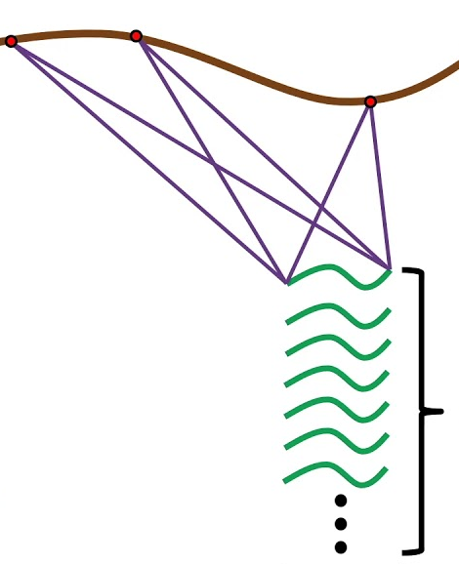

2. Host removal
Objective | Removing host genome sequences
Program | Bowtie2 (2012)
Organism | Source | Note
PhiX | NCBI | PhiX174
Human | NCBI | GRCh38
Mouse_Rat | URSDB | Mus musculus Rattus Norvegicus
Sorex | URSDB | Sorex araneus
Cro | URSDB | Crocidura attenuate
Penguin | URSDB | Pteria penguin
Bat | URSDB | Rhinolophus ferrumequinum
Tick | URSDB | Haemaphysalis longicornis
Host genome
reads

Slide 6
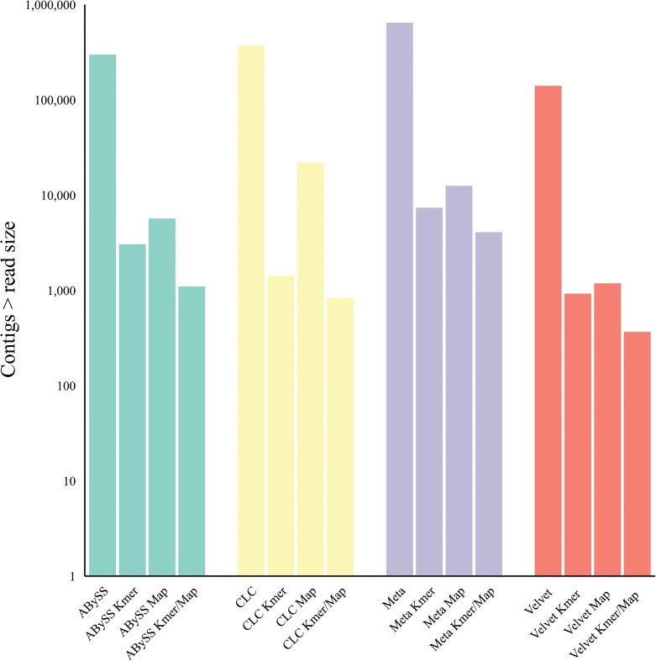
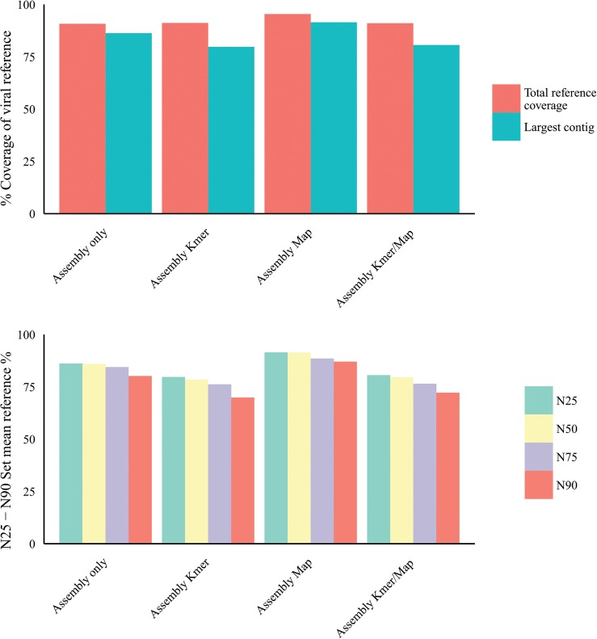
(aligning all contigs made)
*
(aligning only one contig)
*Kmer : align unit is K bps, not read length
- Host Subtraction, Filtering and Assembly Validations for Novel Viral Discovery Using Next Generation Sequencing Data (2015)

Slide 7
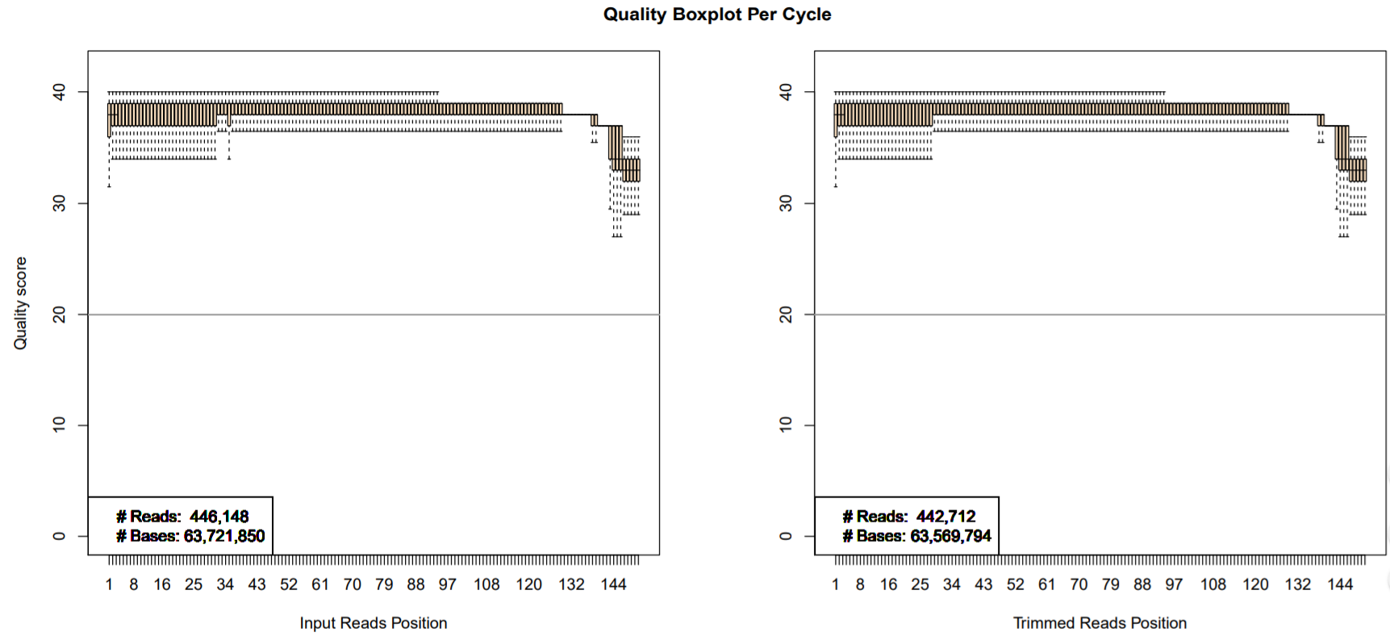
3. Quality Filter
Objective | Removing sequencing reads with imperfect quality
Program | FaQCs (2014)
Cl13-1_MiSeq
No notable change due to good quality of original data

Slide 8
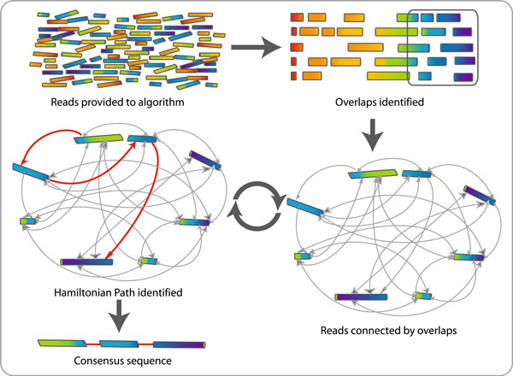
4. De novo Assembly
Objective | Concatenating refined reads into contigs
Program | SPAdes (2012)
(contig)

Slide 9
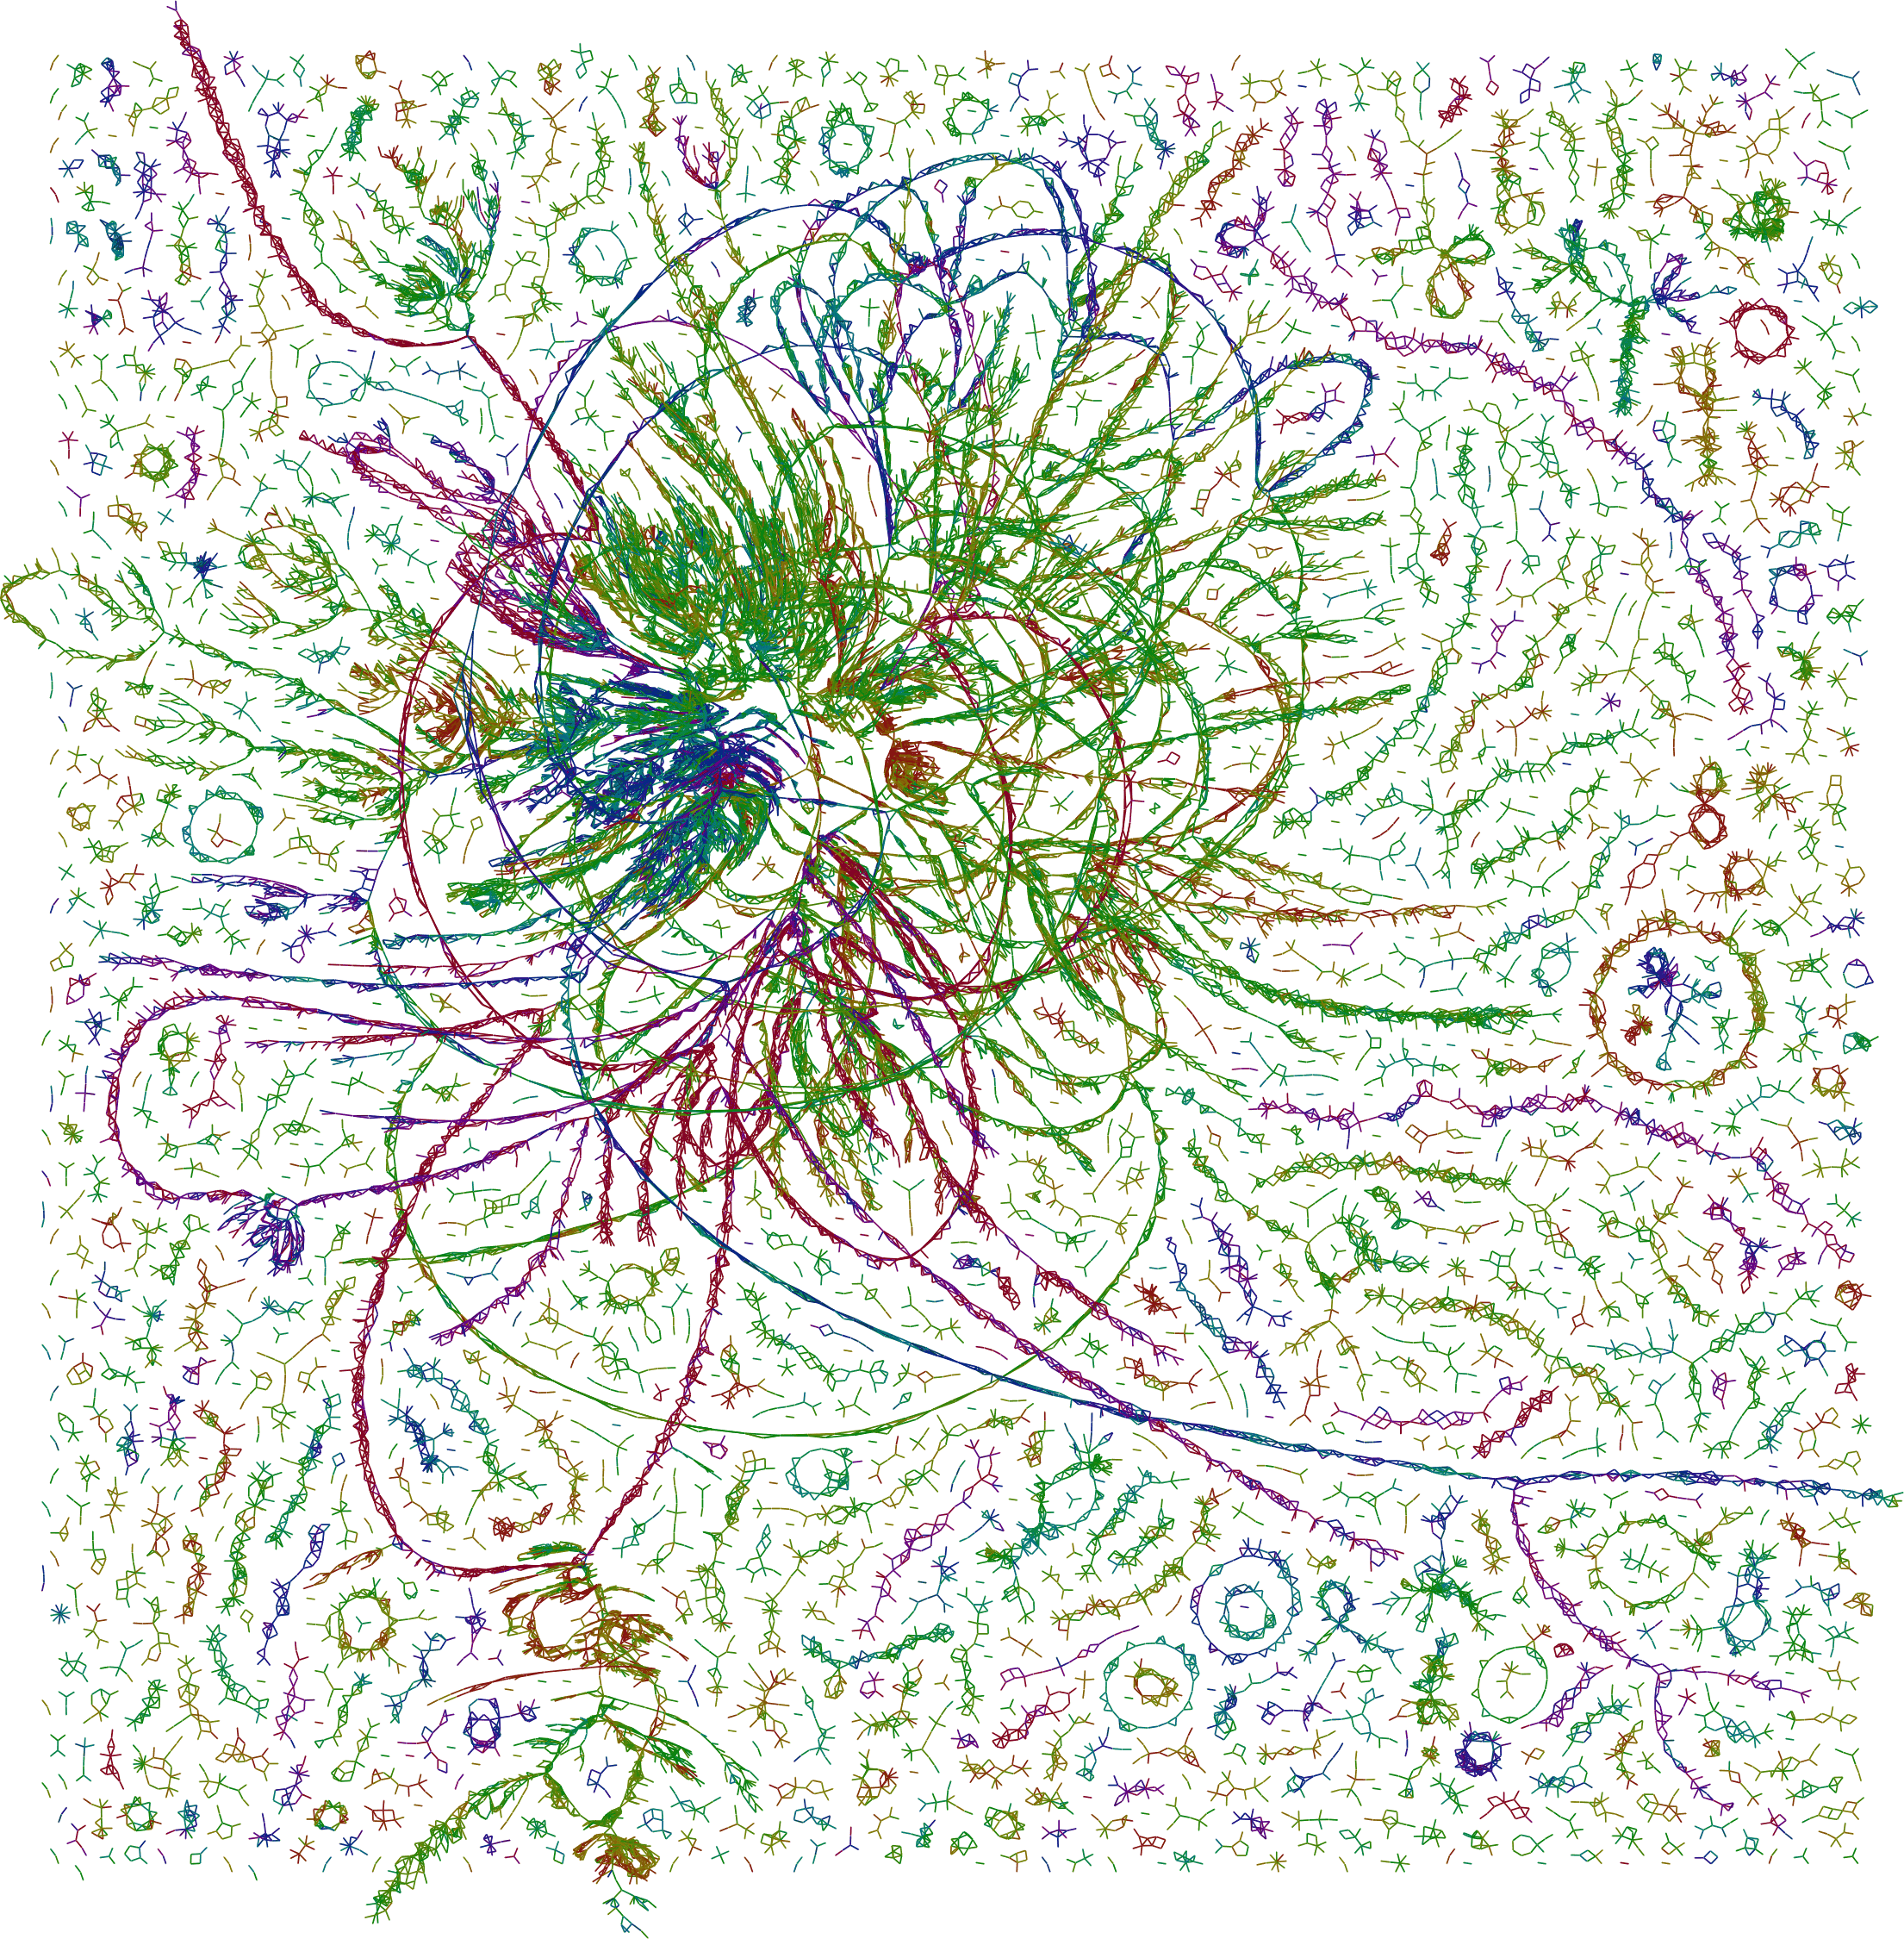

Slide 10
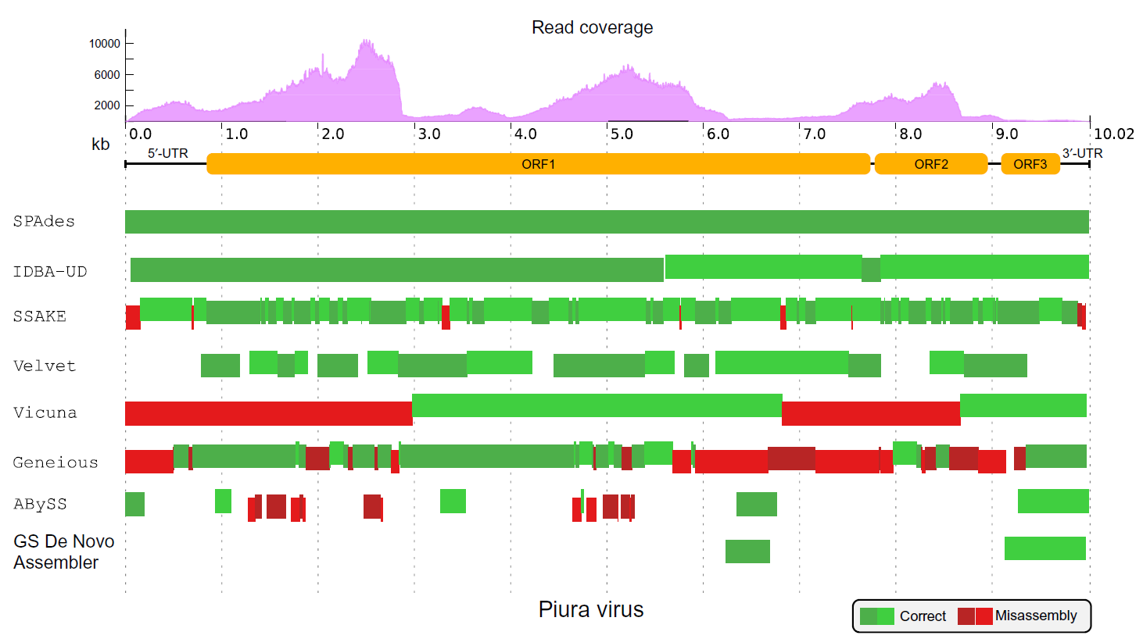
Difference in capabilities of de novo assembler
Chapter Nine - Software Dedicated to Virus Sequence Analysis “Bioinformatics Goes Viral”

Slide 11
5. Screening
Objective | Screening assembled contigs against reference sequences database
Program | BLAST+ (1990) – megablast, discontiguous megablast, blastn, tblastx
Reference DB | NCBI RefSeq Viral sequences
algorithms | sequence type | similarity | sensitivity | note
megablast | DNA | High | Low | more than 95% identity
discontiguous megablast | DNA | Somewhat | High | ignoring 3rd base mismatches
blastn | DNA | Somewhat | Somewhat | allow least similarity
tblastx | Amino acid |  |  | Bottleneck stage

Slide 12
Reference Database
NCBI RefSeq Viral sequences + Lab’s own reference sequences
NCBI RefSeq : non-redundant set of reference sequences database provided by NCBI
Updates in odd number months (January, March, May, July, September, November)
7546 species included (Latest version)
Lab’s own reference sequences : reference sequences which are not included in RefSeq
29 Sequences
Seeweis virus, Imjin virus, Muju virus, Seoul virus, Soochong virus, etc.

Slide 13
Final product
BLAST result comes out as file (viewed and modified in Microsoft Excel)
①
②
③
④
⑤
⑥
⑦
⑧
⑨
① Contig Number : ID of screened contig among assembled ones
② Contig Length : Length of screened contig
③ Accession Number : NCBI accession number of reference sequence
④ Alignment Length : Length of aligned sequences between contig and reference sequence
⑤ Subject Title : Taxonomy, Strain title of reference sequence
⑥ Status : Normally complete, seldom partial
⑦ Identity : Identical sequences / Alignment length * 100
⑧ Start : Starting sequence of aligned sequences in reference sequence
⑨ End : Ending sequence of aligned sequences in reference sequence

Slide 14
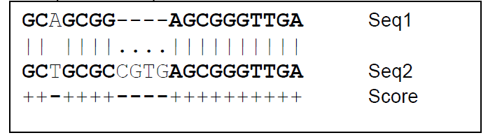
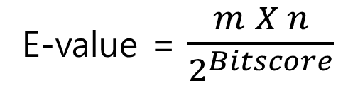
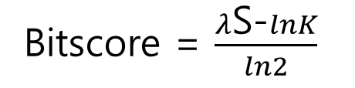



Raw score(S)
: degree of homology in a certain alignment
“Unless the scoring system is understood, citing a raw score alone is like citing a distance without specifying feet, meters, or light years”
- BLAST manual
Bitscore
: normalized raw score to compare between different scoring systems
Bitscore = $\frac{λ\text{S}\text{−}lnK}{ln2}$
$$λ, K :statistical factor$$
Higher is better, but don’t adequately represent significance of alignment
E-value
: number of expected hits of similar quality (score) that could be found just by chance
E-value = $\frac{m X n}{2^{Bitscore}}$
m$:query sequence length$
n $:database sequences length$
Lower is better. Especially, smaller than 1 x e⁻⁵⁰ means very high quality match (empirically)

Slide 15
Published papers use E-value 1 x e⁻⁶ or 1 x e⁻⁵ as a criterion
Characterizing the virome of Ixodes Ricinus ticks from northern Europe (2017), Scientific Reports
“screened with blastX against a local database with hits with an e-value of 1 × 10⁻⁵ or better collated”
Virome analysis for identification of novel mammalian viruses in bats from Southeast China (2017), Scientific Reports
“In all the blast results, optimal results were used as the gene annotation with the parameter of E value < 10e⁻⁵”
Metagenomic Profile of the Viral Communities in Rhipicephalus spp. Ticks from Yunnan, China(2015), PLOS ONE
“Based on the most significant BLASTx similarities (e-value < 10⁻⁶)”

Slide 16
Comparison with EDGE
Strength
Easy to install and modify : few efforts to need when changing any program in pipeline
Easy to update or add database sequences
Can extract virus-like contigs
Can choose host whose genome will be subtracted from raw data
Weakness
No support for taxonomic classification
No support for GUI (Graphic User Interface)
Low-level pre-assembly filtering (repeat, low complexity, etc) ⇒ Perhaps, reason for too many results

Slide 17
Further advancement
Taxonomic classification
More pre-assembly filtering (repeat, low complexity, etc)
Development for GUI (Graphic User Interface)
Addition of Bacterial screening step

Slide 18
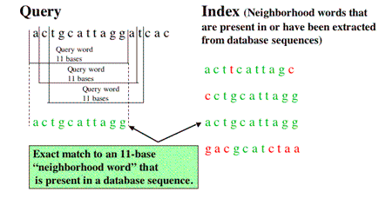
[Supplementary Slide 1] BLAST
When mapping query to reference sequence, a certain size of sequences has to exactly match with each other, and the size is Word size
Word size
a c g g c a t t c g g
1st

Slide 19
algorithms | similarity | Word size | sensitivity | note
megablast | High | 28 bp | Low | more than 95% identity
discontiguous megablast | Somewhat | 11 – 12 bp | High | ignoring 3rd base mismatches
blastn | Somewhat | 7 – 11 bp | Somewhat | allow least similarity
But in case of discontinuous megablast, 3rd base mismatches are ignored when matching so as to consider wobble pairing

Slide 20

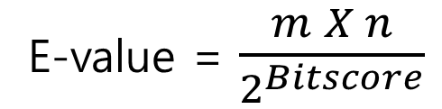

[Supplementary Slide 2] E-value
①
100 bp
30 bp
E-value = $\frac{m X n}{2^{Bitscore}}$
②
50 bp
m$:query sequence length$
30 bp
n $:database sequences length$
⇒ E-value₁ = 2 * E-value₂

Slide 21
[Supplementary Slide 3] Duration
Environment | Workstation (CJ 식품안전관), Server (문숙의학관)
Sample | Cl13-1 NGS data (total 98.7 MB for paired files), 7027 contigs
Workstation (CJ 식품안전관)
Server (문숙의학관)
Step | Duration (seconds)
Adaptor Clipping | 6
Host Removal | 126
Quality Filter | 162
De novo Assembly | 237
blastn | 113
megablast | 2
dcmegablast | 85
blastx | 8929 (2h 28m)
Step | Duration (seconds)
Adaptor Clipping | 6
Host Removal | 183
Quality Filter | 288
De novo Assembly | 256
blastn | 128
megablast | 2
dcmegablast | 85
blastx | 9946 (2h 46m)

