Slide 1
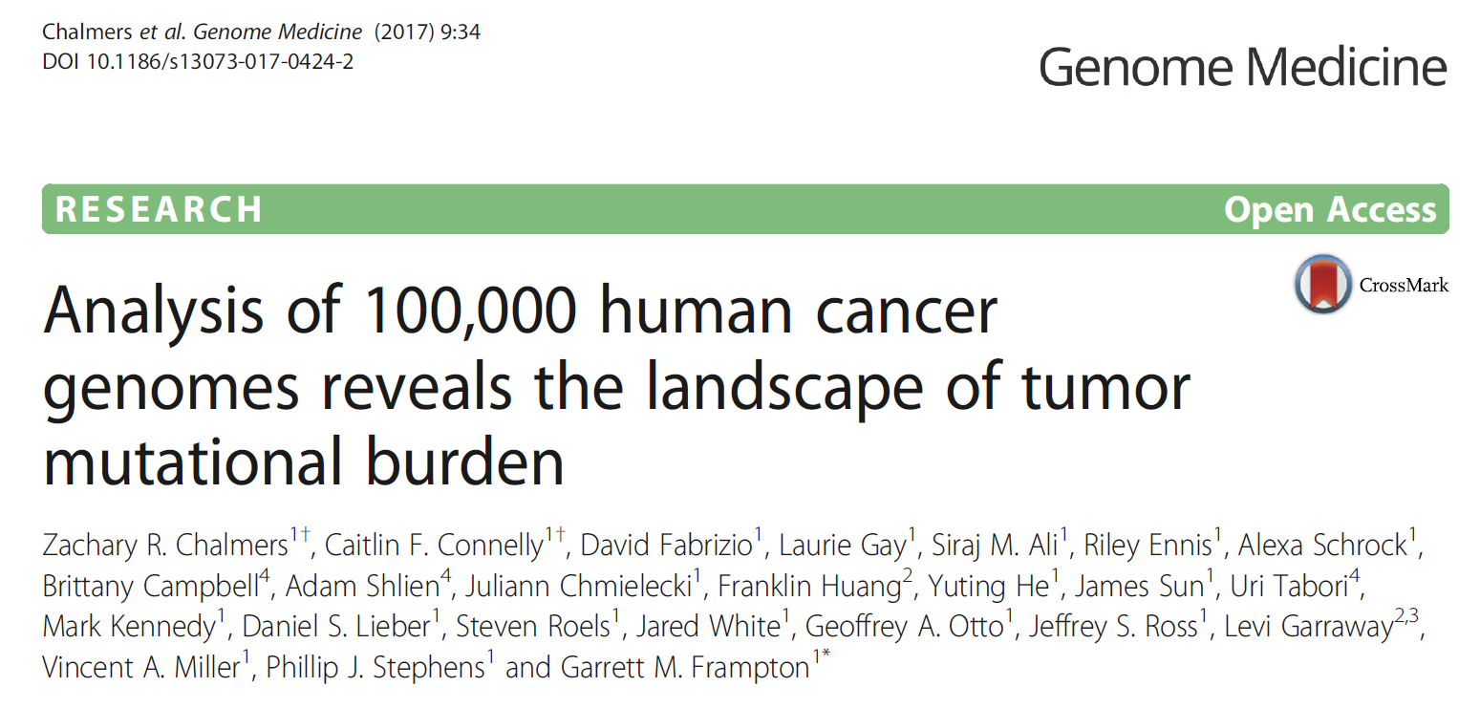
TMB Paper Review
2018/05/08
Kijin Kim
2017/04 Published

Slide 2



Slide 3

Immune Checkpoint Blockade Immunotherapy
Notes:
인터넷이 필요

Slide 4
Tumor Mutational Burden as an Independent Predictor of Response to Immunotherapy in Diverse Cancers,
Aaron M. Goodman, et al. (2017)

Slide 5
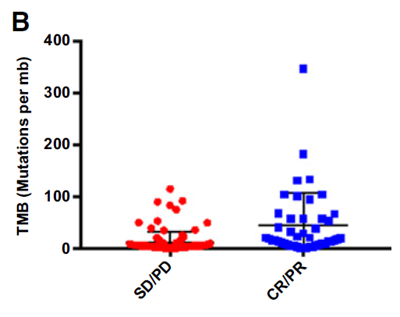
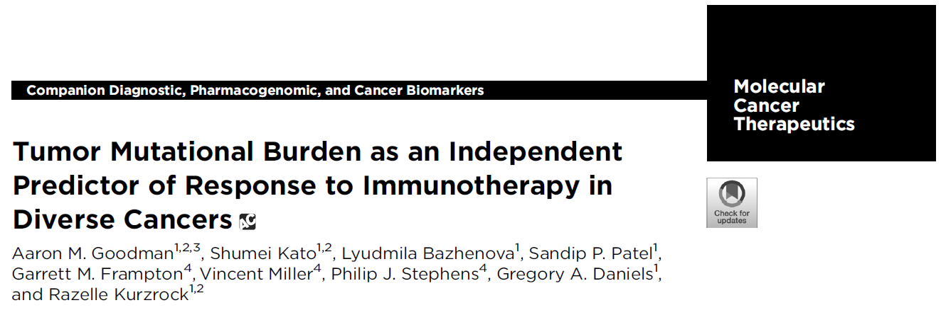
TMB (Tumor Mutational Burden)
= Measurement of somatic mutations within a tumor
Responses to PD-1/PD-L1 immunotherapy
SD, stable disease; PD, progressive disease; CR, complete response; PR, partial response
2017/11 Published

Slide 7
Objective
TMB in WES → TMB in Smaller gene set
Understanding landscape of TMB based on > 100,000 CGP data
Identifying association between certain gene mutation and TMB

Slide 8

All SNP, INDEL
in coding region
somatic alteration in COSMIC
truncation in tumor suppressor gene
predicted as germline
by SGZ algorithm
recurrently predicted as germline
previously in the cohort
known germline in dbSNP
known germline with 2>= counts in ExAC
Define TMB
Rare functional gene
Germline alteration
TMB = $\frac{\text{\# }\text{of} \text{mutations}}{\text{Size} \text{of} \text{coding} \text{region}\text{ (}\text{Mb}\text{) }}$

Slide 9
WES vs CGP in TMB analysis
29 samples sequenced both on exome and gene panel (CGP)
Gene panel targets 315 genes (1.1 Mb of coding genome) using FoundationOne CDx™
WES sequence both tumor and normal, CGP only tumor

Slide 10
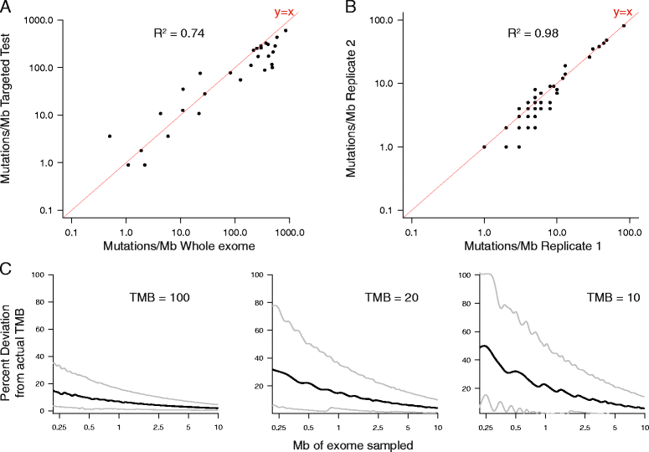

Slide 11

Downsampling simulation
Percent deviation (%) = $\frac{\text{simulated}\text{ − }\text{expected} }{\text{expected} }$ x 100
(100 mutations per Mbps)
(20 mutations per Mbps)
(10 mutations per Mbps)
90% CI
Median
10% CI
Sampling 1000 times for each TMB (binomial distribution) and sequencing amounts

Slide 12

TCGA data analysis
WES profiles from 8917 cancer specimens
Calculate TMB from 315 gene set (1.1 Mb of coding genome)
Highly correlated ($R^{2}$ = 0.98)
Notes:
우리도 해보면 좋을듯 합니다

Slide 13
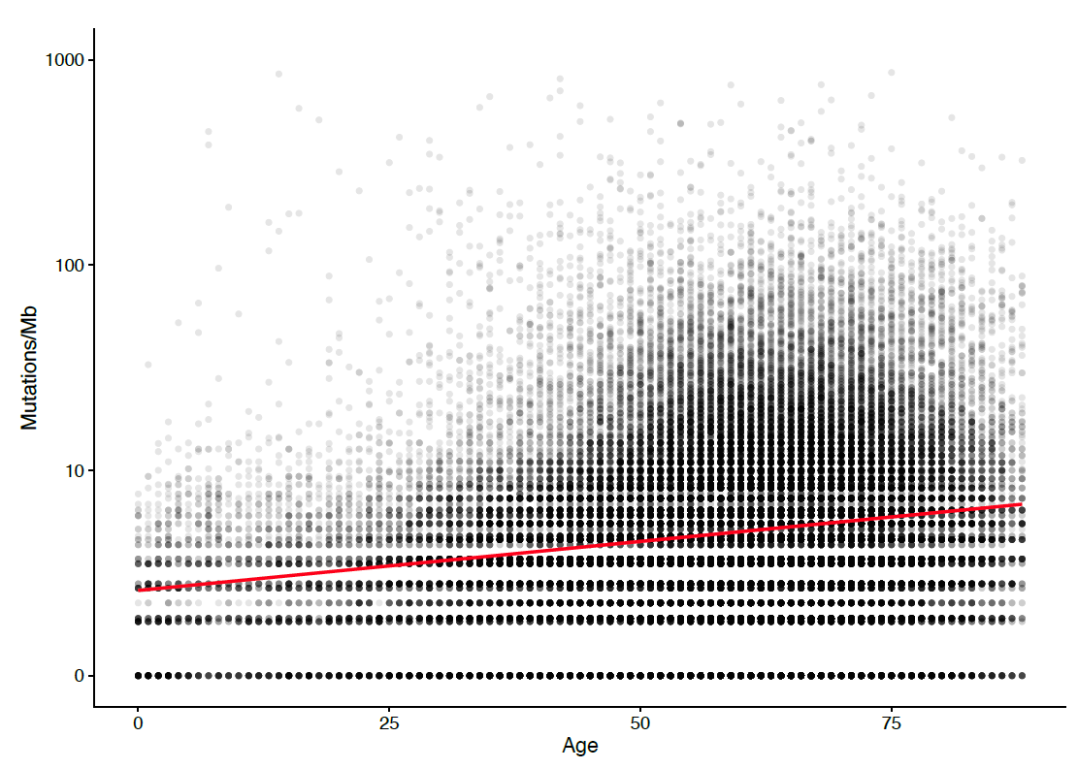
CGP TMB analysis
Used FoundationOne CDx™
Used 92,439 samples (only tumor) which has >300x exon coverage
541 distinct cancer types
Median : 3.6 mutations/Mb
TMB increase with aging

Slide 14
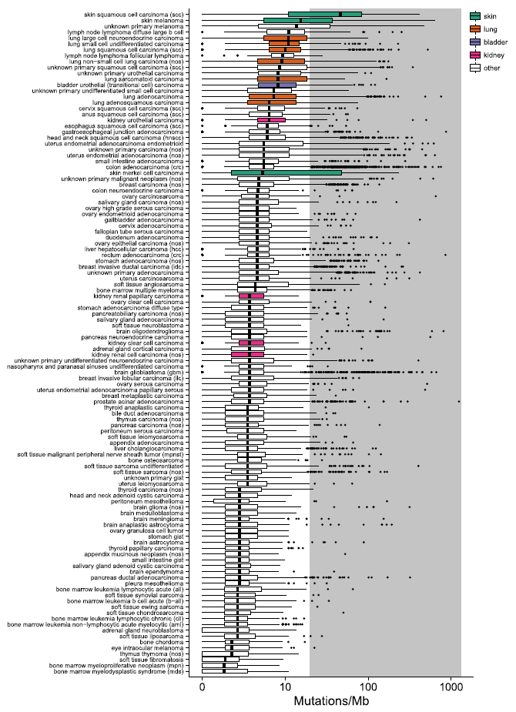

Slide 15
Disease indications with greater than 5% of specimens showing high TMB (>20 mutations/Mb)
Disease type | Specimen count | Median TMB
skin basal cell carcinoma | 92 | 47.3
skin squamous cell carcinoma (scc) | 266 | 45.2
skin melanoma | 879 | 14.4
unknown primary melanoma | 1324 | 12.6
lung large cell carcinoma | 74 | 12.2
lymph node lymphoma diffuse large b cell | 348 | 10.0
lung large cell neuroendocrine carcinoma | 288 | 9.9
lung small cell undifferentiated carcinoma | 913 | 9.9
lung squamous cell carcinoma (scc) | 2102 | 9.0
lung non-small cell lung carcinoma (nos) | 2636 | 8.1
bladder carcinoma (nos) | 77 | 8.1
unknown primary squamous cell carcinoma (scc) | 606 | 7.6
lung sarcomatoid carcinoma | 130 | 7.2
unknown primary urothelial carcinoma | 188 | 7.2
bladder urothelial (transitional cell) carcinoma | 1218 | 7.2
head and neck melanoma | 59 | 6.3
lung adenocarcinoma | 11855 | 6.3
lymph node lymphoma b-cell (nos) | 88 | 6.3
unknown primary undifferentiated small cell carcinoma | 117 | 6.3

Slide 16
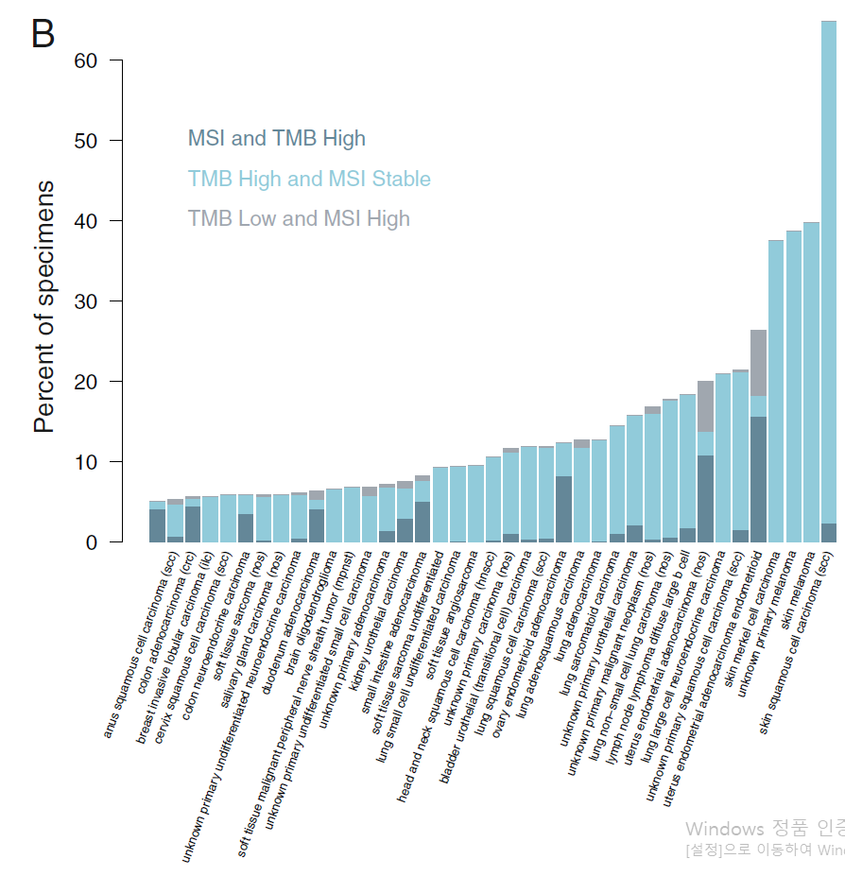
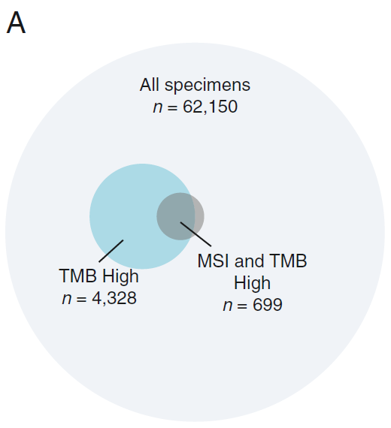
TMB and MSI

Slide 17

TMB increase-associated genes and mutations
gene1
Factor loading (meaningful variable as it increase)
0.7
Factor 1
gene2
0.11
$$\log_{10}{\text{(}\text{TMB}\text{)}}$$
gene3
0.05
Factor 2
gene4
…
…
Factor m ( < n)
gene n
Notes:
Remove noise components

Slide 18
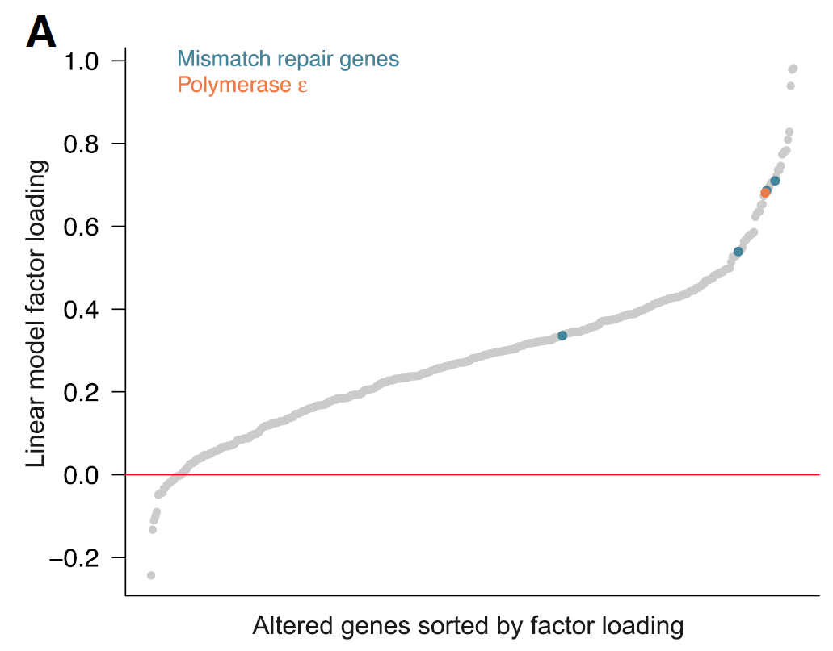
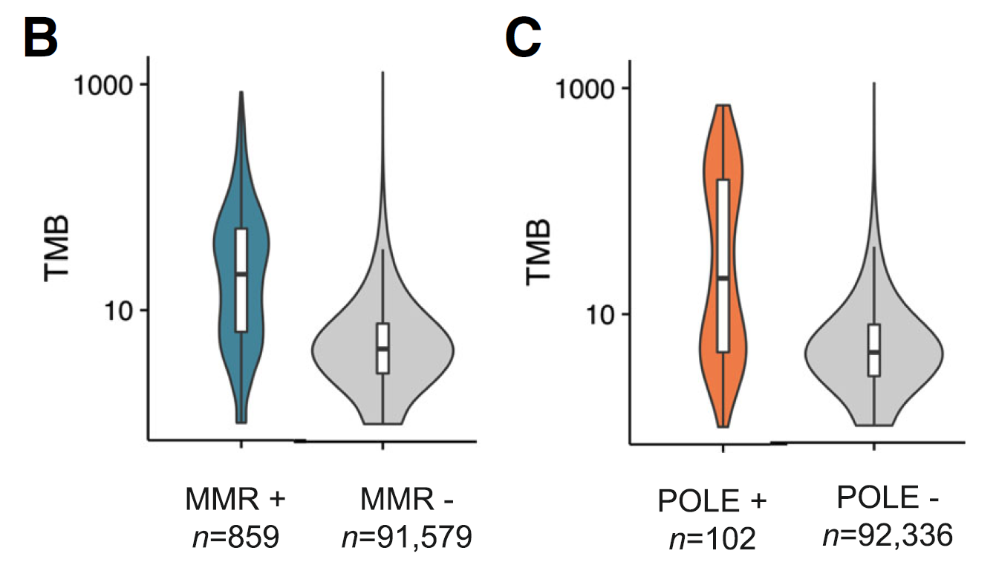
(MSH2, MSH6, MLH1, PMS2)

Slide 19
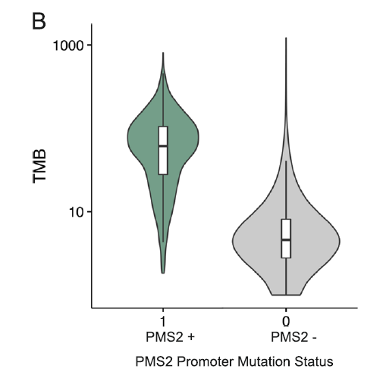
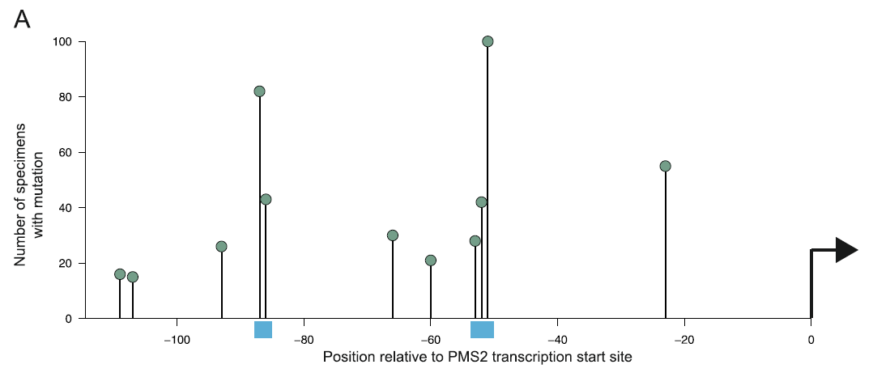
PMS2 promoter region mutation

Slide 20
Discussion
1.1Mb CGP assay agree well with WES TMB
Filtering out germline alteration and rare variants is important to obtaining accurate measurement of TMB
Sampling variation increase as sequenced size (Mb) decrease, especially at lower levels of TMB
Extensive landscape of TMB across hundreds of genes including newly found TMB associated region, PMS2 promoter

