Slide 1
Clinical Trial in
Soft Tissue Sarcoma
Roland Hentz Zihan Yang
Haojia Li Yueqi Feng

Slide 2
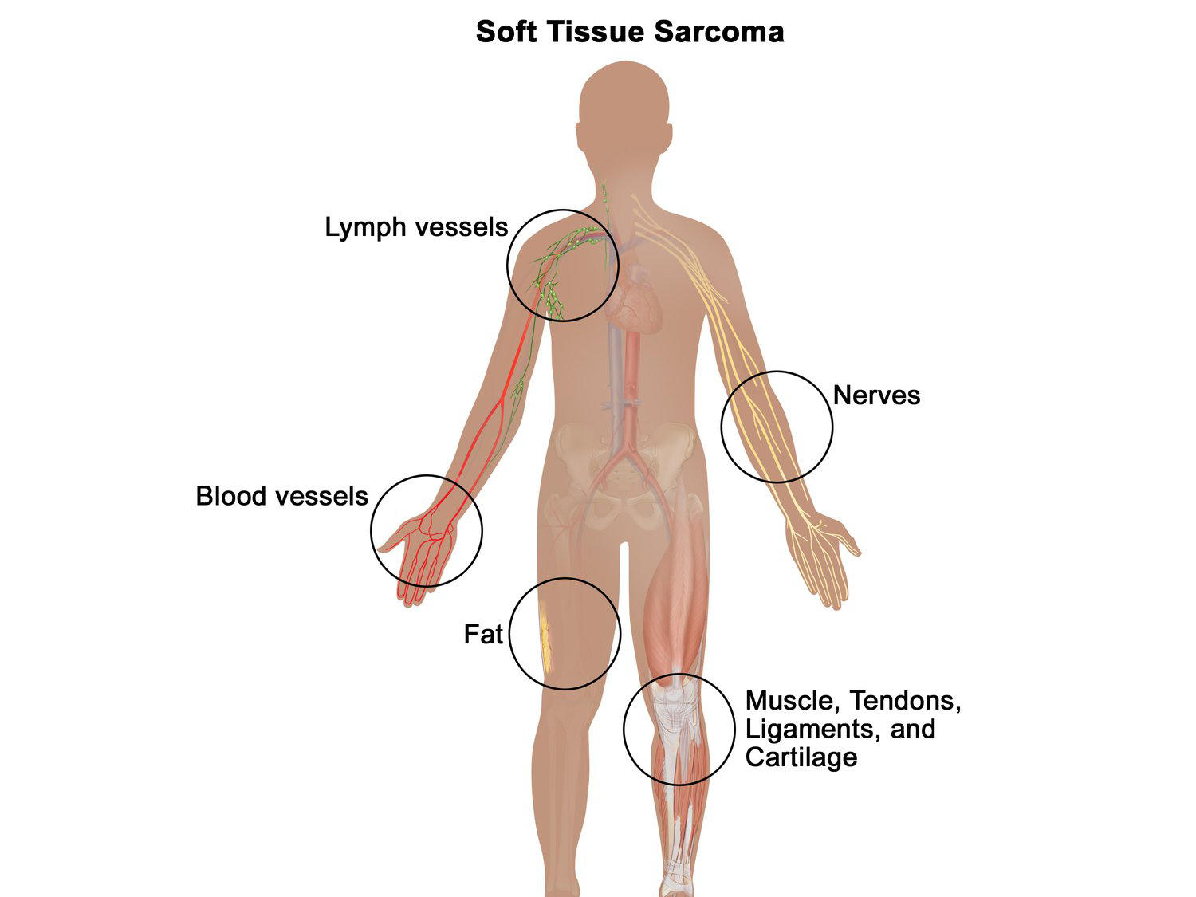
Introduction
Soft Tissue Sarcoma
Doxorubicin
Ifosfamide
Two-Drug Combination
Evofosfamide
Hypoxic microenvironment
Solid Tumors
Rapid Cell Growth
cancer progression
Efficacy and Safety
Combination: Evofosfamide and Doxorubicin
VS.
Doxorubicin alone.

Slide 3
Introduction
Randomized (n = 635)
Arm A: Combination Group
Doxorubicin plus Evofosfamide
(n = 314)
Arm B: Single-drug Group
Doxorubicin alone
(n = 321)

Slide 4
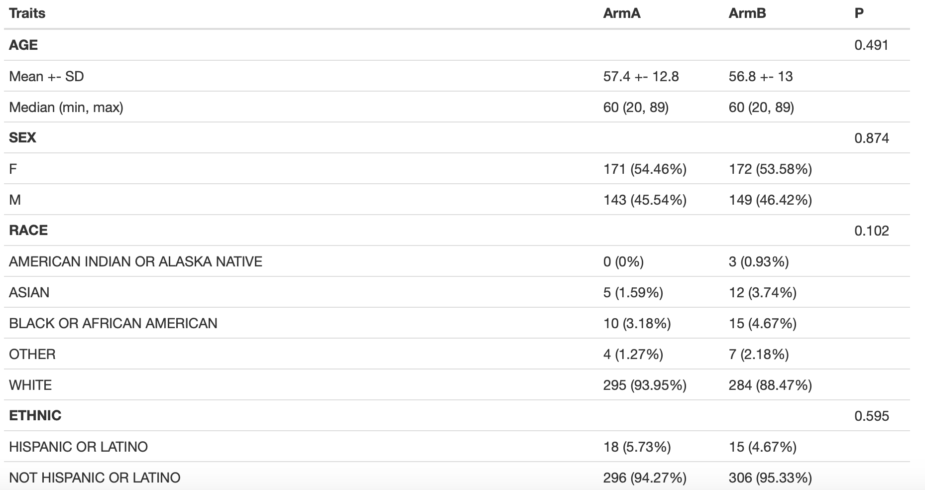
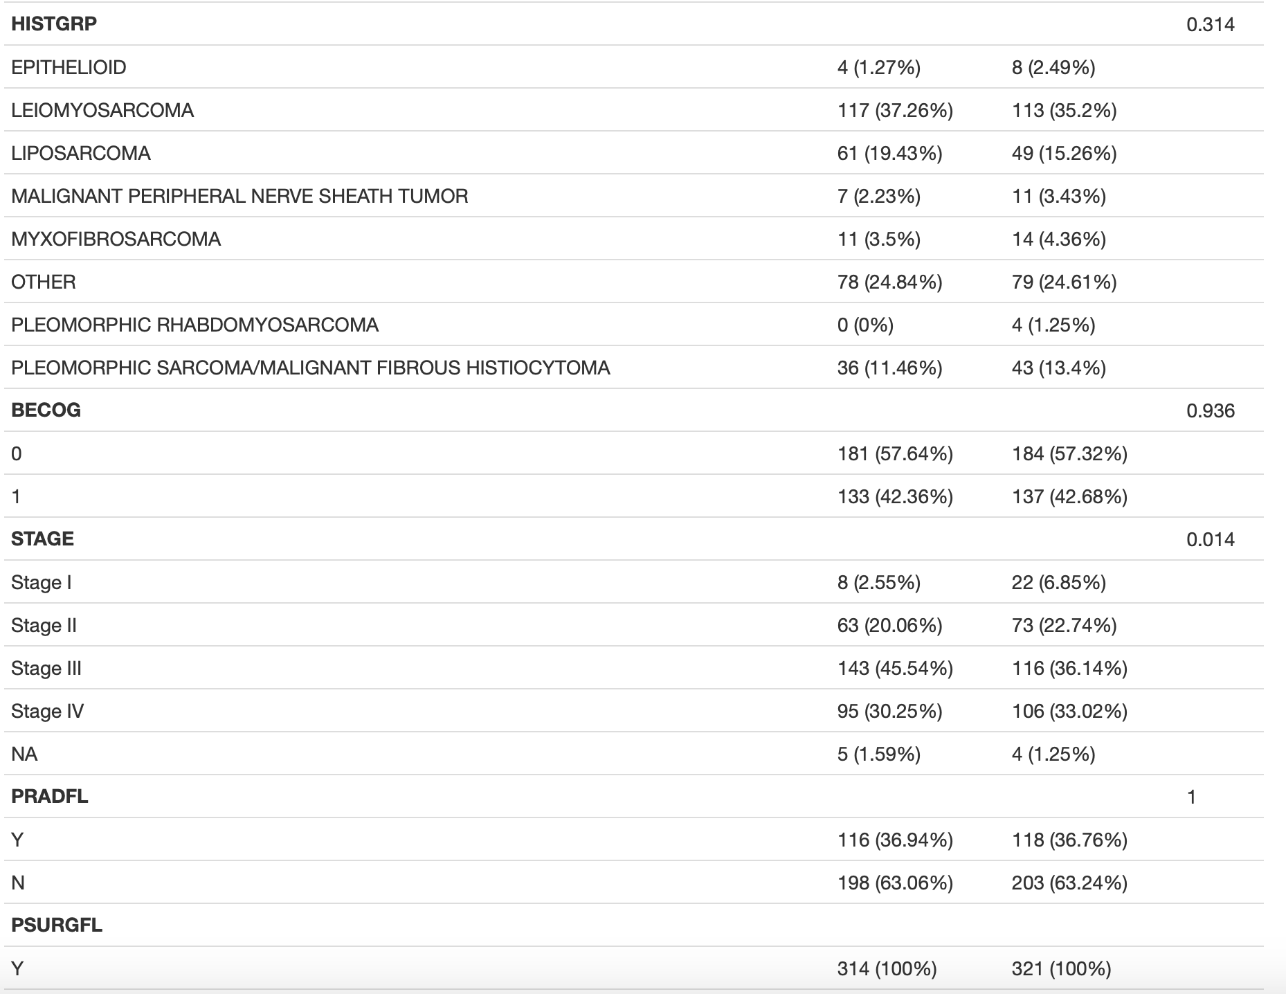
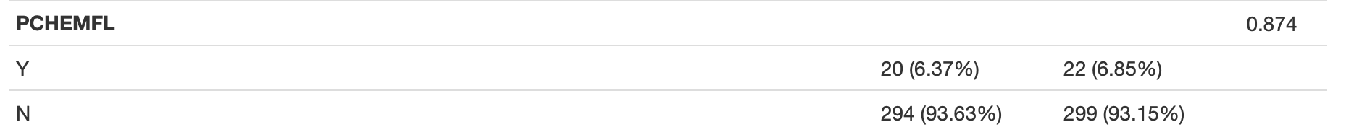
Baseline Values
Baseline ECOG
Stage at Diagnosis
Prior Radiotherapy Flag
Prior Systemic Therapy Flag
Prior Cancer Surgery Flag

Slide 5
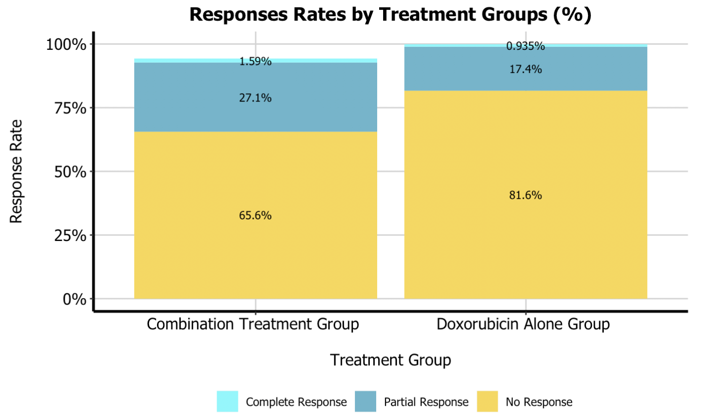
The Response Rate
Combination Group
Doxorubicin Alone Group
314
321
PR
CR
+
90/314
P=0.00222
59/321
CR
8/314
P=0.501
3/321
PR
85/314
P=0.00353
56/321

Slide 6
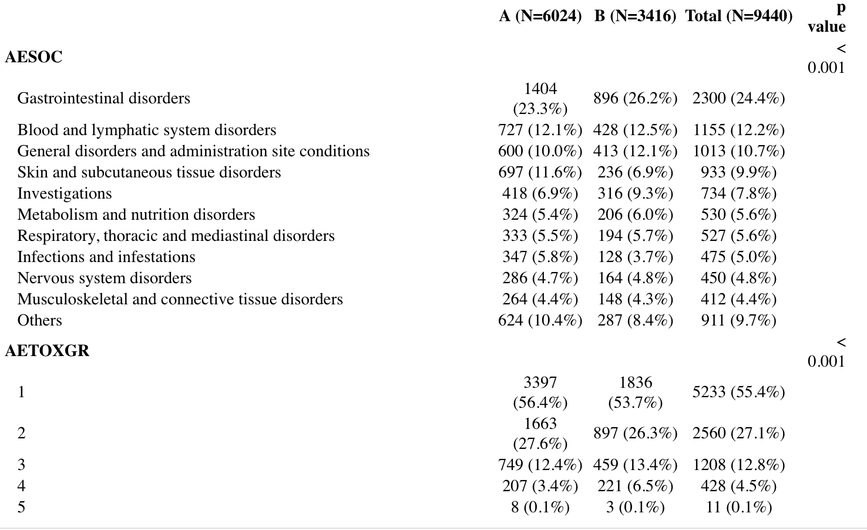
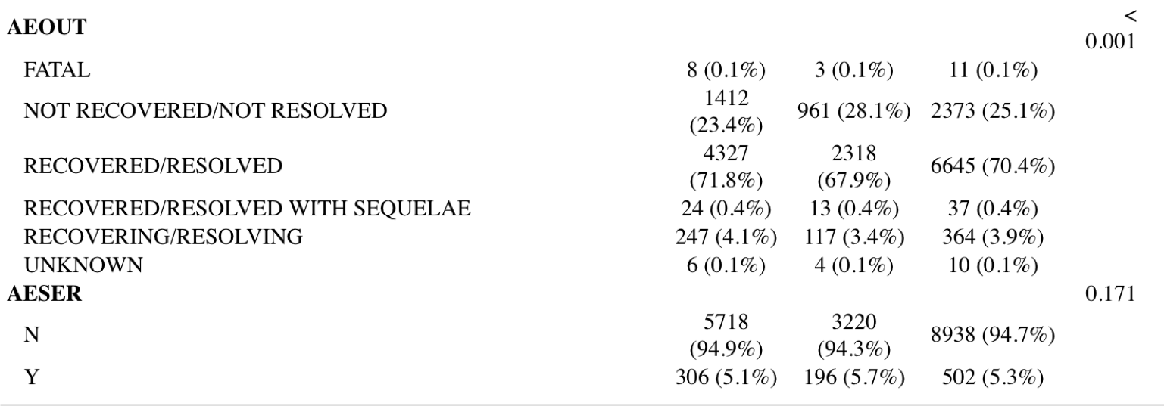
Adverse Event Profiles
Primary System Organ Class
Outcome of AE
Toxicity grade
Serious Event

Slide 7
Conclusions
Tumor Response:
Response%: A - 28.7% vs B - 18.4%; p-value = 0.002
Adverse Events:
Significant difference in (significance level = 0.01):
System organ class (3 / top10 – higher risk for group A);
Outcome of adverse event (recovery / recovering proportion: A – 71.8% vs B – 67.9%);
Toxicity grade (AETOXGR >= 3 proportion: A – 16% vs B – 20%).
No significant difference in:
Severity of adverse event (p-value = 0.171).

Slide 8
Thank you
Roland Hentz Zihan Yang
Haojia Li Yueqi Feng

