Slide 1
GraphRAG
From local to global query-focused summarization
Sarmada Alla (22CS30067)
Karanam Keerthi Chandrika (22CS30035)
Ganta Devi Abhijna (22CS30024)

Slide 2
Agenda
Why GraphRAG
Our pipeline
Dataset and knowledge graph
Evaluation setup
Results and what improved them
Limitations and next steps

Slide 3
Why GraphRAG?
Vector RAG
GraphRAG
Embeds the question, retrieves the top-k most similar chunks
Great for specific, local questions
Misses facts scattered across many documents
LLM builds a knowledge graph of entities and relations
Groups it into hierarchical communities with summaries
Map-reduce over all communities answers corpus-wide questions
Question we test: does GraphRAG answer global “sensemaking” questions better?

Slide 4
Our pipeline
Indexing (once)
Documents
32 Wikipedia
articles
Chunks
61 × ~1k
tokens
Extraction
Gemini: entities
+ relations
Knowledge graph
712 nodes
885 edges
Communities
Louvain
3 levels
Summaries
bottom-up
Gemini reports
Query time
Global question
Map
each community:
partial answer + score
Reduce
merge best partials
(≤ 27k chars)
Global answer
Baseline (vector RAG): question → Gemini embedding → top-5 chunks (~27k chars) → Gemini answer

Slide 5
Dataset and setup
32
Wikipedia articles
65k
tokens (~249k chars)
61
chunks, shared by both systems
12
global questions
Topic: space exploration: Space Race, Apollo, ISS, ESA, ISRO, CNSA, SpaceX, telescopes, rovers
Questions: corpus-wide, e.g. “How has international cooperation and competition shaped space exploration?”
Why this size: fits a day of Gemini free-tier quota
LLM: Gemini (free tier)
  index: 3.5 Flash-Lite
  answers + judge: 3.1 Flash-Lite
Embeddings: gemini-embedding-001
Graph: NetworkX + Louvain

Slide 6
What the index contains
712
entities
885
relations
495
communities
≈200
Gemini calls to build
Level | Communities | With 3+ entities (LLM report) | Largest | Mean size
Level 0 (finest) | 241 | 72 | 23 | 3.0
Level 1 | 136 | 39 | 43 | 5.2
Level 2 (coarsest) | 118 | 21 | 62 | 6.0
Entity types: spacecraft 215, organization 155, person 146, location 73, mission 66, concept 25

Slide 7
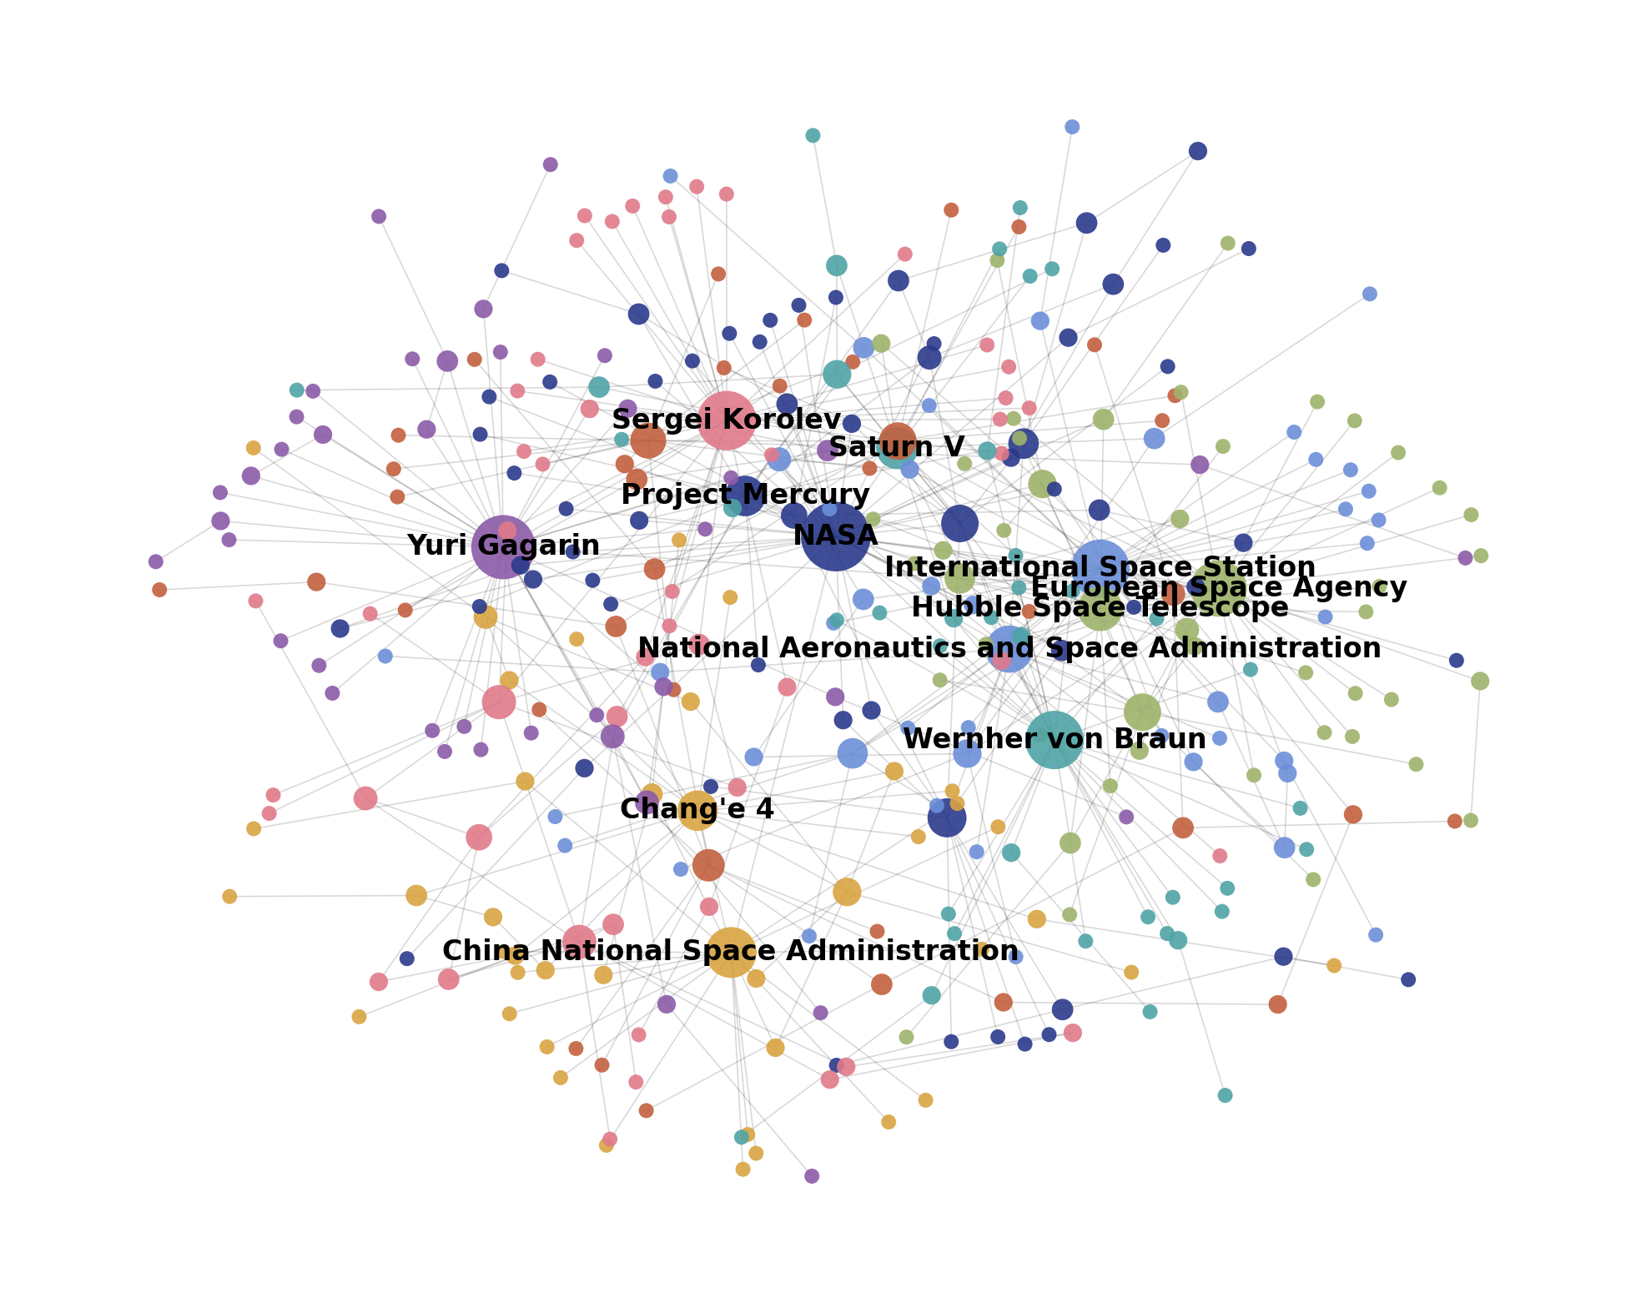
Knowledge graph
8 largest communities = the corpus's main themes
Evolution of American Spaceflight and Policy (62)
Origins and Impact of Early Soviet Rocketry (50)
Global Space Agencies, Missions, and Astronomical Observatories (47)
NASA History and Global Space Cooperation (46)
China's Lunar Exploration and Space Program (42)
Life, Career, and Historic Flight of Yuri Gagarin (41)
Wernher von Braun and Saturn V Rocket Development (41)
Evolution and Achievements of India's Space Program (39)

Slide 8
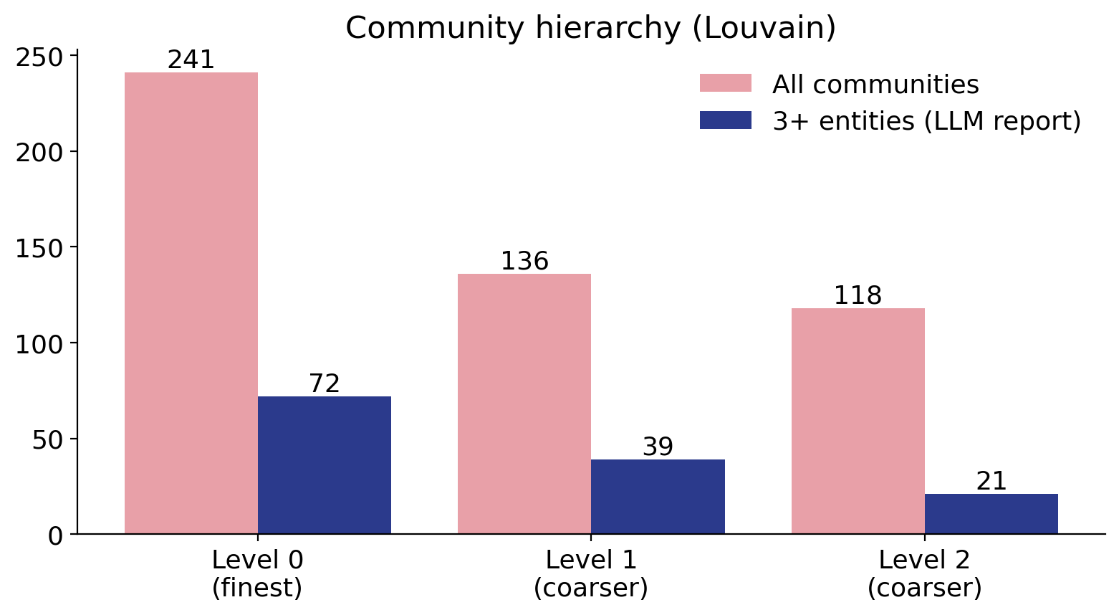
Community hierarchy
Louvain nests communities: level 0 finest, level 2 coarsest.
Summaries are bottom-up: leaves from entities and relations, parents from child reports.
We answer from level 2: 21 rich communities cover the whole corpus.

Slide 9
Engineering for the free tier
Rate limiting
Requests spaced to the per-minute limit; 429s retried with Gemini's own delay
Disk cache
Every reply cached: a run that hits the daily quota resumes at no cost
Budget
1 extraction call per ~1k-token chunk; extractive summaries for tiny communities
Robust JSON
Malformed model replies repaired, then retried once
Embeddings
Token-bounded batches under the 30k tokens/minute limit

Slide 10
Evaluation setup
Both systems answer the same global questions (final run: 6 of 12 judged before the daily quota ran out).
An LLM judge compares each pair, in both orders, to cancel position bias.
Same 27k-character context cap for both.
Criterion | The judge asks
Comprehensiveness | How much detail covers all aspects?
Diversity | How varied are the perspectives?
Empowerment | Does it help the reader judge the topic?
Directness | How clearly does it answer?
Cheap metrics | entities mentioned, communities touched, context, time

Slide 11
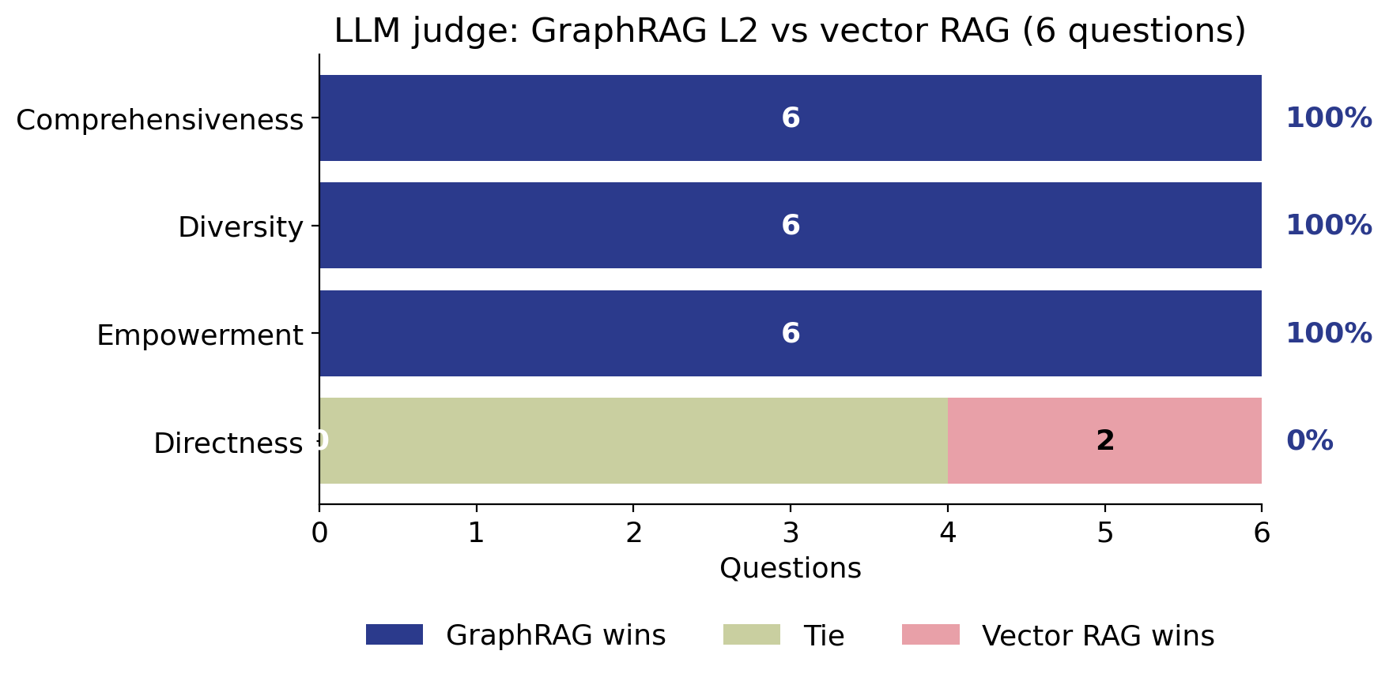
Results: LLM judge
GraphRAG win rate
100%
Comprehensiveness
100%
Diversity
100%
Empowerment
0%
Directness

Slide 12
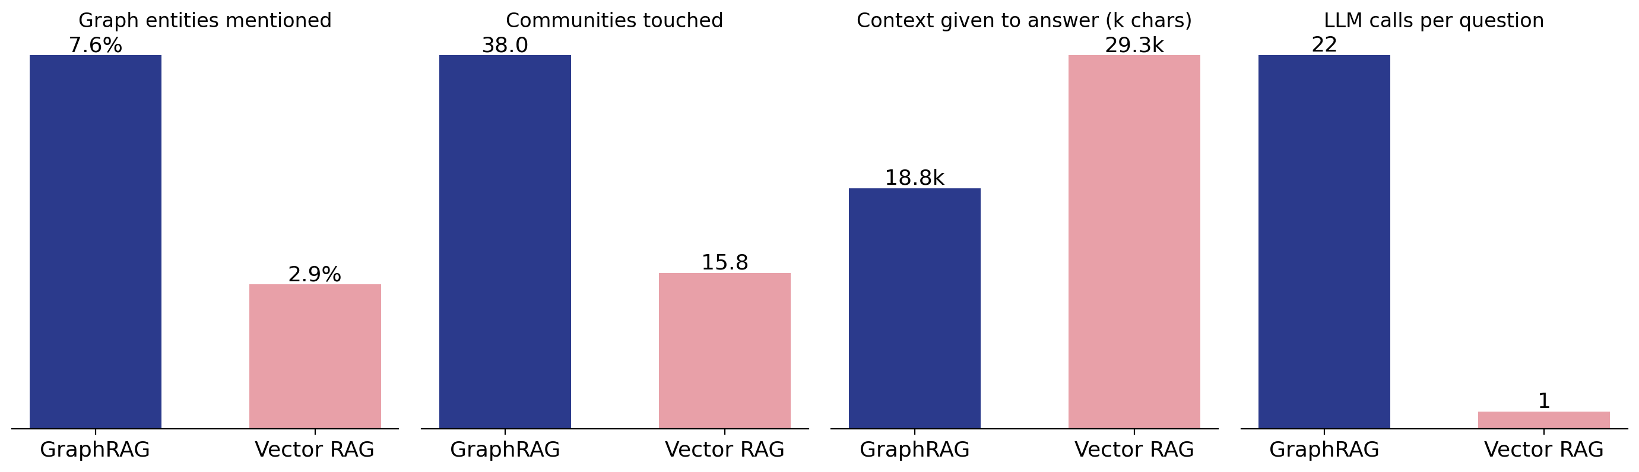
Coverage, context and cost
GraphRAG mentions 2.6× as many graph entities and touches 38 vs 16 communities, at the cost of 22 LLM calls per question vs 1.

Slide 13
What made GraphRAG better
GraphRAG vs vector RAG | Unbalanced (10 questions) | Equal budget (12 questions) | + community details (final, 6 questions)
Comprehensiveness win rate | 40% | 42% | 100%
Diversity win rate | 30% | 50% | 100%
Empowerment win rate | 30% | 42% | 100%
Directness win rate | 20% | 0% | 0%
GraphRAG context (chars) | 2.4k | 6.5k | 18.8k
Entities mentioned | 4.4% | 5.8% | 7.6%
Fix 1: partial answers no longer capped at 5 sentences; all 21 communities mapped. Fix 2: map step also reads each community's extracted entity and relation descriptions.

Slide 14
Analysis
Same corpus, different evidence: vector RAG read ~27k chars of raw text; GraphRAG read 4-6 sentence summaries of summaries, so facts were lost
Fix: the map step also reads each community's extracted entity and relation descriptions (no extra indexing cost)
Result: GraphRAG now wins comprehensiveness, diversity and empowerment 6/6, matching the paper
Directness: vector RAG still more direct (2 losses, 4 ties), as in the paper
Breadth
2.6× as many graph entities mentioned
38 vs 16 communities touched
Cost
22 LLM calls per question vs 1
Caveat: final run judged 6 of 12 questions before the free daily quota ran out

Slide 15
Limitations and next steps
Limitations
Next steps
Louvain, not Leiden: Leiden guarantees well-connected communities
No claims or gleaning: kept the build within the free tier
Small corpus: 65k tokens vs ~1M in the paper
Small sample: one Lite judge; final run judged 6 questions
Larger corpus (≥ 500k tokens)
Compare community levels 0-2
Leiden + claim extraction
Stronger judge model, more questions
Hybrid: add top chunks to the reduce step

Slide 16
Thank you
Questions?
Code: github.com/Kiki150804/sdm_proj

