Slide 1
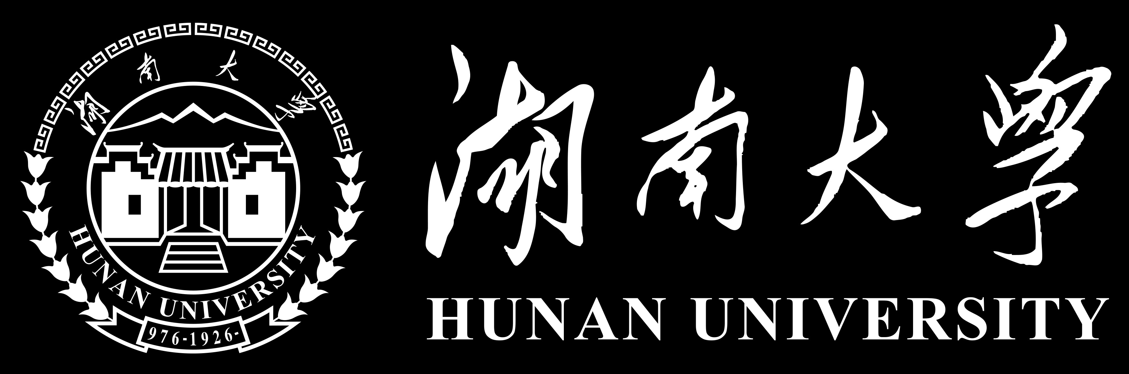
Making Pre-trained Language Models Better Few-shot Learners
Reporter: Huiqing Zhang , Lianying Yin , Xiangjv Chen
Date: May, 19th
Notes:
Hello everyone, my name is Zhang Huiqing. Today, I would like to talking about an excellent work, which is a prompt-based Few-Shot learning method that can be applied to any pre-trained model. What’s more, this work is task-agnostic. We can call this work LM-BFF simply. Another straightforward explanation is “language models ’best friend forever”.

Slide 2

PART 01 Introduction
目录
CONTENTS
PART 02 Methods
PART 03 Experiments
PART 04 Conclusion
Notes:
OK, this is the catalogue of our sharing. At first, I would like to give a brief introduction for you, so that you can have a general impression of this work. Later, my partners will show more implement details.

Slide 3

01
Introduction

Slide 4
Abstract
Few-shot learning problem:
1) Medium-sized language models (e.g., RoBERTa) can be accessed on common hardware resources.
2) Fine-tuning can be performed with a small number of samples.
The method includes:
1) Prompt-based fine-tuning together with a novel pipeline for automating prompt generation.
2) A refined strategy for dynamically and selectively incorporating demonstrations into each context.
The performance:
30% absolute and 11% on average improvement compared to standard fine-tune.
Notes:
At first, I would like to summarize the total work as an abstract. In this paper, they study a few-shot learning problem more in line with real-world scenarios:
1） medium-sized language models can be accessed on common hardware resources. 2）fine-tuning can be performed with a small number of samples.
The main method mainly includes a prompt-based fine-tuning together with a novel pipeline for automating prompt generation and a refined strategy for dynamically and selectively incorporating demonstrations into each context.
This method dramatically outperform standard fine-tuning procedures in this low resource setting, achieving up to 30% absolute improvement, and 11% on average across all tasks.

Slide 5
Motivation
1
The number of parameters of GPT-3 model is so huge. => apply difficultly
2
Current templates for prompts and label words are artificial. => not extensible
3
GPT-3’s naive “in-context learning” paradigm was limited by sampled examples and input length
=> difficult to learn
Notes:
Then, we can analyze the motivations of this paper.
First, GPT-3 has been able to achieve significant performance on downstream NLP tasks without updating the parameters of the pre-trained model by using a small number of task demonstrations as input contexts and adding natural language prompt. However, the number of parameters of GPT-3 model is so huge that it is difficult to be applied to practical applications. Therefore, this work investigate the performance improvement of prompt-based prediction and task demonstration methods for medium-sized models (e.g., BERT, RoBERT) on few-shot learning.
In addition, most of the prompt templates and label words are currently selected by hand, which relies heavily on the level of the designer, and the designed templates and selected label words are not very extensible. This paper proposed a method to automatically generate prompt templates and label words,and optimize the method for selecting task demonstrations example of GPT-3.
---
GPT-3’s naive “in-context learning” paradigm is not guaranteed to prioritize the most informative demonstrations ,and the number of demonstrations is limited by input length. This paper sample a single example to create demonstration sets and devise a novel sampling strategy that pairs inputs with similar examples, thereby providing the model with more discriminative comparisons.

Slide 6
Contribution
1
Proposed a fine-tuning pre-trained model method based on prompts and demonstrations
2
Proposed an automatic prompt generation method
3
Incorporated demonstrations as additional context
Notes:
Finally, we can see the contributions of this paper.
Firstly, this paper proposed a fine-tuning pre-trained model method based on prompts and demonstrations.
Secondly, This paper introducing automatic prompt generation, including a pruned brute-force search to identify the best working label words, and a novel decoding objective to automatically generate templates using the generative T5 model. In this case, we can cheaply obtain effective prompts that match or outperform manually chosen ones.
Thirdly, This paper sample a single example to create demonstration sets and devise a novel sampling strategy that pairs inputs with similar examples, thereby providing the model with more discriminative comparisons.

Slide 7
Related Work
Language model prompting
GPT series, PET => inspired this work
Automatic prompt search => search rely only on a few annotations
Only search label words automatically / limited domains / large number of examples
Fine-tuning of language models
focus on optimization and regularization techniques => standard optimization techniques
Few-shot learning => making minimal assumptions about available resources
semi-supervised learning / meta-learning / intermediate training
Notes:
Because of time limitation, we will skip this part.

Slide 8
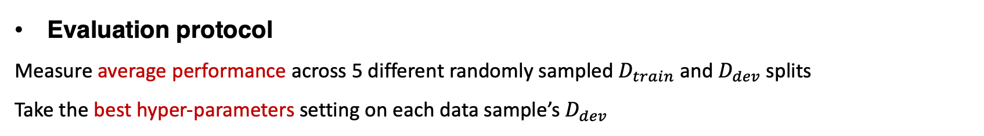
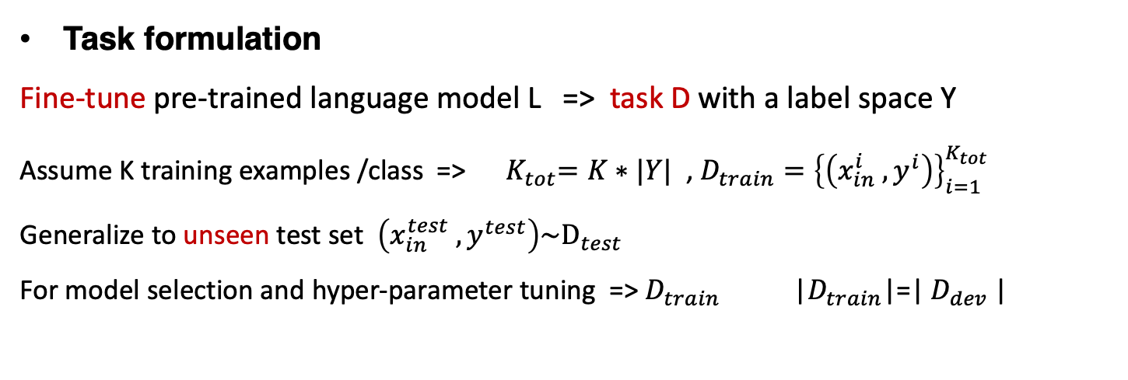
Problem Setup
Task formulation
Fine-tune pre-trained language model L => task D with a label space Y
Assume K training examples /class => ${ K}_{tot}=K∗|Y|$ , $D_{train}={\left\{\left(x_{in}^{i} , y^{i}\right)\right\}}_{i=1}^{K_{tot}}$
Generalize to unseen test set $\left(x_{in}^{test} , y^{test}\right)\sim D_{test}$
For model selection and hyper-parameter tuning => $D_{train}$ |$D_{train}$|=| $D_{dev}$|
Evaluation datasets mainly focus on SST-2 and SNLI
8 single-sentence (make a prediction) and 7 sentence-pair (predict the relationship between inputs) English tasks
Evaluation protocol
Measure average performance across 5 different randomly sampled $D_{train}$ and $D_{dev}$ splits
Take the best hyper-parameters setting on each data sample’s $D_{dev}$
Notes:
And this part I will show you the problem Setup.
Assuming that we want to fine-tune on a task D with label space Y, using the pretrained model L. For the task, we only assume K training examples per class for the task’s training set, such that the total number of examples is K total. And we want to develop task-agnostic learning strategies that generalize well to an unseen test set. Noticed that the size of develop set is the same as train set.
About the evaluation dataset, Here conduct a systematic study across 8 single-sentence and 7 sentence-pair English tasks, and detailed description of the evaluation dataset will be shown in the experiment section.
To account for the variability of results, this work measure average performance across 5 different randomly sampled train set and develop set splits. Sampling multiple splits gives a more robust measure of performance, and a better estimate of the variance.
This work also sweep multiple hyper-parameters for each data sample, and take the best setting as measured on the develop set of that sample, cuz hyper-parameters can make a significant difference.
And latter, my partners will show the detailed task modeling of this method for all of you.

Slide 9
02
Methods
Notes:
Hello everyone, my name is YinLian Ying, then I will introduce some methods of this paper.
The paper simply introduces the automatic prompt-based fine-tuning and fine-tuning with demonstrations. So, what is the automatic prompt-based fine-tuning? We should know the prompt-based fine-tuning first.

Slide 10
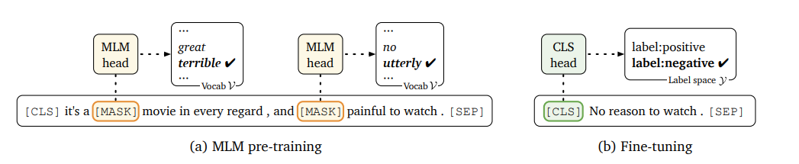
Prompt-based fine-tuning
Linear layer and softmax
Add
(a) The main pre-training tasks of BERT
Notes:
In the standard fine-tuning approach (shown in picture b above, The [CLS] is a special symbol added before each input example and [SEP] is a special separator, for a classification task for example, an additional classifier (like linear layer + softmax) is typically added to the [CLS] section, however the number of newly initialized parameters that independent of those outside the pre-trained model can be large, which can make learning from small samples difficult.
The picture (a) shows one of the main pre-training tasks of BERT: masked language modelling (MLM), where the original token of the input is masked with symbol [mask] to drive the model to recover the original token. In order not to introduce new parameters and to make full use of the knowledge of the pre-trained model, this paper takes the approach of MLM and converts the downstream task directly into an MLM task, constructing a specific prompt template for a specific task and then "auto-completing" the prompt template through the language model. This is called the 'prompt-based fine-tuning approach' in the paper.

Slide 11

Prompt-based fine-tuning
Step1
x₁ = “No reason to watch it.”
x_{prompt} = [CLS] x₁ It was [MASK] . [SEP]
Step2
Step3
Notes:
Taking the sentiment analysis task as an example, given a sentence x₁ = "No reason to watch it ." The prompt-based fine-tuning method first constructs a prompt template as shown in step 2, with [MASK] contained in the prompt template;
then it predicts the mapping contained in [MASK], and the output of the prediction are label words, which are mapped to specific labels: for example, the label “positive” corresponds to the word “great”, and label “negative” corresponds to the word “terrible”.
From the above analysis, we can know that prompt consists of two parts:
One is Template, and another is label word mapping M(y).

Slide 12
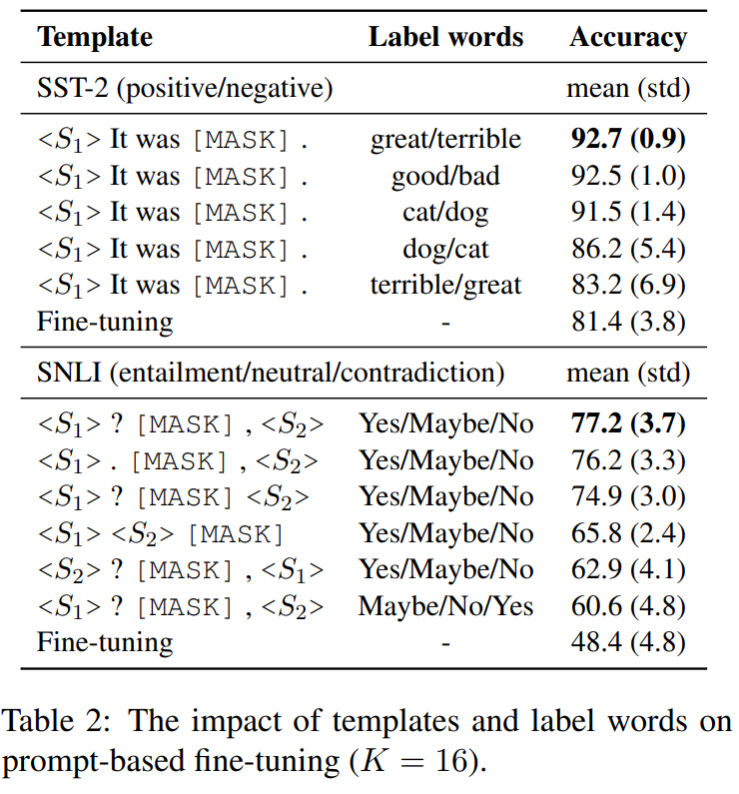
Prompt-based fine-tuning
Using the same template, different label words have different effects;
Using the same "label word", even minor changes to the "template" will result in different results.
Notes:
In order to better understand what is a good template or label word, the paper conducts a pilot study on the SST-2 and SNLI datasets, and the experimental results are shown in picture.
It can be seen that different templates and label word choices actually have a great impact on the final result. using the same "template", different “label words” have different effects, such as the exchange of cat and dog; Using the same "label word", even minor changes to the "template" (such as removing punctuation) will result in different results.
The above "prompt" is designed based on artificial intuition and can better complete similar tasks. However, finding a suitable and correct "prompt" requires both expertise and a solid understanding of how the language model works internally. Therefore, the paper proposes that we should try to automate the construction of prompts: to automatically build a cheap method that is task-agnostic.

Slide 13
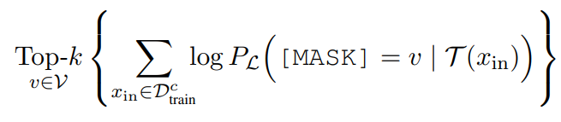
Automatic selection of label words
Fixed template T
1
For each class in the training set, the top-k words are selected such that the conditional probability is maximized.
3
Then fine-tuning is performed to construct the label mapping relationship M by comparing the accuracy of the validation set to select the best one of the n allocation methods for label words.
2
The candidate label words under each class are combined, and then the top-n allocation that makes the training set most accurate is found.
Notes:
This paper distinguishes between the automatic construction of templates and label words. First they investigate how to construct a label word mapping M given a fixed template T so that it can maximize the accuracy of fine-tuning. A simple search strategy is used in the paper, which can be divided into three steps:
At first, With the untuned pre-training model, for each class in the training set, the top-k words are selected such that the conditional probability is maximized. That is, samples from each class are first fed into the pre-training model, and the top-k words with the highest probability at [mask] are directly taken as candidate label words for that class.
And second, The candidate label words under each class are combined, and then the top-n allocation that makes the training set most accurate is found.
Then fine-tuning is performed to construct the label mapping relationship M by comparing the accuracy of the validation set to select the best one of the n allocation methods for label words.

Slide 14
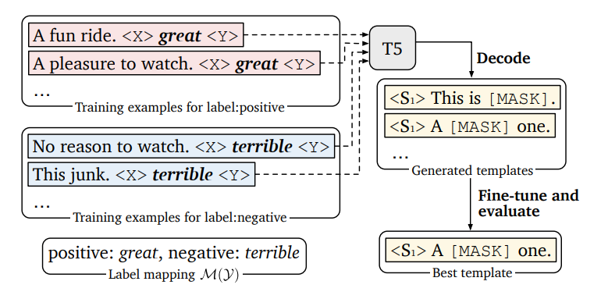
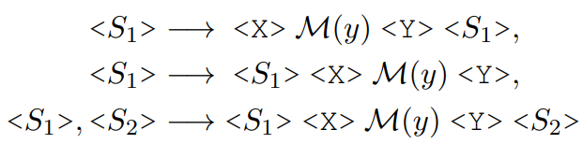
Automatic template generation
Fixed label words and mapping M(Y)
Example
T5
"Thank you < X > me to your party < Y > week"
"< A > for inviting < B > last < C > "
1
Padding tokens are added before and after the label words and then fed into the T5 model to automatically generate the template sequence.
2
Select the best template after fine-tuned.
Notes:
The authors then investigate fixed label words, using the T5 model proposed by Google to automatically generate templates. T5 is pre-trained to fill in missing spans in its input .
For example, given an input "Thank you < X > me to your party < Y > week" after the resulting mask operation, T5 will generate a string of text "< A > for inviting < B > last < C > ", meaning that "for inviting" can replace < X > and "last" can replace < Y >.
The paper argues that this approach to T5 is particularly suitable for template generation, as there is no need to specify the number of tokens for the positions to be filled in advance. The main steps are as follows:
At first, we should fixed label word mapping relationships.
Then Padding tokens are added before and after the label words and then fed into the T5 model to automatically generate the template sequence. The authors list three methods of padding tokens.
Finally, the T5 model output is decoded using beam search to decode multiple templates that perform well on the training set, and then each candidate template is fine-tuned to select the best one of them.
These are all about the automatic prompt-based fine-tuning , the fine-tuning with demonstrations another one will show with your.

Slide 15
Fine-tuning with Demonstrations
Defects in GPT-3 input
1
The number of demo examples that can be added is limited by the maximum input length of the model
2
A large number of random examples of different types are mixed together, resulting in a long context, which is not conducive to model learning.
Notes:
Hello everyone, my name is… Next, let me introduce the rest to you.
1. In addition to introducing prompt, the author also added some in-context information, which is also based on the idea of GPT-3. As mentioned above, GPT-3 is fine-tuned by adding context sample examples. It randomly selects 32 training samples and splices them directly to the input sample sentences in the form of context. The paper believes that there are two problems with this approach:
2. GPT-3 maximum input length is 2048(twenty forty eight), while bert is only 512(five hundred twelve).

Slide 16





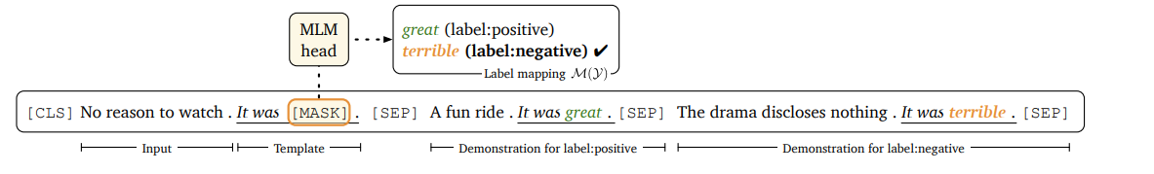
Fine-tuning with Demonstrations
1
At each training step, we randomly sample one example
from each class, convert it into with [MASK] replaced by —we denote this as —and then concatenate them with Xin .
2
Proposed LM-BFF using prompt-based fine-tuning with demonstrations.
Notes:
1. In order to solve these problems, the paper proposes a simple solution: for each input sentence x_{in}, only one sample is randomly sampled from each class in the training dataset, and obtain the representative label words of the class, and then generate a template for it through T5 model, and concat with the sample to form a prompt. Each class will get such a prompt, all of which are spliced with the input samples, as shown in the following figure after splicing.
2. Here ⊕ denotes concatenation of input sequences.
3. When selecting, the authors found that it was sufficient to select only one sample for each class, while picking more than one found no improvement in the effect. In addition, to ensure that the selected sentences were more similar to the input sentences, the authors calculated the cosine similarity between the input sentences and each sample in advance and selected the top 50% of the samples at random.

Slide 17
03
Experiments
Reporter: Xiangju Chen

Slide 18
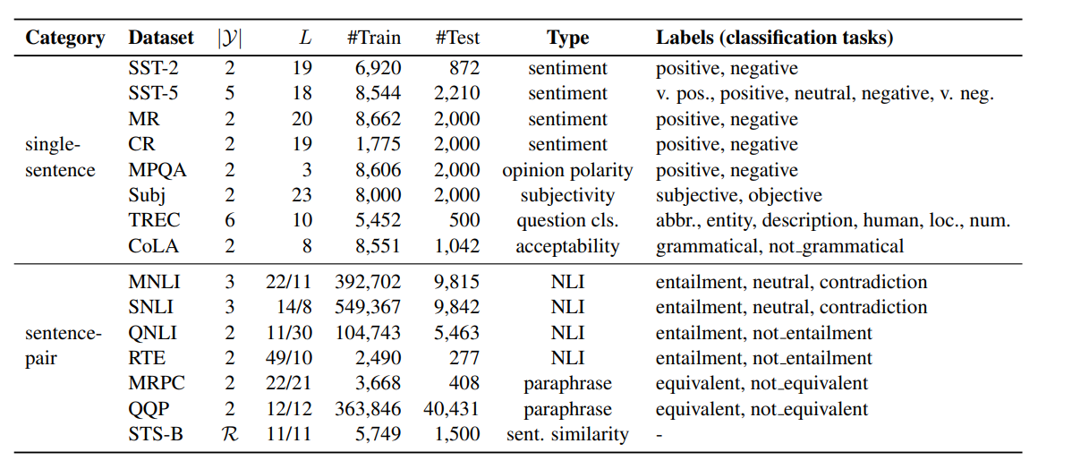
Datasets
note
1. |y| denotes the number of categories.
2. L denotes the average length of the sentences (pairs).
Notes:
1. The authors tested this on a number of datasets(8 single sentences, 7 sentence pairs task), which are shown in the figure.
2. where |y| denotes the number of categories (the STS-B dataset is a regression task) and L denotes the average length of the sentences (pairs).

Slide 19
Baselines
Majority: using the most frequent category in the training set as the prediction result.
Prompt-based zero-shot: a zero-sample setup, using a manually designed template and not introducing additional sample examples.
"GPT-3" in-context learning: zero-sample setting, using a manually designed template, as in GPT-3, with examples randomly selected from the training set and added to each input in context.
Fine-tuning : small-sample setup, standard fine-tuning approach, introducing new parameters.
Fine-tuning(full): standard fine-tuning using the full amount of annotated data.
Prompt-based FT(man) : the fine-tuning method of this paper, using manually designed prompt templates.
Prompt-based FT(auto): the fine-tuning method in this paper, which automatically builds the prompt templates.
+demonstrations: introduction of additional sample examples into the context.
Notes:
There are baselines used in this paper, which are the models paper used for comparision. Due to time constraints, I won't go into details about this content.

Slide 20
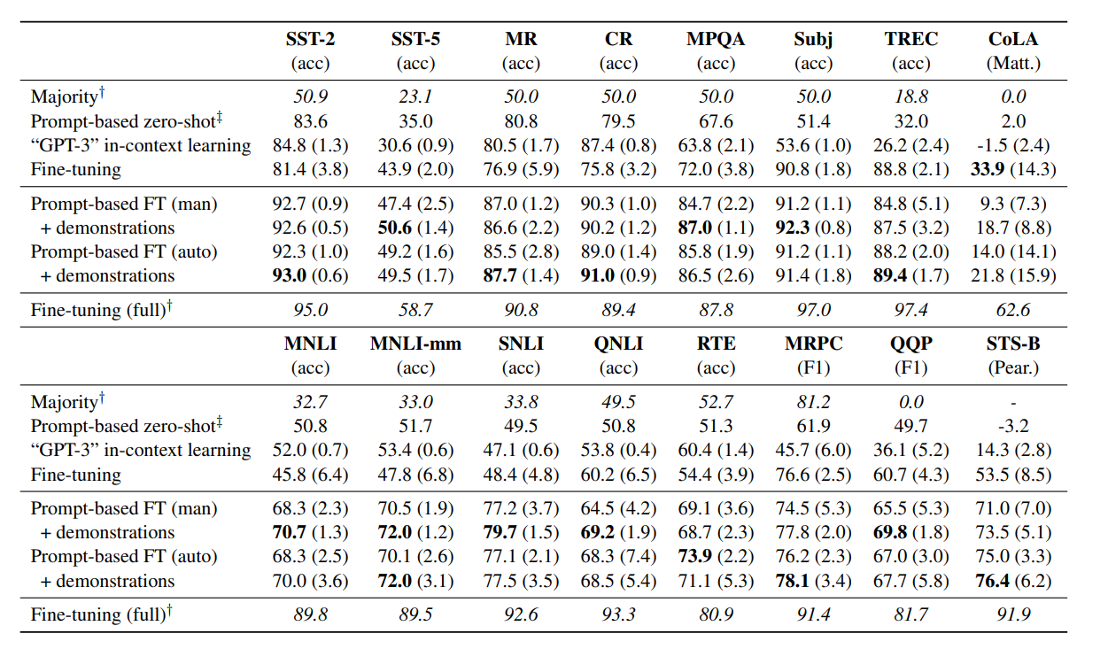
Main results
note
The model used was RoBERTa-large, with each category sampling K = 16 samples to simulate small sample learning
Notes:
The results of the above experiments reveal that:
Prompt-based zero-sample prediction ("GPT-3" in-context learning) outperformed direct majority-class prediction, reflecting the role of precoding knowledge in RoBERTa.
The GPT-3 approach to in-context learning ("GPT-3" in-context learning) did not always outperform prompt-based zero-sample prediction, probably because smaller language models are less expressive and cannot use off-the-shelf knowledge as GPT-3 does.
The prompt template based fine-tuning approach clearly outperforms the normal standard fine-tuning approach.
In general, automatically searched templates can achieve comparable or even higher results than manually, especially for tasks where building powerful manual templates is less intuitive (e.g. TREC, QNLI and MRPC)
Finally, the use of presentations in context can yield consistent gains across most tasks. In summary, the combined solution of the paper resulted in a 30% improvement in the SNLI dataset compared to standard fine tuning, with an average improvement of 11%. While prompt-based fine-tuning can be substantially better than standard fine-tuning under small sample conditions, it still lags behind standard fine-tuning using the full amount of data.

Slide 21
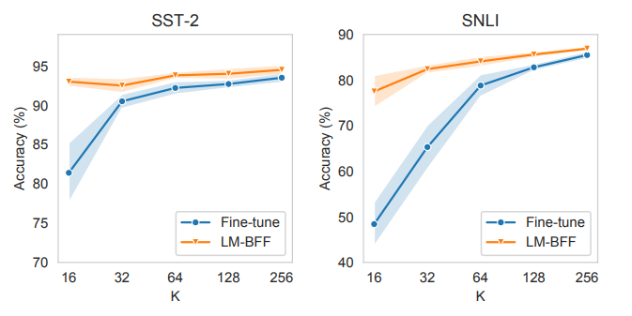
Sample efficiency
note
Standard fine-tuning vs our LM-BFF as a function of K (# instances per class). For lower K, the method consistently outperforms standard fine-tuning.
Notes:
1. In addition, the paper also compares prompt-based fine-tuning with standard fine-tuning for different K (the number of annotated samples under each category), as shown in the figure below. In the case of small samples, cue-based fine-tuning consistently outperforms standard fine-tuning until both converge at K= 256.
2. In summary, the authors have carried out a number of experiments, but here only a comparison of the prompt and in-context based fine-tuning method (LM-BFF) with the standard fine-tuning method for small sample scenarios shows that LM-BFF can achieve good fine-tuning results with only a small number of samples (small number K).

Slide 22
04
Conclusion

Slide 23
Advantages and Disadvantages
Proposes a prompt-based fine-tuning strategy and automates the generation of prompt templates.
A
A
Dynamic selection of sample examples for in-context training.
LM-BFF still lags behind standard fine-tuning methods based on the full amount of an notated data.
Only applicable to a small number of categories, limited sentence template length, etc.
D
D
Notes:
1. the automated generation of prompt requires manual selection and determination of the set of tag words before generating the template, and manual determination of the template before generating the tag words, which has the potential to bias the search towards areas of the search space that we might have imagined.

Slide 24
Conclusion
1
Can naturally be used as 'fill-in-the-blank' problems.
2
Have relatively short input sequences.
3
Do not contain many output classes.
Notes:
This approach is more suitable for certain tasks that (1) can naturally be used as 'fill-in-the-blank' problems; (2) have relatively short input sequences; and (3) do not contain many output classes. Problems (2) and (3) may be improved by longer contextual language models, while for tasks that cannot be formulated directly in prompts, such as structured prediction, this is a larger problem that needs to be addressed in future work.

Slide 25
Thank you
Group 7

