Slide 1
Assignment 1
Observability in the Wild
Arquitetura de Sistemas
2025/2026
Francisco Costa, 131224

Slide 2
Problem & Architecture

Slide 3
Problem and Flow
nopCommerce is a popular e-commerce platform
But it has no way to observe what is happening
Costumer places an order
PII Risk Management
Most critical area of the platform
3

Slide 4
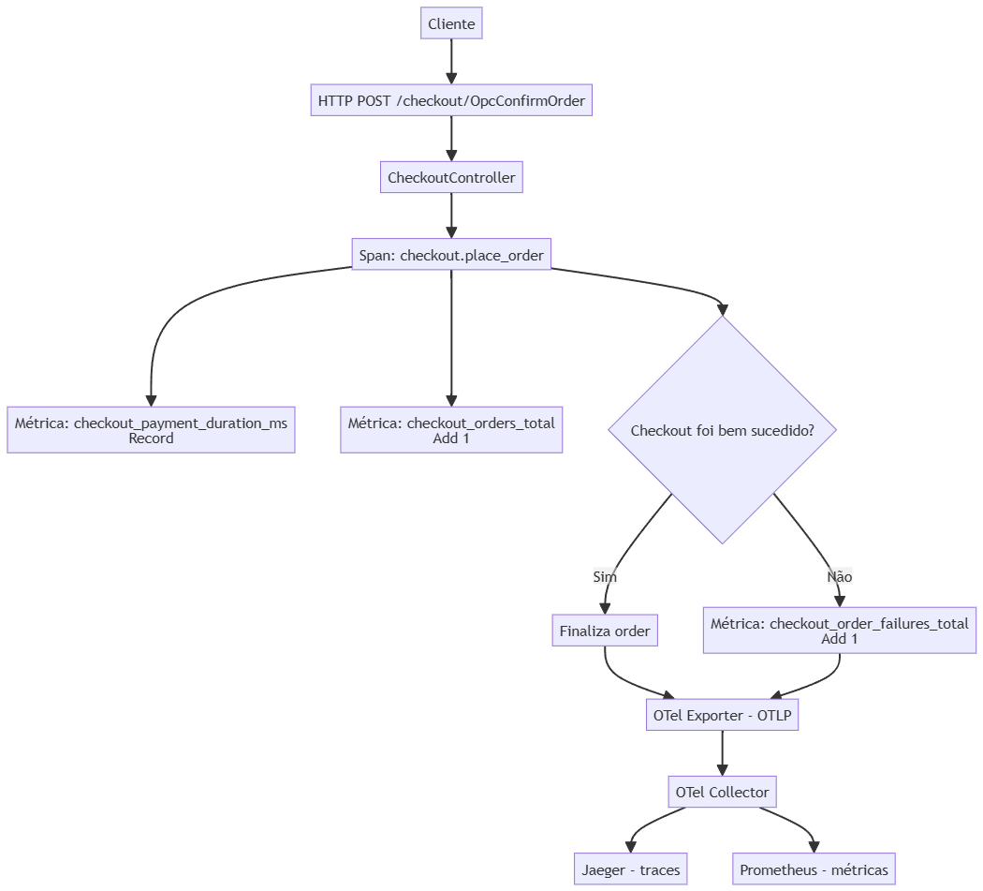
Used Spans and Metrics
Spans
checkout.place_order
Metrics
checkout_orders_total checkout_payment_duration_ms checkout_order_failures_total
4

Slide 5
PII
Some omitted elements: name, email, phone, address, payment
Elements not omitted: order id, product id
PII excluded at SDK level, before sending to the collector
Considered excluding from database and collector
5
Notes:
Pensei omitir na database ou no collector mas apercebi-me que já seria tarde demais

Slide 6
Loadtest & Live Demo

Slide 7
Loadtest
k6
Stage 1: Ramp up
30 seconds
0 – 8 VUs
Stage 2: Sustained load
1 minute
8 VUs
Stage 3: Ramp down
30 seconds
8 – 0 VUs
7

Slide 8
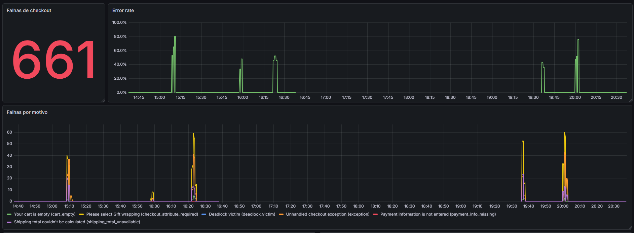
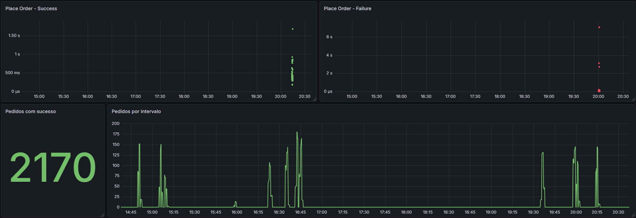
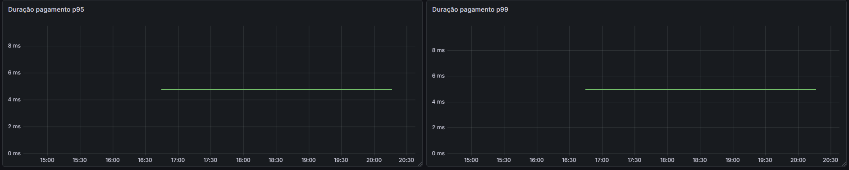
Dashboard
8

